Slide 1
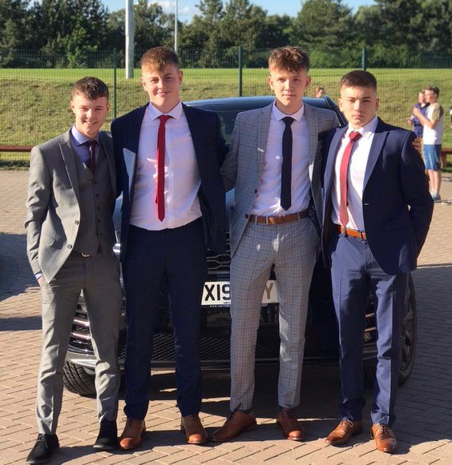

Passport to the Prom
2021 - 2022

Slide 2

Why does SAX hold a Prom?
To reward students for:
Academic achievement or improvement
ATL achievement or improvement
Attendance
Taking an active role in academy life
Exceptional work in and beyond the classroom

Slide 3
ACHIEVED points
10 ACHIEVED Points = 1 Prom Merit

Slide 4
Scans
 | Number of Prom Merits?
Top 10 ATLs in each scan | 5 Prom Merits
Top 10 most improved ATLs in Scan 11-1 from Scan 10-3 | 5 Prom Merits
Mean ATL on each scan of Outstanding | 5 Prom Merits
Mean ATL on each scan of Good | 3 Prom Merits

Slide 5
Attendance
 | Number of Prom Merits?
100 % Attendance in a half term | 10 Prom Merits
Attendance above the academy target in a half term | 3 Prom Merits

Slide 6
Being an Active Member of SAX
 | Number of Prom Merits?
Volunteering to help at Open Evening | 1 Prom Merit
Raising at least £10 sponsorship money for the Sponsored Walk | 1 Prom Merit
Raising the most Sponsorship money in Year 11 for the Sponsored Walk | 10 Prom Merits
Raising the most Sponsorship money in form for the Sponsored Walk | 5 Prom Merits
Representing the form in the Student Council | 3 Prom Merits
Active Prefect in the academy per term | 2 Prom Merits
Reading Ambassador in a half term | 2 Prom Merit
Representing SAX in extracurricular activities | 5 Prom Merits

Slide 7
Can you lose Prom Merits?
 | Number of Prom Merits?
3 lates in a half term | -1 Prom Merit
More than 3 lates in a half term | -1 Prom Merit for each one
Not wearing the correct uniform | -1 Prom Merit
IGLU | -1 Prom Merit
Second IGLU | - 5 Prom Merits
Three or more IGLU | No Prom
Excluded | No Prom

Slide 8

Criteria to be invited?
Starts Monday 20th September
 | Number of Prom Merits
Invite to the Prom | 30
Remember - Prom is a privilege not a right

Slide 9
How do I get an Invite?
Activity | Number of ACHIEVED Points
1 ACHIEVED Point a day x17 weeks | 8.5 (9.0)
Attendance above academy target for three half terms | 6
ATL average of 2 on scans | 6
TOTAL | 21
What else can you do?

