Slide 1

North and North East Lincolnshire Adolescent Vaccination Programme

Slide 2
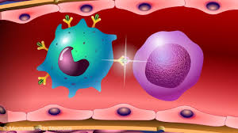

The vaccinations
Getting the vaccine helps protect you against Diphtheria, Tetanus and Polio and the Meningococcal ACWY diseases.
Its stimulates your immune system, so that you have the antibodies needed to fight the infection if you come into contact with these diseases.

Slide 3

What is Diphtheria, Tetanus and Polio
Diphtheria – a contagious bacterial infection which effects the upper respiratory tract (chest and throat) and occasionally the skin.
Tetanus – a bacterial infection that can attack the muscles and nervous system (Lockjaw)
Polio (poliomyelitis) - a contagious virus which can attack the nervous system. It can sometimes cause paralysis of the arms or legs.
These diseases are now rare in this country due to immunisations

Slide 4
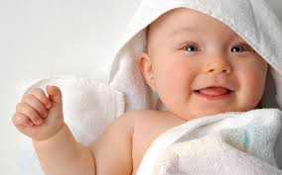
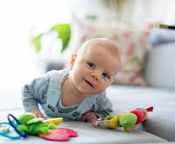

Diphtheria, Tetanus and Polio vaccination
The Diphtheria, Tetanus and Polio vaccination was given to you as a baby and before starting school. That is why we call this one your booster vaccination as it ‘boosts’ your protection against those diseases before you leave school.

Slide 5

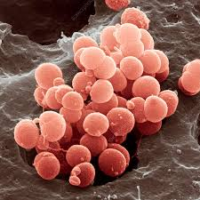
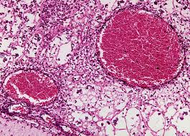
What is Meningococcal ACWY
Meningococcal ACWY is four strains of a bacterial infection which can cause meningitis and blood poisoning (septicemia).

Slide 6
Meningitis and Septicaemia
Meningitis - is a dangerous swelling of the lining around the brain and spinal cord. It can be the result of infection with bacteria or a virus or as a result of injury.
Septicaemia - is when bacteria enters the bloodstream and cause blood poisoning which can trigger Sepsis. Sepsis is an overwhelming and life-threatening immune response to any infection and can lead to tissue damage, organ failure and death.

Slide 7
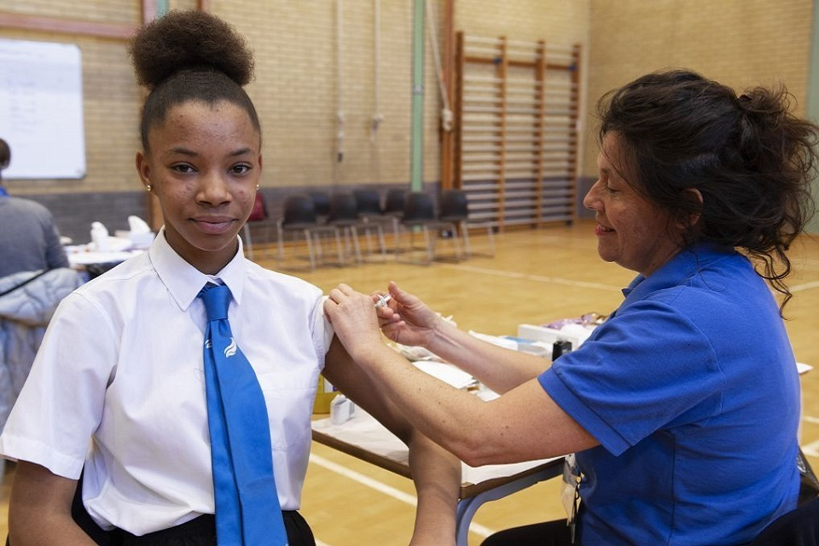
How will you have the vaccinations
You will have two injections. One in each upper arm, or some people may have them 2.5cm apart in the same arm.
Nobody likes injections, but it is very quick.

Slide 8

Vaccinations are important to prevent you from getting and spreading serious diseases or viruses.
Vaccinations keep you healthy !

Slide 9


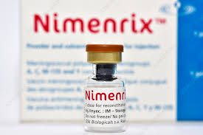
Who can have the vaccination
Children aged 13 to 15 (school Years 9 or 10) are routinely offered the Men ACWY vaccine in school alongside the Diphtheria Tetanus and Polio vaccine (the 3 – 1 booster).

Slide 10

Consent forms
We can’t give you your injection without receiving a completed consent form.
Make sure you ask your parents to fill in the e-consent sent to your parent’s email from school.
Young people under the age of 16 can give consent if considered competent to do so by nursing staff.
You can refuse to have the vaccines, your parents will be informed of your refusal this via email.

Slide 11

On the day
Remember to be considerate to others having their vaccinations.
Have your breakfast in the morning.
1
Wear a short sleeve school shirt or a T Shirt / vest top under your school shirt if it has long sleeves.
2
The nurse will ask you some simple health questions. You can ask questions too!
3
You will be going back to class after the injection.
4
If you are very nervous or have any special needs or concerns please let your teacher know or speak to one of the nurses in the session.
5

Slide 12


Slide 13
Further information
NHS Vaccination Choices: https://www.nhs.uk/conditions/vaccinations/
A guide to immunisation for young people: https://assets.publishing.service.gov.uk/media/5cb72426e5274a673426cd81/PHE_MenACWY_leaflet_for_schools.pdf
Vaccination UK Number: Local office 01724 514800
Vaccination UK email: lincs@v-uk.co.uk

