Slide 1

Paper 1 question 4: evaluation

Slide 2
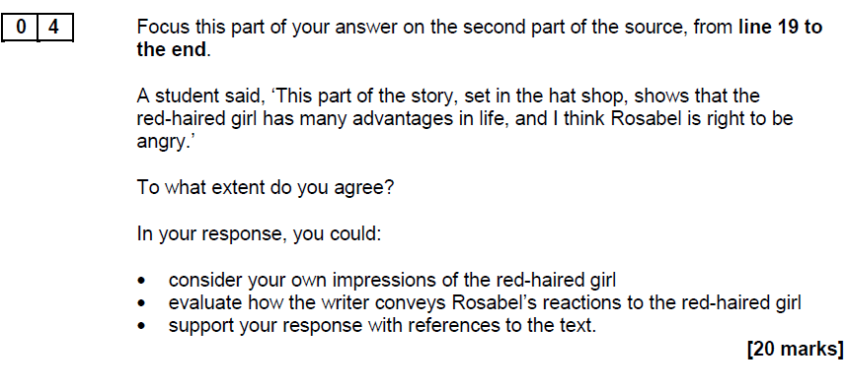

Slide 3
Question 4:
Level 3
Clear, relevant evaluation
11-15 marks
Shows clear and relevant evaluation:
Evaluates clearly the effect(s) on the reader
Shows clear understanding of writer’s methods
Selects a range of relevant textual references
Makes a clear and relevant response to the focus of the statement
Level 4
Perceptive, detailed evaluation
16-20 marks
Shows perceptive and detailed evaluation:
Evaluates critically and in detail the effect(s) on the reader
Shows perceptive understanding of writer’s methods
Selects a judicious range of textual detail
Develops a convincing and critical response to the focus of the statement

Slide 4
Response method…
Make a clear statement in response.
Make your opinion clear immediately then each paragraph is the same:
Make a statement linked to the question (agree, disagree, partly agree/disagree)
Provide evidence
Refer to writer's method (terminology.... what has writer done/used)
Explain WHY the writer has used that particular term/technique and link your explanation back to the question
Evaluate (using key words) the effect on reader/meaning/inference.

Slide 5

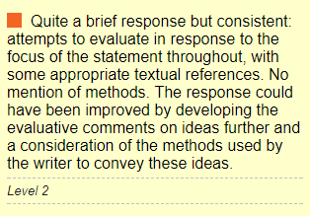
I agree with the statement, the red-haired girl is obviously from a higher class than Rosabel, so has more money. “her carriage at the door”. This suggests the girl has her own transport so doesn’t use public transport like the lower class. Rosabel doesn’t have this advantage. As the reader you can understand Rosabel’s anger towards the girl.
The girl makes Rosabel try on the hat and pays her a compliment. “It suits you beautifully”. Rosabel might be angered by this because she knows she could never afford a hat like that, because she's of lower class.
Rosabel might feel jelous of the girl because she has a man to pay for her hat, the girl doesnt have to pay for it herself. “the girl swept out to her carriage and left Harry to pay”. Rosabel has to earn her money and pay her way but the girl doesnt.
Question 4:
What method do we use?
What mark would this get?

Slide 6

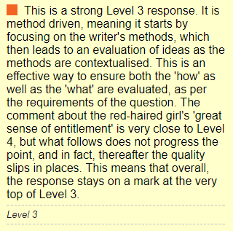
I agree that the red-haired girl is presented as having many advantages in life. This is evident from one of the very first description of the girl’s eyes colour as ‘green ribbot shot with gold’. The colour imagery of ‘gold’ has connotations of royalty and treasure, both suggesting she is of a higher class than ‘Rosabel’. In addition, the use of the imperatives and the exclamation statement in the red-haired girl’s speech in ‘Let me’ and ‘I must have that!’, demonstrate the great authority and power the red-haired girl acquires. This shows she has many advantages as she is able to have whatever she wishes. Moreover, Rosabel calls the red-haired girl ‘Madam’ which strengthens her superiority and likens ‘Rosabel’ to a servant, therefore distinguishing greatly between the two. Furthermore, the red-haired girl ‘left Harry to pay’, presenting her great sense of entitlement as she can simply assume things will be done for her.
However, I do not agree that Rosabel has a right to be angry. This is because the red-haired girl kindly compliments Rosabel and says ‘It suits [Rosabel], beautifully’. This is presented to be quite a genuine statement and the comma slows down the pace, making the red-haired girl’s speech seem gentler. This idea is further strengthened by the red-haired girl who ‘smiled again at Rosabel’. A smile is thought to be an affectionate gesture and is normally associated with happiness and kindness. Therefore, in some ways it seems almost unreasonable for Rosabel to be angry. Furthermore, Rosabel’s anger is described as ‘sudden’ and ‘ridiculous’ and both imply that Rosabel’s anger is rash, impulsive and without thought. In addition, the anger ‘seized’ Rosabel suggesting how powerful and reckless it is and can be interpreted to overpower rational feelings.
Therefore, although I do agree that the red-haired girl is advantageous, I do not believe it is necessary right for Rosabel to be so furious.
Question 4:
What about this one?

Slide 7

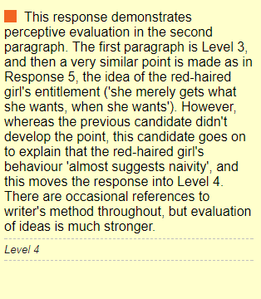
I agree with this student, as the red haired girl seems to have come from a higher class background, with more privileges. She seeming carries an air of grace and respectability, carefree but with high standards. This is shown throughout her dealings with Rosabel, for example when she found the perfect hat the girl exclaimed ‘Isn’t it adorable”, “I must have that”.
The use of ‘must’ here shows how used she is to getting her own say, as she feels no need to ask or even use manners, she merely gets what she wants, when she wants. Even after she said this, she goes on to compliment how well it suits Rosabel. This almost suggests naïvity, as though the red headed girl doesn’t realise not everyone lives like her, and can afford the luxuries she can.
This is very contrasting to Rosabels life; as she works tirelessly for the upper class who care not for her, and she gets little reward.
Rosabels ‘sudden ridiculous feeling of anger’ seems to be the pent up rage at the system she is stuck in, serving hats to wealthy women with rich tastes. The writer’s use of ‘ridiculous’ makes it seem as though Rosabel doesn’t want to be angry at the woman and the use of the verb ‘flushing’ shows how she contains herself.
‘Flushing’ almost shows embarrassment at the anger, as though a girl like her shouldn’t be angry with what she has, she has steady income, and for some people this would be reason for her not to be angry, as she is making a livelihood
Question 4:
And this one?

Slide 8
Creating the Answer
Level 3
Clear, relevant evaluation
11-15 marks
Shows clear and relevant evaluation:
Evaluates clearly the effect(s) on the reader
Shows clear understanding of writer’s methods
Selects a range of relevant textual references
Makes a clear and relevant response to the focus of the statement
Look at this example: The red-haired girl does seem to have many advantages in life. She arrives in a carriage to go hat shopping, which tells us she’s wealthy, and she has a ‘well-dressed’ boyfriend, all outward signs of success. She is also attractive, and the writer uses colour to imply how alive and vibrant she is: ‘beautiful red hair and a white skin and eyes the colour of that green ribbon shot with gold’. She has everything that Rosabel doesn’t have, and I think this makes Rosabel jealous because she recognises how unfair life is. However, the girl isn’t unpleasant so I’m not sure that Rosabel is right to get annoyed. When Rosabel tries on the hat, her anger is ‘sudden’ and ‘ridiculous’, adjectives that show her reaction is unexpected and ultimately silly because there’s nothing she can do about the girl having all these advantages and her having none.

Slide 9
Creating the Answer
Level 4
Perceptive, detailed evaluation
16-20 marks
Shows perceptive and detailed evaluation:
Evaluates critically and in detail the effect(s) on the reader
Shows perceptive understanding of writer’s methods
Selects a judicious range of textual detail
Develops a convincing and critical response to the focus of the statement
Look at this example: Although Rosabel’s anger is understandable, it is not entirely justified, even though the red-haired girl does appear to have many advantages in life. She has wealth, beauty and happiness, all characteristics of a privileged lifestyle, and the writer’s use of colour to describe her - ‘beautiful red hair and a white skin and eyes the colour of that green ribbon shot with gold’ - implies she is also radiant, vivacious and exotic. This is in direct contrast to the brown-haired Rosabel, who can only dream of being like this. I think Rosabel is envious and maybe even resentful, which is why her anger is understandable. When Rosabel tries on the hat, the key sentence ‘Let me see how it looks on you,’ is significant because, just for one moment, their lives overlap. In a way, Rosabel is being taunted with a symbol of another, much better life, but this is not deliberate, which is why her ‘sudden, ridiculous feeling of anger’ is not really fair on the girl. The adjective ‘sudden’ implies the fury comes out of nowhere, as if Rosabel has no control over it, and ‘ridiculous’ suggests it is unreasonable to the point of being absurd. The girl does have many of life’s advantages, but she is a product of her upbringing in much the same way as Rosabel, and is not to blame for the class divisions in society.

