Slide 1
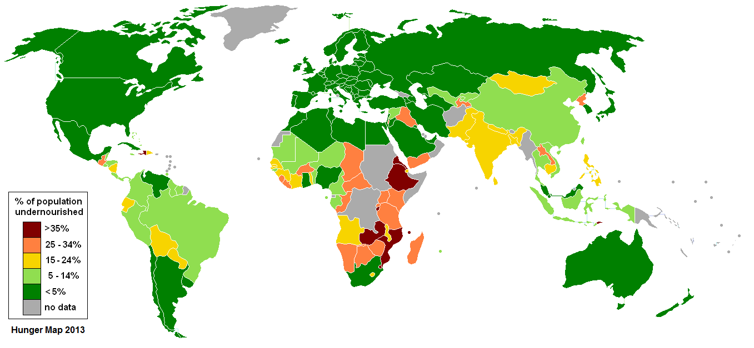


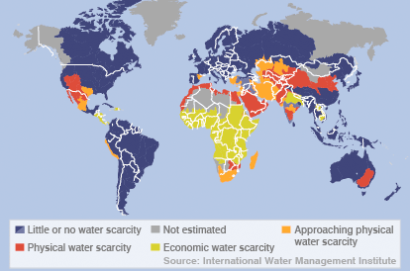


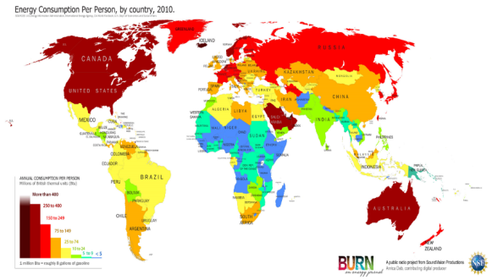



Global inequalities in the supply and consumption of resources
Food | Average UK calorie consumption is 3200 calories per person per day. Average calorie consumption in Mali is 2590 calories per person per day. Areas of greatest population growth have highest levels of undernourishment. Demand depends on changing diets and increasing population. Supply depends on climate, soil and level of technology.
Water | Fresh water is unequally distributed. Water footprint is the amount of water used per day. Global average is 1240 litres per day (Bangladesh = 896 litres per day, USA = 2483 litres per day) Water scarcity (where demand is greater than supply) can be physical e.g. reduction in rainfall or economic e.g. lack of money to enable access to water. 1 in 5 (more than 1.2 billion people) live in areas of water scarcity. 1 in 3 (2.4 billion people) have no access to clean drinking water.
Energy | The richest 13% of people globally use 50% of the world’s energy. The poorest 13% of people globally use 4% of the world’s energy. Countries import and export energy. Some countries do not have their own sources of energy.
The significance of food, water and energy to economic and social well being
Water food and energy are key for human wellbeing. All lead to social and economic benefits, which all increase the standard of living and quality of life.
Food | Calories provide energy. Availability of food depends on climate, soil and level of technology. Malnourishment leads to disease and death. In children it can lead to underperforming at school which decreases economic wellbeing in life. In adults they will be less productive (less able to work). Globally more than 1 billion people are malnourished. 2 billion are undernourished (poor diet). Obesity is an issue in some areas, mainly HICs.
Water | Used for survival, washing, food production, industry. Clean, safe water enables development and allows people to break free from the cycle of poverty. Globally 2 billion people drink from contaminated water sources. Over 500,000 people a year die because of diarrhoeal diseases linked to contaminated water supplies.
Energy | Traditionally we get energy from oil, coal and wood. Many different sources are generated by changing technology. Used for electricity production, heating, transport and for water supply (e.g. wells). Supports industrialisation and development.
What are Resources?
Key term | Definition
Resources | Materials that have value for people. They may be needed for basic survival e.g. water, or appreciated as something that improves quality of life e.g. coffee.
Resource management | The control and monitoring of resources so they don’t become depleted or exhausted.
Surplus | When there is more of a resource than is needed to meet demand.
Deficit | When there is not enough of a resource to meet demand.
Resource security | When the demand is lower than the supply there will be a surplus. This means that a location is resource secure.
Resource insecurity | When the demand is greater than the supply there will be a deficit. This means that the location is insecure/has scarcity
Distribution of malnourishment
Distribution of water scarcity
Distribution of energy consumption
The Challenge of Resource Management
Changing demand for water in the UK creates opportunities and challenges
The changing demand for water | Amount of water used by the average household in the UK has risen 70% since 1985 due to: Increase in wealth leading to more use of domestic appliances e.g. dishwashers/washing machines Home hygiene changes – most homes have showers rather than a once weekly bath! Demand for out-of-season food requiring additional watering e.g. in greenhouses Increased leisure use e.g. golf courses Increased UK population
Water Quality and Pollution Management | Pollution sources e.g.: pesticides/fertilisers from farm run-off; industrial waste into rivers; runoff from roads and motorways (oil, salt from gritting) Effects: Toxic waste poisoning wildlife; drinking water supply contaminated; eutrophication with growth of algae in water; spread of disease in aquatic life Management: Law e.g. EU Water Framework Directive; Waste water treatments; Pollution traps; Education campaigns to inform public about appropriate waste disposal
Supply and demand – areas of deficit and surplus | Areas of surplus: More water than needed e.g. low population density and high rainfall such as Wales and Western Scotland Areas of deficit: Less water than demand e.g. high population density and low rainfall such as SE England. Water stress are areas which suffer from serious water deficit
The need for transfer to maintain supplies | Need to transfer from NW to SE. e.g. reservoirs in the Lake District provide water for densely populated urban areas such as Liverpool and Manchester Some consideration of a national water grid to transfer from surplus to deficit Concerns: impact on environment of river basin in the source; displacement of local communities; disruption to ecology in rivers; potential droughts in source areas
Changing demand for food in the UK creates opportunities and challenges
The growing demand for high value food exports from LICs and all year demands for seasonal food and organic produce. | Food used to be seasonally and locally sourced. Now we eat globally sourced foods all year. In 2013 47% of UK food was imported. More disposable income has led to an increased demand for greater quantities and wider choice. Not all foods can be grown the UK due to the climate; some foods can only be grown at certain times e.g. strawberries in June/July High quality products are five times the price of similar products e.g. Madagascan vanilla, gourmet coffee. Positive impacts : Jobs and wages for those in LICs, more tax income leads to a better quality of life. Negative impacts: Less land for locals to farm for themselves, high water use and exposure to chemicals (pesticides and fertilisers). Organic – no pesticides or fertilisers used. Since the 1990s there has been an increase in demand. Now worth £2 billion a year in the UK.
Larger carbon footprints due to the increased number of food miles travelled. | Food can be grown more cheaply elsewhere. Production and transport create a carbon footprint (CO₂) 17% of the UK’s carbon footprint is due to food. Tomatoes have less of a carbon footprint being grown in Spain and imported to the UK than if we grew them in the UK where greenhouses would have to be heated. Annual food miles travelled by UK food imports is 18.8 billion miles. 68% of food imported to the UK is from within the EU, 32% from the rest of the world. UK are now encouraging buying local and having an allotment.
A trend towards agribusiness. | Agribusiness is a farm run as a business with the main aim being profit. Agribusiness has significant impacts on the environment as they are associated with heavy use of pesticides and fertilizers leading to reduction in wildlife and eutrophication. East Anglia has a lot of agribusinesses.

Slide 2
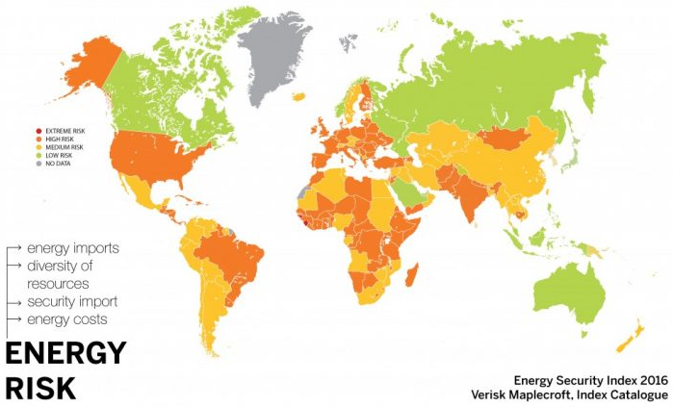
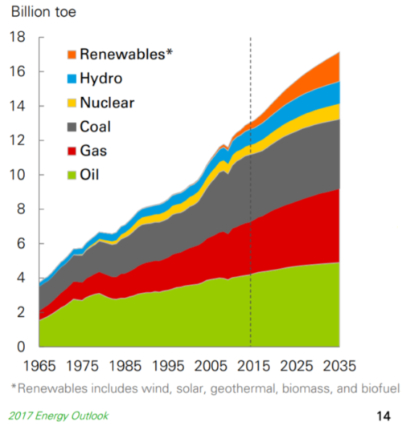

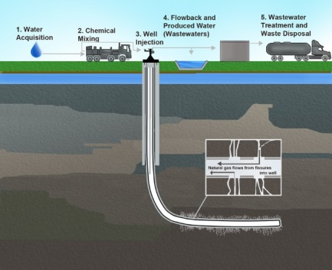

Global distribution of energy insecurity
Factors affecting energy supply – Physical and Human
Geology | Decides whether a country has any fossil fuel deposits, how much of them there is and if they are easily extracted or not.
Climate | Affects possibility of renewable sources. Three most important aspects are rainfall, sunshine and windy days – the more of there are of these, the better chance of renewable electricity generation
Environmental conditions | Affects accessibility of energy sources. The more difficult the environment, the greater the costs involved in overcoming physical difficulties e.g. oilfields of Alaska in the North Sea
Cost of Exploitation and production | Low production costs mean relatively cheap energy supply which encourages high energy demand. The cost of conversion into electricity varies from one source to another. Energy supply and consumption affects the price paid by the customer.
Technology | Advances in technology can lead to discovery of new sources of energy and new ways of generating energy as well as new ways to exploit more inaccessible sources of energy e.g. fracking
Political Factors | Energy security is affected by importing energy from other countries. They need to be politically stable so uninterrupted supply is guaranteed (i.e. no wars) and politically ‘friendly’ counties in the same alliance e.g. EU, NATO
Impacts of energy insecurity
Exploration of difficult and environmentally sensitive areas | Economic and Environmental Costs | Food production | Industrial output | Conflict
Lack of energy supply will mean countries take more risks with the environment e.g. clearing forests for wood then using land to grow biofuels as in Brazil (Amazon rainforest). Drilling for oil in areas such as the Arctic. Flooding valleys to generate more HEP (3 Gorges Dam, China). Building wind farms in areas of scenic beauty | Pressure to use energy sources in economically marginal situations will add to the cost of energy production and therefore increase the price to the consumer | Modern, large-scale agriculture uses vast amounts of energy – meaning high energy costs or insecurity could impact on farming production. There could be increased competition from foreign food suppliers in countries that are more energy secure | Very vulnerable to impacts of energy insecurity. Risk of losing out to more energy secure foreign competition – leading to reduced output and redundancies for workers. Affects production costs and consumer prices. Businesses could end up facing closure. Unreliable energy supply could lead to power cuts or rationing. | 1. Conflict between main energy consumers -people, agriculture, industry and transport 2. Conflict between home-produced goods and imported goods. 3. Conflict between countries with sufficient energy supplies and those without
World’s major consumers of energy are also the major producers of energy – mostly HICs (which are energy secure) Energy production is low in countries where demand is also low – mostly LICs (which are mostly energy insecure) Lowest risk energy insecurity include Canada, Russia, most Middle Eastern countries, Indonesia and Australia High risk countries occur in Africa as well as in parts of Asia and Latin America – although some of these countries have no need to import energy as their demands are small.
Strategies to increase energy supply
Renewables | Biomass: Biodiesel and ethanol made from crops e.g. sugar cane/soy beans. Methane capture from rubbish in landfill. Tidal: concerts energy from tides into electricity. Proposals for River Severn estuary but large environmental conflict Geothermal: generated and stored in the Earth – so far limited to near tectonic margins Wave: Energy from up and down motion – still in development to be efficient Also – wind, HEP and solar.
Non-Renewable | 2/3 global energy still from fossil fuels Fossil Fuels: - natural gas is cleanest to rely on. Can focus on reducing CO2 emissions and making fossil fuels better for environment Nuclear: 5% of global energy supply. Very efficient – not much uranium required. Challenges with conflict in using nuclear.
Sustainable energy future
Energy conservation – minimising wastage of energy and using it as efficiently as possible
Individual Usage and Carbon Footprints Loft insulation Double glazing Draught proofing New efficient boilers Cavity wall insulation Create your own energy e.g. solar panels | Reducing Energy Use Designing homes and workplaces Sustainable transport options e.g. car-share Demand reduction – by conserving energy Modern Technology – e.g. carbon capture or combined head and power (CHP)
Reasons for Increasing Energy Consumption
Economic Development | Rise in living standards increase energy consumption e.g. advances in agriculture, industry and transport
Rising Population | Increased population increases consumption
Technology | More people have access to electricity and other forms of energy across the world. Technology can reduce energy costs making it more available and affordable so increasing consumption
Changing demand for energy in the UK creates opportunities and challenges
The changing energy mix | UK Energy mix in 2015 : Fossil fuels (65%) Coal 31%, Gas 25%, Nuclear 19%, Renewable sources 22%. In 1970 91% from fossil fuels. The UK has invested in renewable energy e.g. solar energy and subsidies are given by the government.
Decreasing domestic supply of oil, coal and gas. | Reserves of North Sea oil and gas are declining. EU regulations on gas emissions has led to a decrease in fossil fuel use. Energy efficient appliances and industry mean less energy is used in homes and industry.
Economic and environmental issues linked to energy use. | It is cheaper to import coal into the UK than to mine it. Nuclear Power Stations are being decommissioned and all current plants will close by 2023 – there are issues of contamination and disposal of nuclear waste. Economic issues – costs, jobs, set up costs, research, reliability. Environmental costs – ecosystems, waste, noise, emissions, pollution, radiation leaks.
An example to show how the extraction of a fossil fuel has both advantages and disadvantages.
Shale Gas (via Fracking)
Opportunities Shale gas is readily available in UK. Will act as a bridging fuel until alternative technologies are developed. Increased cost of fuel makes fracking now affordable. Economic benefit to UK and local area e.g. job creation | Challenges Contaminated water is pumped back into the ground and can affect water supplies. Fracking uses a lot of energy. 3% of gas extracted is lost to atmosphere; this is methane, a greenhouse gas. Earthquakes in local area
An example of a local renewable energy scheme in an LIC or NEE to provide sustainable supplies of energy.
Micro-hydro power in Nepal
Context: LIC country land-locked and mountainous – difficult to import fossil fuels. No significant reserves and wood use has led to deforestation | Government and World Bank working together to create micro-hydro plants across rural Nepal. Run by local communities – sustainable source of energy
Low-cost power production. Little environmental damage. Appropriate technology. Leads to multiplier effect and creation of other small businesses in local area. Ideal for mountainous country with good water supply. Renewable energy .

Slide 3
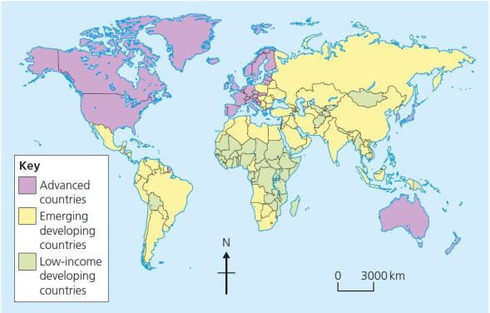



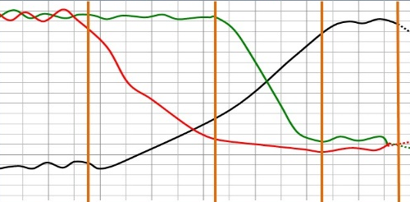
What is development?
Development is an improvement in living standards through better use of resources.
Economic | This is progress in economic growth through levels of industrialisation, types of jobs and use of technology in farming.
Social | This is an improvement in people’s standard of living. For example, access to clean water (quantity and quality, electricity and access to education.
Environmental | This involves advances in the sustainable management of the environment.
Variations in the level of development
LICs | Poorest countries in the world. GNI less than $1045 per capita is low and most citizens have a low standard of living.
NEEs | These countries are getting richer as their economies are progressing from the primary industry to the secondary industry. Greater exports leads to better wages. (BRIC countries)
HICs | These countries are wealthy with a high GNI per capita (>$12,746) and standards of living. These countries can spend money on services.
Economic
Lots of Debt | Trade
Very poor countries borrow money from other countries and international organisations e.g. to cope after a natural disaster. This money has to be paid back usually with interest. Any money a country makes thus has to be used to pay back debts and not used to develop. For example Bangladesh owes $36,210,000,000 in external debt. | Countries that mainly (LIC), export primary products (raw materials like wood, metal and stones) tend to be less developed. This is because by selling primary products, their prices can fluctuate (go up or down) sometimes the prices falls below the cost of production, e.g. Banana prices in Ghana
Poor trade links | Health
Trade is the exchange of goods and services, the world trade pattern is that poor countries produce raw materials and sell them for low prices to richer countries that then manufacture them and make a large profit. For example, Ghana. | Lack of clean water and poor healthcare means a large number of people suffer from diseases. People who are ill cannot work so there is little contribution to the economy. More money on healthcare means less spent on development.
Historical
Politics | Colonialism
Corruption in local and national governments. e.g. Zimbabwe. The stability of the government can effect the country’s ability to trade. Ability of the country to invest into services and infrastructure. If there is a civil war (war within a country by opposing groups wanting to take power) or a war between two countries, can lead to low levels of economic development due to wars being very expensive. In Uganda the civil war which ended in 1986, has caused development levels today to be less than those of Uganda in 1986! | Countries that were conlonialised (ruled by a foreign country) often have lower levels of development than when they gained independence. For example, European countries colonised much of Africa in the 19th century. They controlled the economies of the colonies, removed raw materials, exported slaves and sold back expensive manufactured goods. This was negative for African development as it made parts of Africa dependent on Europe, which led to famine and malnutrition.
Measuring development
We never use of measure of development as this can be misleading, a range of measures (social and economic)I s fairer) e.g. HDI
Economic indictors examples
Employment type | The proportion of the population working in primary, secondary, tertiary and quaternary industries.
Gross Domestic Product per capita | This is the total value of goods and services produced in a country per person, per year.
Gross National Income per capita | An average of gross national income per person, per year in US dollars.
Social indicators examples
Infant mortality | The number of children who die before reaching 1 per 1000 babies born.
Literacy rate | The percentage of population over the age of 15 who can read and write.
Life expectancy | The average lifespan of someone born in that country.
Mixed indicators
Human Development Index (HDI) | A number that uses life expectancy, education level and income per person.
Causes of uneven development
Development is globally uneven with most HICs located in Europe, North America and Oceania. Most NEEs are in Asia and South America, whilst most LICs are in Africa. Remember, development can also vary within countries too.
The Changing Economic World
Physical factors affecting uneven development
Natural Resources | Natural Hazards
Fuel sources such as oil. Minerals and metals for fuel. Availability for timber. Access to safe water. | Risk of tectonic hazards. Benefits from volcanic material and floodwater. Frequent hazards undermines redevelopment. Eg. Haiti Earhquake (2010)
Climate | Poor farming land
Reliability of rainfall to benefit farming. Extreme climates limit industry and affects health. Climate can attract tourists. | If the land in a country is too steep or has poor soil (or no soil due to desertification) then they won’t be able to produce enough food. This could lead to famine.
Consequences of Uneven Development
Levels of development are different in different countries. This uneven development has consequences for countries, especially in wealth, health and migration.
Wealth | People in HIC have higher incomes than less developed countries so have a higher SoL.
Health | Better healthcare means that people HIC have higher life expectancy than those in less developed countries. LIC countries have higher case of diseases such as Malaria and HIV/AIDS. Eg 15% of Zimbabwe’s population has HIV/AIDS!
Migration | If nearby countries have higher levels of development or are secure, people will move to seek better opportunities and standard of living. (Think push and Pull factors!) e.g 1/5 Syrian and refugees.
The Demographic Transition Model
The demographic transition model (DTM) shows population change over time. It studies how birth rate and death rate affect the total population of a country. |  | STAGE 1 | STAGE 2 | STAGE 3 | STAGE 4 | STAGE 5
 |  | High DR High BR Steady | BR Low Declining DR Very High | Rapidly falling DR Low BR High | Low DR Low BR Zero | Slowly Falling DR Low BR Negative
 |  | e.g. Tribes | e.g. Kenya | e.g. India | e.g. UK | e.g. Japan

Slide 4


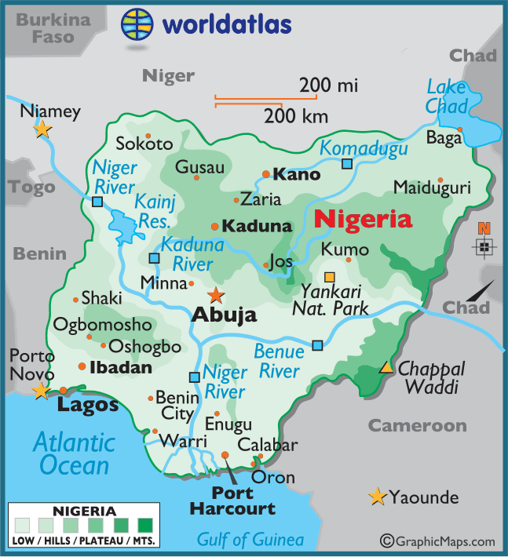
Reducing the Global Development Gap
Microfinance Loans This involves people in LICs receiving smalls loans from traditional banks. + Loans enable people to begin their own businesses Its not clear they can reduce poverty at a large scale. e.g. Grameen bank in Bangladesh | Foreign-direct investment This is when one country buys property or infrastructure in another country. + Leads to better access to finance, technology & expertise. -Investment can come with strings attached that country’s will need to comply with. e.g. Cahora Bassa dam in Mosambique
Aid This is given by one country to another as money or resources via bilateral, Multi-lateral or NGO + Improve literacy rates, building dams, improving agriculture. - Can be wasted by corrupt governments or they can become too reliant on aid. E.g.. Nigeria receives $5billion per year in aid | Debt Relief This is when a country’s debt is cancelled or interest rates are lowered. + Means more money can be spent on development. - Locals might not always get a say. Some aid can be tied under condition from donor country.
Fair trade This is a movement where farmers get a fair price for the goods produced. + Paid fairly so they can develop schools & health centres. +Fair trade means prices doesn't fluctuate and leads to emancipation of women. -Only a tiny proportion of the extra money reaches producers. | Intermediate Technology Includes tools, machines and affordable equipment that improve quality of life. + Renewable energy is less expensive and is sustainable -Requires initial investment and skills in operating technology e.g. building a mini HEP dam in Kenya and Nepal by Practical Action (NGO)
Case Study: Economic Development in Nigeria
Location & Importance
Nigeria is a NEE in West Africa. Nigeria has a population of 182 million. It has the highest GDP in Africa and has the world’s fasted GDP growth in 2015. Economic growth has been base on oil exports (2.7% of the world’s oil production.
Influences upon Nigeria's development
Political | Social
Suffered instability with a civil war between 1967-1970. From 1999, the country became stable with free and fair elections. Stability has encouraged global investment from China and USA. | Nigeria is a multi-cultural, multi-faith society. A range of religions including Christianity and Islam Although mostly a strength, diversity has caused regional conflicts from groups such as the Boko Haram terrorists.
Cultural | Industrial Structures
Nigeria’s diversity has created rich and varied artistic culture. The country has a rich music, literacy and film industry (i.e. Nollywood). A successful national football side. | Once mainly based on agriculture, 50% of its economy is now manufacturing and services and major oil exporter. A thriving manufacturing industry (10% of GDP and Nigeria has increasing foreign direct investment (e.g Shell and GlaxoSmithKline).
The role of TNCs | Changing Relationships
TNCs such as Shell have played an important role in its economy creating 60,000 direct and 250,000 indirect jobs). + Investment has increased employment and income. - Profits move to HICs. - Many oil spills have damaged fragile environments and oil theft is increasing! | Nigeria plays a leading role with the African Union and UN. Growing links with China with huge investment in infrastructure. Main import includes petrol from the EU, cars from Brazil and phones from China. -Is now part of OPEC!
Environmental Impacts | Aid & Debt relief
The 2008/09 oil spills devastated swamps and its ecosystems. Industry has caused toxic chemicals to be discharged in open sewers - risking human health. 80% of forest have been cut down. This also increases CO² emissions and desertification. | + Receives $5billion per year in aid. + Aid groups (ActionAid) have improved health centres, provided anti-mosquito nets and helped to protect people against AIDS/HIV. +£1.4 billion from the UK over 5 years (2015). E.g. 10 million Mosquito nets given out/500,000 more girls have access to education.
Effects of Economic Development
Life expectancy has increased from 46 to 53 years. 64% have access to safe water. Typical schooling years has increased from 7 to 9. Improved HDI score of 0.50 in 2015. Internet use now 38% of the population.
Case Study: Economic Change in the UK
UK in the Wider World
The UK has one of the largest economies in the world. It is part of the Commonwealth which in 2014 produced a GDP of $10.45 trillion with a population over 2 billion people. The UK has huge political, economic and cultural influences. The UK has global transport links i.e. Heathrow and the Eurostar. The UK trades all over the world, but mainly with other EU countries. Outside the EU, its main trading partner is the USA. Inside the EU, it’s Germany. Many British companies are transnational corporations (TNCs) with branches all over the world, e.g. Shell, Vodaphone, and Barclays Bank. Many TNCs from other countries have set up branches in the UK, like Sony, Coca-Cola, Nike, and McDonalds. The UK exports many cultural products e.g. BBC and Channel 4 programmes.
Causes of Economic Change | Towards Post-Industrial
De-industrialisation and the decline of the UK’s industrial base. This was caused by Deindustrialisation: The decline of a country's traditional manufacturing industry due to exhaustion of raw materials, loss of markets and competition from NEEs. Globalisation: The process which has created a more connected world, with increases in the movements of goods (trade) and people (migration and tourism) worldwide. Government Policy: A plan or course of action decided by a government to manage issues in a country. | The service and quaternary industry has increased, whilst secondary has decreased. Numbers in primary and tertiary industry has stayed the steady. Big increase in professional and technical jobs. In 2011, 81% of the UK’s workforce worked in the tertiary and quaternary sector. For example, research and development (£30 billion spent on this in 2015) and Finance with places like Canary Wharfe having the global HQ) for HSBC.
Quorum Business Park
A major quaternary industry on the outskirts of Newcastle on the A167. A good location for sourcing highly educated workers from Newcastle University. Staff benefit from attractive working conditions, and high paid jobs within an hour of Newcastle. The site Attracts clusters of related high-tech businesses which share knowledge. The science park is sustainable due to: There are 132 cycle parking spaces and 9 showers on site to encourage people to cycle.. Windows are triple glazed to keep heat in, green roofs have been input and bee hives to encourage biodiversity.
Change to a Rural Landscape - South Cambridge vs Outer Hebrides
South Cambridgeshire | Outer Hebrides
Population currently 150,000 people. Easy access to London along the M11 or A1M Increasing investment in the Uk’s knowledge economy, rising quartenary sector and globalisation allow more people to work from home. Exacerbated by Covid-19 Rising house prices have caused tensions in villages. Villages are. unpopulated during the day causing loss of identity. Resentment towards poor migrant communities. | Aging population with a decline population less than 300 people. Few services within the area. Decline of the fishing industry and a lack of services for young people resulting in major migration to the Scottish mainland. The majority of jobs are primary and so limits potential residents. Poor internet speeds prevent people working from home.
Improvements to Transport | UK North/South Divide
A £15 billion ‘Road Improvement Strategy’. This will involve 10 new roads and 1,600 extra lanes.(Smart motorways) £50 billion HS2 railway to improve connections between key UK cities. £18 billion on Heathrow’s controversial third runway. UK has many large ports e.g London Gateway for importing and exporting goods. | - Wages are lower in the North. Health is better in the South. London makes 20% of UK GNI - Education is worse in the North. + The government is aiming to support a Northern Powerhouse project to resolve regional differences. + More devolving of powers to disadvantaged regions.
CS: Reducing the Development Gap In Kenya through tourism
Location and Background Kenya is a LIC nation In Africa. Location makes Jamaica an attractive place for visitors to explore. It has savannah plains, mountains and beautiful beaches.
Tourist economy | Multiplier effect
-In 2015, 2.12 million visited. -Tourism contributes 27% of GDP and will increase to 38% by 2025. -130,000 jobs rely on tourism. -Global recession 2008 coupled with terrorist attacks caused a decline in tourism. Now tourism is beginning to recover. | -Jobs from tourism have meant more money has been spent in shops and other businesses. -Government has invested in infrastructure to support tourism. -New sewage treatment plants have reduced pollution.
Development Problems
Tourists do not always spend much money outside their resorts. Infrastructure improvements have not spread to the whole island. Many people in Kenya still live in poor quality housing and lack basic services such as healthcare. Foreign direct investment from companies such as TUI can remove profits to the host country

Slide 5

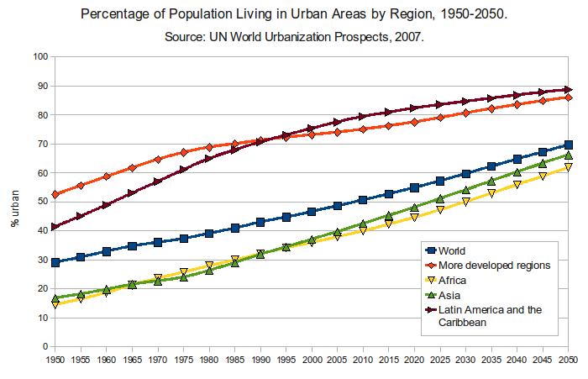










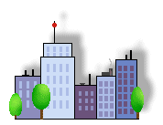
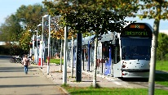
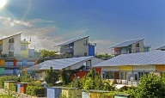
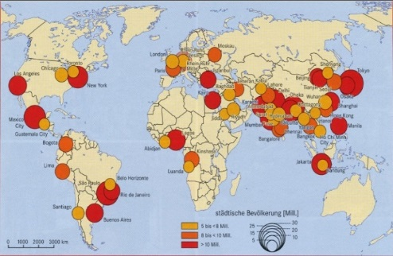
What is Urbanisation?
This is an increase in the amount of people living in urban areas such as towns or cities. In 2007, the UN announced that for the first time, more than 50 % of the world’s population live in urban areas.
Where is Urbanisation happening?
Urbanisation is happening all over the word but in LICs and NEEs rates are much faster than HICs. This is mostly because of the rapid economic growth they are experiencing and natural increase due to higher fertility rates.
Sustainable Urban Living
Sustainable urban living means being able to live in cities in ways that do not pollute the environment and using resources in ways that ensure future generations also can use then.
Water Conservation | Energy Conservation
This is about reducing the amount of water used. Collecting rainwater for gardens and flushing toilets. Installing water meters and toilets that flush less water. Educating people on using less water. | Using less fossil fuels can reduce the rate of climate change. Promoting renewable energy sources. Making homes more energy efficient. Encouraging people to use energy.
Creating Green Space | Waste Recycling
Creating green spaces in urban areas can improve places for people who want to live there. Provide natural cooler areas for people to relax in. e.g. Queen Elizabeth Olympic park Encourages people to exercise. Reduces the risk of flooding from surface runoff. | More recycling means fewer resources are used. Less waste reduces the amount that eventually goes to landfill. Collection of household waste. More local recycling facilities. Greater awareness of the benefits in recycling.
Traffic Management
Urban areas are busy places with many people travelling by different modes of transport. This has caused urban areas to experience different traffic congestion that can lead to various problems.
Environmental problems Traffic increases air pollution which releases greenhouse gases that is leading to climate change. Economic problems Congestion can make people late for work and business deliveries take longer. This can cause companies to loose money. Social Problems There is a greater risk of accidents and congestion is a cause of frustration. Traffic can also lead to health issues for pedestrians.
Congestion Solutions
Widen roads to allow more traffic to flow easily. Build ring roads and bypasses to keep through traffic out of city centres. Introduce park and ride schemes to reduce car use. Encourage car-sharing schemes in work places. Have public transport, cycle lanes & cycle hire schemes. Having congestion charges discourages drivers from entering the busy city centres.
Causes of Urbanisation
Rural - urban migration (1) | The movement of people from rural to urban areas.
Push |  | Pull
Natural disasters War and Conflict Mechanisation Drought Lack of employment |  | More Jobs Better education & healthcare Increased quality of life. Following family members.
Natural Increase (2) | When the birth rate exceeds the death rate.
Increase in birth rate (BR) |  | Lower death rate (DR)
High percentage of population are child-bearing age which leads to high fertility rate. Lack of contraception or education about family planning. |  | Higher life expectancy due to better living conditions and diet. Improved medical facilities helps lower infant mortality rate.
Traffic Management Example: Curitiba
Curitiba experienced rapid urbanization during the 1990s (much like a lot of Brazilian cities). As a result of this there were huge issues regarding transport in the city. Traffic congestion had reached such levels that it had become fashionable to get a helicopter around the city as this was quicker and easier than trying to drive. Air pollution was massively increasing from the amount of cars on the road causing health issues for people living in Curitiba. | Public Transport: Curitiba introduced a new sustainable transport system called Bus Rapid Transit (BRT). These buses have their own individual bus lanes running through the city purely for bus use. The buses have been extended meaning that up to 400 people can get on one bus at one time. The bus platforms have been raised so they are on the same level as the bus now so people can embark and disembark easily. Tickets cost the same no matter how far you are travelling and air pollution in Curitbia has dropped massively as a result of this. Over 2 million people use these buses every day, and housing in Curitiba is now built along the bus corridor as this is sought after land.
Urban Issues & Challenges
Sustainable Urban Living Example: Freiburg
Background & Location | Sustainable Strategies
Freiburg is in west Germany. The city has a population of about 220,000. In 1970 it set the goal of focusing on social, economic and environmental sustainability. | The city’s waste water allows for rainwater to be retained. The use of sustainable energy such as solar and wind is becoming more important. 40% of the city is forested with many open spaces for recreation, clean air and reducing flood risk.
Types of Cities
Megacity | An urban area with over 10 million people living there.
 |  | More than two thirds of current megacities are located in either NEEs (Brazil) and LICs (Nigeria). The amount of megacities are predicted to increase from 28 to 41 by 2030.
Integrated Transport System | Greenbelt Area
This is the linking of different forms of public and private transport within a city and the surrounding area. | This is a zone of land surrounding a city where new building is strictly controlled to try to prevent cities growing too much and too fast.
Brownfield Site | Urban Regeneration
Brownfield sites is an area of land or premises that has been previously used, but has subsequently become vacant, derelict or contaminated. | The investment in the revival of old, urban areas by either improving what is there or clearing it away and rebuilding.

Slide 6


Urban Change in a Major UK City: London Case Study
Location | City’s Importance
London is the capital of the UK, it has a population over 8.6 million people and is classed as a World City. London is located in the South East of England on the River Thames. It was originally a Roman settlement. | Nationally: 841,000 private sector businesses were based in London at the start of 2013, more than in any other region or country in the UK. 18 per cent are in the professional, scientific and technical activities sector. London generates approximately 22% of the UK’s GDP. London contains universities and research centres such as the London School of Economics and Imperial College London. Internationally: London is a centre for tourism. In 2015 the city welcomed 17.4 million international visitors. A second financial district has developed at Canary Wharf to the east of the City, which includes the global headquarters of two of the world's largest banks, HSBC and Barclays. 6 international airports such as Gatwick, Heathrow and Stansted serve London.
Migration to London |  | City’s Opportunities
During the industrial revolution, the population dramatically increased with people migrating from nearby rural communities and other parts of the UK. London has a youthful population as many young people (20s and 30s) especially graduates, move to London for work. They are attracted to high pay and the impressive social life in London, which has also led to natural increased due to higher than national average fertility rates. Migrants from around the World, particularly within the Commonwealth and the EU have migrated to London. |  | Social: This migration and multiculturalism has been advantageous for London. It enriches huge areas of London cultural life, from the amazing array of food to the music variety (the BBC's Asian Radio channel). Other advantages include the great exposure people get to other religions, languages and cultural parties. The London also benefits from cultural events such as the Notting Hill Carnival. It has a huge number of cultural attractions such as the British Museum, the National Gallery and the Natural History Museum.
Environmental: London has a really developed INTEGRATED transport system. Public transport accounts for 25% of London's journeys. London also has an integrated cycle network, it is estimated that over one million Londoners own bicycles but as of 2008 only around 2 per cent of all journeys in London are made by bike. There are 700 green roofs in central London alone, covering an area of over 175,000m2. Using canals, rivers bird breeding. Green spaces open to the public including Hampstead Heath and Queen Elizabeth Park. |  | Economic: London is by far the largest contributor to the economy among the English regions and countries of the UK. In 2010 London’s gross value added (GVA) was over £274 billion. It represented 22 per cent of the UK total, the largest regional share. London was responsible for 46 per cent of the total UK GVA from the financial and insurance activities sector London residents (aged 16 to 64 and working) are more likely to be employed in managerial, professional occupations, compared with the UK (54 and 43 per cent respectively in 2011).
City Challenges |  | The London 2012 Olympics. Regeneration Project
Social: High amounts of inequalities- 16% of Londoners are in the poorest tenth nationally, whilst 17% are in the richest tenth of people in the country The richest 10% of people in London have 60% of all assets whilst the poorest 80% of the population share just 20% of all asset wealth in London. House prices and rents are higher in London than any other part of the country. More people in London rent than own their house and those that rent pay more than half their weekly pay in rent. |  | Aims: Improve the social, economic and environmental characteristics of North East London-The Lea Valley (Hackney, Newham, Tower hamlets). Main features: Brownfield sites and derelict buildings pulled down, Queen Elizabeth Olympic Park built (100 hectares open space), Olympic Stadium (now West Ham United ground), build 2800 new homes in the East Village development, build the International Quarter, a new commercial and high rise office development employing 25,000 people and creating new job opportunities. Cost: £8.7 billion including holding the 2012 Olympics and Para-Olympics!
Economic: The unemployment rate was 10.0 per cent compared with 8.4 per cent for the UK in 2011. Poor transport connections to large economic hubs such as London and Manchester.
Environmental: Urban sprawl has led to increased pressure and decline of greenfield sites around the city. There is a sizeable supply of brownfield land in London, which to date remains untapped. London suffers from air pollution, mainly due to the sheer size of the city, a dense road network and high buildings. This means that central London tends to be one of the most polluted places in the UK.
Urban Change in a Major NEE City: RIO DE JANEIRO Case Study
Location | City’s Importance
Rio is a coastal city situated in the South East region of Brazil within the continent of South America. It is the second most populated city in the country (6.5 million) after Sao Paulo. Rio is a major port, industrial and financial centre | Has the second largest GDP in Brazil, producing 5% of Brazil’s GDP. It is headquarters to many of Brazil’s main companies, particularly with Oil and Gas. Sugar Loaf mountain is one of the seven wonders of the world. One of the most visited places in the Southern Hemisphere with 1.5 million visitors in 2013. Hosted the 2014 World Cup and 2016 Summer Olympics.
Migration to Rio De Janeiro | City’s Opportunities
The city began when Portuguese settlers with slaves arrived in 1502. Since then, Rio has become home to various ethnic groups. Rural to urban migration accounts for 65% of all population growth in Rio de Janeiro, millions of people have migrated from rural areas that have suffered from drought, lack of services and unemployment to Rio. People do this to search for a better quality of life. This expanding population has resulted in the rapid urbanisation of Rio de Janeiro. This has led to the growth of favela's in Rio such as Rocinha. | Social: Standards of living are gradually improving. The Rio Carnival is an important cultural event for traditional dancing and music. Improvements life expectancy in Rio is 77 years in comparison to a 73-year average for Brazil. In Rio there are 1000 primary schools and 400 secondary schools. Rio contains 19 of the top 50 schools in the country and 6 major universities.
 | Economic: Rio has one of the highest incomes per person in the country. The city has various types of employment including oil, retail and manufacturing. Rio provides 6% of all employment in Brazil. Land Rover has recently opened a £240 million car-manufacturing factory in Rio employing 300 people. Transnational corporations such as Microsoft have identifies Rio as a growing market, building a $100 million technology park in order to promote investment.
City Challenges
Social: There is a severe shortage of housing, schools and healthcare centres available. Large scale social inequality, is creating tensions between the rich and poor. There are 105 hospitals in Rio however only 34% of these are public. Murder, kidnapping, carjacking and armed assault occur regularly in the Favelas of Rio. With there being over 750 Favelas across Rio and many of them controlled by drug gangs controlling them is a huge issue!
 | Environmental: The hosting of the major sporting events encouraged more investment in sewage works and public transport systems. 95% of the population has mains water supply in Rio de Janeiro compared with only 65% of the rural population. The lowering of energy costs and building of hydroelectric power plants in Rio now means that 99% of the city has access to the power grid. The Simplicio hydroelectric complex built in 2013 supplies the city with 30% more energy.
 | Self-help schemes - Rocinha, Favela Bairro Project
Economic: Unemployment rates in the favelas of Rio are over 20% and most people have to make a living by working in the informal economy. called Favelas. The richest 1% of the population of Rio earn 12% of total income and the poorest 50% of the population only earn 13% of the total income. | Budget of $1 billion US dollars. Paved and formally named streets.. Access to credit for inhabitants of the Rocinha to build their own homes. Giving school grants to poor families to help meet the cost of keeping their child in school. Making money available to pay for free lessons in volleyball, football, swimming and squash in Rocinha Favela.. Opening a private university in the Rocinha Favela. The authorities have provided basic materials to improve peoples homes with safe electricity and sewage pipes. Government has demolished houses and created new estates. Community policing has been established, along with a tougher stance on gangs with military backed police through the process of ‘Pacification’. Police units put in favelas – 38 areas covered, more than 9000 police officers in total. Greater investment in new road and rail network to reduce pollution and increase connections between rich and poor areas. New cable car system to the favela with one return ticket per day for inhabitants. 100% mortgages available so inhabitants can purchase their own homes.
Environmental: Shanty towns called Favelas are established around the city, typically on unfavourable land, such as hills. Air pollution is estimated to cause 5000 deaths per year in Rio! Cars have increased by 40% and many people prefer to travel by car due to high crime rates. The city is often covered in smog due to heavy traffic and congestion as well as mist from the Atlantic mixing with car and factory fumes.

