Slide 1
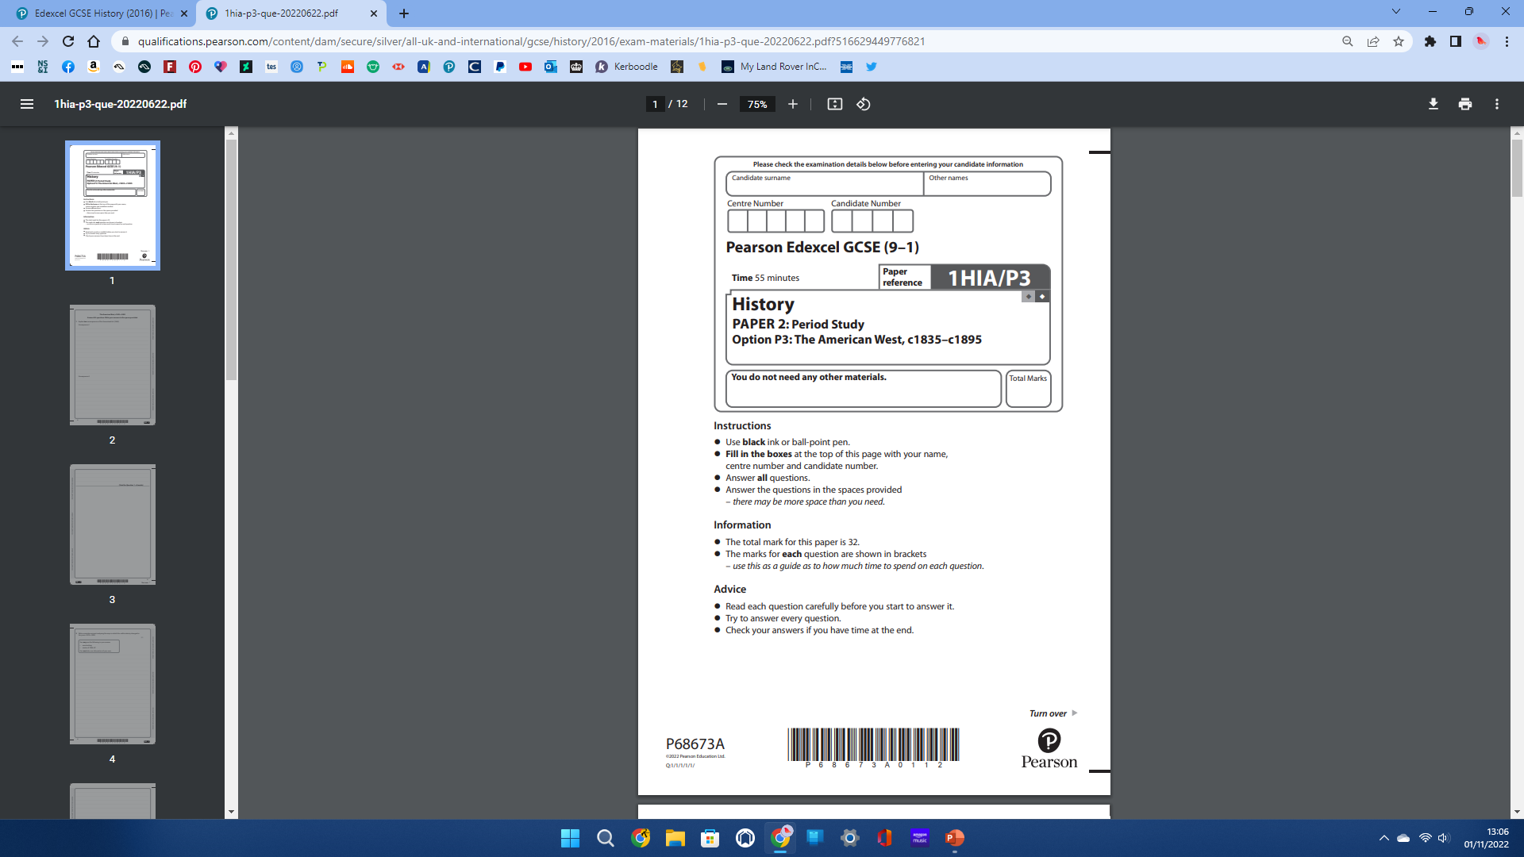


Paper 2 – American West
You will have roughly 55 minutes to complete
your American West paper
There are 32 marks available for this paper.
You will complete a total of 3 different question types:
1
Consequence
2
Narrative Account
3
Importance
NOTE: You will complete your American West exam during the time sitting as your British Depth Study exam. Total time: 1h 55mins.

Slide 2

Question:
Explain one consequence of… [2 x 4 = 8 marks]
Example:
1a. Explain one consequence of the Gold Rush (1849) for migration to the American West. [4] _____________________________________________________________________________________________________________________________________________________________________________________________________________________________________________________________________________________________________________________________________________________________________________________________________________________________________________________________________________________
1b. Explain one consequence of the Homestead Act (1862). [4] ________________________________________________________________________________________________________________________________________________________________________________________________________________________________________________________________________________________________________________________________________________________________________________________________________________________________________________________________________________________________________________________________________________________
A consequence is what happens as a result of something – what happens afterwards.
You just need one consequence.
The paper provides you with enough space to explain the consequence.
Think:
What was the Gold Rush?
What was the short-term and long-term impact of it for migration to the American West?
You have two different consequence questions to answer.

Slide 3

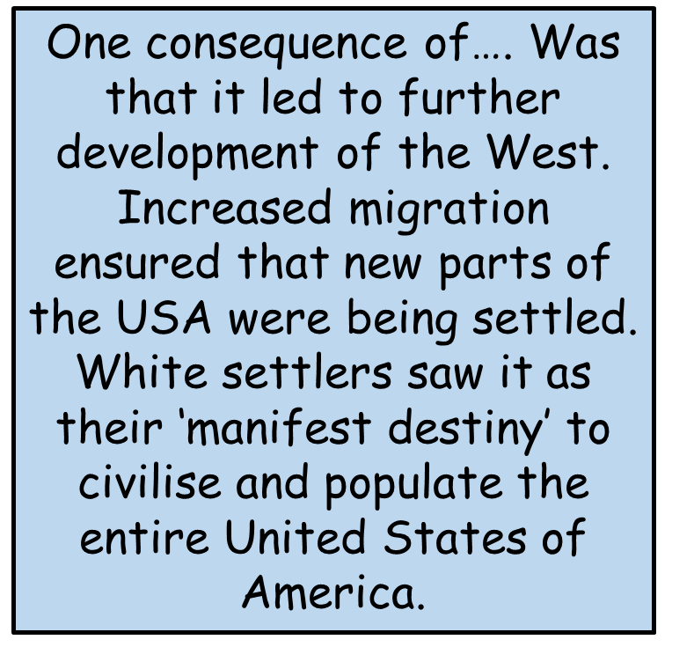

Question 1a & 1b: The ‘Consequence’ Question
Question 1:
If you are ever unsure what to write....
One consequence of …… was that Plains Indians way of life was taken away from them. They were forced to live a more ‘white American’ way of life, by moving onto reservations and farming land. This went against their beliefs in land being sacred, and took away their ability to be nomadic and hunt buffalo to survive on the Great Plains.
If you are unsure of the event in the question, use the following answers;
Change to Plains Indians way of life
Increase in migration
NEVER leave this question blank
Notes:
American West clipart - <a href="https://www.flaticon.com/free-icons/cowboy" title="cowboy icons">Cowboy icons created by Freepik - Flaticon</a>

Slide 4
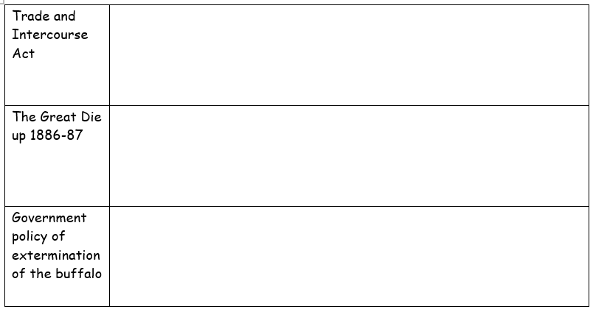
Question 1a & 1b: The ‘Consequence’ Question
Question 1:
Two minutes to have a go at filling in the table...
Trade and Intercourse Act – 1834 –
After the Indian Removal Act, the American government wanted to create a visible and physical border between Indian Territory and the Americans. This line between the two sides was known as the Permanent Indian Frontier.​
To show this, American troops built a military road and began to build forts along the border. ​
This law actually banned any Americans from settling on any land beyond the Indian Territory.
Extermination of the buffalo
The loss of the buffalo shattered the Plain’s Indian way of life. This forced some to attempt to ‘assimilate’ by cattle ranching or farming crops.
The government reduced the food rations given to the Plains Indians. With no buffalo or food, this led to in starvation. Many died as a result.​
With no buffalo, the Plains Indians had no choice but to stay on the reservations. They lost their independence as they now depended on the US government for food, money and property.
The government benefitted from the extermination of the buffalo at it allowed them to build even more in the West. For example, it was able to develop the railroads without the buffalo potentially causing harm to workers.
The Great Die up 1886 – 87
The winter of 1886 into 1887 was very harsh with temperatures falling to -55 degrees.
At least 15% of the open range cattle died which led to thousands of lost cattle.
Many cattlemen and their ranches became bankrupt.
The only way for cattle ranches to survive was to end ranching on the huge areas of the open range. Cattleman began to develop much smaller ranches.
It meant that there was much less demand for the cowboys. Those that remained were just employed as basic ranch hands during parts of the year and many had to seek other employment.
Notes:
American West clipart - <a href="https://www.flaticon.com/free-icons/cowboy" title="cowboy icons">Cowboy icons created by Freepik - Flaticon</a>

Slide 5

Question 2: The ‘Narrative Account’ Question
Question 2:
Write a narrative account analysing the… [8]
Example:
2 Write a narrative account analysing the growth of the cattle industry between 1861–c.1870s
You may use the following in your answer:
The American Civil War (1861-65)
Abilene
You must also use information of your own.
Analysis: This means being able to explain how one event led to another.
Bullet Points: They just act as hints about what you could write about.
Must: You cannot achieve high marks without including events of your own.
Focus: Stick to the topic you have been given.
Useful terms:
To begin with…
Without this…
This led to…
A turning point…
This caused…
Ultimately…
Structure: Try to make your answer having a beginning, middle and an end.

Slide 6

Question 2: The ‘Narrative Account’ Question
Question 2:
In really simple terms....
Identify the first event .
Give some detail about the event
What was the result of the event?
As a result, this led to etc... .
Identify the second event .
Give some detail about the event
What was the result of the event?
As a result, this led to etc... .
What was the result of the event? Overall outcome
As a result, this led to etc... .
Identify the third event .
Give some detail about the event
Notes:
Cowboy clipart - <a href="https://www.flaticon.com/free-icons/horse-riding" title="horse riding icons">Horse riding icons created by smalllikeart - Flaticon</a>

Slide 7
In really simple terms....
The government attempted to separate Plains Indians with the Indian Removal Act in 1830.
Established the Permanent Indian Frontier. This led to 46,000 Natives moving west into the newly established Indian Territory which was further west
This resulted in the deaths of many Plains Indians along the routes which became known as the trail of tears.
The government’s policy started to shift following the discovery of gold in California in 1848
The government encouraged white Americans to make the journey West, which would go through Indian territory. As a result the government put in place the Indian Appropriations Act (1851)
Led to a reduction of the nomadic lifestyle of the Plains Indians who were placed on the reservations.
Furthermore, in 1851 the government created the Fort Laramie Treaty to protect white settlers using trails such as the Oregon Trail
This showed very little regard to the needs of the Indians and meant that migrants would be able to travel safely along the trails through Indian land.
As a result, increased migration from the east whilst at the same time meaning the Indians now had a relationship which enabled the government to increase their control over them
Notes:
Cowboy clipart - <a href="https://www.flaticon.com/free-icons/horse-riding" title="horse riding icons">Horse riding icons created by smalllikeart - Flaticon</a>

Slide 8

Question 3: The ‘Importance’ Question
Question 3:
Explain the importance of… [8 x 2 = 16 marks]
Example:
3. Explain two of the following:
Explain the importance of the Second Indian Appropriations Act (1871) for the development of the West
Explain the importance of John Iliff for the growth of the cattle industry
Explain the importance of Wounded Knee Massacre for the way of life of Plains Indians
Choice: You can pick two questions from the three options.
TOP TIP:
Carefully read through all three options before making a choice about your two answers.
Focus: Carefully read what the focus of each question is about.
Importance: By importance, the question is getting you to think about the following:
Why was it a turning point?
What difference did it make?
What impact or influence did it have?
Why was it significant?
Marks
4 marks = knowledge
4 marks = Explanation of importance

Slide 9
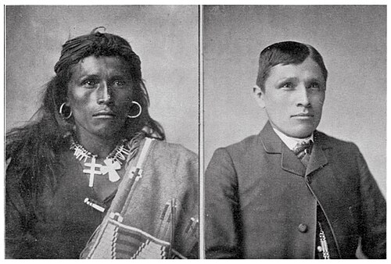
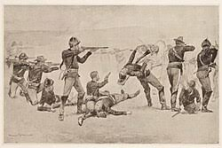


Importance : Complete the 2nd paragraph for importance

Slide 10
Importance : Complete the 2nd paragraph for importance
The government wanted reservations to control the Indians more easily. They believed and hoped that reservation life would encourage Plains Indians to learn about farming, be taught about Christianity, and Plains Indian children could be taught to read and write English as well as be taught American traditions.
Relations between the Indians and Government were becoming increasingly hostile, even after Grants Peace policy.
Under the Peace policy, President Grant appointed an American Indian, named Ely Parker as the main Commissioner of Indian Affairs.
Surprisingly, despite coming from American Indian descent, Ely Parker believed that the US Government should no longer try to negotiate with the Plains Indian tribes. Instead he believed that they should be treated as ‘helpless and ignorant children’ and the government should decide for them what was best. As a result, a new law declared that the Plains Indian tribes would no longer be recognised as an independent nation or power.
Why was it important?
This made it even easier for the US government to do what it wanted with the Plains Indians and take even more of their land. It seemed that President Grant’s Peace Policy had failed.

Slide 11
Importance : Complete the 2nd paragraph for importance
John Iliff realised that there was great demand for beef from the gold prospectors as well as from the Indian tribes who were running low on food. ​
By 1870, Iliff had built up his own herd in the state of Colorado in a town called Denver. He had over 26,000 cattle over 16,000 acres of land. He became Denver’s first millionaire, selling beef to the mining towns, the teams building the railroad and to the government for Plains Indian Reservations. ​
Why was it important?
He was the first to raise cattle on the Great Plains rather than Texas. This led to large scale OPEN RANGE cattle industry where the cattle were not fenced off but allowed to roam free ​
He won a contract with the government to supply a 7,000 Sioux reservation with beef.​
He showed others that this could also be done and because of this the 1870s saw a ‘Beef Bonanza’. The men who dominated this industry were called CATTLE BARONS. They made huge profits, had lots of investment and were able to sell meat cheaply. These men were so powerful they also controlled local politics as well as lots of land.

Slide 12
Importance : Complete the 2nd paragraph for importance
The Ghost Dance (Plains Indians rejecting white ways of life and dancing a sacred dance) spread through reservations
President Harrison sent the army in to take control – killing Sitting Bull in the process
Sitting Bull’s followers fled south and joined the band of Big Foot (another refugee from a reservation). The army caught up with them at Wounded Knee Creek
A Sioux warrior resisted arrest and others began to dance – in confusion the army opened fire – killing 250 Sioux in ten minutes (half the dead were women and children)
Why was it important?
Public opinion of the massacre was actually quite positive – showing that white Americans thought Plains Indians should be killed if they could not be controlled
In 1890 the US census office announced that the Indian Frontier had ended: nowhere within the USA’s borders now belonged to any other nation or people

Slide 13


Anglo-Saxon & Norman England Exam
You will have roughly 55 minutes to complete the paper (longer with a concession)
Candidate surname
Other names
Centre Number
Candidate Number
There are 32 marks available for this paper.
Time 55 minutes
History
You will complete a total of 3 different question types:
PAPER 2: British Depth Study
Option B1: Anglo-Saxon and Norman England, c.1060-88
1
‘Describe one feature of…’ [4]
Instructions
Answer questions 1a, 1b and either 1c (i) or 1c (ii)
Information
The total marks for the paper is 32
The marks for each question are shown in brackets [ ].
2
‘Explain why…’ [12]
3
‘How far do you agree?’ [16]
NOTE: You will complete this exam during the time sitting as your Period Study exam. Total time for both: 1h 50 mins.

Slide 14

QUESTION 1a & 1b: Anglo-Saxon & Norman England
Question:
Describe one feature of … [2 x 2 marks = 4 marks]
Example:
1a. Describe one feature of the Battle of Gate Fulford. [2]
____________________________________________________________________________________________________________________________________________________________________________________________________________________________________________________________________________________________________________________________________
1b. Describe one feature of the Battle of Stamford Bridge. [2]
____________________________________________________________________________________________________________________________________________________________________________________________________________________________________________________________________________________________________________________________________
Focus: What in particular do you know about castles in Norman England?
Describe: This means we are looking for some good specific facts.
Two: You are given two different features to describe.
Features: A feature is like an overall aspect or characteristic of something.

Slide 15
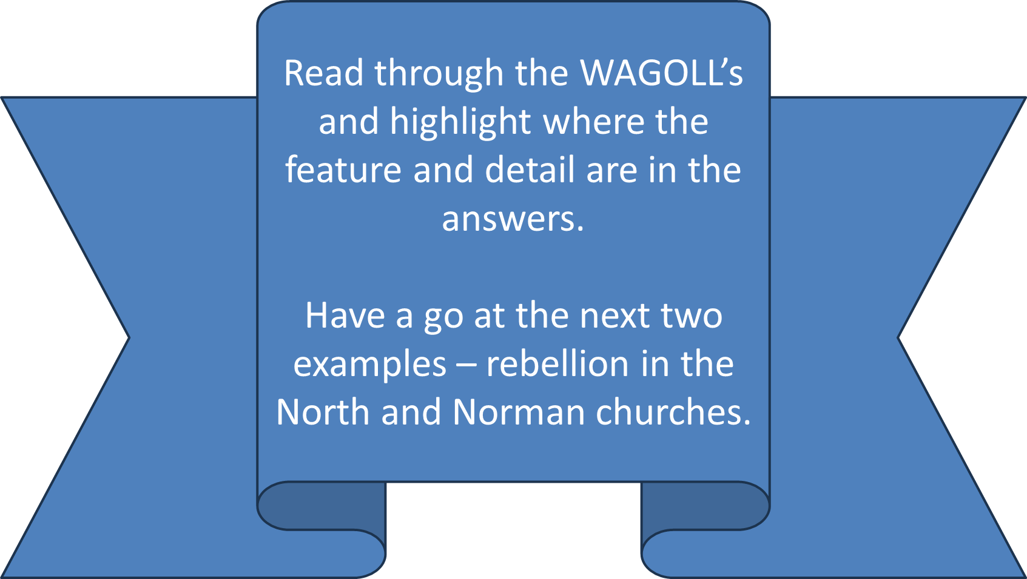

QUESTION1: Anglo-Saxon & Norman England
Question 1:
Describe one feature of … [2 x 2 marks = 4 marks]
1a. Describe one feature of castles in Norman England. [2]
__________________________________________________________________________________________________________________________________________________________________________________________________________________________________________________________________________________________
1b. Describe one feature of the Domesday Book. [2]
_________________________________________________________________________________________________________________________________________________________________________________________________________________________________________________________________________________________
How do I start my answer?
One feature of castles in Norman England was…
Use the wording of the question to make a start. This will help keep your focus on the question.
For example, …
How much do I need to write?
The exam paper gives you a set number of lines to use. This should be enough – remember that these are only 2-mark answers.
One feature of the Domesday Book was…
What are the 2 marks awarded for?
One mark is awarded for identifying an accurate main feature.
One more mark is awarded for giving specific facts to support this.
For example,…

Slide 16
Features : Green Pen Upgrades...
Rebellions in the North
King Sweyn of Norway sent a large fleet of ships and warriors to join the rebellion. This army joined forces with Edgar the Aethling and the Northumbrian rebels.
Anglo Saxon rebels murdered the Earl of Northumbria, Robert Cumin. Williams anger over the death of his friend contributed to his Harrying of the North.
William responded quickly to the rebellion. He routed the rebels and laid waste to York.
The Norman Church
The Normans went through a process of Normanising the church. Within 50 years of 1066, every English church, monastery and cathedral had been destroyed and rebuilt in the Norman style.
The Norman church enhanced the power of the king. The king now gave final say on all decisions regarding the church.
William controlled controlled communication between church leaders and the pope in Rome. He would not allow any attempts of the Pope to convince church leaders that they should obey the Pope instead of him,

Slide 17

QUESTION TYPE 2: Anglo-Saxon England
WHERE YOU GAIN MARKS FROM
AO1: Knowledge [6]
AO2: Explanation [6]
Question 2:
Explain why… [12]
The focus is about WHY the Anglo-Saxon monarchs had so much power NOT just what powers they had.
4. Explain why Anglo-Saxon monarchs had so much power. [12]
The question gives you hints about what you may wish to talk about in your first two paragraphs.
You may use the following in your answer:
Landholding
Law Making
You must also use information of your own.
However, you do not need to use these. Feel free to swap them and use your own ideas instead.
It also tells you to use another reason of your own. This will form your third paragraph.
In total, you should have three main reasons – three paragraphs why.

Slide 18
QUESTION 2: The 12 Mark Structure
How to Structure – Use three P.E.E. paragraphs
4. Explain why Anglo-Saxon monarchs had so much power.
Point:
State what your first overall reason will be. This can be just one sentence.
One reason why Anglo-Saxon monarchs had so much power was because…
You may use the following in your answer:
Landholding
Law making
You must also use information of your own.
Evidence:
Give facts about this reason to show your knowledge. Use facts that are specific such as key terms, dates, events, names, statistics etc – show off your revision.
For example…
Explain:
Use these facts to EXPLAIN WHY the Anglo-Saxon monarchs had so much power.
Expand your explanation as far as possible – even if you think this means stating the obvious.
This part of your paragraph should be the longest.
This meant that the Anglo-Saxon monarchs had great power because…

Slide 19
Explain why William ordered the creation of the Domesday Book in 1086. (12)
Geld Tax
Land disputes
Paragraph One: Financial reasons
Many of William’s Tenants-in-Chief did not have to pay geld tax, something which William may have wanted to change
The Domesday Book showed the holdings of each tenant-in-chief to work out the financial opportunities whenever they died or forfeited their land
Paragraph Two: Legal reasons
The survey were made as fairly as possible, with all key people having a say in who owned what
The book had an important role in sorting out legal disputes over land
Paragraph Three: Military reasons
There was an increased threat of Viking invasion in 1085 – leading to William bringing thousands of troops across from Normandy
Although the Domesday Book did not record knight service – it would have shown how many soldiers each tenant-in-chief could provide
In your workbook complete paragraph three on military reasons for the Domesday Book

Slide 20
Explain why there was a disputed succession following William’s death in 1088. (12)
Robert Curthouse
Bishop Odo
Paragraph One: Robert Curthouse
William I’s eldest son, Robert, was given the dukedom of Normandy but he also wanted control of England
Norman custom was that the eldest son inherited all his father’s estate
Barons also preferred Robert, as those with land in Normandy and England did not want to have to deal with demands from two different rulers
Paragraph Two: William Rufus
William Rufus was selected to be the next King of England, which was also supported by Lanfranc
William II was crowned in September 1087, and such was Lanfranc’s power that no other council or Witan was required to authorise this
Paragraph Three: Bishop Odo
In 1087 Odo was released from prison, and led a rebellion against William II in 1088
Odo felt he would be able to gain more power with Robert as king
The Norman aristocracy did not support Odo, and he was defeated by William II making him even more popular
In your workbook complete the Evidence and Explanation section for each paragraph

Slide 21
QUESTION TYPE 3/4: Anglo-Saxon & Norman England
Question 3 or 4:
How far do you agree…? [16]
This is a statement. It is much like reading someone’s opinion. You must think how much you agree with this opinion.
WHERE YOU GAIN MARKS FROM
AO1: Knowledge [6]
AO2: Explanation [10]
Example:
3. ‘The main reason for William’s victory at the Battle of Hastings was the tactics used by the Normans’.
How far do you agree? Explain your answer.
YOU HAVE CHOICE
The exam paper allows you to pick from two 16-mark questions.
Like the 12-mark question, you may use the bullet points to help structure your first two paragraphs.
You may use the following in your answer:
Norman knights
The march from Stamford Bridge
You must also use information of your own.
READ BOTH OPTIONS BEFORE DECIDING WHICH QUESTION TO ANSWER
You then need to think of another reasons why William gained victory at the Battle of Hastings.
Form a balanced answer
The two bullet points provide you with two sides of the argument

Slide 22
ARGUE YOUR CASE!
Make sure your opinion at the start is argued strongly all the way through – be convincing!
QUESTION 3/4: Anglo-Saxon England
Structure
3. ‘The main reason for William’s victory at the Battle of Hastings was the tactics used by the Normans ’.
How far do you agree? Explain your answer.
Argument:
State what your opinion is from the start. Use this argument all the way through if possible.
Overall, I agree, partly agree, disagree that the tactics used by the Normans was the main reason…
Point:
As the focus of the statement is about Norman tactics, your first paragraph should focus on this.
You may use the following in your answer:
Mounted Norman knights
The march from Stamford Bridge
You must also use information of your own.
Evidence:
Now show off your knowledge about the use of Norman tactics – use specific facts.
Explain:
Explain why these Norman tactics resulted in William’s victory at the Battle of Hastings.
Argue:
At the end of each paragraph, aim to argue back to your point.
Make sure you give an argument for and against the statement as well as arguing what your opinion of the statement is.

Slide 23
‘The Norman conquest led to the transformation of English society’. (16 marks)
How far do you agree?
Norman aristocracy
Tithings
Agree
Tenant-in-chief effectively replaced earls. William had greater control in his Feudal System – in terms of land they were allotted and services they provided
Most thegns were replaced by knights (Normans that depended on their tenant-in-chief for land in return for knight service to the King). The Feudal system made knights far less independent than thegns had been.
Disagree
Some parts of society experienced more continuity than change. For peasants in villages, life continued much as it would have before – dominated by agriculture
In your workbook complete the evidence for the disagree side and write a conclusion giving an overall judgement

Slide 24
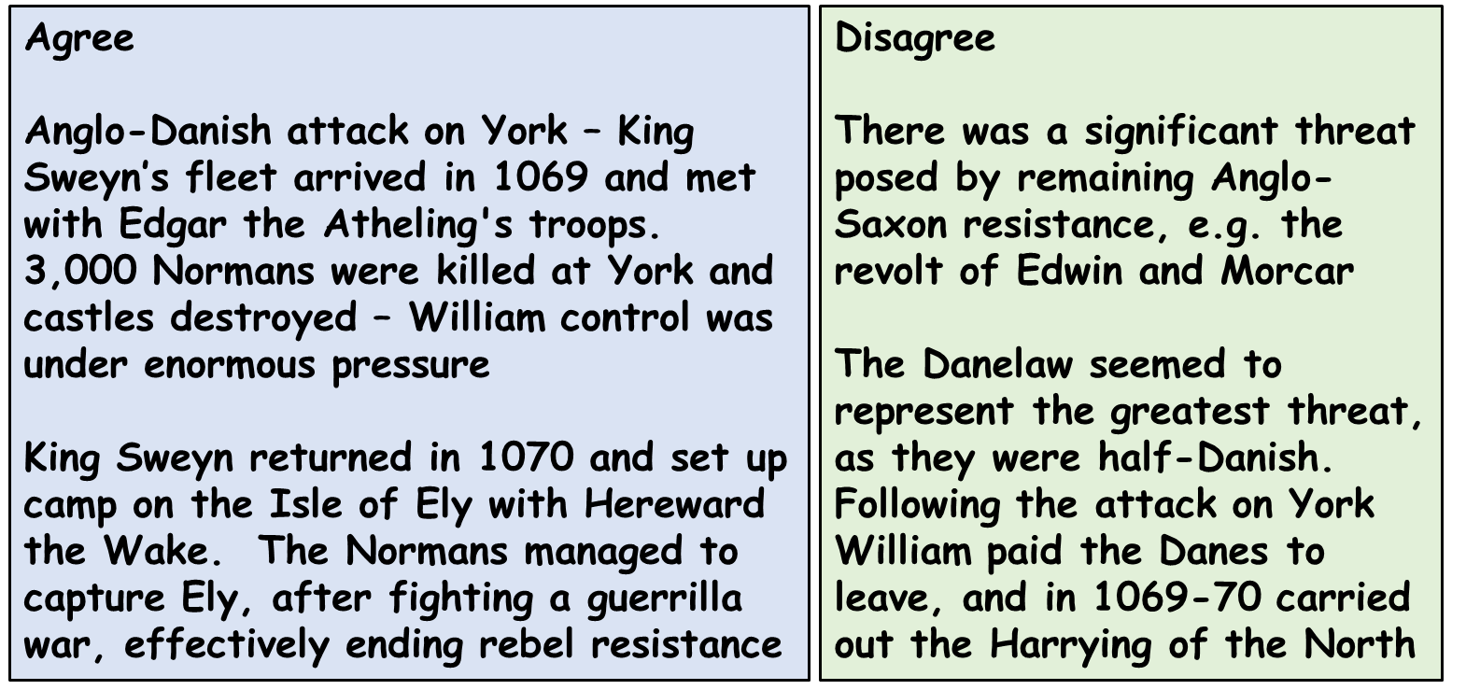
‘The Danish invasion fleet was the greatest threat to William between 1068-71’. (16 marks)
How far do you agree?
King Sweyn
Northern Rebellion
In your workbook complete the evidence for the disagree side and write a conclusion giving an overall judgement

