Slide 1
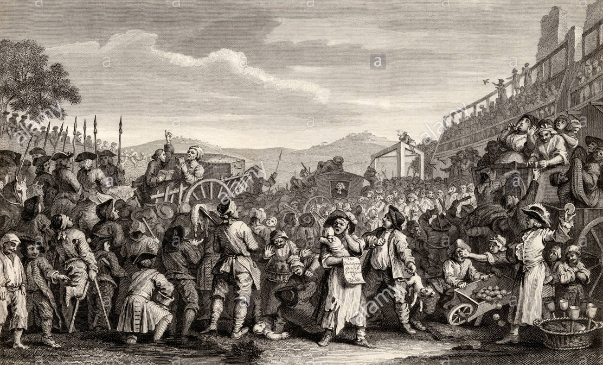
Learning Aim
To Understand revise the content of Crime and punishment
To explain the decline of the death penalty and the end of public executions.
KEY TERMS
Marks
Levels
Coherent
Structure
SFD – Specific Factual Detail.
Challenge
You will gain a good understanding of the structure of the paper 1 exam.
Aspire
Be able to confidently explain the key features of the period selected.
WOW! Aspire**
To be able to confidently approach paper 1 and have a sound knowledge.

Slide 2

Lets see how well you can do…..

Slide 3
Task…
In three’s, you are going to visit each period of history and gather info to feed back to your group.
To explain the decline of the death penalty and the end of public executions.
KEY TERMS
Marks
Levels
Coherent
Structure
SFD – Specific Factual Detail.
Challenge
You will gain a good understanding of the structure of the paper 1 exam.
Aspire
Be able to confidently explain the key features of the period selected.
WOW! Aspire**
To be able to confidently approach paper 1 and have a sound knowledge.

Slide 4
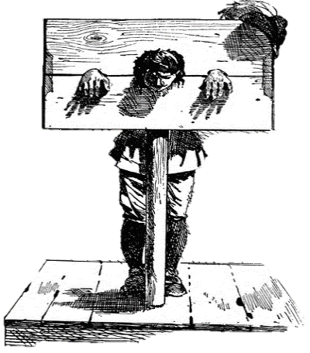

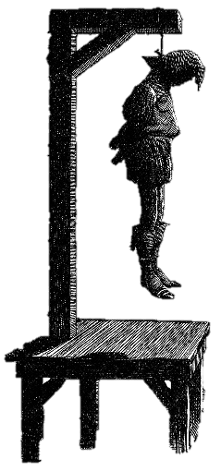
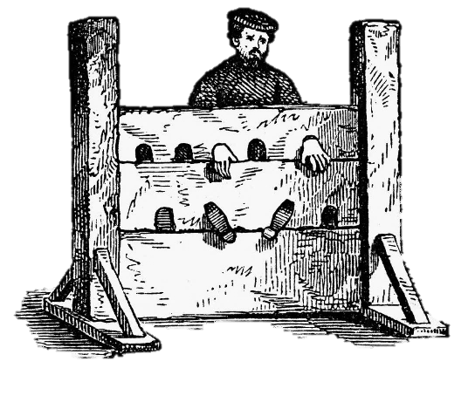
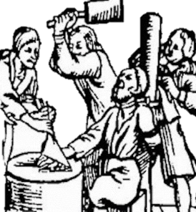

The Wirgild
Even for the crime of murder, a compensation or fine would be made by the guilty individual to the family of the victim. This was compensation for the loss of life in the family.
The name of this fine was the wergild. This translates to the phrase ‘man price’. The money was paid directly to the victim’s family and it was meant as a way to simply stop the victim’s family from setting out to kill the murderer themselves, as this would just lead to more violence in the village.
However, a key feature of the wergild was how the amount paid in compensation would depend on the social status of the victim and the criminal.
Capital Punishments
A capital punishment is one that results in the death penalty.
The use of the death penalty was a form of retribution (to match the severity of the crime) and a form of deterrent (to frighten others in the community into not committing the same crime).
Treason and arson were seen as the two most serious crimes and most were punished with the capital punishment of hanging.
Arson was seen as serious as much land and property belonged to the nobility and the king, therefore it was seen as an attack on their authority.
Corporal Punishments
A corporal punishment is a term which includes a range of punishments which result in physical harm and pain to the body. Even though some of the examples below sound very harsh, they were viewed at the time as being quite lenient compared with the death penalty. Also, any criminal with permanent disfigurement would also act as a deterrent to others in their community.
Social Status of the victim | The wergild to be paid to the family.
A noble | 1500 shillings
A freeman | 100 shillings
A serf | 40 shillings

Slide 5
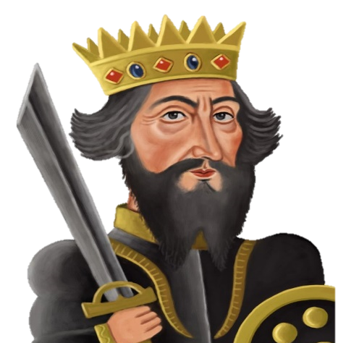
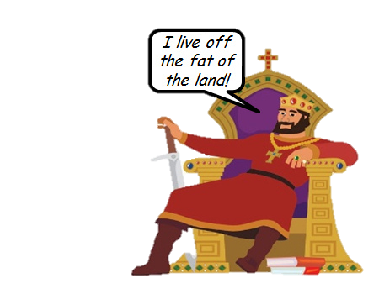
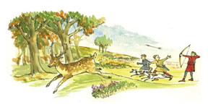

How William the Conqueror Controlled the Anglo-Saxons.
Changes to the Law
The Murdrum Fine
The Forest Laws – poachers and outlaws
The idea of paying a fine for murder stayed the same. However, William introduced two main changes to the law to show his authority.
Change 1: Unlike the wergild where the money would be paid to the family of the victim, the new Murdrum fine would be paid directly to the King. This was further evidence of how the laws were centralised.
Change 2: Rather than an individual paying the fine; the whole community would have to contribute. This meant the idea of collective responsibility was still used. It was also an even greater deterrent to committing murder knowing that a whole community had to pay
William declared large areas of the English countryside as ‘Royal Forests’. 40 village communities were evicted from land to make way for William’s ‘New Forest’ in the south. These forests were to be a ‘royal playground’ for hunting. Only nobles and the King had a right to use them. This meant that land which had been used by peasants for grazing animals, collecting fire wood and catching rabbits was now controlled by the King and peasants banned.
Crime 1: Poaching
The crime for illegally entering the King’s land was called poaching. A poacher could be hanged, blinded or even castrated. However, many in a local community were unwilling to take collective responsibility to stop poaching they saw it as unfair as it took away their right to natural resources to survive.
Crime 2: Being an ‘outlaw’.
The Forest Laws created another crime. It became illegal for any peasant to move away from their village. Any that did this were called outlaws. If caught by the King’s men, outlaws could be killed there and then.

Slide 6
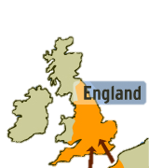
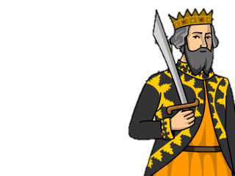
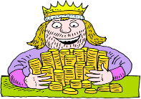
Law Enforcement: Continuity
The King’s Duty
In Anglo-Saxon times, it was the King’s duty to protect his people. This was called keeping the ‘King’s Peace’. In Norman times, this idea remained. It was the belief that all men should expect to be safe from crime under the authority of the King. The Normans just called this something different. For them it was called the ‘King’s Mund’.
Trials
The system of trials by ordeal continued exactly the same as under the Anglo-Saxons. The only difference being that the Normans also used trial by combat (see below). It was still God who was thought to have the final judgement.
Collective Responsibility – tithings – hue ad cry.
The idea of collective responsibility within the local villages continued. Tithings were still used and included every man over the age of 12. The hue and cry also remained. These methods remained effective as many people still lived in small local villages where everyone knew each other.
Punishments: Continuity
Fines
Even though who the money was paid to changed under the Normans (see below), the fact that it remained a payment of money stayed the same.
Crimes against Authority
Another similarity was how any attempt to disrupt or challenge the King and his laws would be punished. In the same way, in both times this ‘crime against authority’ would carry the harshest punishment.
Punishments: Change
The Wergild
Rather than a criminal pay the compensation directly to the family of the victim, under Norman rule, the fine would have to be paid directly to the King. This way, punishments were becoming even more centralised rather than kept local. It proved the authority of the King and gave him extra revenue.
Brutal punishments
William needed to show his royal authority even more than the Anglo-Saxon kings, and there was still resistance from the Anglo-Saxon people who did not a foreign king. William used brutal force to make sure his people submitted to him.
Group punishments
He also made sure that large groups of people were punished as a way to show his power. E.g., farmlands and animals were killed as a punishment just to prove that he had authority. It is estimated that 100,000 people died of starvation as a result of the food shortages caused by William’s punishments towards rebelling Anglo-Saxons.
Increase in the use of the death penalty
Under the Norman Kings, there was an increase in the number of crimes that resulted in the death penalty. E.g., under the Forest Laws. A poacher would be punished by hanging.

Slide 7
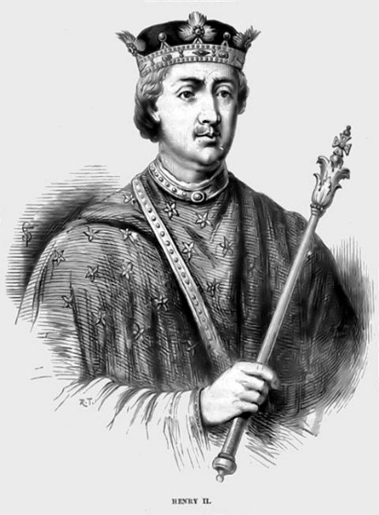
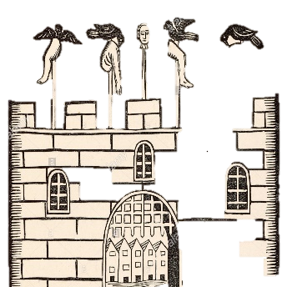

Later Medieval England – Crimes, law enforcement and punishments.
The Role of Henry II: The Assize of Clarenden 1166.
The Assizes of Clarenden - These were a new set of rules to improve the way trials and courts were run. They made the process of enforcing the law even more centralised. He reorganised courts by making sure that a jury of 12 men from the local ‘hundred’ were used to help decide the verdict.
He also set up prisons to hold on to suspects before they went to a court.
He ordered royal judges called Justices of Eyre to visit each county twice a year to decide upon the most serious cases in the area. This made sure that the worst criminals were being judged by the king’s men and not the local community.
He introduced standardised written instructions to the local Shire Reeves. This meant rules and the way of running law and order was becoming more uniform (the same) across the whole country.
NEW LAW 1: The Statute of Labourers 1351
After the Black Death had killed 1/3 of the population, there was more work and fewer workers. Peasants started to demand higher wages. The ruling classes were worried that if the peasants were too wealthy they would gain more power and of course they wanted to keep the money themselves. As many members of Parliament wanted to protect their power and money, they all voted for the following changes known as the Statute of Labourers:
To keep wages the same as before the Black Death.
To make it illegal to ask for higher pay.
To make it illegal to move to a new area to look for better paid work.
Punishments
CONTINUITY
Punishments still fines, corporal punishments and executions.
CHANGE
Any person convicted of high treason (plotting to kill or betray the king) would be sentenced to be ‘hanged, drawn and quartered’. After strangulation, the stomach was cut open and organs ‘drawn’ out before death. After death, the limbs would be sent to different areas of the town for display as a deterrent.
NEW LAW 2: Heresy 1382
Heresy is the crime of disagreeing and acting against the beliefs of the Christian Church.
A person committing the crime of Heresy was known as a Heretic. Punishment for this was extreme – being burned at the stake. This would be a powerful deterrent to other heretics. The government and the church worked closely together to punish heretics. Justices of the Peace had to power to arrest suspected heretics.
A change in title.
Tythingmen were still used in some areas, but had their title changed to ‘constables’.
Shire Reeves sent by the King were also still employed in local areas but their name had been shortened to a ‘Sheriff’.

Slide 8

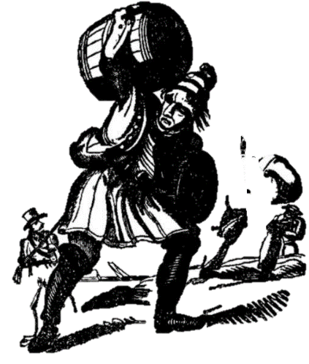
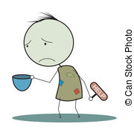
1500-1700 Tudor and Stuart – New types of Crime.
CRIME #1 – Heresy & Treason
CRIME #2 - Vagabondage
CRIME #3 – Poaching/trespassing
Change was known as the Reformation. This created a divide between the traditional Catholic church and the ‘reformed’ Protestant church.
A person who committed heresy was known as a heretic. Treason was a challenge to the authority of the ruler. Anyone who challenged the ruler’s authority as the head of the Church of England would therefore be seen as committing heresy and treason. Put simply, a sudden change of monarch could result in a completely different set of laws about which religion to follow.
The main punishment for heresy was being burned at the stake. Not everyone accused of heresy was burned at the stake. Many took the option to ‘recant’ – to make a public statement that you have changed your religious beliefs.
A bigger population, lower wages and higher prices led many to move into towns to find work. Monasteries which had previously offered charity were closed down. Many remained jobless and were known as vagabonds or vagrants. It was inevitable that many turned to crime as their only way to survive. NEW LAWS:
The Vagrancy Act 1547 – Any vagabond without work to be punished.
The Relief of the Poor Act 1597 – harsh corporal punishments such as whipping or branding as a deterrent to other vagrants.
The Poor Law 1601 – Support known as ‘Poor Relief’ given to deserving poor such as the elderly and disabled. Undeserving poor would send to new ‘Houses of Correction where they were forced to work.
Like in Medieval England, those with land wanted to protect it from anyone using the land or stealing from it. The rural poor were used to using ‘public land’ to hunt for food or firewood. By the 1500s, more land owners were ‘enclosing’ the land (fencing it off) so they could use their land for themselves. Sheep farming made a lot of profit for the wool trade and parks were created for the rich. This made many of the rural poor struggle to survive.
NEW LAW:
1671 Game Act made hunting for animals and fishing illegal on enclosed land. This was a law that was seen as unfair and so it became a social crime. Poaching gangs were even formed in local villages. Of course the wealthier classes saw poaching as theft & demanded harsh punishments.
CRIME #4 - Smuggling
In the 1600s, the government made luxury goods coming into England such as tea and alcohol, more expensive by adding ‘import duty’ - a tax. Anyone who illegally smuggled these goods could make money by easily selling them cheaply. It was seen as a social crime as few people would report smugglers to the authorities. Even the rich were willing to take advantage of the cheaper prices for smuggled goods and so rarely reported them

Slide 9
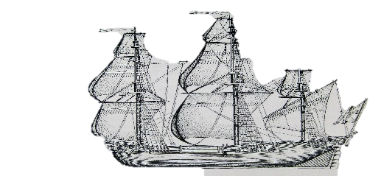


1500-1700 Tudor and Stuarts – Punishments and the Bloody Code.
*NEW PUNISHMENT*
Transportation To North America
From the 1600s, some criminals were transported to the English colonies in North America.
Although prisoners were not given the death penalty, it was still a harsh punishment.
Prisoners were taken in chains, held under the decks of a ship and taken to North America. They would have to carry out tough physical labour for between 7 - 14 years.
They were freed at the end but with no money they would have little chance returning.
Who and how many?
Between 50,000 and 80,000 people were transported to North America before 1770.
This would include men, woman and children.
King James I gave permission for vagrant children in London to be arrested and transported. They were called ‘duty boys/girls’ Many died due to conditions on the ship.
*NEW PUNISHMENT*
Early prisons as a punishment
Before 1500, a prison was just a place where people waited before their trial. They were not purpose built – just a locked room in a local castle or village building.
Conditions in these early prisons:
Prisoners had to pay the wardens for food and clothing. If they could not pay they went without.
Women, men and children all locked together. Petty criminals and murderers all locked together in the same space. Conditions were dirty and prisoners died of diseases such as typhus.
*NEW PUNISHMENT*
Houses of Correction
By 1556, newer, purpose built prisons called ‘Houses of Correction were built. The first was Bridewell Prison in London. It was used to punish poor people of all ages who had broken the law
All inmates had to do hard labour such as breaking up rocks to pay for their keep and encourage them to work harder after their release. This was seen as a form of rehabilitation and reform as well as deterrent.
This prion influenced other prisons to open up around the country.
Why was transportation introduced?
EXPLORATION to the New World made this possible.
POLITICAL/POWER - Sending criminals to North America was another way of increasing the population of a colony and to help build it up.
SOCIAL - It was seen as a way of removing criminals from the people who had influenced them into crime in the first place. Also, the poor were blamed for spreading plague, it was an easy way to remove this risk.
CHANGING ATTITUDES: It was hoped a new start, especially for younger criminals would be a form of rehabilitation. It was seen as more effective form of a deterrent.
ECONOMIC/SOCIAL - There was no organised prison system, so this was a way to deal with criminals to keep them off the streets.
CAPITAL PUNISHMENT –
THE BLOODY CODE
The number of crimes resulting in the death penalty increased. There were 50 capital crimes by 1688. Some of these crimes seem minor e.g. poaching.
The harsh punishments given in this time have been known as the BLOODY CODE.
They were simply intended to be a strong deterrent – to stop the crime rate increasing. but also a method used to simply remove the criminal altogether to prevent them ever committing a crime again.

Slide 10
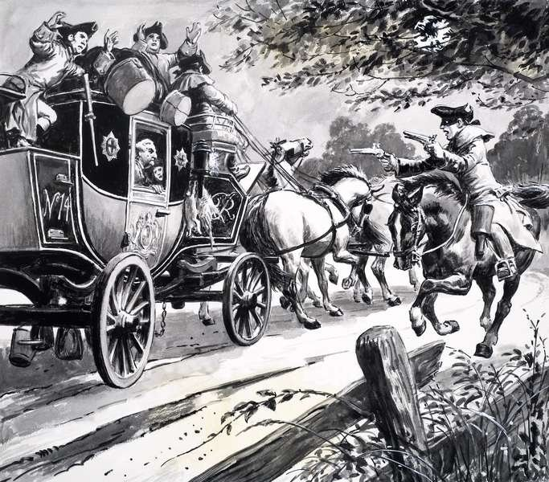
1700-1900 Victorian England – Types of Crime: Smuggling, highway robbery and poaching.
Smuggling
What was smuggling?
Smugglers were still bringing goods into the country without paying tax/duty – then selling goods illegally. They were able to sell the goods cheaper and make a bigger profit.
Type of crime
Social crime – many people benefitted from cheaper goods, and did not see it as wrong. They were less likely to inform the authorities. Some smugglers were seen as local heroes. Even the upper classes would buy luxury goods illegally and not want to inform.
Continuity
Authorities still found smuggling hard to tackle.
Smuggling was still taking place at night on small boats around the coast so they were difficult to catch.
Change
Smuggling increased as even more goods now had import duty: cloth, wine, salt, leather and soap.
Larger smuggling gangs appeared. E.g. The Hawkhurst Gang who controlled smuggling along the south coast. Gangs were better organised than earlier smugglers.
Some leaders (Arthur Gray and Thomas Kingsmill) were hung as a punishment.
Why did it decline?
Prime Minister, William Pitt, reduced import duty. This made goods cheaper to import anyway. By the end of the period, smuggling reduced as the profit became less.
Poaching
What was poaching?
Illegally hunting/taking natural resources on private land.
Continuity
The group mainly responsible were the poor, who often did it just to survive.
The poor did not report poachers as they saw it as unfair.
The rich still ruled the land & made the laws strict.
Change
There was a rise in poaching gangs who were better organised and worked on a larger scale.
More poaching forced the authorities to make the laws even harsher. Punishments became more extreme as a deterrent.
1723 Black Act made poaching a capital offence (death penalty). It also made it illegal to own a trap or even owning hunting dogs near restricted land. This could end in a fine or prison sentence.
The Black Act was repealed (stopped) in 1823 when Robert Peel changed the law to remove the death penalty.
Highway Robbery
What was Highway Robbery?
Attacking travellers and forcing them to hand over goods
Robbers on horseback were called ‘highwaymen’.
Example of a famous highwayman – Black Harry in Derbyshire who was eventually caught and executed.
Why was it such a serious crime?
It disrupted trade and travel between towns.
The crimes were committed on the ‘King’s Highway’ so it was seen as an act of treason.
In 1772 – the death penalty was introduced.
Continuity
It had taken place as far back as the Middle Ages as the rich and tradesmen would travel between towns.
Change
Highway robbery dramatically increased.
Trade around the country increased so there were more people out on the tracks/horseback with cash or goods.
With no banks to keep money, the rich would have to carry cash with them so they were easy targets.
When out of towns, the tracks were very isolated. This made the robbers difficult to catch.
Regular ‘stagecoach’ services for the rich between towns which meant more opportunity for crime.
Why did it decline?
Patrols on the roads of officers on mounted horseback – this made it easier to catch.
Banks developed and so there was less need for people to carry their cash around with them. It could be stored safely.
The last case of a highway robbery was in 1831.

Slide 11
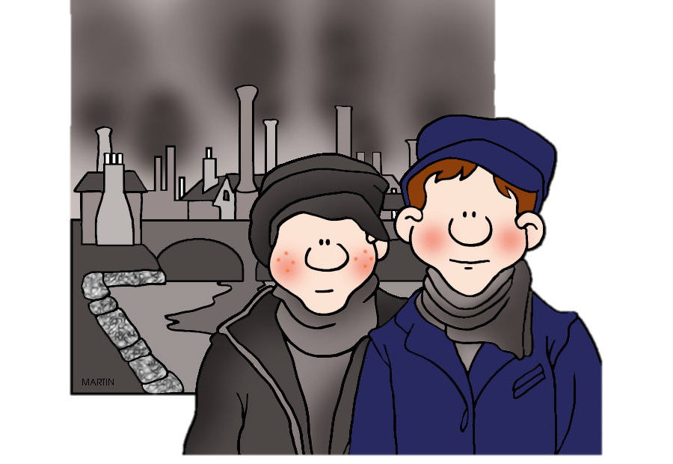

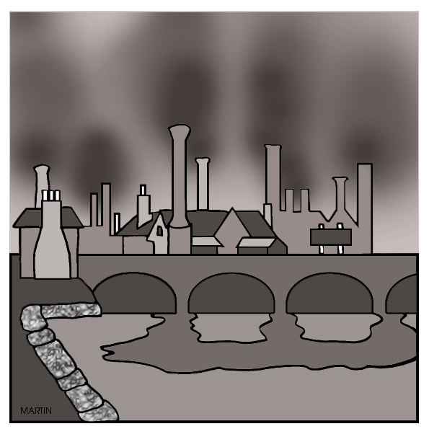








1700-1900 Victorian England – The Impact of the Industrial Revolution.
Background information:
It is possible that you may be asked to explain why there were changes to crimes, law enforcement and punishments between 1700-1900. Most of the era between 1750 and 1900 has been known as the Industrial Revolution. Many changes took place to the population, mechanisation, transport, exploration and the economy. Below are a number of factors you could use to explain the changes towards law and order in this time. For each factor, think of the impact it would have had and how it could explain some of the crimes, methods of law enforcement and punishments.
Population rise and movement. 1700 - Only 9 million people who mainly lived in scattered villages in rural areas. 1900 - 41.5 million people with a mass migration to towns due to urbanisation and industry. | Work 1700 – most people made a living with farm work in rural areas. 1900 – most people found work in busy factories, workshops or mills in or near towns. | Voting Rights 1750 – Only one in every 8 men could vote. 1885 – Nearly all men had this right. Governments now had to take notice of the needs of all voters, not just the rich and powerful. | Agriculture 1700 – Poor harvests more common due to simple farming methods. 1900 – Better knowledge of farming and food. Food could be produced easily and imported cheaply from abroad. | Politics and government 1700 – The government was led by rich and powerful landowners who would only look after their own interests. 1900 – The government had a wider role to look after the wellbeing of ordinary citizens.
Travel 1700 – Basic mode of travel using horse and cart on gravel tracks. Weather could affect this. 1900 – Huge improvement with railways, steam power, canals. Transport much cheaper and quicker – especially for ordinary people, not just the rich. | Economy/Trade 1700 – Some trade outside England for luxury goods such as tea, sugar, tobacco. A time of the Save Trade. 1900 – Britain now a leading trading country. Links with all parts of the globe to a variety of cheaper goods. The government collecting higher taxes which they could use to make changes to law enforcement and punishments. | Education 1700 – A small number of richer children educated and literate. 1900 – 95% of the population could read and write. The law made all children go to school until the age of 13. It was possible for ordinary people to make an impact if they wanted to as they were more educated. | New beliefs and attitudes 1700 – New ideas had just started to appear about science, medicine and the world. The Enlightenment had some impact. England still a highly religious country. 1900 – Charles Darwin’s theory of evolution started to make people believe that some people were born as ‘criminals’. Humanitarianism gave people a belief that human beings could be rehabilitated and reformed. Religion being challenged further by science. | Taxes 1700 – Fewer people in the country would work, and so the government got a limited amount of money from taxes. 1900 – With a huge population and many in work, the government had much higher taxes and could spend this money developing new forms of law enforcement and punishment systems.

Slide 12
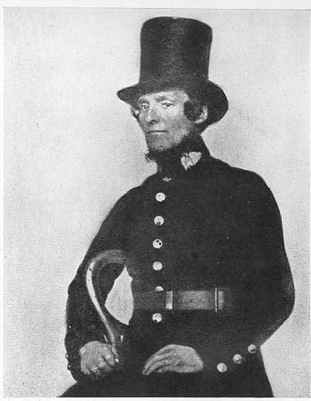
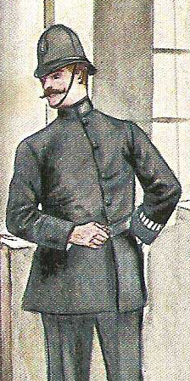
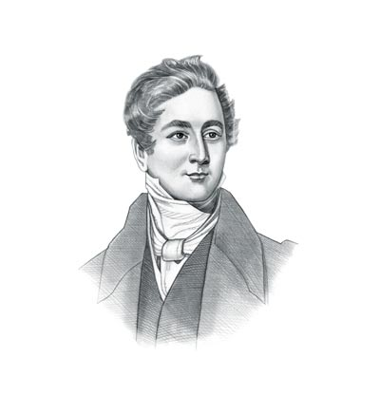
1700-1900 Law Enforcement – The Development of the Police with the Bow Street Runners.
Background information: Before the 1700s, the main development with law enforcement was the reduction in community based collective responsibility with an increase in officials employed by the local authorities with the responsibility for dealing with crime and catching criminals. With an even bigger population and towns becoming even more crowded, the government needed to do much more to keep law and order. This period saw a key development with the creation of an official, nationwide police force.. It started with a group called the Bow Street Runners in London, whose success inspired the government to introduce the police in a more formal setting.
STAGE 1: The Bow Street Runners
They were a crime fighting team set up in London in 1748 by a judge called Henry Fielding who worked in Bow Street, London.
They investigated crimes and detected criminals. They became known locally as the Bow Street Runners.
He realised his men needed to be disciplined and trained, to achieve a better reputation with the public.
At first, the Fielding brothers charged a fee for the capture of a criminal just like the Thief Takers who went before them.
They then set up a newspaper called The Hue and Cry which appealed for help and information from the public about crime.
They introduced patrols on horseback to stop highwaymen.
By 1785, The Bow Street Runners were officially paid by the government and they were the first modern detective force.
Why were they successful?
POLICE PRESENCE:
They wanted to deter criminals. Just being present on the streets could do this.
ORGANISATION:
They organised regular foot patrols and horse patrols along all major roads.
PAY
Their men were paid and so more motivated.
INFORMATION
They knew the importance of sharing and collecting information – so could use their office as a meeting place.
STAGE 4: Establishing the police force outside of London 1829 -1856
Improving the police outside London was very slow.
1839 Rural Constabulary Act allowed all rural areas create a force. Only 59 did.
Some had professional, paid police, others still relied on the Parish Constable.
WHY WAS IT SLOW?
Worry about the costs of the police.
It was not yet compulsory in all areas.
London were not quick to share ideas about how it worked.
STAGE 6: Detecting Crime The start of the CID 1842
1842 – A detective branch was set up at Scotland Yard (the headquarters of the Metropolitan Police). They specifically investigated crimes and wore ordinary ‘plain clothes’. It had 16 officers.
By 1878, this was set up as the CID – Criminal Investigation Department. It employed 200 detectives. This increased to 600 detectives in 1883.
However, the public often saw these men as suspicious and even treated them like spies.
1750 | 1760 | 1770 | 1780 | 1790 | 1800 | 1810 | 1820 | 1830 | 1840 | 1850 | 1860 | 1870 | 1880 | 1900
Similarities with law enforcement before 1700:
Parish constables – still dealt with local disorderly behaviour and petty criminals in the smaller towns and villages.
Watchmen – were still responsible for protecting property at night.
Soldiers – could be used by the government when needed to deal with riots or rebellions.
Similarities with modern police force after 1900:
Some officers were paid for the job.
They carried out regular and routine foot patrols.
They had the power to arrest.
STAGE 2 Opposition to an official police force in the early 1800s
FREEDOM
People believed they would not have privacy or freedom with the police watching all the time.
WOULD IT WORK?
People did not believe an organised police force it would reduce crime.
MONEY
It might prove to be too expensive to run.
STAGE 3: London’s 1st Professional Police Force.
Set up in London by Home Secretary Robert Peel in 1829. Peel was inspired by the success of the Bow Street Runners.
Set up by the Metropolitan Police Act.
It became the first uniformed police.
17 districts had their own police ‘division’ with 4 inspectors and 144 constables.
The aim was to deter criminals by being a uniformed presence on the streets. They had far more officers than the Bow Street Runners.
They had a blue uniform so they did not have a negative reputation linked with the army who had a green uniform.
STAGE 5: Setting up an official, national police force.
1856 Police Act meant that ALL areas now had to have a professional police force that was controlled by and inspected by the government.
It also emphasised the ‘detection’ of criminals as well as the ‘deterrence’.
By 1869, National Crime Records were set up.
Telegraph technology could be used to communicate and share information about criminals and crimes.

Slide 13
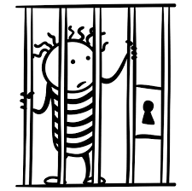
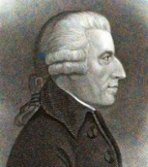
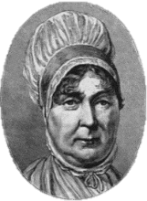




1700-1900 Punishments: Prison Reform and humanitarianism.
KEY INDIVIDUALS
Elizabeth Fry
Elizabeth Fry led a campaign to improve women’s prison’s through education, religion, better food and clothing.
She investigated Newgate Prison in 1813. She wrote a shocking report about the treatment of women to the government.
Elizabeth Fry led bible classes in Newgate Prison to encourage reform
In 1817, she set up the Association for the Reformation of Female Prisoners at Newgate Prison.
Her recommendations were brought in by the government after her campaign.
KEY INDIVIDUALS
John Howard
John Howard led a campaign to make sure that prisoners who had finished their time in prison were actually released rather than remain in prison until they could pay their way out.
In 1777, John Howard published his findings of prison life called The State of Prisons in England and Wales. It was hugely influential as it contained accurate evidence to prove change was needed by the government.
John Howard made visits to individual prison leaders around the country to convince them to make all of his changes.
THE LAW
The Gaols Act (1835) made sure that all prisons were inspected.
The Gaol’s Act (1823). Prisoner should be separated into groups such as men, women, children, violent and non-violent.
The Prisons Act (1865) New rules for all prisoners and prison staff.
National Prisons Commission (1877). All prisons brought under government control.
The Prison’s Act (1898). A law which made rehabilitation and reform a priority for the treatment of prisoners.
CHANGING ATTITUDES
Humanitarians such as Fry and Howard influenced the government and public opinion. They believed that humans such be treated fairly and with dignity.
There was an increasing feeling that punishments should now be equal to a crime committed and a varying the time in prison could achieve this.
There was no longer a belief in the Bloody Code.
People believed that prison should not be about sitting around, but working hard to pay back society.
RELIGION
Howard and Fry both believed that prisoners should be given Christian teaching from a prison chaplain, then time in on their own to reflect on their behaviour.
Christian groups pressured the government to make prisons humane.
SOCIAL
Crime rate reported per year had risen from 5,000 to 20,000 BY 1900.
Despite Britain’s wealth, poverty led to an increased crime rate.
TECHNOLOGY
The treadwheel, despite being a harsh punishment, split prisoners into individual cubicles. The power from this was able to pump water through prisons such as Pentonville in London.
Better building techniques allowed prisons to be made more secure & safe.
Better hygiene was possible in prisons due to the development of sanitation and sewage systems in more modern buildings.
ECONOMIC
John Howard disliked prison staff being bribed by prisoners for food, drink and other ‘pleasures’. He wanted an official wage for prison staff. This would make the service more respected and stop the rich receiving better treatment than the poor while in prison.
Britain was economically wealthy due to the Industrial Revolution. The government had money to spend on building new prisons.

Slide 14
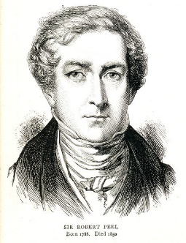
1700-1900 The influence of Robert Peel on the Police and Penal (punishment) System
ROBERT PEEL BASIC FACTS:
Home Secretary:1822-1830
Prime Minister: 1834-1835
Prime Minister: 1841-46
Known as: ‘The father of modern policing’
Responsible for: Setting up the Metropolitan Police Force in London. This modelled other forces around the country.
Influenced: A wide range of laws which changed punishment and law enforcement.
PEEL’S STRENGTHS
He had a open mind to new ideas.
He listened to the views of campaigners such as Elizabeth Fry and John Howard.
He was a skilful politician when making sure laws were voted for and passed – despite tough opposition.
PEEL IN THE 1820s
Peel wanted penal reforms to rehabilitate criminals rather than just focus on the harsh punishment itself.
He reduced the number of crimes punishable by death by 100.
He made sure minor crimes such as poaching were punished more proportionally.
He reformed prisons.
He organised the legal system by making sure criminals received the same punishments for the same crime.
KEY LAW: PEEL’S 1823 GAOLS ACT
Ensured regular visits from prison chaplains Ensured a wage was paid to prison staff to prevent bribery and increase professionalism. Made sure that female prisoners were to be watched by female wardens.
Made sure that prisoners were not held in chains or irons.
HOWEVER - At this time there were no inspectors to check this was happening.
The first Metropolitan Police officers were appointed in September, 1829.
PEEL FORMED THE MET. POLICE IN 1829
He had been thinking about a change to the police in 1822 when he set up a parliamentary committee to look into it.
In 1826 there was an economic downturn which increased poverty. There was a crime wave, rioting and the army had to be brought in. This was proof that a police force were needed.
Peel saw that wealthier parts of London had good numbers of watchmen while poorer parts lacked watchmen and constables. He wanted to make this more equal and fair.
CRITICISMS OF THE METROPOLITAN POLICE
At first there was a hostile attitude from the public and the press.
Newspaper cartoons mocked police officers for being poorly trained, from dubious backgrounds and for not behaving as they should on duty such as being drunk or taking bribes.
2,800 officers were signed up but only 600 stayed for a year or more.
The public worried about:
Public worried about the police being too much like the army.
Their freedoms being threatened.
The cost of the police from increasing taxes.

Slide 15
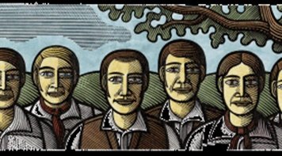
1700-1900 – The treatment of the Tolpuddle Martyrs 1830s.
How did the government react to this?
The Home Secretary, Lord Melbourne refused to accept the petition and went ahead with the transportation to Australia.
The Background
In February 1834, in the village of Tolpuddle, a farm labourer called George Loveless was arrested for a made up crime – just because he and his men had promised to support a trade union. It seemed the authorities needed an excuse to arrest them for something, even though they did not threaten a strike or violence.
Their Punishment
George Loveless and the other 5 were sentenced to 7 years transportation to Australia.
Transportation was the most severe punishment the judge could give for this crime. The conditions on these ships and the forced labour after the journey was extremely harsh.
Why was this punishment given?
It was a way for the authorities to deter others from forming or joining a trade union and stop workers from demanding higher pay. Trade Union members were treated at criminals.
Why did the government change their mind?
Four years later, in 1838, the government pardoned and released the men who were now known as the Tolpuddle Martyrs. The men returned home to a ‘hero’s welcome’.
Why were they really arrested?
The real reason for their arrest was to stop their political activities. The men had promised other workers in the area that they would do what they could to protect wages.
They had also formed a group they called a ‘friendly society’. This was actually an early version of a trade union.
They wanted to protest about their wages. They were only getting 6 shillings per week as a farm labourer, rather than the average wage of 10 shillings of the time in other jobs.
What does this example tell us about government control of crime and punishment?
That governments could change and manipulate laws in reaction to changing attitudes of the time. In this case, they wanted to protect business owners and stop workers from demanding higher wages.
How did the public find out about this punishment?
Mass protests were organised in support of the men. A demonstration was held in London where around 100,000 people and a petition with 200,000 signatures was presented to parliament.
Notes:
Designed to be a back to back homework sheet to go with the next slide.

Slide 16

Explain one similarity/difference…[4] | Explain why… [12] | How far do you agree… [16]
Explain one way in which conditions in prisons in the 19th century were different in the 17th century. [4] Explain one way in which policing in the 19th century was similar in the 16th century. [4] Explain one way in which policing in the 19th century was different in the 1600s. [4] Explain one way in which smuggling in the 16th century was similar to smuggling in the 19th century. [4] Explain one way in which smuggling in the 16th century was different to smuggling in the 19th century. [4] Explain one way in which law enforcement in the Medieval period was different to law enforcement in the period 1700-1900. [4] Explain one way in which law enforcement in the Medieval period was similar to law enforcement in the period 1700-1900. [4] | Explain why the problem of highway robbery increased in the period 1700 – 1900. You may use the following information in your answer: Increased wealth Improved transport You must also use information of your own. [12] Explain why the Bloody Code came to an end by the late 1800s. You may use the following information in your answer: Public Executions Humanitarianism You must also use information of your own. [12] Explain why transportation was used as a punishment in the period 1600 – 1850. You may use the following information in your answer: Colonies abroad Hard Labour You must also use information of your own. [12] Explain why there were changes in the prison system in the period 1700-1900. You may use the following information in your answer: John Howard Hard labour You must also use information of your own. [12] Explain why the crime of smuggling increased after 1700. You may use the following information in your answer: The Hawkhurst Gang The growth of the British Empire You must also use information of your own. [12] | ‘Robert Peel was the most important reason for prison reform in the period 1800-1900’. How far do you agree? Explain your answer. You may use the following information in your answer: Gaols Act 1823 Humanitarianism You must also use information of your own. [16] ‘In the period 1700-1900, the main aim of punishment was as a deterrent’. How far do you agree? Explain your answer. You may use the following information in your answer: Pentonville Prison Tolpuddle Maryrs You must also use information of your own. [16] ‘The role of reformers was the main reason why prison conditions improved in the 19th century. How far do you agree? Explain your answer. You may use the following information in your answer: Elizabeth Fry Technology You must also use information of your own. [16] ‘The use of public execution remained an important feature of the punishment system in the years 1500-1900’. How far do you agree? Explain your answer. You may use the following in your answer: The Gunpowder Plot Transportation You must also use information of your own. [16]

Slide 17

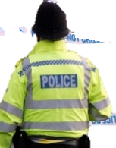
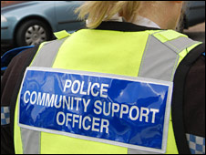


1900-Present Day – Law Enforcement with the development of policing.
AT THE START OF THE 1900S
Positives:
Every area in the UK had its own police force.
Most officers were being paid for their work.
A standardised dark blue uniform was used to easily identify the police.
Police were starting to gain the respect of most people.
Negatives:
The 200 separate forces had no central records (details of all crimes committed in the UK.
Police forces rarely shared information with each other or worked together.
Police officers patrolled local areas on foot ‘walking the beat’.
Police only had a whistle to call for help or raise the alarm.
1900: Photographs were being used to identify criminals. Police would display a ‘Rogues Gallery’ of local criminals.
1901: Fingerprinting first used by the Metropolitan Police. A national fingerprint system still keeps a record of every fingerprint and is part of a nationwide central system.
1901: Blood types start to be used to identify victims and criminals.
1909: Bicycles allowed officers to move around a large area and catch criminals quickly.
1920: Women recruited into the police. At first to work with female victims or criminals.
1930s: Police cars now common.
1930s: Two way radios (so an officers could talk with each other) were used in cars.
1937: The Police Phone Box (Dr Who style) to save officers on the beat needing to return to the station to report information.
1937: 999 emergency telephone number started for the Metropolitan Police.
1947 – Police Training College was created to give formal training.
1965: Tear gas allowed to be used by the police to break up riots.
1967: Breathalysers used for the first time to deal with motor crime.
1969: Police two-way radio now attached to the uniform.
1970s: CCTV developed for the first time to monitor public behaviour.
1980: The National Police Computer launched which was able to hold records of 25 million individuals (amazing for the time).
1982: The Neighbourhood Watch scheme. Proof of continued Collective Responsibility.
1988: DNA used to convict a murderer for the first time.
1992: Speed cameras introduced to act as a deterrent and catch speeding cars.
1995: National DNA and fingerprinting databases introduced.
2007: The Neighbourhood Watch became a national network.
THE OVERALL CHANGES DURING THE 1900S:
An increasing use of science and technology to help police methods.
More specific roles given to police officers in separate specialist units.
A greater move towards crime prevention, education and rehabilitation.
The cost of all of these changes increased due to the higher demand of the police service.

Slide 18






FACTORS WHICH LEAD TO INCREASE THE NUMBER OF SPECIALIST POLICE UNITS
Increase in a specific type of crime. E.g. terrorism, drug dealing, internet fraud.
Media present the crime via radio, TV, newspapers, internet.
Public concern increases and attitudes against the crime change.
The public pressure the government to make harsher laws and methods of law enforcement to prevent the crime.
Government respond with new laws.
The police develop a specialist unit to enforce this law.
Dog Handling Units (1946)
Aim: To accompany officers as they patrolled the streets as a deterrent and a way to catch criminals.
Specialism:
Dogs handlers and their dogs used :
To sniff out illegal drugs and find explosives
To track and catch criminals or search and rescue people in trouble.
To act as a deterrent and to strengthen police presence at major events.
Similarity/difference?
Remember that the Metropolitan Police aimed to use sniffer dogs to try and catch Jack the Ripper (even though this failed). The first units were set up by the Met. Police in 1946 and by 1950 most forces used dogs.
Special Branch (1883)
Aim:
To tackle threats to national security & terrorism. A responsibility to protect the royal family & VIPs from danger.
Specialism:
Trained to work with the security forces such as MI5 and
MI6 to prevent terrorist attacks. Under cover officers
use specialist surveillance & ‘intelligence’ technology.
Similarity/difference?
They were first created in 1883 in London to protect the movement of the royal family and other VIPs. Now, every part of the country has its own Special Branch.
The Fraud Squad (1946)
Aim:
To tackle crime in business and
finance and money.
Specialism:
Officers have expert knowledge in
finance, business, internet fraud and art theft.
Similarity/difference?
A new type of squad set up in reaction to the varied number of fraud cases.
National Crime Agency & Drug Units (1971)
Aim:
To reduce the use, transportation, making and dealing of illegal drugs.
Specialism:
They have the power to carry out drugs raids, monitor drugs gangs and dealers. They are also trained to prevent further spread of drug use through education and rehabilitation.
Similarity/difference?
It was only created by the 1971 Misuse of Drugs Act which made drugs illegal like heroin, cocaine and cannabis. A unit was needed to enforce this new law. All police forces in the UK have specialist drug units.
EXAMPLES OF SPECIALIST UNITS
Police Community Support Officer (2002)
Aim:
Set up by the Met. Police at first to reduce local, anti-social behaviour. Specialism: Trained to deal with local communities. Increased time ‘walking the beat’ on foot to be visible to the public. They only have a limited responsibility to arrest individuals but can confiscate alcohol, drugs and items seen as weapons.
Similarity/difference?
Police are visible in uniform ‘walking the beat’ as a deterrent, similar to the aim of the police when they were created in 1829.

Slide 19

1900-Present Day – Conscientious Objectors in WW1 and WW2.
WHAT CHANGED? A NEW LAW.
The Military Service Act 1916 – Men were conscripted into the army for the first time ever in Britain. It was now illegal – against the law to avoid taking part in war.
WHO HAD TO JOIN?
March 1916 – all unmarried men aged 18-41
May 1916 – married men now included and age raised to 51.
The First World War (1914-39)
Some men refused to fight as their ‘conscience’ (their personal feelings/opinions) would not allow them.
The reasons for not fighting:
Religious beliefs against war.
Political reasons against war.
Ethical reasons against war.
COULD MEN OBJECT TO JOINING THE ARMY?
The Military Services Act included a section called the CONSCIENCE CLAUSE which allowed men to ask not to join because of their feelings towards war.
16,500 men made this request.
A judge would decide a case was genuine in a TRIBUNAL
WHY WERE THE JUDGES AND TRIALS NOT FAIR?
Held locally and could sometimes make very personal judgements on people they knew.
The judging panel was made up of local people so not all decisions were equal across the country.
The judging panel were often far to old and did not understand the attitude of the younger men not to fight.
THE TREATMENT OF Cos in the SECOND WORLD WAR
Government attitudes relaxed by WW2 - It would be hypocritical to punish COs in a brutal way while fighting against the Nazis who were brutally treating groups such as the Jews.
COs offered alternative work to help the war.
Prison was now a last resort and not used as a deterrent.
Men who actively oppose the war could still end up in court. They were put on trial but given light punishments.
WHAT WERE THE ATTITUDES TOWARDS Cos?
The government propaganda and newspapers made COs out to be:
Unmanly and feminine if they did not do their ‘man’s duty’.
Cowards, traitors & unpatriotic.
That Cos were lazy and shirking their responsibility.
Some Cos were ignored by their own family and neighbours or received hate mail in the post.
WHY WERE Cos TREATED SO HARSHLY?
The government needed soldiers as many soldiers were being killed.
They needed to prevent ‘pacifist’ ideas spreading and recruit many more men.
The government wanted to avoid protests and resistance during the war time.
The harsh punishments would be a deterrent to any men wanting to refuse.
HOW WERE Cos TREATED?
Many absolutists were imprisoned. E.g. 1,000 prisoners jailed in Dartmoor and made to work in a local granite quarry.
Many absolutists were also put in solitary confinement to stop them mixing with other prisoners?
Some Cos were sent to France anyway, and told to fight. If they refused they were taken to a military court.
Some military courts punished Cos with death.
The Prime Minister then found out about this and reduced the punishment to 10 years in prison.

Slide 20
Learning Aim
To Understand the exam structure of paper 1 and its content.
To explain the decline of the death penalty and the end of public executions.
KEY TERMS
Marks
Levels
Coherent
Structure
SFD – Specific Factual Detail.
Challenge
You will gain a good understanding of the content of one period of C &P
Aspire
Be able to confidently explain how two periods compare in the C & P topic.
WOW! Aspire**
To be able to confidently approach paper one.

Slide 21
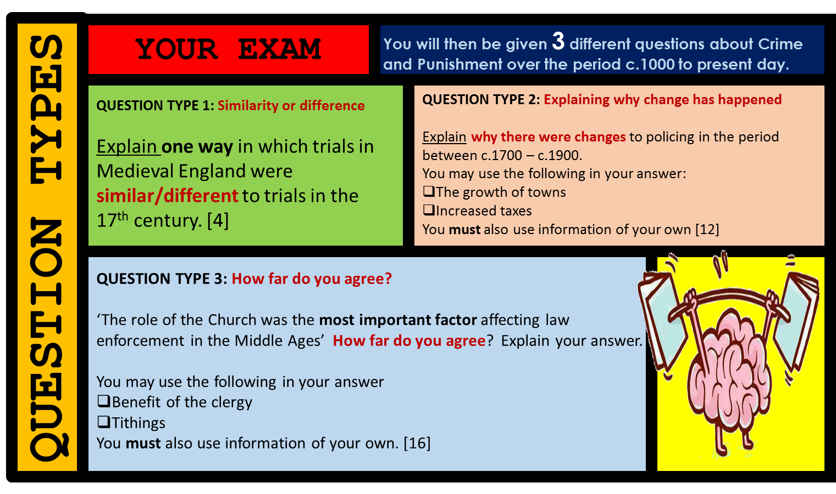

Slide 22




PAPER 1: How to answer questions about Crime and Punishment
1. Explain one way … similar or different. [4] EXAMPLE QUESTION Explain one way in which conditions in prison were different in the mid 19th century and the late 20th century. [4] 5 MINUTES | Keep your answer brief but use accurate and specific terms and knowledge. Show your knowledge of both periods. SENTENCE STRUCTURE: In (the first era mentioned) ……. By (the second era mentioned) ……… (Explain why it changed or stayed the same
2. Explain why… [12] EXAMPLE QUESTION Explain why there were changes in criminal activity in the period 1900 to the present day. You may use the following in your answer: Transport The Internet You must also use information of your own. [12] 15 MINUTES | 3 X P.E.E. Paragraphs POINT: One factor ……was…. EVIDENCE: For instance…. EXPLAIN: This explains the… POINT: Another reason for……was…. EVIDENCE: For example EXPLAIN: This was a cause as… POINT: A final reason why……was…. EVIDENCE: For example/instance…. EXPLAIN: This was a factor as…
3. How far….. [16+4] 30 MINUTES EXAMPLE QUESTION ‘Attitudes in society were the most important factor influencing how criminal activity was dealt with in the period 1500 – present day’. How far do you agree? Explain your answer. You may use the following information in your answer: Laws against witchcraft in the 16th century Conscientious objectors in the 20th century. You must also use information of your own. | 3 X P.E.E. Paragraphs + Conclusion POINT: One factor ……was…. EVIDENCE: For instance…. EXPLAIN: This explains the… POINT: Another reason for……was…. EVIDENCE: For example EXPLAIN: This was a cause as… POINT: In addition, another factor was…. EVIDENCE: For instance…. EXPLAIN: This was a factor as…
POINT
One similarity was…
One factor was..
Firstly, secondly, finally…
In addition….
Adding to this….
A further….
One difference was…
Finally, ….
However, another factor..
In contrast..
It can be argued that…
Alternatively….
S – Statistics
P – People
E – Events
L - Laws
D – Dates
F – Facts
T – Key Terms
EVIDENCE
For example…
For instance…
Such as…
Explaining
One factor behind the change was…
This caused change as…
This resulted in…This led to…because…
This factor was key as…
This meant that….
This factor caused……because…
This explains a change as…
This had an impact as…
This led to….
This meant that…
CONCLUSION/FINAL JUDGEMENT:
You MUST reach an overall judgement
Try to LINK the points together to show a greater understanding of the factors.
Be convincing in your argument
FINAL JUDGEMENT/LINKING
To an extent…
X was partly the most important cause
The most important factor was certainly…..
All factors are important, however…..
It can be strongly argued that…..
If this hadn’t happened…
The main reason for X was…without this…..
The root cause of X was…
The main catalyst for X was….

Slide 23

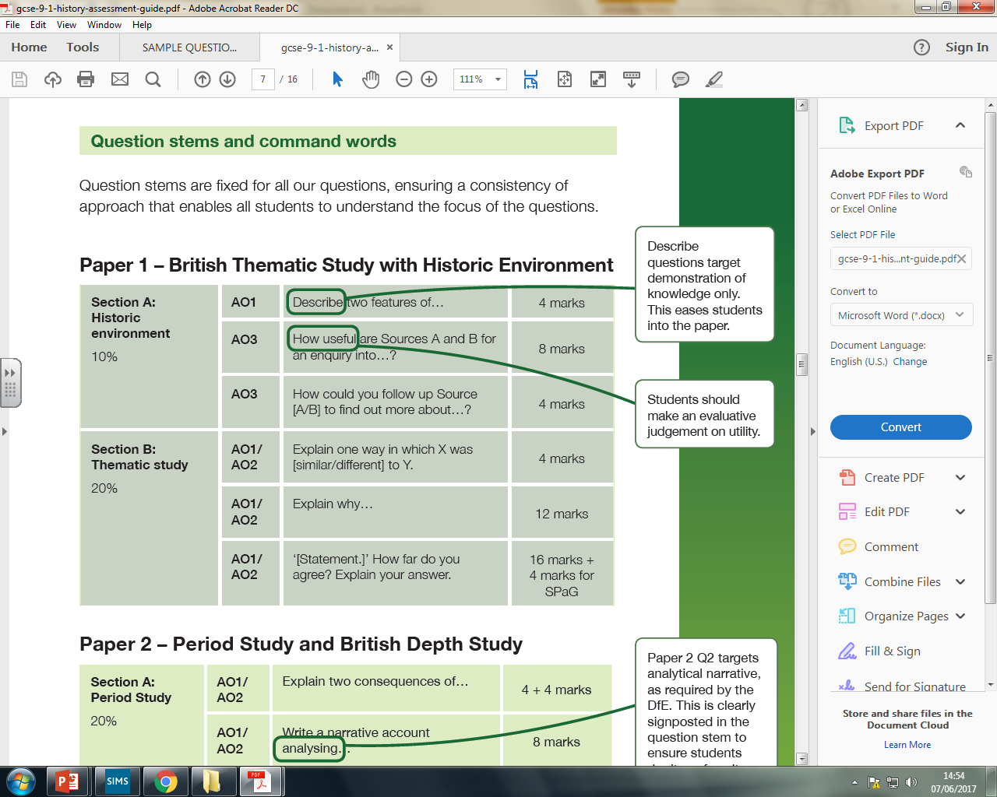
3 Question Types
Explain one way that prison conditions were different in the 19th century and 20th century.
Your Exam
Explain why there were changes in criminal activity from 1900 to present day? You may use the following in your answer:
Transport
The internet. You must also use information of your own
KEY SKILLS
Explanation
Continuity and change
Evaluating
‘Attitudes in society was the most important factor to influence criminal activity during 1500-2000’. How far do you agree? Explain your answer. You may use the following in your answer:
Laws against Witchcraft in the 16th Century
Conscientious objectors in the 20th century.
You must also use information of your own.

Slide 24
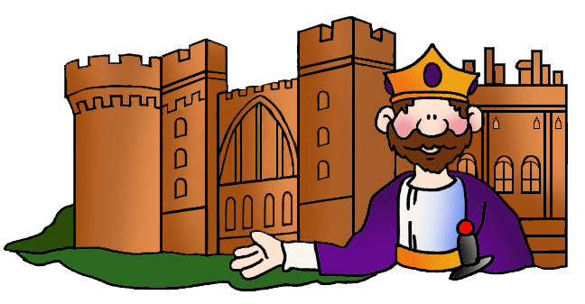
What do the questions ALL ask you to do?
How would you go about answering this question in a structured way?
EXAMPLE QUESTIONS
‘The system of law and order became harsher after the Norman conquest’.
How far do you agree?
You may use the following in your answer:
Public execution
Benefit of the clergy
You must also use information of your own.
16 marks + 4 SPaG
‘Government law and order saw considerable change after the Norman conquest’.
How far do you agree?
You may use the following in your answer:
Execution
Trial by jury
You must also use information of your own. 16 marks + 4 SPaG
EXAM QUESTION

Slide 25
6. It helps to think about your argument before you start. Even start your answer with it.
7. Always try to use the wording of the question in your answer.
8. Use as many key terms and specific knowledge as you can. Avoid being vague.
1. Will always give a statement with a point of view included.
9. You will not be able to mention everything. Use information you are confident with.
Government law and order saw considerable change after the Norman conquest’.
How far do you agree?
You may use the following in your answer:
Forest Laws
Tithings
You must also use information of your own.
2. ‘How far..’ means you have to think about ‘how much’ you agree with the statement.
EXAM QUESTION
3. ‘How far..’ should also prompt you to think of a balanced argument – both sides of the argument in your answer.
5. Always think of at LEAST one more piece of information that can help your argument on either side.
4. The bullet points will give you some prompts. Usually one with agree and the other will disagree with the statement.

Slide 26
‘Government law and order saw considerable change after the Norman conquest’.
How to structure
Intro.
Paragraph 2:
Not essential but you can use this to actually set out your opinion at the start and to show some knowledge of the topic the question is asking you about.
‘It is clear that…’ ‘In this period after 1066…’ ‘It can be strongly argued that…’
Use one of the bullet points to give a balanced view. Use another detailed P.E.E paragraph to do this.
‘However, some aspects of law and order remained such as…..’
‘This method was…’
‘This aspects of law and order continued as….’
Paragraph 1:
Use one of the bullet points to agree or disagree with the statement. Use a detailed P.E.E paragraph to do this.
‘Certainly, there was significant change in law and order after the Norman Conquest as..
‘For example….’
‘This brought great change to law and order as previously….
Where to add your own point?
A separate P.E.E. paragraph OR inside paragraph 1 or 2.
P. In addition, another factor in support of great change after this period is….. E. This was….E. This brought change as…..
CONCLUSION:
Refer back to the statement and make your final judgement.
Does the rest of your answer support your final judgement?
What is your strongest argument/proof and why?

Slide 27
Government law and order saw considerable change after the Norman conquest’.
How far do you agree?
You may use the following in your answer:
Forest Laws
Tithings
You must also use information of your own.
Highlight or underline in different colours where:
A clear argument has been set out.
Where the answer refers back to the question.
Where the first prompt is used.
Where the second prompt is used.
Where a separate point has been explained.
Where specific terms or facts are used.
Any examples of good language used.
There is a strong argument that government control over law and order saw considerable change after William’s victory over the Anglo-Saxons in 1066. In fact, it was the King and his nobles who needed to show their strength after this victory that brought about such changes.
The Forest Laws brought great change to law and order. For the first time, the king established areas of the countryside which were no longer common land and banned peasants from using vast areas of land for hunting and collecting wood, instead using this land as his own royal playground. This brought about change as for the first time, a new form of ‘social’ crime was established where the law was seen as that unfair, if any peasant did try to hunt, most other people would not have reported it as a crime. The Forest Laws even created a new crime called poaching. If caught, again deterrent for other ordinary people would be as severe as blinding or castration.
Another factor that saw significant change was the use of punishments. While the methods themselves largely stayed the same, there was a huge increase in the number of them. For example, William made sure that whole communities were punished for a crime to show his authority rather than one individual. For example, the Anglo-Saxon Wergild was replaced with the Murdrum Fine. In addition, rebellions would be punished by destroying farmland and animals. It was estimated that 100,000 people died of starvation. Another considerable change was the more centralised way that William took control. The use of the feudal system and building castles in most parts of England played a huge role in the government taking further control over law and order.
However, there was some continuity after 1066. The system of using tithings as a form of collective responsibility remained. The Normans saw this as a very effective way to maintain order in the villages. During this time, people still knew each other well as the population of each village would remain low. It would be difficult for any criminal to escape justice. Even the idea of the ‘hundred’ and the use of the ‘hue and cry’ were kept the same for the same reason.
Overall, government law and order did see much change after the Norman conquest. The Normans had to show their authority towards the Anglo-Saxons as a way to control them. By making their own new laws and most of all, by ensuring that punishments acted as a deterrent, this was the aspect that law the most change. Indeed, in this time there were far more crimes that had the death penalty.
EXAMPLE 1

Slide 28
Government law and order saw considerable change after the Norman conquest’.
How far do you agree?
You may use the following in your answer:
Forest Laws
Tithings
You must also use information of your own.
Highlight or underline in different colours where:
A clear argument has been set out.
Where the answer refers back to the question.
Where the first prompt is used.
Where the second prompt is used.
Where a separate point has been explained.
Where specific terms or facts are used.
Any examples of good language used.
What does this answer not include?
There is a strong argument that government control over law and order saw considerable change after William’s victory over the Anglo-Saxons in 1066. In fact, it was the King and his nobles who needed to show their strength after this victory that brought about such changes.
The Forest Laws brought great change to law and order. For the first time, the king established areas of the countryside which were no longer common land and banned peasants from using vast areas of land for hunting and collecting wood, instead using this land as his own royal playground. This brought about change as for the first time, a new form of ‘social’ crime was established where the law was seen as that unfair, if any peasant did try to hunt, most other people would not have reported it as a crime. The Forest Laws even created a new crime called poaching. If caught, again deterrent for other ordinary people would be as severe as blinding or castration.
However, there was some continuity after 1066. The system of using tithings as a form of collective responsibility remained. The Normans saw this as a very effective way to maintain order in the villages. During this time, people still knew each other well as the population of each village would remain low. It would be difficult for any criminal to escape justice. Even the idea of the ‘hundred’ and the use of the ‘hue and cry’ were kept the same for the same reason.
Overall, government law and order did see much change after the Norman conquest. The Normans had to show their authority towards the Anglo-Saxons as a way to control them. By making their own new laws and most of all, by ensuring that punishments acted as a deterrent, this was the aspect that law the most change. Indeed, in this time there were far more crimes that had the death penalty.
EXAMPLE 2

Slide 29
Highlight or underline in different colours where:
A clear argument has been set out.
Where the answer refers back to the question.
Where the first prompt is used.
Where the second prompt is used.
Where a separate point has been explained.
Where specific terms or facts are used.
Any examples of good language used.
Government law and order saw considerable change after the Norman conquest’.
How far do you agree?
You may use the following in your answer:
Forest Laws
Tithings
You must also use information of your own.
What would you advise this student to improve?
There is a strong argument that government control over law and order saw considerable change after the Norman conquest. In fact, it was the King and his nobles who needed to show their strength after this victory that brought about such changes.
The Forest Laws brought great change to law and order. The king established areas of the countryside which were no longer used by the poor and banned the poor from using vast areas of land for what they needed, instead using this land as his own royal playground. This brought about change as for the first time, a new form of crime was established where the law was seen as that unfair, if any peasant did try to hunt, most other people would not have reported it as a crime. The Forest Laws even created a new type of illegal hunting. If caught, this would put people off doing the same and they might get mutilated.
Another factor that saw significant change was the use of punishments. While the methods themselves largely stayed the same, there was a huge increase in the number of them. For example, William I made sure that whole communities were punished for a crime to show his authority rather than one individual. For example, the Anglo-Saxon method of collecting a fine was replaced with the Norman version. In addition, rebellions would be punished by destroying farmland and animals. Many people died of starvation. Another considerable change was the more centralised way that William took control. The use of the feudal system and building castles in most parts of England played a huge role in the government taking further control over law and order.
However, there was some continuity after 1066. The system of using groups of 10 men as a form of collective responsibility remained. The Normans saw this as a very effective way to maintain order in the villages. During this time, people still knew each other well as the population of each village would remain low. It would be difficult for any criminal to escape justice. Even the idea of the ‘hundred’ and the use of the ‘hue and cry’ were kept the same for the same reason.
Overall, government law and order did see much change after the Norman conquest. The Normans had to show their authority towards the Anglo-Saxons as a way to control them. By making their own new laws and most of all, by ensuring that punishments acted as a deterrent, this was the aspect that law the most change. Indeed, in this time there were far more crimes that had the death penalty.
EXAMPLE 3

Slide 30
Government law and order saw considerable change after the Norman conquest’.
How far do you agree?
You may use the following in your answer:
Forest Laws
Tithings
You must also use information of your own.
Highlight or underline in different colours where:
A clear argument has been set out.
Where the answer refers back to the question.
Where the first prompt is used.
Where the second prompt is used.
Where a separate point has been explained.
Where specific terms or facts are used.
Any examples of good language used.
What would this student be criticised for?
The Forest Laws brought great change to law and order. For the first time, the king established areas of the countryside which were no longer common land and banned peasants from using vast areas of land for hunting and collecting wood, instead using this land as his own royal playground. This brought about change as for the first time, a new form of ‘social’ crime was established where the law was seen as that unfair, if any peasant did try to hunt, most other people would not have reported it as a crime.
Another factor that saw significant change was the use of punishments. While the methods themselves largely stayed the same, there was a huge increase in the number of them. For example, William made sure that whole communities were punished for a crime to show his authority rather than one individual. For example, the Anglo-Saxon Wergild was replaced with the Murdrum Fine. In addition, rebellions would be punished by destroying farmland and animals. It was estimated that 100,000 people died of starvation. The Forest Laws even created a new crime called poaching. If caught, again deterrent for other ordinary people would be as severe as blinding or castration.
However, there was some continuity after 1066. The system of using tithings as a form of collective responsibility remained. The Normans saw this as a very effective way to maintain order in the villages. During this time, people still knew each other well as the population of each village would remain low. It would be difficult for any criminal to escape justice. Even the idea of the ‘hundred’ and the use of the ‘hue and cry’ were kept the same for the same reason. Another considerable change was the more centralised way that William took control. The use of the feudal system and building castles in most parts of England played a huge role in the government taking further control over law and order.
Overall, government law and order did see much change after the Norman conquest. The Normans had to show their authority towards the Anglo-Saxons as a way to control them. By making their own new laws and most of all, by ensuring that punishments acted as a deterrent, this was the aspect that law the most change. Indeed, in this time there were far more crimes that had the death penalty.
EXAMPLE 4

Slide 31
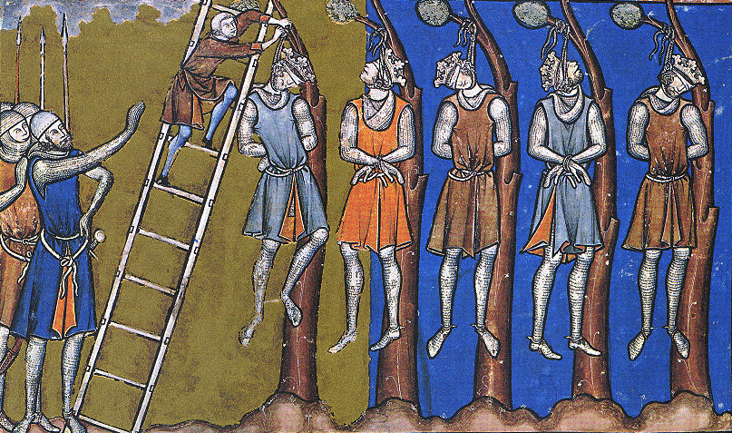

Your turn
EXAM SKILL
Government law and order saw considerable change after the Norman conquest’.
How far do you agree?
You may use the following in your answer:
Forest Laws
Tithings

