Slide 1






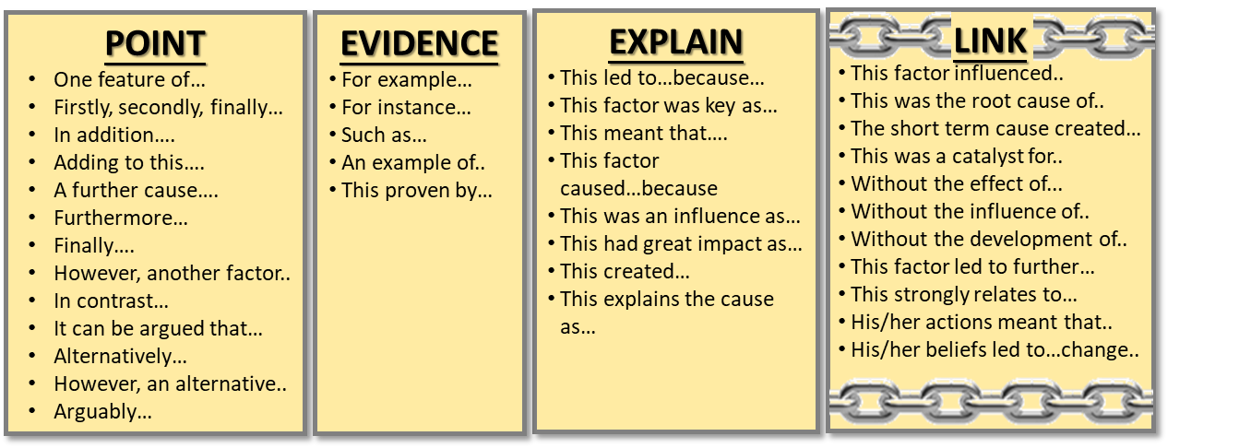

Paper 1 - Section B – 12 mark
Explain why William I changed law and order after the Norman Conquest.
You may use the following in your answer:
Forest Laws
Murdrum fine
You must also use information of your own. 12 marks
We do
Another reason why William was keen to change law and order was to allow them to be more centralised around him.
For example ________________________________________ ______________________________________________________________________________________________________________________________________________________
This explains why William changed law and order because ________________________________________________________________________________________________________________________________________________________________________________________________________
We do
You do
Highlight:
Point
Evidence
Explanation
Link back to the question
A final reason why William changed law and order after the Norman Conquest was _______________________________________ ________________________________________________________________________________________________________________________________________________________________________________________________________________________________________________________________________________________________________________________________________________________________________________________________________________________________________________________________________________________________________________________________________________________________________________________________________________________
After the victory in 1066, William introduced new sets of laws in England. For example, his Forest Laws gave him royal control over huge areas of the countryside and prevented the peasants or serfs from using this land. What had been ‘common land’ was now strictly controlled by the king. Anyone ‘poaching’ could now be punished with a corporal punishment such as castration or even hung. William did this to show his power and another reason was to have full access to the animals and resources of the forests for his own pleasure therefore explaining why he changed law and order.

Slide 2
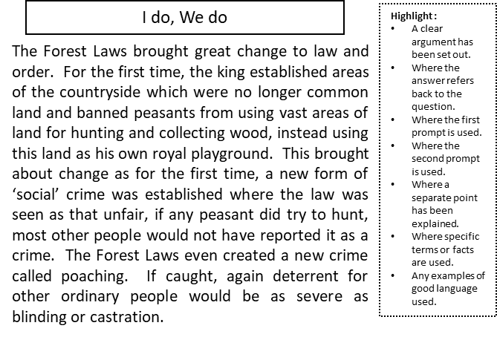
Paper 1 - Section B – 16 mark
Government law and order saw considerable change after the Norman conquest’. How far do you agree?
You may use the following in your answer:
Forest Laws
Tithings
You must also use information of your own.
Key arguments:
Agree – Forest Laws & Punishments Disagree-Collective Responsibility
‘
Another factor that saw significant change was the use of punishments. While the methods themselves largely stayed the same, there was a huge increase in the number of them. For example____________________________________________________________________________________________________________________________________________________________________________________________________________________________________________________________________________________________________________________________________________________________________________________________________________________________________________________________._____________________________________________________________________________________________________________________________________________________________________________________________________________________________________________________________________________________________________________________________________________________________________________________________________________________________________________________________________________
We do
The king established areas of the countryside which were no longer common land. | While the methods of punishments themselves largely stayed the same, there was a huge increase in the number of them | The ‘hundred’ and the use of the ‘hue and cry’ were kept the same for the same reason.
The Normans saw tithings as a very effective way to maintain order in the villages | The Forest Laws even created a new crime called poaching. If caught, again deterrent for other ordinary people would be as severe as blinding or castration. | The use of the feudal system and building castles in most parts of England played a huge role in the government taking further control over law and order.
The Anglo-Saxon Wergild was replaced with the Murdrum Fine | Published in On the Fabric of the Human Body. He paved the way for others, such as Sydenham, to challenge and disprove them. | Banned peasants from using vast areas of land for hunting and collecting wood
You do
‘
However, there was some continuity after 1066. _____________________________________ ____________________________________________________________________________ ________________________________________________________________________________________________________________________________________________________________________________________________________________________________________________________________________________________________________________________________________________________________________________________________________________________________________________________________________.________________________________________________________________________________________________________________________________________________________________________________________________________________________________________________________________________________________________________________________________________________________________________________________________________________________________________________________________________
Overall ______________________________________________________________________ ________________________________________________________________________________________________________________________________________________________
We do

Slide 3
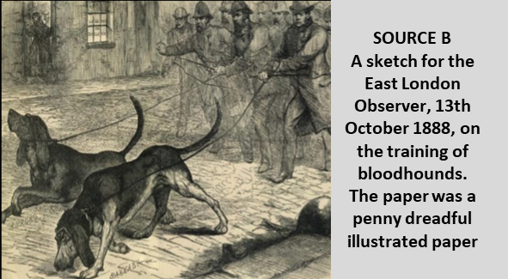
Paper 1 - Section A - Thematic Study: Whitechapel
SOURCE A
From a report in the East London Advertiser newspaper, published 15 September 1888.
The double stupidity of weakening his detective force and strengthening his ordinary police force from reserves and the military destroys two safeguards of a community. It deprives it of a specially trained force of men with brain power specially adapted for detective work and it takes away the old community constable, to be replaced by a man with a few years’ military service, but with not other qualification for serving the public. Nothing has indeed been more characteristic of the hunt for the Whitechapel murderer than the lack of local knowledge displayed by the police. They seem to know little of the dark alleyways of the neighbourhood and still less of the bad characters who swarm through the streets.
How useful are Sources A and B for an enquiry into the methods used in the police hunt for the Whitechapel murderer in 1888? (8 marks)
Remember COP
How could you follow up source B to find out more about the methods used in police hunt for the Whitechapel murderer in 1888? (4 marks)
Source A is useful because ____________________________________ _________________________________________________________
This supports my own knowledge because __________________________ __________________________________________________________________________________________________________________
The provenance of the source further supports its utility as ___________ __________________________________________________________________________________________________________________
Detail in source B that I would follow up: ______________________________________________________ ____________________________________________________________________________________________________________
Question I would ask:
______________________________________________________ ____________________________________________________________________________________________________________
What type of source I could use: __________________________________________________________________________________________________________________________________________________________________
How this might help answer my question:
__________________________________________________________________________________________________________________________________________________________________
Source B is useful because ____________________________________ _________________________________________________________
This supports my own knowledge because __________________________ __________________________________________________________________________________________________________________
The provenance of the source further supports its utility as ___________ __________________________________________________________________________________________________________________

Slide 4
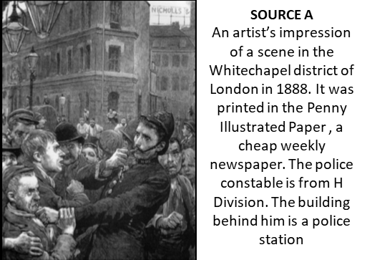
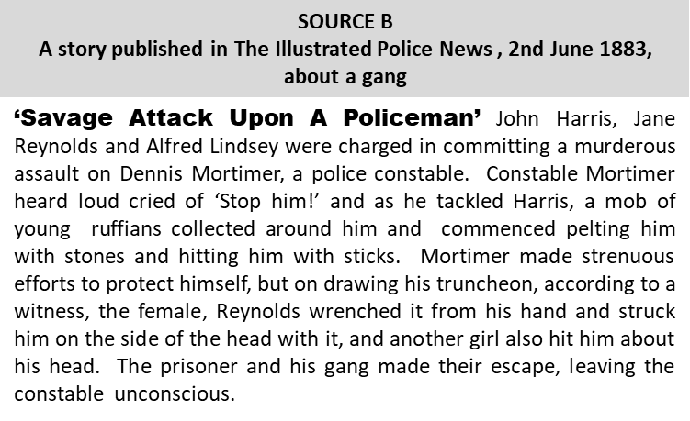
Paper 1 - Section A - Thematic Study: Whitechapel
How could you follow up source A to find out more about the effectiveness of policing in the Whitechapel area? (4 marks)
How useful are Sources A and B for an enquiry into the effectiveness of policing in Whitechapel? (8 marks)
Remember COP
Source A is useful because ____________________________________ _________________________________________________________
This supports my own knowledge because __________________________ __________________________________________________________________________________________________________________
The provenance of the source further supports its utility as ___________ __________________________________________________________________________________________________________________
Detail in source A that I would follow up: ______________________________________________________ ____________________________________________________________________________________________________________
Question I would ask:
______________________________________________________ ____________________________________________________________________________________________________________
What type of source I could use: __________________________________________________________________________________________________________________________________________________________________
How this might help answer my question:
__________________________________________________________________________________________________________________________________________________________________
Source B is useful because ____________________________________ _________________________________________________________
This supports my own knowledge because __________________________ __________________________________________________________________________________________________________________
The provenance of the source further supports its utility as ___________ __________________________________________________________________________________________________________________

