Slide 1
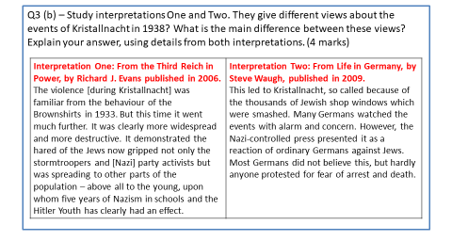
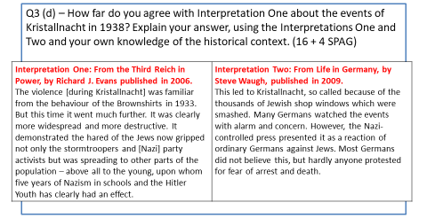
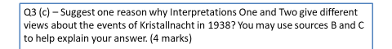
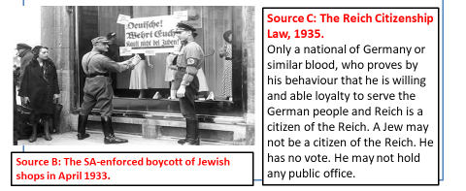
Paper 3, Interpretation questions
3b
3d
Interpretation 1 suggests____________________________, for example when it says_____________________________.
However Interpretation 2 suggests _____________________ which is clear when it says ___________________________ .
Interpretation 1 suggests__________________________________________, for example when it says___________________________________________. This is valid because I know that _____________________________________
______________________________________________________________
______________________________________________________________
______________________________________________________________
______________________________________________________________
______________________________________________________________.
However, Interpretation 2 suggests ___________________________________ which is clear when it says __________________________________________. This challenges the view given in Interpretation 1. Interpretation 2 is valid because I know that ______________________________________________
______________________________________________________________
______________________________________________________________
______________________________________________________________
______________________________________________________________
______________________________________________________________.
Therefore this leads me to question Interpretation 1.
Overall ________________________________________________________
______________________________________________________________
______________________________________________________________.
3c
Interpretations 1 and 2 may be different as they may have focussed on different sources when doing their research.
For example, interpretation 1 __________________________
________________________________________________
________________________________________________
_______________________________________________ .

Slide 2
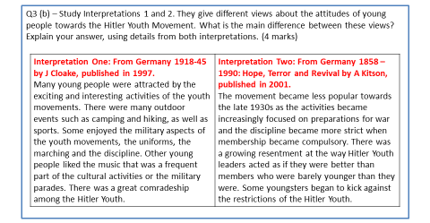
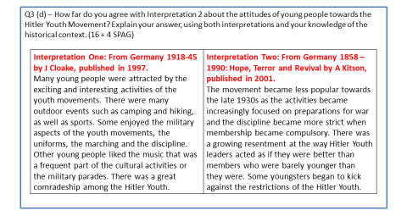
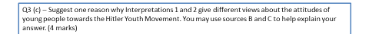
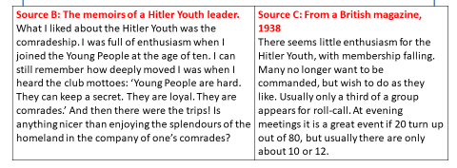
Paper 3, Interpretation questions
3b
3d
Interpretation 1 suggests____________________________, for example when it says_____________________________.
However Interpretation 2 suggests _____________________ which is clear when it says ___________________________ .
Interpretation 1 suggests__________________________________________, for example when it says___________________________________________. This is valid because I know that _____________________________________
______________________________________________________________
______________________________________________________________
______________________________________________________________
______________________________________________________________
______________________________________________________________.
However, Interpretation 2 suggests ___________________________________ which is clear when it says __________________________________________. This challenges the view given in Interpretation 1. Interpretation 2 is valid because I know that ______________________________________________
______________________________________________________________
______________________________________________________________
______________________________________________________________
______________________________________________________________
______________________________________________________________.
Therefore this leads me to question Interpretation 1.
Overall ________________________________________________________
______________________________________________________________
______________________________________________________________.
3c
Interpretations 1 and 2 may be different as they may have focussed on different sources when doing their research.
For example, interpretation 1 __________________________
________________________________________________
________________________________________________
_______________________________________________ .

Slide 3
SOURCE A
From a report in the East London Advertiser newspaper, published 15 September 1888.
DETAIL IN SOURCE B THAT I WOULD FOLLOW UP The local police were replaced by men with a few years’ military service, but with no local experience
QUESTION I WOULD ASK What proportion of the men assigned to the Ripper investigation had strong knowledge of the local community?
WHAT TYPE OF SOURCE I COULD USE Metropolitan Police records stored by Scotland Yard, showing the reports of, and beats patrolled by, H division officers, and the service history of the officers
HOW THIS MIGHT HELP ANSWER MY QUESTION If the most of the reports of daily activity, particularly beat reports, were from longserving men in H Division this would show that the investigation was being carried out by men with local knowledge, but if many reports were from men recently recruited from the army, it would show up the weakness suggested in Source A.
The double stupidity of weakening his detective force and strengthening his ordinary police force from reserves and the military destroys two safeguards of a community. It deprives it of a specially trained force of men with brain power specially adapted for detective work and it takes away the old community constable, to be replaced by a man with a few years’ military service, but with not other qualification for serving the public. Nothing has indeed been more characteristic of the hunt for the Whitechapel murderer than the lack of local knowledge displayed by the police. They seem to know little of the dark alleyways of the neighbourhood and still less of the bad characters who swarm through the streets.
SOURCE B
A story published in The Illustrated Police News , 2nd June 1883, about a gang
‘Savage Attack Upon A Policeman’ John Harris, Jane Reynolds and Alfred Lindsey were charged in committing a murderous assault on Dennis Mortimer, a police constable. Constable Mortimer heard loud cried of ‘Stop him!’ and as he tackled Harris, a mob of young ruffians collected around him and commenced pelting him with stones and hitting him with sticks. Mortimer made strenuous efforts to protect himself, but on drawing his truncheon, according to a witness, the female, Reynolds wrenched it from his hand and struck him on the side of the head with it, and another girl also hit him about his head. The prisoner and his gang made their escape, leaving the constable unconscious.

Slide 4
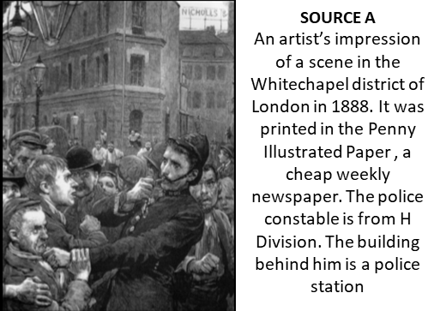
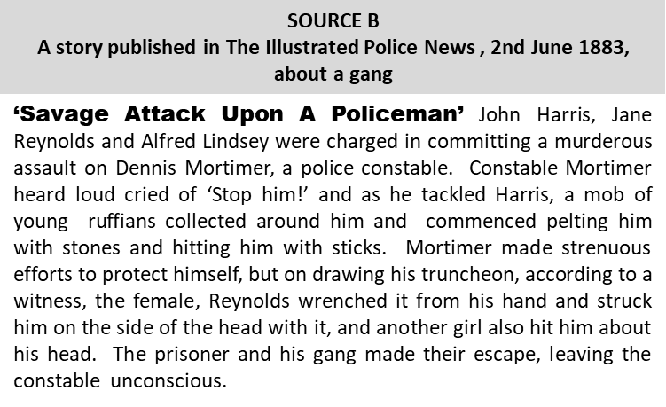
The Whitechapel Union is a model workhouse that is to say, it is the very purpose of the Poor Law made into stone and brick. The men are not allowed to smoke in it, the young women never taste tea, and the old ones may not have a cup during the long afternoons, only at half past six morning and night, when they also receive a small hunch of bread with butter scraped over the surface, which is so dear to their hearts as well as their stomachs. The young people never go out, never see a visitor, and the old ones only get one holiday in the month. Then the aged poor people may be seen skipping like lambs outside the doors of this prison, while they jabber to their friends and relations. A little gruel morning and night, meat twice a week, that is the food of the grown up people, seasoned with hard work and prison discipline. What shall we say of the women, or man, hurt by misfortune, who must come there to die in the street? Why should old people be punished for their existence?

Slide 5

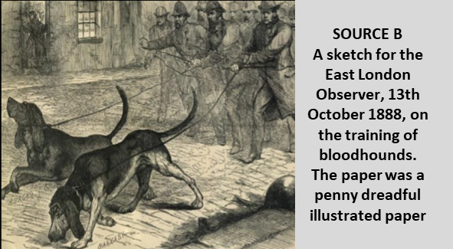
Paper 1 - Section A - Thematic Study: Whitechapel
SOURCE A
From a report in the East London Advertiser newspaper, published 15 September 1888.
The double stupidity of weakening his detective force and strengthening his ordinary police force from reserves and the military destroys two safeguards of a community. It deprives it of a specially trained force of men with brain power specially adapted for detective work and it takes away the old community constable, to be replaced by a man with a few years’ military service, but with not other qualification for serving the public. Nothing has indeed been more characteristic of the hunt for the Whitechapel murderer than the lack of local knowledge displayed by the police. They seem to know little of the dark alleyways of the neighbourhood and still less of the bad characters who swarm through the streets.
How useful are Sources A and B for an enquiry into the methods used in the police hunt for the Whitechapel murderer in 1888? (8 marks)
Remember COP
How could you follow up source B to find out more about the methods used in police hunt for the Whitechapel murderer in 1888? (4 marks)
Source A is useful because ____________________________________ _________________________________________________________
This supports my own knowledge because __________________________ __________________________________________________________________________________________________________________
The provenance of the source further supports its utility as ___________ __________________________________________________________________________________________________________________
Detail in source B that I would follow up: ______________________________________________________ ____________________________________________________________________________________________________________
Question I would ask:
______________________________________________________ ____________________________________________________________________________________________________________
What type of source I could use: __________________________________________________________________________________________________________________________________________________________________
How this might help answer my question:
__________________________________________________________________________________________________________________________________________________________________
Source B is useful because ____________________________________ _________________________________________________________
This supports my own knowledge because __________________________ __________________________________________________________________________________________________________________
The provenance of the source further supports its utility as ___________ __________________________________________________________________________________________________________________

Slide 6
Paper 1 - Section A - Thematic Study: Whitechapel
How could you follow up source A to find out more about the effectiveness of policing in the Whitechapel area? (4 marks)
How useful are Sources A and B for an enquiry into the effectiveness of policing in Whitechapel? (8 marks)
Remember COP
Source A is useful because ____________________________________ _________________________________________________________
This supports my own knowledge because __________________________ __________________________________________________________________________________________________________________
The provenance of the source further supports its utility as ___________ __________________________________________________________________________________________________________________
Detail in source A that I would follow up: ______________________________________________________ ____________________________________________________________________________________________________________
Question I would ask:
______________________________________________________ ____________________________________________________________________________________________________________
What type of source I could use: __________________________________________________________________________________________________________________________________________________________________
How this might help answer my question:
__________________________________________________________________________________________________________________________________________________________________
Source B is useful because ____________________________________ _________________________________________________________
This supports my own knowledge because __________________________ __________________________________________________________________________________________________________________
The provenance of the source further supports its utility as ___________ __________________________________________________________________________________________________________________

Slide 7
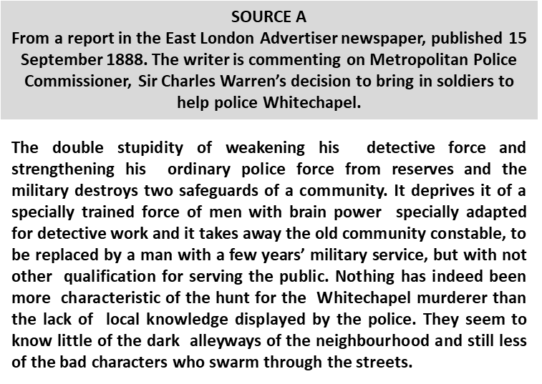
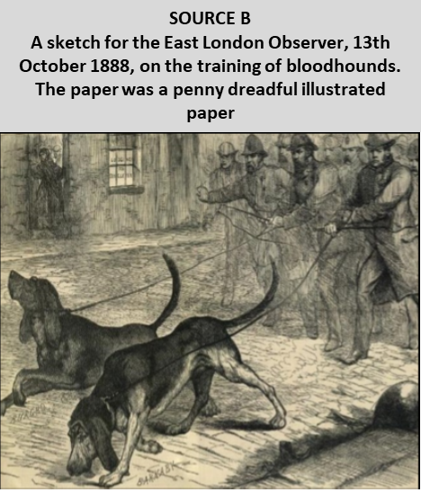
Paper 2, Whitechapel
SOURCE B
A story published in The Illustrated Police News , 2nd June 1883, about a gang
‘Savage Attack Upon A Policeman’ John Harris, Jane Reynolds and Alfred Lindsey were charged in committing a murderous assault on Dennis Mortimer, a police constable. Constable Mortimer heard loud cried of ‘Stop him!’ and as he tackled Harris, a mob of young ruffians collected around him and commenced pelting him with stones and hitting him with sticks. Mortimer made strenuous efforts to protect himself, but on drawing his truncheon, according to a witness, the female, Reynolds wrenched it from his hand and struck him on the side of the head with it, and another girl also hit him about his head. The prisoner and his gang made their escape, leaving the constable unconscious.
However, Interpretation 2 suggests ___________________________________ which is clear when it says __________________________________________. This challenges the view given in Interpretation 1. Interpretation 2 is valid because I know that ______________________________________________
______________________________________________________________
______________________________________________________________
______________________________________________________________
______________________________________________________________
______________________________________________________________.
Therefore this leads me to question Interpretation 1.
Overall ________________________________________________________
______________________________________________________________
______________________________________________________________.
How useful are Sources A and B for an enquiry into the methods used in the police hunt for the Whitechapel murderer in 1888? (8 marks)
Remember COP
Source A is useful because ____________________________________ _________________________________________________________
This supports my own knowledge because __________________________ __________________________________________________________________________________________________________________
The provenance of the source further supports its utility as ___________ __________________________________________________________________________________________________________________
Source B is useful because ____________________________________ _________________________________________________________
This supports my own knowledge because __________________________ __________________________________________________________________________________________________________________
The provenance of the source further supports its utility as ___________ __________________________________________________________________________________________________________________

