Slide 1

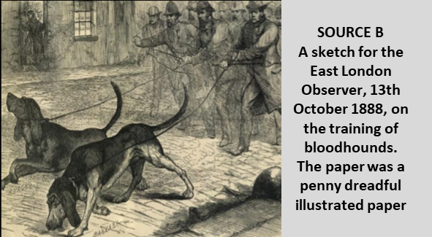
Paper 1 - Section A - Thematic Study: Whitechapel
SOURCE A
From a report in the East London Advertiser newspaper, published 15 September 1888.
The double stupidity of weakening his detective force and strengthening his ordinary police force from reserves and the military destroys two safeguards of a community. It deprives it of a specially trained force of men with brain power specially adapted for detective work and it takes away the old community constable, to be replaced by a man with a few years’ military service, but with not other qualification for serving the public. Nothing has indeed been more characteristic of the hunt for the Whitechapel murderer than the lack of local knowledge displayed by the police. They seem to know little of the dark alleyways of the neighbourhood and still less of the bad characters who swarm through the streets.
How useful are Sources A and B for an enquiry into the methods used in the police hunt for the Whitechapel murderer in 1888? (8 marks)
Remember COP
How could you follow up source B to find out more about the methods used in police hunt for the Whitechapel murderer in 1888? (4 marks)
Source A is useful because ____________________________________ _________________________________________________________
This supports my own knowledge because __________________________ __________________________________________________________________________________________________________________
The provenance of the source further supports its utility as ___________ __________________________________________________________________________________________________________________
Detail in source B that I would follow up: ______________________________________________________ ____________________________________________________________________________________________________________
Question I would ask:
______________________________________________________ ____________________________________________________________________________________________________________
What type of source I could use: __________________________________________________________________________________________________________________________________________________________________
How this might help answer my question:
__________________________________________________________________________________________________________________________________________________________________
Source B is useful because ____________________________________ _________________________________________________________
This supports my own knowledge because __________________________ __________________________________________________________________________________________________________________
The provenance of the source further supports its utility as ___________ __________________________________________________________________________________________________________________

Slide 2
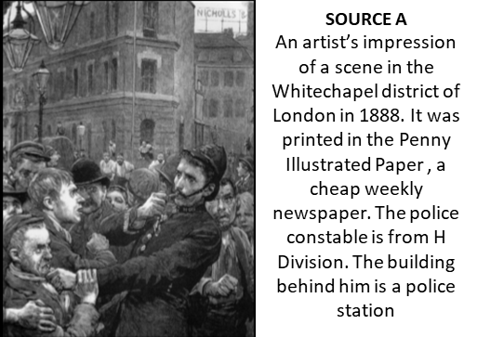
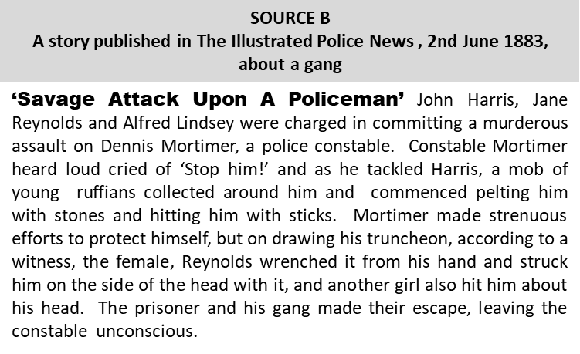
Paper 1 - Section A - Thematic Study: Whitechapel
How could you follow up source A to find out more about the effectiveness of policing in the Whitechapel area? (4 marks)
How useful are Sources A and B for an enquiry into the effectiveness of policing in Whitechapel? (8 marks)
Remember COP
Source A is useful because ____________________________________ _________________________________________________________
This supports my own knowledge because __________________________ __________________________________________________________________________________________________________________
The provenance of the source further supports its utility as ___________ __________________________________________________________________________________________________________________
Detail in source A that I would follow up: ______________________________________________________ ____________________________________________________________________________________________________________
Question I would ask:
______________________________________________________ ____________________________________________________________________________________________________________
What type of source I could use: __________________________________________________________________________________________________________________________________________________________________
How this might help answer my question:
__________________________________________________________________________________________________________________________________________________________________
Source B is useful because ____________________________________ _________________________________________________________
This supports my own knowledge because __________________________ __________________________________________________________________________________________________________________
The provenance of the source further supports its utility as ___________ __________________________________________________________________________________________________________________

