Slide 1
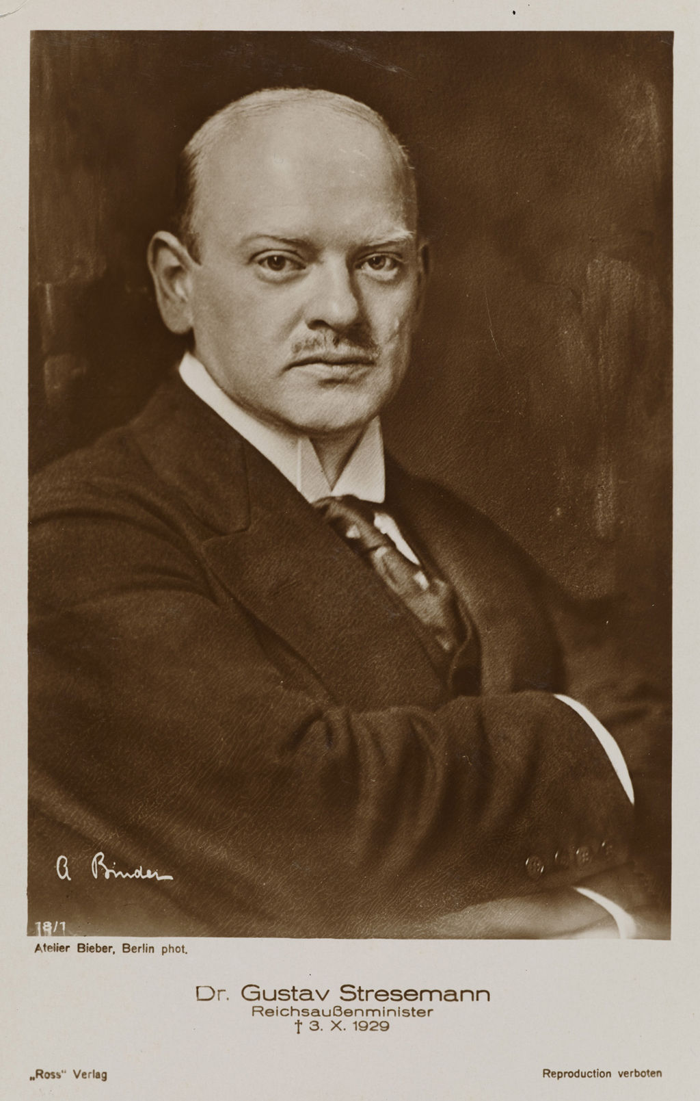


The BIG
Question:
Does Stresemann deserve the Nobel Peace Prize?

Slide 2
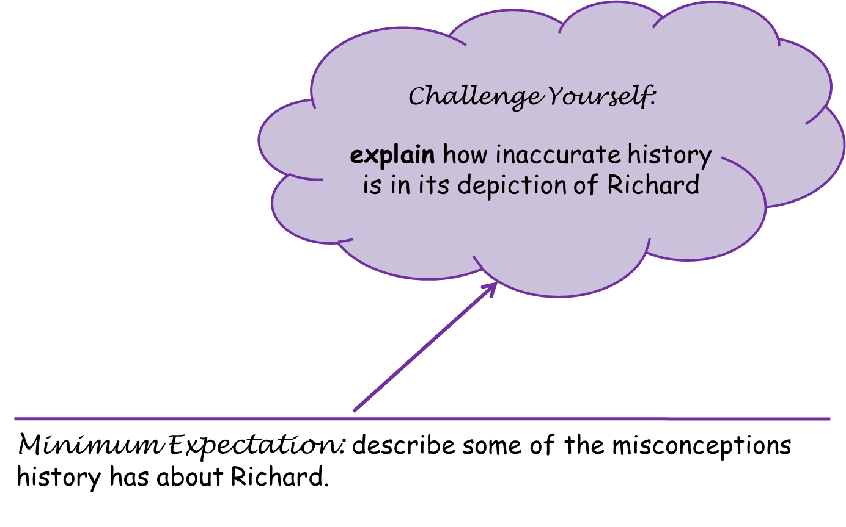
TITLE:
How did life improve for the working class?
To consider the extent to which Weimar Germany recovered for working class Germans.
Explain the emotional impact of these improvements.
Minimum Expectation: Describe various improvements in living standards.

Slide 3
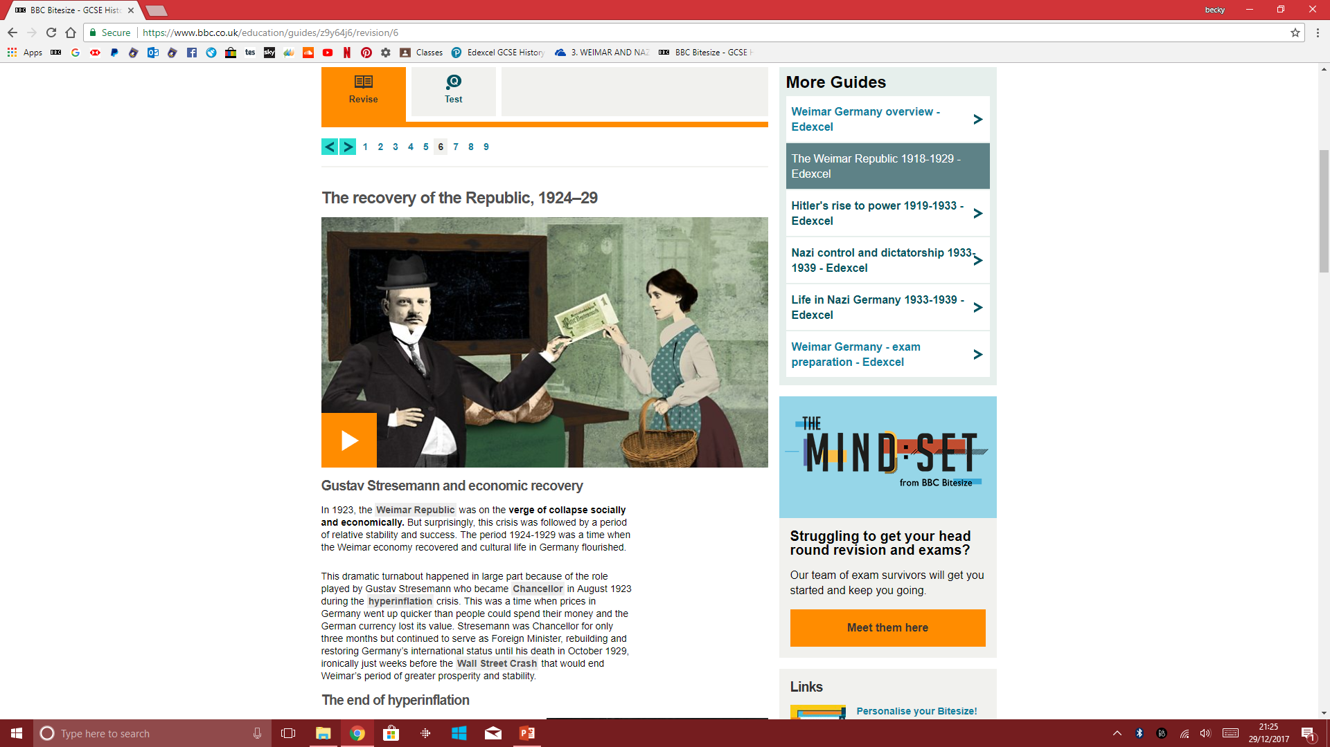
:
Without looking back to previous lessons, discuss the three actions taken by Chancellor Stresemann that caused a recovery in Germany’s economy.
As you watch this clip, jot down three positives you hear of Stresemann’s reforms all Germans.
As you watch this clip, jot down three positives you hear of Stresemann’s reforms on the working class.

Slide 4

Task – Using Pg 33
Expected
Challenge:
Unemployment and Unemployment insurance
How did unemployment improve between 1924 and 1928?
Work and Wages
How did the length of the working week change between 1925 and 1927?
Housing and other improvements
What was introduced in 1925 to fund building associations?
What did private companies do from 1925 to 1929
How did education improve?
Unemployment and Unemployment insurance
How did unemployment improve between 1924 and 1928?
What was the Unemployment Insurance Act 1927?
Work and Wages
How did the length of the working week change between 1925 and 1927?
What happened to ‘real wages’?
Housing and other improvements
What was introduced in 1925 to fund building associations?
What did private companies do from 1925 to 1929?
What happened under the Reich Pension law?
How did education improve?

Slide 5

Due to hyperinflation, many middle class and rich people lost savings and had to start again.
They hated the government helping the workers and not them.
Unemployment never went below 1.3 million – so still plenty out of work.
Farmers were not able to buy new machinery and so also struggled to make money.
Small business owners struggled the most and many had to close down.

Slide 6
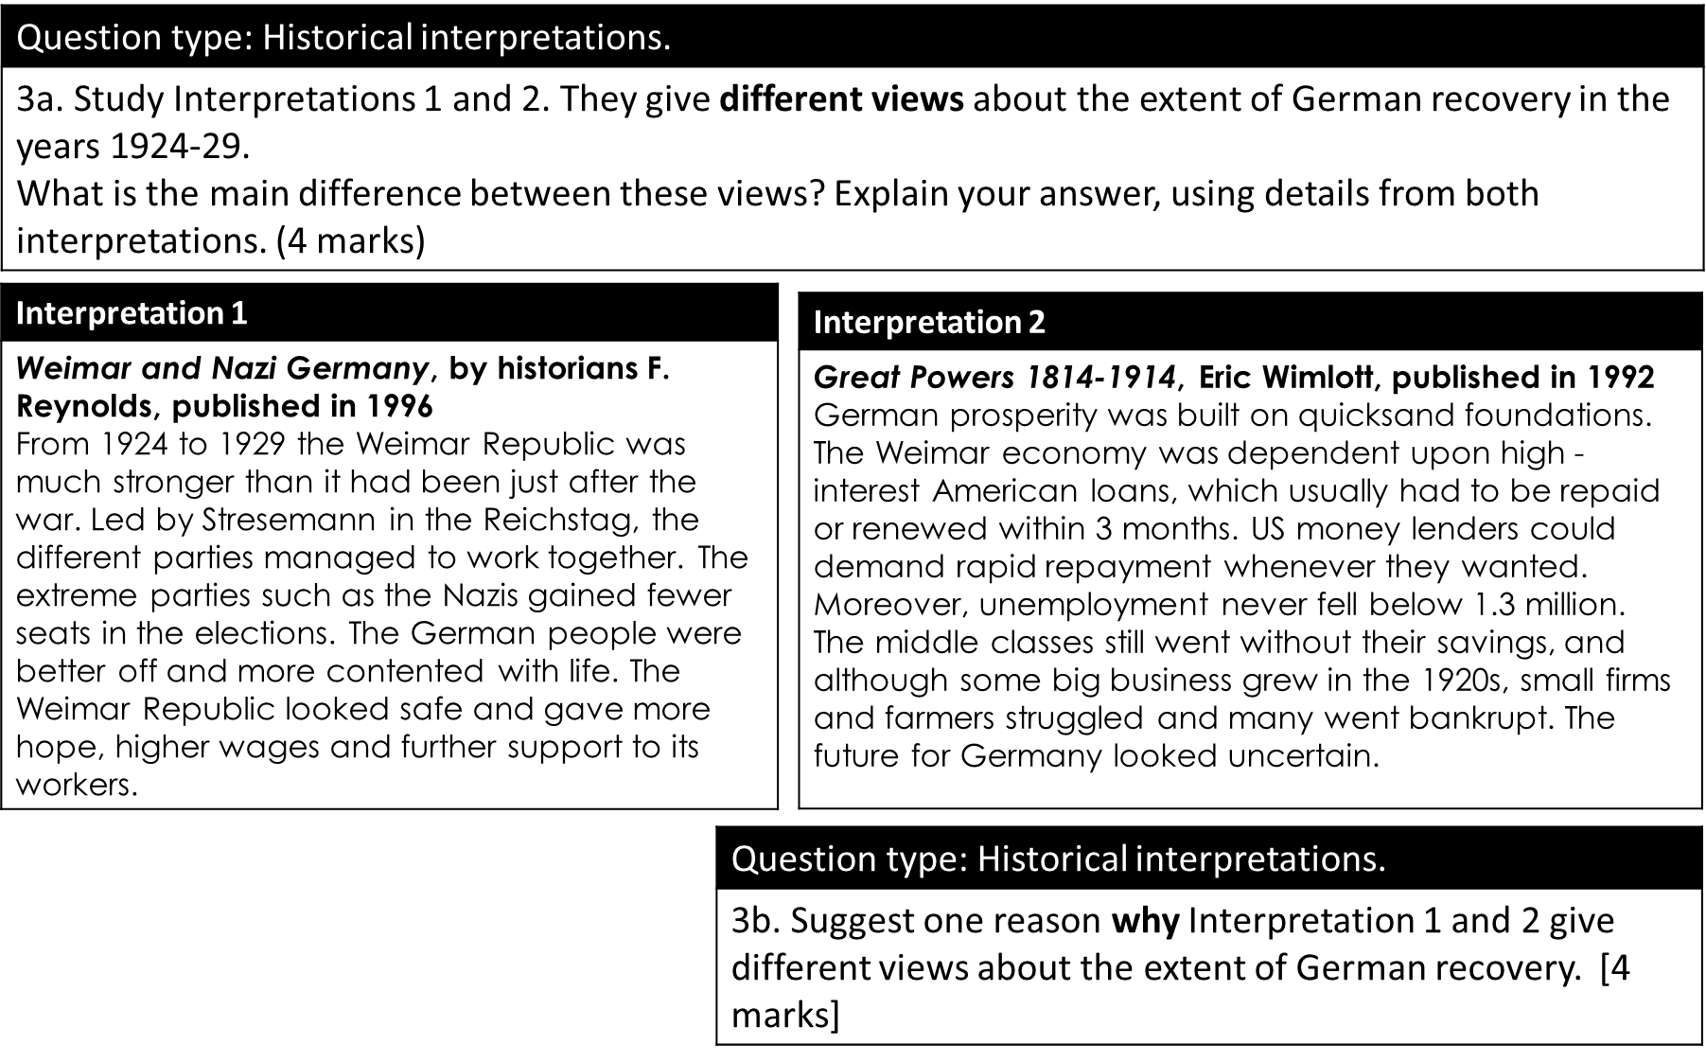

Slide 7


