Slide 1
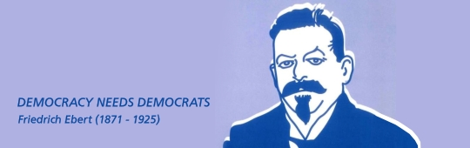
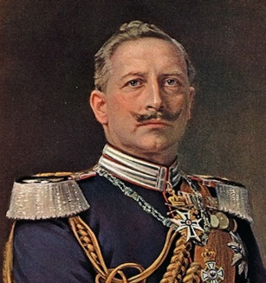
Lesson 1: The consequences of the First World War on Germany.
KNOW YOUR TERMS:
Kaiser – ‘King’ – part of the German royal family.
Abdicated – Stepped down from power.
Exile – Moved safely away from Germany.
Constitution – A new set of rules about how a country is run.
Republic – A country without a royal family.
Communist – A form of government which aims for equality, workers rights and sharing all resources. Linked with Germany’s enemy – Russia.
Reichstag – The Germany government building (like the Houses of Parliament in the UK)
THE KEY POINTS
The German Army had been fighting for 4 years in France and had many victories.
However, back in Germany, the public were not happy:
British ships blocked supplies.
750,000 died from starvation in Germany.
There were protests and strikes.
Even soldiers refused to follow orders or joined in with protests.
Jewish Communists were keen to bring change.
War was too expensive.
This started a German Revolution in Nov. 1918.
THE GERMANS WANTED CHANGE!
GERMANY WAS OUT OF CONTROL!
KAISER WILHELM HAD
LOST CONTROL OF HIS PEOPLE!
Kaiser (King) Wilhelm was under pressure to abdicate, even by his army generals.
10th November, 1918 he abdicated.
What happened next?
Frederick Ebert became leader of the Weimar Republic.
Weimar is a district in Germany
A Republic is a country without a monarchy/royal family.
The start of the Weimar Republic
Crowds (some with guns) gathered on the streets of Berlin outside the Reichstag (German Parliament).
The biggest political party was
the Social Democratic Party
(SDP). Their leader was
Friedrich Ebert.
Friedrich Ebert then became Germany’s Chancellor (Like a Prime Minister)
He did not want the Communists in power. Communism might bring more chaos.
How did he bring calm and stability and avoid anarchy?
Worked with the army to keep the communists.
Removed some old, extreme politicians from the Reichstag .
Demanded a new constitution (set of rules about how Germany was run)
Introduced democracy (a public vote).
The Armistice – 11th November 1918.
The formal agreement between Germany and the Allies to end the war.
Germany agreed to a treaty called the Treaty of Versailles – where it formally had to admit defeat and guilt for the war.
Notes:
Differentiated fact sheet.

Slide 2
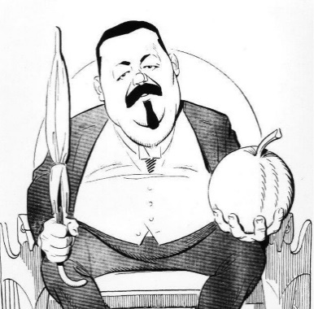


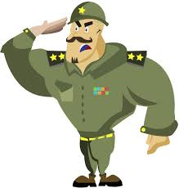






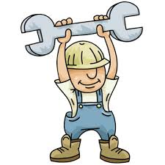
Lesson 2: What was the Weimar Constitution? What were it’s strengths and weaknesses?.
KNOW YOUR TERMS:
CONSTITUTION – a set of rules about how the country is run.
TRADE UNIONS – An organisation that supports workers rights. Traditionally very closely linked with the Communists.
REICHSTAG – An elected group of politicians. Equivalent to the House of Parliament – responsible for deciding on laws.
COALITION – More than one political party ruling the country.
WEIMAR – The town where Ebert and the National Assembly met to agree with new constitution.
THE KEY POINTS
After the Kaiser’s abdication, the new leader Erbert needed to calm Germany down and make people believe in him.
This is what he did…….
CIVIL SERVANTS Government workers (Civil Servants) who worked for the Kaiser stayed BUT were told to work with the new councils REASON This would make sure: country kept running properly & it would stop the councils from causing further unrest.
DEAL WITH THE GERMAN ARMY GENERALS The Generals could stay in power if the army promised to support Erbert & the Weimar Republic. REASON: Avoid arguments with the army & threat of revolution.
INDUSTRY Ebert promised industrial leaders that the government would not take over their businesses. REASON: This would help the economy.
ACTION 4:TRADE UNIONS Ebert supported the Trade Unions who wanted more worker rights by promising a reduced 8 hour day. REASON: To take support away from the Communist parties in Germany.
HOWEVER – PROTESTS & RIOTS CONTINUED IN MANY GERMAN CITIES MANY BELIEVED GERMANY WAS ON THE EDGE OF ANARCHY
Ebert needed a new set of rules about how Weimar Germany should be run – this set of rules is called a constitution.
Erbert wanted a National Assembly to decide on a new constitution for Germany.
THE TIMELINE OF EVENTS.
19th January 1919 – Elections took place.
A massive 82% of Germany voted.
Ebert’s Social Democratic Party (SPD) won 40%
February 1919 - The National Assembly met in a peaceful town called Weimar (as there were protests in Berlin). This is why it was known as the Weimar Constitution and the Weimar Republic.
July 1919 – The National Assembly finished writing the new constitution. Official start of Weimar Republic Germany
The new Weimar Constitution
PRESIDENT: 1ST
Elected every 7 years.
He Selected the Chancellor.
ARTICLE 48
In an emergency, could make laws himself without the need of the Reichstag.
IN CHARGE OF THE ARMY
CHANCELLOR: 2ND
Chosen by the President.
Led the day to day running of Germany.
Needed the support of the Reichstag.
REICHSTAG (House of Parliament)
Voted on all laws.
Voted for every 4 years by the public.
VOTERS ( As Germany was now a Democracy)
Men and women over 21. Known as the electorate.
STRENTHGS
Germany was a democracy (people had a vote).
Women as well as men had a vote.
The Chancellor and President could not get too much power as they needed to be voted for.
The voting system was Proportional Representation so smaller parties given a say
Laws could only be passed if they were voted for by the Reichstag.
Local governments had a say in how their regions were run.
WEAKNESSES
Proportional Representation led to many mixed governments - COALITION GOVERNMENTS
Coalition governments often argued and looked weak
Too many political parties for one clear winner in elections.
No strong party to make quick decisions
The President had to step in & use the Emergency Article 48 to pass a law.
There was never the full support of the public or army.
More extreme political parties such as the Communists (left wing) and nationalists (right wing) did not like it.
Notes:
Differentiated fact sheet – suitable for most.

Slide 3
Lesson 3: Treaty of Versailles 1919
How were Germany punished and why did it cause opposition?
Guilt Clause Reparations Armed Forces Industry Land Empire Dolchstoss Diktat
This lesson you will learn:
What the Treaty of Versailles was.
How the Treaty of Versailles punished Germany.
Why there was opposition towards it.
What the impact of the Treaty of Versailles was.
Terms of the Treaty of Versailles – What is told Germany to do. |  |  |  |  |  | Why was it unpopular?
War Guilt Clause Germany had to admit blame & guilt for the war. | If Germany’s politicians admitted guilt for the war, the people of Germany would be forced to accept any punishment they were given.
Reparations – money/payments. Had to pay £ 6.6 billion compensation for all the damage done to the other nations. |  |  | This meant the German people would have to suffer with a poor economy for years. Damaged economy.
Armed Forces – reduced to stop Germany starting another war. Army: Limited to only 100,000 men & no heavy artillery (guns) allowed. Navy: only allowed 6 battleships, no submarines and remaining boats destroyed. Air Force: Not allowed, planes destroyed. Land on the French border (the Rhineland) was ‘De-militarised’. The German army were not allowed. |  |  |  |  |  |  | Many ex- WW1 soldiers out of work with little chance of gaining employment. Would weaken Germany with no ability to defend itself.
Industry – coal and iron. Lost 50% of its iron reserves to other countries. Coalfields in an important area called the Saar given to France for 15 years. |  |  |  | It meant Germany’s economy would struggle to recover from the war and important jobs would be lost causing further unemployment.
Land Lost 10% of its population. Some ‘Germans’ voted to leave Germany in a public vote called a Plebicite. France, Belgium and Poland gained land. E.g. Poland gained 2 million more people. No link with Austria allowed One part of Germany called East Prussia was cut off by Poland (who owned West Prussia). |  |  |  |  |  |  |  | Weakened Germany and led to a number of German speaking people in ‘other’ countries.
Empire Germany had 11 colonies in Africa & the Far East taken off them by the allies. |  | This dented the pride that many Germans had in their country.
‘Diktat’ – The Treaty of Versailles was dictated – Germany HAD to accept it. Germany only had 15 days to challenge the rules. ALL of their issues were ignored. |  |  |  |  | Caused the German public to hate the Weimar politicians even more.
‘Dolchstoss’ - The stab in the back The German people felt that the army were not actually defeated in the war & it was only the politicians in Germany who admitted defeat. They believed they had been ‘stabbed in the back’ and called these politicians the ‘November Criminals’ as they surrendered in November 1918. |  |  |  |  |  | The German people felt betrayed and let down by their government and Ebert.
Germany and Ebert signed the Armistice on 11th November 1918……WHY?
They had no other choice – they were forced
Money and troops were running out.
The protests and unrest in all major towns.
The USA were now fighting against them and pushing them back. They were going to lose.
Their Kaiser had abdicated which left nobody in full control anyway.
What was the Treaty of Versailles of 1919?
A set of rules or TERMS given to Germany as a punishment for the First World War.
Who decided on Germany’s punishment?
Britain, France and the USA. Germany were not allowed to take part in the discussions so had no say in if they could do what they were asked.
Why was it called the Treaty of Versailles?
The allied leaders (UK, France and USA) met at the Palace of Versailles (in the Hall of Mirrors) near Paris, to agree on the treaty.
The Treaty of Versailles on 28th July 1919, Germany was linked to defeat, humiliation, bitterness and weakness The German people felt betrayed and let down by their government. It caused great fury and anger from the German people.

Slide 4
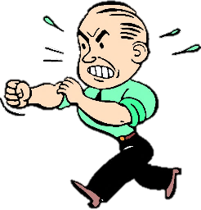
THE KEY POINTS
Lesson 4: The Challenges to the Weimar Republic from right-wing and left-wing political parties.
You will find out:
What we mean by left-wing and right-wing.
Who the main left and right-wing political threats were from.
What these groups did & their impact on Weimar Germany.
Introduction:
Different political parties have different ideas which are left-wing, centre, or right-wing. Most of us will vote for a ‘centre’ party. This was similar in Germany but more ‘extreme’ ideas were being supported & these groups threatened the Weimar Republic.
CHALLENGE 1 Political parties challenging the government in the Reichstag (German Parliament).
The problem.
Extreme parties had gained 20% of the seats in the German parliament – this does not seem much, but enough to really challenge the actions of Ebert and the Weimar Constitution (set of rules)
Extreme Left Wing parties. E.g. Communist Party (KPD) | Extreme Right Wing parties. E.g. - Nationalist DNVP Party
Hated the Weimar Republic, wanted rights for workers and supported trade unions. Wanted wealth to be shared. The idea came from Russia and was hated by upper classes and the right wing parties. | Also hated the Weimar Republic, wanted the return of the Kaiser and for Germany to go back to its traditions. Called ‘nationalists’ as they liked the idea of a strong, independent Germany with a strong army to back it up.
CHALLENGE 2 The Spartacist Revolt
(LEFT WING)
Who? The German Communist Party (KPD) & Spartacist League.
Led by? Rosa Luxemberg (Red Rosa) and Karl Liebknecht.
Strength? They had money & support from Russia, 40,000 members, published 33 daily newspapers.
When? January 1919,
Why did they ‘revolt’? Ebert sacked the police chief of Berlin.
What did they do? 100,000 workers protested & went on strike. Took over government newspapers. How did the Weimar Government react?
Erbert sent in the Freikorps to stop the protests. The leaders were arrested and shot.
CHALLENGE 3: The Freikorps and Kapp Putsch
(RIGHT WING)
Who were the Freikorps? Ex-WW1 soldiers who returned to Germany with their weapons. Ebert organised them into a ‘free-army’ or Freikorps. 250,000 of them.
So WHY did they challenge the Weimar Republic?
Ebert needed them BUT they were getting too powerful – arresting and beating communists up in the street. Ebert wanted to reduce their size.
When? March 1920
What did they do?
They attempted a putsch (to overthrow the government and ‘push’ Ebert out of power. The leader they wanted was called Wolfgang Kapp. So, it was known as the Kapp Putsch. They also wanted the Kaiser back.
How did Ebert stop the take over?
Told the workers of Berlin to go on strike and bring the country to a halt. They did and it proved to Kapp that he did not have enough support.
CHALLENGE 4:
Political Assassinations
There were 376 assassinations of left-wing politicians.
Not one right-wing murderer was sentenced or executed as many of the judges were right-wing and biased.
This proves that even the judges challenged and undermined the Weimar Republic.
CHALLENGE 5:
Armed Guards
With the amount of violence, most political parties organised ex-soldiers to be bodyguards at their meetings. They were meant to be for protection, but caused more violence that Ebert had to deal with.
Notes:
Differentiated summary sheet.

Slide 5





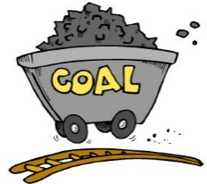
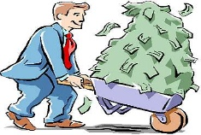

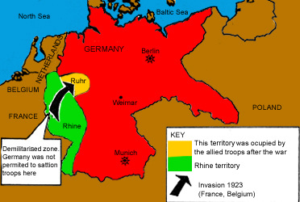
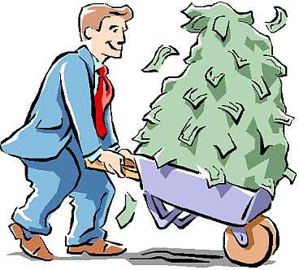
THE KEY POINTS
Lesson 5: The Challenges of 1923 Hyperinflation and the French occupation of the Ruhr in Germany.
You will find out:
Why the French occupation of the Ruhr in Germany was another challenge to the Weimar government.
What the hyperinflation was and how it also challenged Weimar Germany.
ONE: French occupation of the Ruhr 1923………………..Germany’s economy was bankrupt;
Spent money on WW1.
No more gold reserves
The Treaty of Versailles - Had to pay the reparations, lost important industrial areas AND was meant to send coal to France.
By 1923, Germany was not able to send France any coal from an important area known as the Ruhr coalfields. So, the French sent in troops. The French did the following as a punishment:
Confiscated any coal
Took away the machinery.
Sent in their own French workers.
How did the Weimar government react?
German workers went on strike as the Weimar government did not want any violence. It did not have a strong army anyway. The German people hated not being able to fight back.
How did this affect Germany?
The French occupation
crippled Germany as the
Ruhr contained 80% of all
German iron, coal and steel
Reserves.
It led to more debt.
More Germans lost jobs…unemployment.
PLUS……A massive shortage of goods.
Hyperinflation………INFLATION – Price rises
due to fewer goods + higher demand.
Remember the economic problems already by 1923:
Government needed to pay war reparation debts.
Government needed to pay their own war debt.
Fewer factories due to lost land (Saar, Ruhr + Rhineland)
Higher unemployment (Germans without jobs).
Weimar government got less money from
workers paying taxes –only ¼ of what was needed.
NOW: Fewer goods produced due to the French in the Ruhr.
Germans had to pay more money to get what they needed.
How did the Weimar government deal with this?
BADLY….poor decisions about what to do.
What did they do to give people more money?
Literally print more money which made money
almost worthless.
What were the effects of this?
1. Normal living became impossible:
People carried lots of money in baskets/wheelbarrows.
Workers paid twice a day to cope with the amount of money.
Some shops refused to take money – simply swapped goods.
Theft increased as Germans could not afford the goods.
2. Shortages of food and goods:
Foreign countries did not want to trade with Germany so this led to even more shortages of food and other essential goods.
3. The rich and middle classes lost the value of their savings.
Those who had saved money found it was worth little. So they even hated the Weimar government now.
Did anyone benefit? Yes
Foreign visitors could buy a very cheap holiday and buy a huge amount with their foreign money – the Germans hated being taken advantage of like this.
Weimar Germany has already faced threats from:
The reputation of the Weimar politicians as ‘November Criminals’ for signing the armistice.)
The terms of the Treaty of Versailles. Right and left wing threats from within the Reichstag (German parliament)
The Spartacist Revolt
The attempted Kapp Putsch by the Freikorps .
Ongoing political assassinations
Price of a loaf of bread
1919 | 1 mark
1922 | 100 marks
1923 | 200,000 billion
Two more challenges came in 1923.
ONE
The French occupied land just inside the German border called the Ruhr.
TWO
The economy suffered from hyperinflation

Slide 6
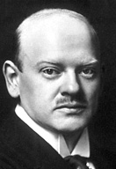


THE KEY POINTS
Lesson 6: How far did Gustav Stresemann help Weimar Germany recover after 1923?
Who was Gustav Stresemann?
In 1923, President Ebert selected Stresemann as his new Chancellor (in charge of the economy) and Foreign Secretary (in charge of dealing with with other countries).
What did he aim to do?
Bring economic stability (stop hyperinflation), unite the Germans to stop them supporting extreme parties & to give Germany a better reputation abroad.
3 reasons for economic recovery:
1. Introducing the Rentenmark 2. The Dawes Plan 3. The Young Plan
3 reasons for the recovery of Germany’s reputation abroad:
1. The Locarno Pact 2. The League of Nations 3. The Kellogg-Briand Pact
The new Rentenmark
Stresemann set up a new bank & a new currency - the Rentenmark. Old ‘worthless’ marks were collected & burned. It was supported by German industries & banks who trusted it more than the old currency. It gave stability. Foreign governments could also now trade with Germany again.
The Locarno Pact 1925
Stresemann signed a pact (agreement) with Britain, Belgium, Italy and France. For the first time Germany had been allowed to play a part in a foreign agreement. Stresemann was even awarded the Nobel Peace Prize in 1926 for his efforts at negotiation and stopping further conflicts.
The positive consequences:
Germany accepted a new border with France in return for Peace.
All nations agreed to start more negotiations with Germany rather than ignoring.
The negative consequences:
Agreement of borders angered extreme political parties like the NSDAP Nazi Party who wanted to ignore the Versailles Treaty.
The League of Nations
The League of Nations was a group of countries who could discuss issues as part of a bigger, more powerful group of allies (friends). It was created after the WW1 to avoid further wars. Stresemann managed to get the other countries in the League of Nations to allow Germany as an important member.
The positive consequences:
This made many Germans confident in the Weimar government as they would now have a say. More extreme parties disliked the League because they believed it would just take advantage of Germany.
The negative consequences.
Extreme nationalist groups like the Nazis did not want Germany to make links with other countries. They set out to attack the Weimar government more.
The Dawes Plan 1924
Germany had not been able to pay its reparations. Charles Dawes (US Banker) worked with Stresemann to negotiate and agree the Dawes Plan. Reparations were reduced to £50 million & US banks agreed to loan German industries $25 billion.
The positive consequences:
The allies knew they would get reparations.
Stresemann called off the strikes in the Ruhr & the French left.
Industrial production doubled.
Higher employment, trade & tax income.
The negative consequences:
The extreme political parties were angered that Germany had started to pay reparations again & saw this as giving in to the allies.
Some German people did not like how a German recovery depended on loans from the USA.
The Young Plan 1929
Stresemann again negotiated with the USA. The total reparation debts were reduced from 6.6 billion to £2 billion. Germany was given 59 more years to pay. This reduced Germany’s yearly repayments.
The positive consequences:
Lower payments = lower taxes for Germans
German people had more money to spend which improved industry.
The French agreed to leave the Rhineland in 1930.
Gave German people more confidence.
In 1929, 85% of the population voted to support the Young Plan.
The negative consequences:
Extreme parties were angered and the leader of the Nazi Party, Adolf Hitler argued that extending the loan was ‘passing on the penalty to the unborn’.
Payments ran to 1988
Payments were still £50 million per year.
Kellog Briand Pact 1928
Germany and 61 other countries promised that they would not use war as a way to achieve foreign policy aims. It showed the world how respectable Germany now was and again brought more support for less extreme political parties.
KEY EVENTS: German President Ebert died in 1925. He was replaced with a former army commander, Paul von Hindenberg. His previous career itself gave Germany a stronger leader.
In October 1929, Stresemann had a heart attack and died.
Notes:
Detailed information sheet.

Slide 7





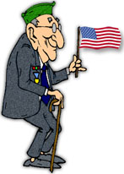

THE KEY POINTS
Lesson 7: How did living standards improve for the German workers?
Living Standards
Of course, the living standards of ordinary, working class Germans suffered after the First World War. However, they did slowly improve as the economy improved. Many of the improvements were paid for by the Weimar Government. This too, made the Weimar government and the Social Democrats more popular.
Work
After WW1, unemployment was high & led to other problems.
4% of the total workforce were unemployed.
By 1926 = 2 million unemployed.
This improved to 1928 = 1.3 million.
EMOTIONAL IMPACT: Employment offered pride and money especially after the effects of Versailles.
Housing
After WW1, there was a shortage of cheap homes. The government did not have the money to build them.
In 1925, the government supported the building of 37,000 new homes. There were 10,000 more homes in Berlin.
EMOTIONAL IMPACT: Seeing massive building projects made Germans believe the country was back up and running again.
Unemployment insurance
In 1927, for a small fee in their wage, workers could get paid for illness or unemployment until another job or returned to work.
EMOTIONAL IMPACT: This removed the stress of unemployment and the risk of returning to poverty.
Improvements for the German workers.
Working Hours and wages.
Workers benefitted from having a shorter number of hours to work WITH higher wages.
Wages increased 25% from 1925-1928.
EMOTIONAL IMPACT: Made German workers believe their government was helping – had more to spend.
Education
The number of students in higher education before WW1 was 70,000. By 1928 this increased to 110,000.
EMOTIONAL IMPACT: Young people had better confidence and hope for a future. More young people went to university.
Pensions for ex-soldiers
Pensions were now paid to 750,000 war veterans, 400,000 war widows (the wives) and 200,000 parents of dead soldiers.
EMOTIONAL IMPACT: This acted as a reward and gave soldiers back dignity. Made people believe that the government cared.
Why didn’t everyone experience these improvements?
Due to the hyperinflation, many middle class and rich lost their life’s savings and had to start again. They did not like having to live the same lifestyle as those they believed were ‘beneath them’ in society. They did not like what the Weimar government had done as they believed it supported the working class too much. Small business owners struggled the most and many had to close down. Farmers were not able to buy new machinery and so also suffered to make money.

Slide 8


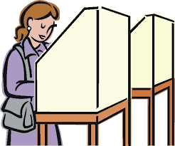


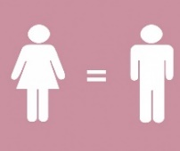
THE KEY POINTS
Lesson 8: How far did women’s lives change in the Weimar Republic.
‘New Women’
The Weimar Government strongly believed that in return for their hard work during the war, women should be able to have more equality in their life. Although some traditional Germans still disagreed and believed in the traditional role as a housewife and mother, many Germans agreed to more equality by the end of the 1920s. They were influenced by similar changes in America where women were often seen as independent women, with money to spend in the movies, magazines and advertising. These women were known as ‘New Women’ in Germany.
Political change
The Weimar Government led by the Social Democrats strongly believed women should be given the vote. By November 1918 women were allowed to vote for the first time AND stand to be elected.
90% of all women voted in Weimar elections.
By 1932, 112 women had
been elected into the Reichstag
10% were now female.
Negative attitudes towards new women
More traditional parts of society were worried about:
The birth rate was falling & Germany needed more women
as mothers to increase the population (especially after the
loss of land at Versailles)
The divorce rate was rising. Many traditional Germans believed that women needed to be loyal wives – NOT independent.
Leisure Opportunities
Who was more likely to be a ‘new woman’?
Young, unmarried and working women who lived in the cities were more likely to earn their own money and be able to decide how to spend their wage.
They were brought up with being independent in war time.
They bought more clothes, went out more, expressed their views more and behaved as they wished.
They had short hair, wore make-up, revealing clothes, smoked and drank alcohol.
For the first time they went out unaccompanied by a husband or father.
They were less interested in marriage and children.
They took advantage of the more ‘liberal’ attitude towards sex.
Work
Due to WW1, by 1918 75% of women were in work – often doing men’s jobs. This dropped after the war to only 35% of women which was the same as before the war.
The positives:
With more shops open during the economic recovery, women could have part-time work in shops and offices. Meaning they could have time with their family too.
There was progress in medicine where there were 2,500 more female doctors by 1932.
The negatives:
Even though the law said women should be treated as equals, often they were not as attitudes were slow to change:
Women were paid 30% lower than men for the same work.
Women were still expected to give up work once married – traditions remained.
Few women were able to enter high status jobs such as judges.
Many traditional attitudes remained with the older generations.
Equal Rights
The Weimar government also stated in law that:
Women had equal rights to men.
Marriage was an equal partnership.
Women should be able to enter any profession with the same rights as men.
HOWEVER, just because the law changed did not mean people’s attitudes changed. Many remained very traditional in their beliefs about the roles of women.
Advertising & Film
The growth of new women had a huge impact in advertising, magazines and film. This encouraged even more women to follow the same lifestyle as it became the ‘in thing’ to do. The media made the idea of a ‘new woman’ more accepted in German society.
Attitudes during the Weimar years.
Women felt liberated by new opportunities and freedoms BUT some women were scared by a different set of expectations.
Some men accepted the change BUT some men believed that the ‘new women’ would challenge the ‘dominant’ role of men and ‘take over’.
Women felt they contributed towards Germany’s economy after the war BUT Some men believed the women were simply taking their jobs.

Slide 9
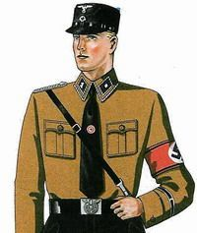
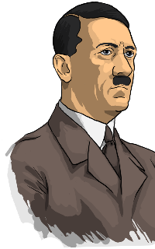



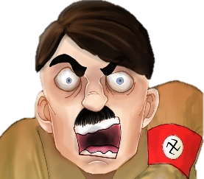
THE KEY POINTS
Lesson 10: Hitler’s Early Career and the development of the Nazi Party 1920-22
We now look at how Adolf Hitler was building up his power during the 1920s. Now you know what happened in Weimar Germany, let’s look at how Hitler manipulated the events of the time to gain more support. In 1918, he joined a political party with only 23 members. By 1923, Hitler had attracted 50,000.
Hitler’s Early years:
1889:
Born in Austria (not Germany)
1907:
Mother died of cancer when he was 18.
1912:
No success at school and failed to be placed at art academy.
1913:
He moved to Munich (Germany)
1914:
Joined the Germany army and fought in WW1. Was a brave soldier and received the Iron Cross twice for bravery.
1918:
The loss of the war & the terms of the Treaty of Versailles hit him hard. He knew then he wanted to make a change & go into politics.
1933:
Became Chancellor of Germany.
1918 | 1919 | 1920 | 1921 | 1922
After WW1, the army used him to spy on political parties to discover any threats. He regularly attended meetings of the German Workers’ Party (DAP). | Hitler joined the German Worker’s Party as he liked their ideas. They had little money & few members. Their leader was Anton Drexler. | Hitler became head of the DAP’s propaganda. Hitler and Drexler wrote their 25 Point Programme Hitler changes the party name to gain wider support – NSDAP (or Nazi Party) for short. The NSDAP starts to use its logo – the swastika & straight arm salute to make the party stand out. Bought their own newspaper ‘People’s Observer’. | Hitler contested with Drexler for the leadership of the NSDAP and won. Hitler created the SA ‘Stormtroopers’, otherwise known as the Brownshirts. | Hitler stopped the election of leaders to the NSDAP which left him as leader without challenge.
How did Adolf Hitler take over the German Workers’ Party in 3 years?
Brownshirts (SA)
Hitler kept control of his own party using the ‘Stormtroopers’ or SA led by Ernst Rohm. They were called brownshirts due to the brown uniform. They were ex-soldiers who were paid by the Nazis. They controlled crowds at meetings & removed opposition. Hitler selected the most loyal men to be his own personal bodyguards. They numbered over 800 by 1922 They made the NSDAP look strong and official.
Leadership Skills
He was so popular that he was elected the leader of the NSDAP in 1921. He became stronger by bringing in his own supporters to help him: Rudolf Hess: (his deputy), Hermann Goering: a wealthy and attractive pilot from WW1 Ernst Rohm: a tough army officer who was very popular with ex-soldiers, Julius Streicher: a publisher who helped publicise Nazi newspapers. His paper regularly sold 14,000 copies by 1927.
Twenty-Five Point Programme
Hitler took control of what the party aimed to do. He and Drexler wrote a list of 25 beliefs of the party called the 25 Point Programme. The main aims were. To destroy the Weimar Government. To re-gain land lost after WW1. To remove democracy. To make a bigger army. To ignore the Treaty of Versailles. To remove Jews and unite all Germans.
Strategy/Strong ideas.
Hitler had strong ideas. Set up a permanent office to work from. Better at raising money for the party. Changed the name of the party to include the terms ‘nationalist’ AND ‘socialist’ to broaden its appeal. It was called the National Socialist German Workers Party (NSDAP). Use the swastika as the party logo. Bought their own party newspaper.
Appeal
Hitler was a talented public speaker. Hitler rehearsed his speeches to make them passionate, powerful and attract attention. His hand gestures and eye contact were a key part of his appeal. Hitler knew the power of propaganda, especially photographs, posters and banners including the eye-catching logo of the swastika.

Slide 10

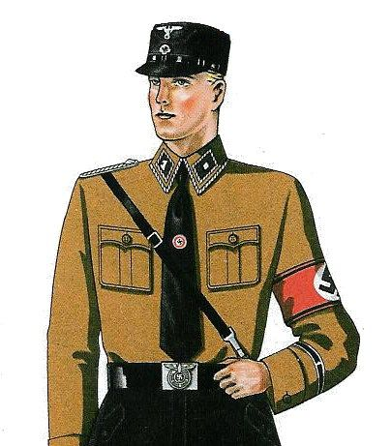
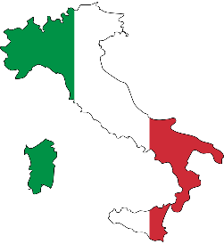

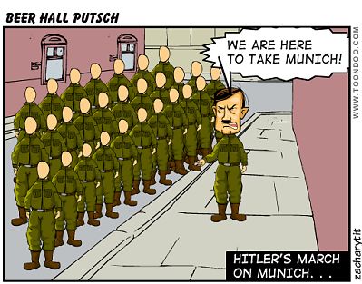
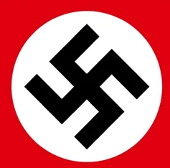
THE KEY POINTS
Lesson 11: Hitler’s failed attempt to overthrow the Weimar Government – The Munich Putsch: 1923
Hitler had gained full control of the Nazi Party. He had gained more supporters & members of the party. He appealed to a wide audience. Hitler believed he could gain power. He aimed to overthrow the Weimar Government in an event known as the Munich Putsch. Putsch = violent attempt to overthrow the government.
Causes of the Putsch
HATRED OF WEIMAR: Hitler believed the public would support his putsch as they hated the Weimar government. ACTIONS OF THE SA: Up to now, Hitler’s SA Brownshirts had not been stopped or punished in their attacks. INFLUENCES: Hitler was inspired by Mussolini in Italy who also ‘marched on Rome’ to gain power. OPPORTUNITY: It was 1923! There was hyperinflation, the French occupied the Ruhr, everyone saw how weak the Weimar Government really was. Hitler could use this opportunity to bring it down! MEMBERSHIP: The Nazi Party had 50,000 members - this proved he had support and strength.
The events of the Munich Putsch (1923)
When did it happen? - 8th and 9th November 1923 Hitler & a famous army general called Ludendorff stormed in to a government meeting with 600 of his Brownshirts (SA). He shot his gun in the air and told the leaders he was taking over. Hitler forced the 3 main leaders of the government to support him. The 3 main leaders at the meeting were: Von Kahr – The leader of the Bavarian Government. Von Seisser – The head of the Bavarian police. Von Lossow – The head of the German Army in Bavaria. Rohm (the SA leader) took over the local police & army HQ. However, 2 KEY MISTAKES were made by the Nazis: The 3 government leaders were released by mistake by Ludendorff and called for help. The army barracks (with all the local soldiers in) was NOT taken over and these troops were free to fight back against the Nazi putsch. The next morning, Hitler & Ludendorff, marched into the town centre to declare himself President of Germany. The Nazis even robbed a Jewish bank to pay 2,000 members of the public to help him. Hitler’s Munich Putsch FAILED…….WHY? The army and police from the barracks outnumbered Hitler & his SA. When fighting began, Hitler was knocked over & broke his arm. Many of the SA and local supporters ran away. Hitler ran away, hid in a friend’s house but was later found.
The negative consequences.
Hitler was defeated and humiliated. Hitler was put on trial for treason. He was found guilty and sent to prison for 5 years. (A short time for treason!) The NSDAP (Nazi Party) was banned.
The positive consequences
Hitler learned that he could not gain power by force/violence. Instead, he needed to get Germans to vote for him. The Nazis were only banned until 1925. Hitler used his trial to get more publicity. While in prison, Hitler wrote a book, Mein Kampf (My Struggle) which gave him a chance set out all of his ideas. This was later published and sold millions of copies. Hitler was released after only 9 months.
Notes:
Differentiated sheet.

Slide 11
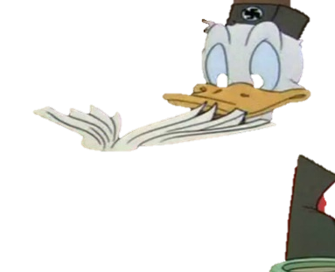
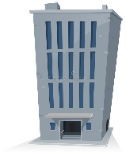

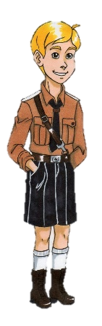

THE KEY POINTS
Lesson 12: The Nazi Party after Hitler’s Release from Prison 1924 – 28.
Hitler was released in 1924 (only 8 months in prison). He realised he needed to gain control in a more peaceful and legal way – by getting the German people to vote for him. He used this time to become even stronger and organise the Nazi Party. However, support for the Nazi Party declined. Why was this?
The importance of Mein Kampf (My Struggle)
What is Mein Kampf? | Why is Mein Kampf useful evidence? | Hitler’s racial ideas: | Hitler’s Nationalist ideas: | Hitler’s socialist ideas: | How Germany should be ruled: | Hitler’s idea about German traditions:
Hitler had time to write his ideas while in prison. They were later published in his book, Mein Kampf (My Struggle). | Mein Kampf is a key source of information about Hitler’s beliefs as it tells us about his attitude, his feelings and his ideas at the time. | Hitler was not alone in his anti-Semitic views. The German race (called the Aryan race) was the strongest. Hitler believed that Aryan blood was ‘pure’. The Jews and communists have caused all of Germany’s problems and must be destroyed. | To make Germany stronger by removing the Versailles Treaty terms. Wanting more ‘living space’ or ‘Lebensraum’ for the German people to live and work in. | To use money from industry and powerful businesses to help German workers. | Hitler believed in ‘totalitarianism’. This is the idea that a country should have one strong leader who has full control with no democracy. | He believed in a strong traditional family with clear roles for men & women. He wanted to bringing back traditional German culture such as art, theatre and music.
How Hitler re-organised the Nazi Party
NEW AIM:
Hitler had learned he needed to be voted into power rather than use force.
FINANCE:
Hitler persuaded rich business and industry owners to give the party money.
ITS STRUCTURE:
The Nazi Party was run like a small country, with Hitler as leader in full control. The official HQ based in Munich.
YOUTH &WOMEN:
The Nazi Party created a section for children called the Hitler Youth and a female section called the German Women’s Order.
NAZI LEADERS IN EVERY REGION
Hitler made sure that the Nazi Party had a strong leader in all 35 regions of Germany.
REPLACING THE SA WITH THE SS:
Hitler believed the SA were disloyal, too violent.
He created a NEW group called the SS ‘Protection Squad’.
He replaced Rohm with Heinrich Himmler as leader of the SS.
They had menacing, fearful smart black uniform.
Hitler shows full control at the Bemberg Conference in 1926
After all these changes, Hitler gathered his leaders together. He made sure everybody was aware of the aims, beliefs and expectations. Anyone who went against his wishes would be thrown out of the party (or worse). For example, in 1934, Gregor Strasser, who was once a regional leader in the north, was murdered. Hitler showed the Nazis he could do what he wanted.
From 1923, Stresemann had agreed the Locarno Pact, Kellog Briand Pact, a membership of the League of Nations. This gave Germany more status and power in the world. Germans felt less need to support parties like the Nazis.
So why did the Nazi Party not gain much more support?
From 1923, Stresemann’s actions improved the economy with the Rentenmark, Dawes Plan, Young Plan and higher employment. Fewer Germans were interested in the extreme parties like the Nazi Party
In 1925, Paul von Hindenburg became president. He was an ex Field Marshall & war hero. He was highly respected by many Germans & more Germans respected the Weimar Republic. This took support from the Nazis.
A better economy = fewer Nazi votes.
Overall, fewer working class Germans who now had jobs and a better life, wanted to vote for the Nazi Party as they were happier with their life.

Slide 12
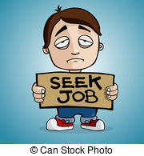
THE KEY POINTS
Lesson 13: The Wall Street Crash, depression and increase in Nazi Support, 1929 - 1932
By 1929, the Weimar Republic gained more support and fewer Germans felt the need to support more extreme political parties like the Nazis. However, in October 1929, one events in America changed all this to cause a world wide crisis – The Wall Street Crash! This caused an economic depression across the world and became good news for Hitler and the support for his Nazi Party.
What was the Wall Street Crash?
In October 1929, the US economy collapsed. This was known as the Wall Street Crash.
Wall Street is in New York and is where all the business in America Is run from.
The crash led to an economic depression around the world and this hit Germany HARD!
Date | Unemployment
1929 | 1.3 million
1931 | 4.3 million
1932 | 5.1 million
1933 | 6.1 million
Why did this result in more support for the Nazi Party?
The appeal of Hitler and the image of the Nazi Party
Hitler became popular with those who hated the Weimar government and even promised to scrap the Versailles Treaty. He used new technology in his propaganda campaigns, brightly coloured posters & the radio to appeal to the young.
The growing appeal of the SA
Their smart uniforms made the SA look wealthy, organised, aggressive and powerful. They appeared stronger than the communists. By 1930, the SA had 400,000 storm troopers. They easily disrupted elections by tearing down Communist Party posters.
The German Economy
America wanted the money it had loaned to Germany in the Dawes Plan and Young Plan returned.
Germans panicked and rushed to the banks to take out their cash!
German banks literally ran out of money.
How each group was affected by the crash.
WHY each group then supported the Nazis.
UNEMPLOYED: 1.3 MILLION Germans were already unemployed. The government could not afford to give them unemployment benefit. Crime up 25% in cities.
Hitler promised ‘bread and work’ for all. He also promised ‘law and order’ in the streets to tackle crime caused by poverty. He promised action to help Germany.
WORKING CLASS: 40% of factory workers lost their job. Those that had a job had wages cut by 70%
The term ‘socialist’ in the NSDAP title help gain some support. Also the promise of ‘bread and work’.
How it led to unemployment
LOAN REPAYMENTS
Industries were told to pay back the money lent to them by the banks. They could not then pay all their workers and so jobs were lost.
TRADE WITH OTHER COUNTRIES
Other countries could not trade as much and buy German goods as they too were suffering from the depression. German factories lost even more money so could not pay their workers.
UNEPLOYMENT LED TO MORE UNEMPLOYMENT
The unemployed Germans could not afford to buy goods and so industries lost even more money – and more workers had to lose their jobs.
MIDDLE CLASS: They lost savings, jobs, land and business. They felt like they had lost their status and did not like living like the working class.
They saw Hitler as strong. He could return their wealth. They hated communism as they wanted to be richer than the poor not equal to them. They liked traditional values promised by Hitler not the drinking and sexual openness.
Why did the Weimar Government not help?
The Chancellor Heinrich Bruning had to increase taxes.
He had to use 44 Emergency Decrees just to get things done.
The Government could not make any decisions and argued about what was best.
All this chaos made Germany look weak.
BUSINESS OWNERS AND THE RICH: They lost sales, had to pay even higher taxes, lost profit and also had to re-pay loans given to them by the German government.
Hitler promised bosses that the NAZIS Party was the only party who could protect them from communism. Hitler promised to increase factory production.
THE YOUNG: Were hit the hardest with unemployment. 50% of Germans aged 16-30 lost jobs. 60& of university graduates lost jobs. They saw no hope or future.
The Nazis were exciting, new, colourful and used modern technology. Hitler was exciting with his speeches which inspired passion and hope for the future of the youth.
WOMEN: Found it hard to look after a family with less money and unemployed husbands. Difficult to feed a family and were the first to lose a job if they had one.
Hitler promised women that a vote for the Nazi Party was a vote for their family. The Nazis made traditional family life look attractive and beneficial to Germany.
FARMERS: Lost sales, lost savings, could not pay rent. Afraid of a communist government who would take land.
The Nazis gained 60% of farmer votes in some rural areas.

Slide 13
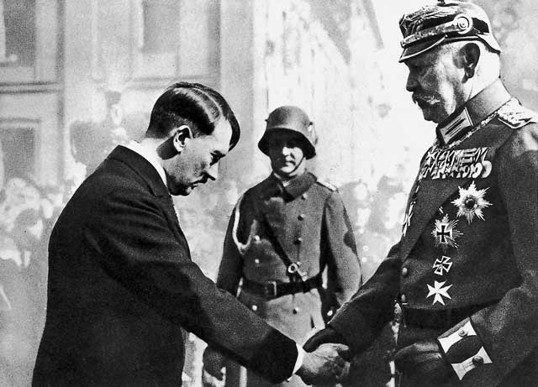
THE KEY POINTS
Lesson 14: How did Hitler become Chancellor by January 1933?
In 1929, the Nazis were a small party who only had 18% of the votes in Germany. A new Chancellor, named Chancellor Bruning struggled to keep control and had to use 44 Emergency Decrees (Laws that did not need to voted on) just to get things done. Not only this, but the Economic Depression hit Germany hard, with over 6 million unemployed. So how, in all this disaster did Hitler become the Chancellor of Germany by January 1933?
March 1932
April 1932
May 1932
July 1932
November 1932
December 1932
January 1933
A Presidential Election
Another Presidential Election
Chancellor Bruning resigns
Meet Von Schleicher and Von Papen
Hitler will support Von Papen but only if.
General Von Papen becomes Chancellor.
Nazi Election Success. Hitler wants to be Chancellor.
Von Papen sacked by Hindenburg.
Von Schleicher made President
Hitler made Chancellor!
People needed to vote if they wanted President Hindenburg as President again. He was old and frail but still had respect. He needed over 50% of the vote to win. However, look how close this was - RESULT: Hindenburg - 49.6% Hitler (NSDAP) - 30% and Thalmann (Communist) 14%
As no candidate gained over 50% of the vote, there had to be another election. Hitler used aircraft to fly him to many towns in Germany to gain support. The SA continued to break up Communist meetings. RESULT: Hindenburg : 53% Hitler (NSDAP): 36% and Thalmann: 14%. HINDENBURG WIN
Chancellor Bruning was still in charge but he made 2 very poor decisions that led to him to resign. HE RESIGNED BEFORE HINDEBURG SACKED HIM.
He banned the Nazi SA and SS in an attempt to control the Nazis. This angered Hitler and made him more determined to gain power.
2. He wanted to buy up land from rich landowners to give to the poor. This angered Hindeburg who was a huge landowner and annoyed the rich.
Next, a high ranking army official called General Von Schelicher believed the new Chancellor should be another General named Von Papen - also a friend of Hindenburg! However, Von Papen could only be Chancellor if he gained enough support from Hitler and the Nazi Party. He needed Hitler!
Hitler agreed to give his support to Von Papen AS LONG AS the ban on the SA was ended. This worked. In return for Hitler’s help, the Nazi Party were now officially part of the German parliament and could gain more power and influence. 30th May, Von Papen becomes Chancellor
Von Schleicher shows off! He thinks he has manipulated (taken advantage of) the Nazis who are ‘merely children who had to be led by the hand’.
There is another election. Campaigning is violent between the Nazis and Communists with 100 people killed and 7,000 injured. The Nazis won 38% of all votes which makes them the most popular party in Germany. Hitler asks Hindenburg to sack Von Papen and make him Chancellor instead! Very confident!
Von Papen is not doing well as Chancellor and so Hindenburg sacks him. However, Hindenburg dislikes Hitler so much he refuses to give him the position of Chancellor. Imagine how this makes Hitler feel!
Hindenburg appoints his old friend Von Schleicher Chancellor instead. Schleicher even has the confidence to say that ‘Hitler is no longer a problem’.
However, Von Schleicher struggles too, with little support and no success with the economy.
As a way to seek revenge for his own sacking, Von Papen suggests that Hindenburg makes Hitler the Chancellor. He believed Hitler would be a stronger leader but Hindenburg could still control him.
Von Papen said he had ‘Hitler in his pocket’ and ‘within two months, we will have pushed Hitler so far into a corner he will squeak’.
President Hindenburg agrees to this plan and Hitler was appointed Chancellor on 30th January 1933.
Notes:
Differentiated

Slide 14
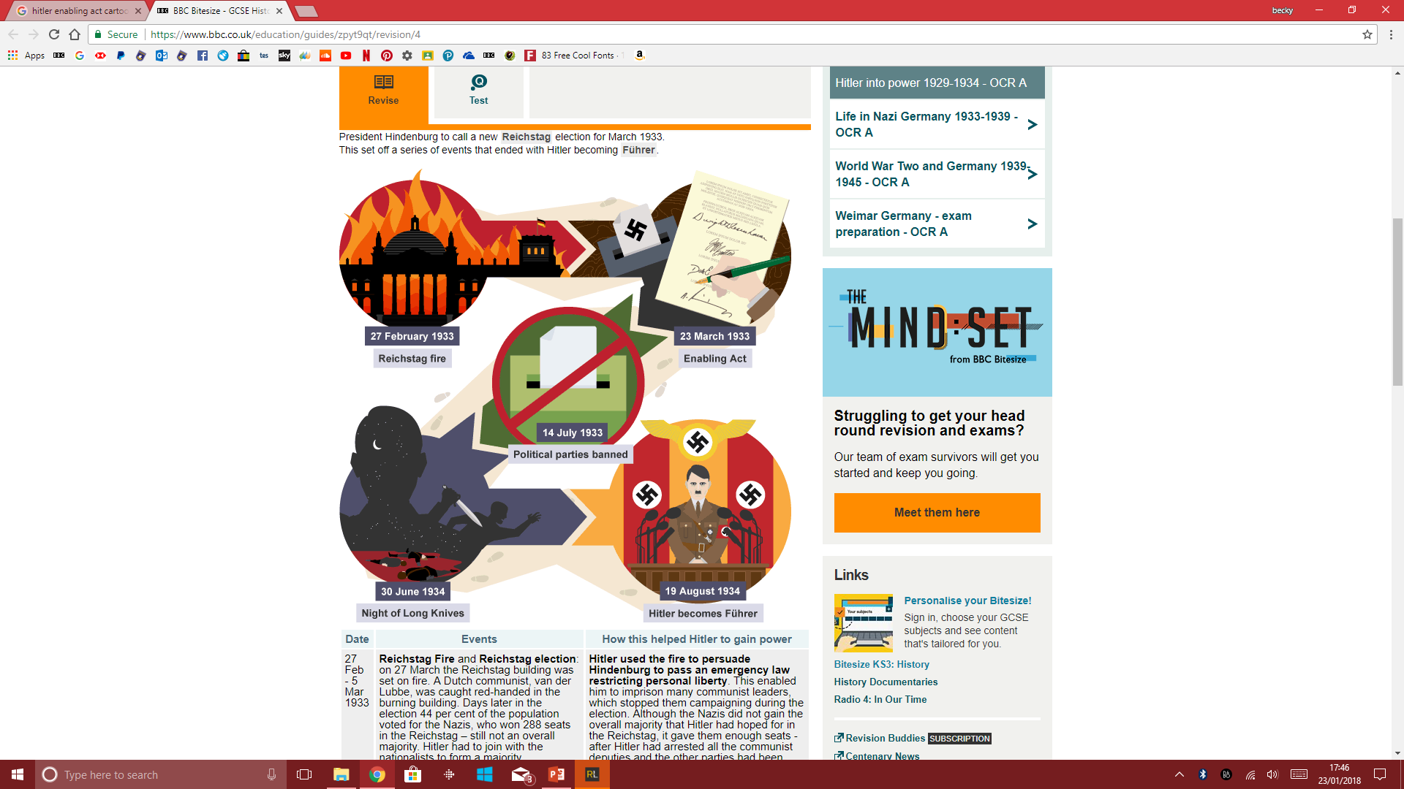
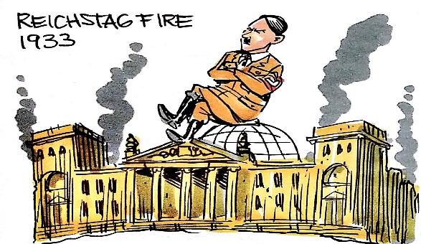
THE KEY POINTS
Lesson 15: How did Hitler go from Chancellor to Dictator: 1933 - 1934?
In January 1930, Hitler was appointed Chancellor. Even though Hitler was Chancellor, he still had limited power: The Weimar Constitution (set of rules of the government) restricted what a Chancellor could do on their own. President Hindenburg still had more power than Hitler. These are the 5 events that led to Hitler’s dictatorship of Germany in a ‘One Party State’.
EVENT 1: The Reichstag Fire, Berlin, 27th Feb. 1933
The German Parliament building was set on fire. A Communist was caught, blamed and executed.
What did Hitler do about the fire?
Hitler used this fire to blame all communists of plotting against Germany. 4,000 communists were arrested that night.
What did Hitler ask Hindenburg to do?
He persuaded Hindenburg to declare a STATE OF NATIONAL EMERGENCY - to give Hitler the right to make decisions on his own. Hitler also wanted another election.
What did Hitler do with his new emergency power?
Hitler decided to arrest communists and put them in prison. He also banned communist newspapers.
He told the German police to ignored the violence of the SA against the communists despite 70 deaths during the election.
Hitler persuaded rich industry bosses to give him money to stop communism. He made 3 million marks in just one night.
What was the election result and why was this significant?
The Nazis gained even more power. He banned the Communist Party from being part of the Reichstag.
He had enough Nazi politicians to vote in any law he wanted.
Importantly,
Hitler achieved
this this legally.
EVENT 2: The Enabling Act
March 1933
Hitler wanted a law called the Enabling Act. This would allow him to make any law WITHOUT the need of a vote to agree it for 4 years.
Why did other politicians allow the law?
Other politicians and parties did not oppose it because…
The Nazis already had a two-thirds majority to vote for it.
The Communist Party were banned so could not vote.
The SA used their violence to intimidate politicians to agree.
The end of democracy in Germany.
The Enabling Act was agreed. Hitler could make any law he wanted without a vote.
Importantly, Hitler again did this legally.
EVENT 3: Bans other political parties July 1933
Hitler used the Enabling Act to ban other political parties. Hitler made Germany a ‘one party state’.
The Nazis took over the regional governments.
Trade Unions were banned and their leaders arrested.
The SA attacked the headquarters of other political parties.
Hitler officially banned all political parties in Germany apart from the NSDAP/Nazi Party.
Hitler again
did this
legally.
EVENT 4: The Night of the Long Knives June 1934
Hitler believed the leader of the SA, Ernst Rohm was a threat to his power and wanted to take over as leader of the Nazi Party.
Why did Hitler think this?
Rohm had openly opposed Hitler’s ideas.
Leader of the SS, Heinrich Himmler was jealous of the SA & wanted the SS to be powerful.
So what did Hitler do?
Hitler arranged to meet Rohm and 100 other SA leaders at a hotel. Here they were arrested and put in prison.
Over a 4 days, 400 SA members were shot.
A pistol had been left in Rohm’s cell with the idea of him committing suicide. Rohm refused and two soldiers came in to shoot him anyway.
How did Hitler get away with this?
The Nazis publically announced that they had found out about a ‘secret plan’ to start a revolution by the SA.
People were told the killings had to take place to protect Germany.
The propaganda used
throughout this time,
made every action Hitler
made, seem like the right
one for Germany.
EVENT 5: The Death of President Hindenburg August 1934
President Hindenburg died. Hitler declared himself ‘Fuhrer’ (Leader) of Germany.
He gave himself all the power of the President.
He forced an oath of loyalty from every soldier in the army.
How did Hitler do this legally?
With no other option, 90% of
Germans agreed with a huge
amount of propaganda.
Hitler again
did this legally.
Notes:
Differentiated version,

Slide 15
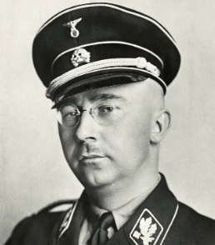
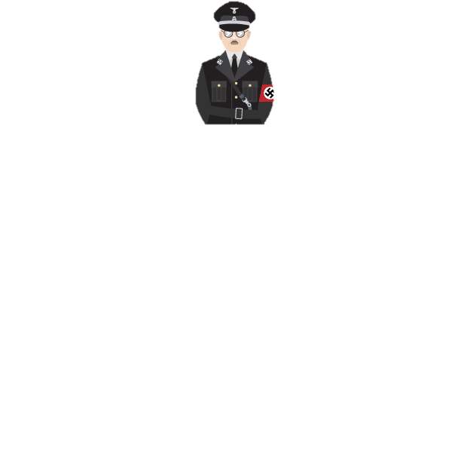
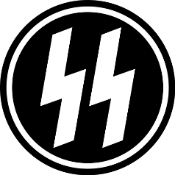
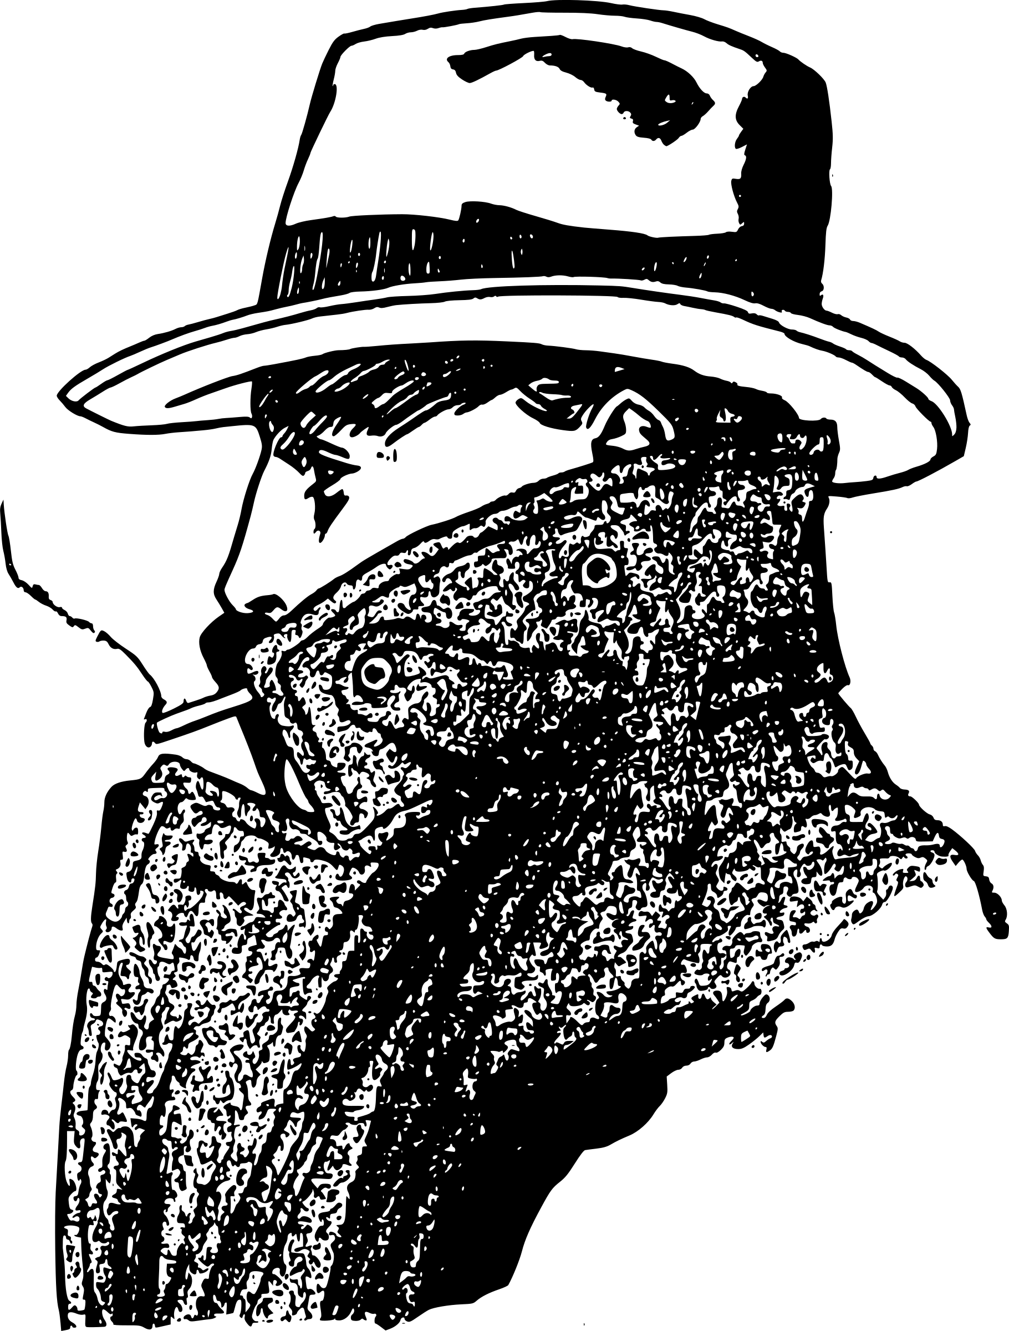
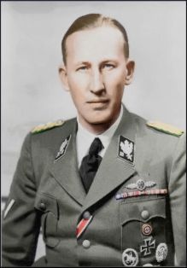
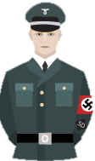
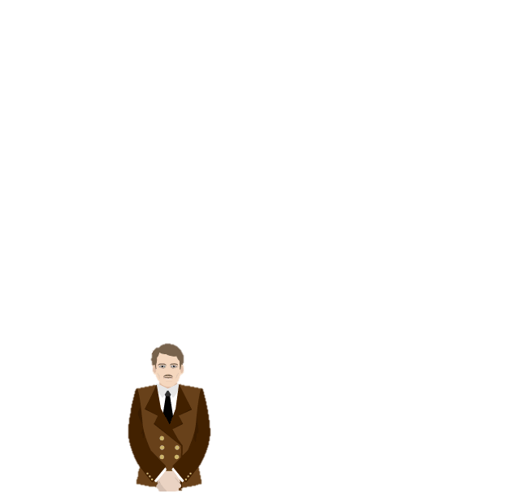
THE KEY POINTS
Lesson 16: Nazi Control of Germany: The creation of the ‘Police State’.
After 1933, Germany was controlled by a ‘Police State’. Anyone who said or did anything against the Nazis was punished. The fear this created was another way of keeping control – a deterrent to any form of opposition. The Nazi Party ran the police. The 3 main police units were the SS, SD and Gestapo. The Nazis also created Concentration Camps & controlled courts & judges.
The SS (Protection Squad)
Created: 1925
Leader: Heinrich Himmler
Purpose: An organisation which controlled all other police units.
The SS and SD
In the 1930s, it totalled over 240,000 men. Himmler believed his men could use any methods they wanted to ‘protect the Fuhrer’.
Himmler was very strict about who could joint the SS. They had to be totally loyal to the Nazi Party and Hitler.
Himmler only wanted ‘pure Aryan’ men who were expected to marry racially pure women & produce pure Aryan children. Officers had to produce birth certificates and family History before they could join.
Originally set up as elite bodyguards for Hitler to rival the SA.
The SS had intimidating black uniforms from 1932 to make them stand out against the SA ‘Brownshirts’.
Hitler then increased the responsibility of the SS to take control of all police organisations in the 1930s.
It was even the SS who arrested members of the SA during the Night of the Long Knives in 1934.
The SD (Security Service)
Created: 1931
Leader: Reinhard Heydrich
Purpose: Took action against all known opponents of the Nazis.
The SD were set up by Himmler but then given to Heydrich to lead. It kept a well organised card index of anyone suspected of opposing the Nazis. They constantly monitored opponents. They were under the control of the SS.
The Nazi Peoples’ Courts & Nazi Judges
The Gestapo
All judges had to be Nazi Party members. If they refused, they would lose their job. Judges were therefore biased in favour of the Nazis.
The beliefs of the Nazis came first, even if this meant going against some existing laws.
Hitler abolished juries (members of the public who decided on the verdict). It was the judge alone who decided this and the punishment.
Hitler set up a People’s Court. Judges were specially selected & trials would take place secretly.
Hitler sometimes got involved in some cases & decided the punishment himself.
Citizens had no right to appeal against the verdict of the People’s Court.
Between 1934-1939, 534 people were given the death sentence.
The Gestapo (Secret Police)
Created: 1933
Leader: Reinhard Heydrich
Purpose: Non uniformed secret police to spread fear.
A non-uniformed secret police.
They Identified anyone who criticised or openly opposed the Nazi Party.
They spied on people, tapped phones, opened mail & used networks of informers.
They were given permission to use torture to gain confessions.
EXAMPLE = Roland Freisler was a People’s Court Judge. 90% of his cases resulted in a death penalty
Their main weapon was fear because Germans could not tell them apart from ordinary Germans.
Prisoners could be imprisoned without a trial and family members often received letters saying they had died in prison. Many were sent to Concentration Camps.
Prisoners were sometimes released from camps on purpose to spread the fear of the camps to family & friends.
The Concentration Camps
Concentration Camps opened in 1933. They were run by the SA and the SS. Even one even for women.
One well know camp opened in 1933 was Dachau.
Camps were located in isolated areas, away from public knowledge.
By 1939 there were 150,000 people under ‘protective arrest’. They had not officially committed any crimes but they were locked up for doing or saying things the Nazis did not approve.
Types of prisoners in the Concentration Camps:
‘Undesirables’ such as prostitutes & homosexuals.
Political prisoners who were seen as a threat to the Nazis. E.g. teachers, communists, journalists, writers.
Minority groups such as Jews and Poles
Example: Carl Von Ossietzky. A German journalist who was willing to speak up against the Nazis. He was arrested in 1933. The next time he was seen by 1935 he was described as ‘ a trembling, pale creature, one eye swollen, teeth knocked out, dragging a broken body’. He died in prison in 1938.
There were only 30,000 Gestapo to police about 80 million people but the German public were never aware of this and believed they were everywhere.
For example, there were only 50 Gestapo officers for one key city Hamburg.
Even children were encouraged by their teachers and Hitler Youth leaders to inform on their parents – even if they made an anti Hitler Joke.
In 1939 alone, 160,000 people were arrested

Slide 16
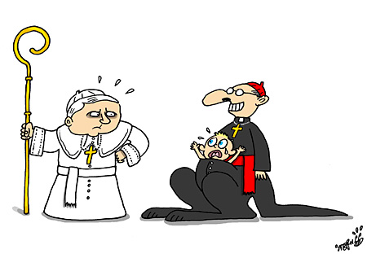
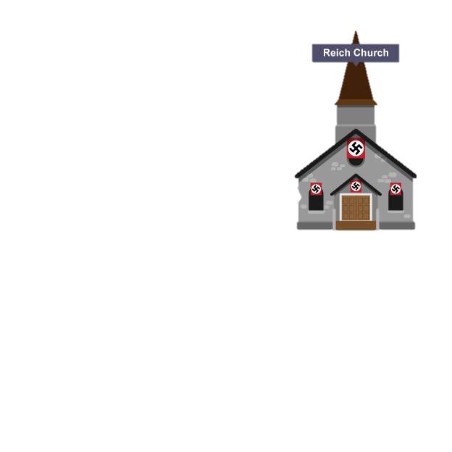
THE KEY POINTS
Lesson 17: Nazi Control of Religion 1933-39
Why was the religion a tricky problem for the Nazis?
Hitler had to be very careful about the relationship he had with key ministers and pastors so he could both gain their support but also ensure they followed Nazi beliefs.
POWER & INFLUENCE OF RELIGION
Influential church ministers and pastors could easily persuade& influence the German people against the Nazis.
OPPOSITE BELIEFS
The Church and the Nazis had two opposing set of beliefs. The Nazis wanted power, survival of the fittest and conflict; the Church wanted peace between men and tolerance between religions.
A THREAT TO TOTALITARIAN CONTROL
Hitler could not have full, totalitarian control of Germany if the Church also influenced the views of ordinary Germans.
EDUCATION AND YOUTH
The Church still played a huge part in people’s lives including their children’s education. Catholic schools were popular and allowed to teach their faith to children. Away from government control.
ATTRACTING OPPOSITION FROM ABROAD
If the Nazis challenged religion too strongly, it might attract opposition from other countries, especially if Hitler opposed the beliefs of the Pope. He had to keep Protestants and Catholics on side.
Why did the Catholic and Protestant Church support and trust the Nazi government so much – especially in 1933?
Both Churches believed that the Nazi Party were the only regime who would protect them from ‘anti-Christian Communists’. In Communist Russia, churches had been destroyed with priests arrested and shot. The Church worked with the Nazis as they feared Communism
The Nazi Party set out to control the power and influence of the Christian Church in Germany. At first, Hitler tried to reassure the Church that it would benefit them from working with a Nazi government. In the early years, there was some co-operation between them. However, this did not last long and by 1937, the Christian Churches had little power to oppose the Nazis as they had been ‘Nazified’ and their power taken.
The Nazi Party and the Catholic Church
1/3 of Germans were Catholic.
The two main issues they disagreed about were:
For Nazis, their leader was Hitler but for Catholics their leader was the Pope in Rome.
Catholics had their own faith schools which taught a different set of beliefs to the Nazi run education system.
The Concordat 1933
This was an agreement between Hitler & Pope/Catholic Church.
Hitler agreed to allow Catholics the right to worship freely without changes from the Nazi Party & not interfere with Catholic schools.
The Pope agreed that the Catholic Church would not get involved in politics and its German bishops would swear an oath of loyalty to the Nazi regime. He would not publically criticise the actions of the Nazis.
However, Hitler broke this agreement throughout the 1930s:
Priests were bullied & arrested – many ended up in con. camps.
Catholic schools were brought in line with Nazi schools anyway.
Catholic youth groups such as the Catholic Youth were simply banned and children by law had to join the Hitler Youth after 1936.
Only in 1937, Pope Pius realised the Concordat was worthless & publicly criticised the Nazis in a speech known as ‘With Burning Anxiety’. In response, Hitler had over 400 Catholic priests arrested.
The Nazi Party and the Protestant Church
2/3 of Germans were Protestant. Germany was in fact a founding country of the Protestant faith and it had a strong traditional following. At first, many ordinary Germans still felt more loyal to their traditional church rather than the Nazi approved one.
The Reich Church 1936
Many Protestant Churches wanted to work with the Nazis and they agreed with Hitler to form the ‘Reich Church’. Its leader was Ludwig Muller who Hitler made the Reich Bishop of Germany. This was a good way to get the church on side.
It was agreed that:
Protestant leaders were allowed to continue with their church services.
Protestant pastors even allowed the Nazi Swastika in their churches along with images of Hitler.
No Jew could change their beliefs and come to the Reich Church.
Some Protestants, such as Martin Niemoller spoke out against the Nazis. In 1933, he set up the Pastor’s Emergency League to call for action against the Nazis. But in 1937 he was sent to a concentration camp.
Find out more! Hitler was very keen to promote a more pagan church called the German Faith Movement. This was a non-Christian movement based on the worship of the sun and sometimes linked with the occult.

Slide 17




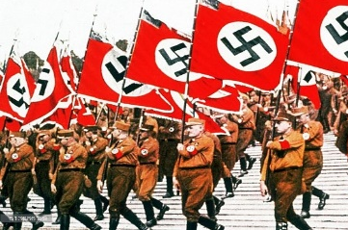


THE KEY POINTS
Lesson 18: Propaganda & Censorship – Controlling and influencing attitudes.
If the Nazi regime wanted totalitarianism (total control) they had to make sure they controlled what the German public believed in and their attitudes. If Hitler wanted to ‘Nazify’ the German people, he had to ‘Nazify’ everything they watched, heard or did. The big Nazi idea was to ‘synchronise’ (bring together) all parts of German society, organisations and government together to believe in the same Nazi ideas. A term used to describe this is ‘Gleichschaltung’.
Newspapers (the press)
The Nazi Party owned their own newspapers and took over the press.
Any information published in a newspaper had to be approved by Goebbels's Ministry of Propaganda. As early as 1933, Jewish editors and journalists would be sacked.
Anti-Nazi newspapers would be attacked and then closed down. E.g., 1,600 newspapers were closed down in 1935.
The press were often censored and told what they could NOT publish.
Key individual: Joseph Goebbels (Minister for Propaganda)
Propaganda: Persuading a person to believe or do something.
Censorship: Stopping a person seeing something so they only believe in one idea and don’t get to see other opinions.
Sport
Goebbels was keen to use sport as a way of influencing beliefs and support for the Nazi Party as well as a way to unite Germany.
Sport was ‘Nazified’.
Sports stadiums being covered with Nazi symbols.
Goebbels made sure that all teams used the straight arm salute during the German national anthem.
Any victory in sport was linked to the victory of the Nazi Party.
Any German win made the Aryan race seem real.
Radio and loud speakers.
All radio stations were put under Nazi control.
Hitler & leading Nazis often made speeches on the radio.
Cheap radios were sold to the German public.
70% of German homes had a radio.
Every workplace would have a radio.
Loud speakers would be placed in the streets.
All radios were designed to only have a short range – this stopped Germans from listening to foreign radio stations.
Listening to the BBC could result in the death penalty.
The radio could broadcast Nazi events, speeches, interviews, music, parades, rallies – anything that supported the Nazi regime.
Advertising techniques.
The Ministry for Propaganda used modern advertising techniques to sell the cheap radios, advertise Nazi events or Hitler’s speeches.
New techniques such as bold colours, photomontage and propaganda techniques used during the war.
1936 Berlin Olympics
Germany in a good light when the Olympic Games were held in Berlin.
Germany built the largest stadium in the world then covered it with swastika flags and banners.
The Olympic Games was so well organised it showed Germany’s pride and hard work.
Germany won more medals than any other country (33) – this was linked to the success of the Nazi Party.
The games were filmed by Leni Riefenstahl – these films were released for propaganda.
Mass Nazi Rallies
Goebbels made the parades bigger and more frequent after 1933.
The largest rally was held every year at Nuremberg.
They showed German strength, unity and the power of the Nazi Party.
E.g, a giant eagle with 100ft wing span was used in the 1934 rally.
They would include thousands of swastika flags, lights, banners and use the loudest speaker systems.
Up to 200,000 supporters could attend in the massive stadiums.
The rallies had a huge emotional impact on the crowd.
Cinema and newsreels
Positive films about life inside Nazi Germany were created and used as propaganda. E.g. The Triumph of the Will (1935) which followed the Nazi Party rallies in 1934
More than 250 million Germans visited the cinema in 1933 – so, film and newsreels were a powerful propaganda method.
Before every film, a 45 minute newsreel about the achievements of the Nazi regime would be shown.
All films had to be approval by the Ministry of Propaganda.
Notes:
Differentited if needed.

Slide 18






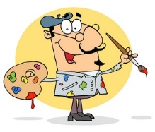
THE KEY POINTS
Lesson 19: Propaganda & Censorship – The Arts and Culture.
To really influence every aspect of German life, the Nazis went as far as censoring the arts. The arts is a term which includes: literature, film, music, art, painting and even architecture. Those that the Nazi Party believed went against their beliefs were stopped from showing work and many moved away from Germany as they felt their own life was at risk.
The Reich Chamber of Culture.
This was set up in September 1933.
Joseph Goebbels had overall responsibility for it.
He had to ensure that any part of culture was in line with Nazi beliefs.
Putting every aspect of life in line or synchronising it with Nazi beliefs was called Gleichschaltung.
It banned any aspect of culture that disagreed with Nazis beliefs.
What was banned?
Anything linked with the Jews.
Anything linked with being black or ‘negro’.
Anything ‘modern’ – the Nazis wanted tradition.
Anything that was linked with the Weimar era.
Anything that was not approved by the Nazi Chamber of Culture or Goebbels.
What was promoted?
Anything promoting a strong Germany.
Anything which promoted German families and traditional roles of men and women.
Anything which promoted the loyalty, discipline and self-sacrifice of an individual for their country.
Art in Nazi Germany
Remember that Hitler had been an artist and so he had very strict rules about what types of art should be allowed.
All artists had to become members of the Reich Chamber for Visual Arts or be banned from showing their art and stopped from teaching. 42,000 people were accepted as members.
The Gestapo made visits to artists’ studios to check they were doing the art they had promised.
In 1936, 12,000 paintings were removed from art galleries by the Nazis. This included work by famous artists such as Picasso and Van Gogh. Some were destroyed/burned.
Art which was NOT liked by the Nazis was called ‘degenerate’. A famous art exhibition was opened in 1937 called the ‘Degenerate Art Exhibition’. Hitler wanted to ‘shame’ the artists involved. In fact it was more popular than the Nazi approved exhibition that opened up at the same time.
What the Nazis did like:
Traditional landscape art, classical art, military art, examples of racial purity.
What type of art was banned as ‘degenerate’?
Artists such as Otto Dix and George Grosz from the Weimar period, war in a negative light, expressionism, ‘ethnic’ arts, abstract art, Jewish or Communist.
Architecture in Nazi Germany
The Nazis disliked anything ‘modern’ or ‘futuristic’ like had been the fashion of the Weimar period.
New buildings had to make Germany look strong and powerful
Albert Speer became the most famous and most liked architect of Hitler.
Albert Speer built major projects such as parade grounds for the Nuremberg Rallies and new offices for the Nazis in Berlin.
He built them as tall as possible as size meant strength.
They looked like great Roman buildings so they looked grand and historic.
Buildings included huge Nazi flags and symbols so every aspect was linked to the Nazis.
Literature in Nazi Germany
Books had to be approved by the Chamber of Culture before being published.
Books had to promote Nazi beliefs or banned.
2,500 writers were banned.
Millions of books were taken from schools, libraries and universities and burned publically.
In 1933, students in Berlin burned 20,000 books by Jews, Communists or anti-Nazi authors, even some by Albert Einstein.
Film in Nazi Germany
Every film would have a 45 minute newsreel showing Nazi propaganda before it.
All films had to be approved by the Nazis.
The Nazi Party itself made around 1,300 films.
Many were for entertainment but with underlying political propaganda messages.
Goebbels even had a propaganda cartoon created, based on the style of Mickey Mouse called ‘Hansi’. Hansi often had to fight the ‘villainous black crows’ who had stereotypical Jewish features.
Music in Nazi Germany
Jazz and swing music was banned as it linked to black people who the Nazis believed were inferior. It was also linked to the modern Weimar age and the open sexual freedom of women in Germany, which the Nazi frowned upon.
Wagner was a favourite of Hitler as he was German and his music sounded heroic and powerful.
Beethoven, Bach & traditional German folk music were liked.

Slide 19

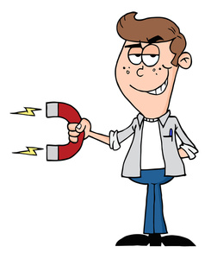
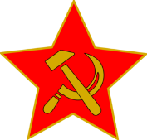



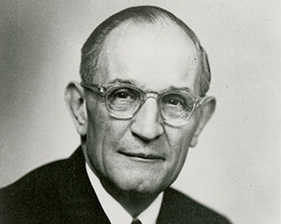
THE KEY POINTS
Lesson 20: Opposition and Resistance towards the Nazi Regime.
Trade Unions & Communists The Communist Party encouraged workers to oppose the Nazis. 150,000 communists were arrested and taken to concentration camps. 30,000 were executed. The Red Orchestra were communists who passed information about Nazi war tactics to Russia. Their leaders were found & killed.
Military & Army General Beck was high ranking in the German Army. He led plots to kill Hitler in 1943/4 & tried to get Hitler arrested in 1938. In 1944, a group of army officers called the Kreisau Circle tried to bomb Hitler. The bomb was planted by Colonel Stauffenberg. It exploded, but Hitler survived. In retaliation, 5,000 people were executed by the Nazis.
Political Parties – Social Democratic Party The SPD printed opposition newspapers. They tried to get support from other countries. The organisers were arrested and sent to concentration camps. A military section of the SDP, destroyed railway lines and acted as spies.
German Workers. Workers stayed off sick or worked slowly. E.g. on autobahn projects & factories. Workers deliberately broke machinery in ammunition factories. George Elser, a worker and Communist planted a bomb in a Beer Hall where Hitler was due to speak in 1939. Hitler did not attend & the bomb exploded exactly when he was meant to be talking.
OPPOSITION FROM THE CHRISTIAN CHURCH
PROTESTANT OPPOSITION |  | CATHOLIC OPPOSITION
The most well known Protestant to oppose the Nazis was Martin Niemoller. He helped set up the Pastors’ Emergency League in 1933 to decide how to challenge the Nazis. They decided to create The Confessing Church in 1934. This would go against the rules set out by the Nazis. It aimed to keep LOCAL Protestant Church services separate from the Nazi Reich Church. 6,000 pastors joined the Confessing Church while only 2,000 pastors joined the Nazi Reich Church. The Confessing Church spoke out about against the Nazis in church. They got a lot of applause for this from the congregation (audience). This was itself a form of opposition against the Nazis. |  | There was less opposition from the Catholic church. Some priests spoke out about the Nazis. The Catholic Archbishop of Munster, von Galen, led a successful campaign to end euthanasia of mentally-disabled people. The Pope's message 'With Burning Concern' attacked Hitler as 'a mad prophet with repulsive arrogance‘.
How did the Nazis react to this opposition?
800 pastors were sent to concentration camps. | 400 priests were put in a special ‘Priest’s Block’ in Dachau Concentration Camp.
Why did so few members of the church/clergy oppose the Nazis? FEAR: Few were brave enough to speak out, let alone actively oppose the Nazis.
KEY INDIVIDUAL FOCUS: Martin Niemoller At first he voted for the Nazis. He hated the Weimar Republic & was an ex-soldier before training to be a priest. What changed his mind? He did not like the control and changes that Nazis were making to the Protestant Church. He also discovered his phone was tapped by the Gestapo and was being spied on. What did he do? Spoke out in public against the Nazis. He was arrested several times after 1934 and sent to concentration camps for ‘treason’ against the Nazi Party.
OPPOSITION FROM YOUTH GROUPS
The White Rose The White Rose group was a small group formed by students at Munich University. Its leaders were Hans and Sophie Scholl. who illegally produced anti-Nazi leaflets in 1942-3 and were caught throwing these around the university then arrested by the Gestapo. They were put on trial, sentenced to execution and beheaded the same day.
The Edelweiss Pirates Who were they? Created in the 1930s, teenagers, mainly in the cities. Local groups called themselves different names like ‘Travelling Dudes’ and they used the Edelweiss flower to identify each other. What would they do? Boys grew their hair long and copied ‘cool’ American clothes. They would tease and bully Hitler Youth children. They went on long hikes to be away from their parents and the Nazis. They camped out, told Hitler jokes, sang songs. | The Swing Youth Who were they? Teenagers from wealthy middle class families based in the cities. What would they do? As they were wealthy, many owned record players & played swing and jazz records illegally imported from America. They would meet up, smoke, dance and drink alcohol. They ran illegal dances which were attended by over 6,000 young people.
Why was youth opposition limited? Their actions were limited. Jokes, graffiti, leaflets and songs would not result in bringing down the Nazis. They did not aim to bring down the Nazi Party – they just wanted more freedom and to have a good time. Their numbers were limited. Membership of the Edelweiss Pirates reached 2,000. The Hitler Youth was 8 million by 1939. Most young people simply accepted the Nazi Regime as they had known no different in their lives. The young feared the consequences of being caught too much.
Notes:
Differentiated Sheet for more basic overview

Slide 20
THE KEY POINTS
Lesson 21: Nazi Attitudes and Policies towards women between 1933-1939.
Nazi Attitudes
THE APPEARANCE OF WOMEN | WOMEN AS WIVES. | WOMEN AND THE FAMILY | WOMEN AND WORK | WOMEN AS MOTHERS
KEY POINT: There were no LAWS to force women to look in a certain way BUT propaganda was used to encourage women to look a certain way. One Nazi newspaper commented that ‘No true German woman wears trousers’. Women should look ‘natural’ with no make-up, no coloured hair, no permed hair, simple modest clothing and no smoking. Women were told not to diet, as they should have ‘broad hips’ to make child-birth easier. | Relationships between women and other minority groups was forbidden as a way to keep the race ‘pure’. Women were told it was a duty to be a wife & take care of her husband. | KEY POINT: There were no LAWS to force women to have children BUT many policies encouraged women to do this. The Nazis promoted traditional family life. ‘Kinder, Kirche Kuche’ (Children, Church, Kitchen) was the motto given to women The family unit was encouraged. Divorce was discouraged. Families were expected to be pure German (Aryan). | Women were forced to give up their jobs once married. Discrimination for jobs was actually encouraged by the Nazis to increase the employment of men. Propaganda was used to encourage women to give up work. Posters showed women as wives, mothers and housewives instead. Girls and women were given a traditional ‘female’ education. | Women were seen as ‘mothers’ and ‘carers’. The main role of women was as a mother to future Aryan (pure German blooded) children. Women were encouraged to have as many children as possible to increase Germany’s population. Abortions were prohibited.
Nazi Policies and Legislation (Laws)
1933 | 1934 | 1935 | 1936 | 1937 | 1938 | 1939
Law for the Encouragement of Marriage (1933):
Gave loans worth 8 months wages for German couples to marry. The loans only available if the women gave up work. For each child born, ¼ loan was paid off.
Gertrude Scholtz-Klink made Reich Women’s Leader and put in charge of laws for women.
Lebensborn - (Fountain or Spring of Life) :
Started in 1935, a programme to encourage the birth of pure ‘Aryan’ children. It provided childcare and money for women who had children with SS officers.
Lebensborn homes opened. One home helped over 540 mothers give birth in 3 years.
Single women ‘of good blood’ would be made pregnant by an SS man and their child would be given to a deserving German family for adoption.
The Nurenburg Race Laws made marriage between a German and a Jew illegal.
Grammar schools for girls which prepared girls for university were banned. The number of female university students fell from 17,000 (1932) to 6,000 (1939).
Reich Marriage Law (1938)
A wife could be legally divorced if she would not or could not have children.
1.7 women had been to Nazi run courses on childcare & cooking run by the German Women’s Enterprise.
Cross of Honour for the German Mother (1938)
Awarded on Mother’s Day and given as a medal for women with 4-5 children (bronze), 6-7 children (silver), 8 (gold).
If a mother had 10 children, she was expected to call it ‘Adolf’ and name Hitler as the godfather. In 1939, 3 million women were awarded the medal.
All women’s groups were forced to be part of the German Women’s Enterprise or be banned.
Women banned from professions such as teachers, doctors and government workers.
Band of German Maidens (BDM) was the young female version of the Hitler Youth and gained more popularity after 1933.
School text books re-written for girls to teach Kinder, Kirche Kuche
The effectiveness of Nazi attitudes and policies.
Did the Nazi policies work?
Fewer women went to university.
Birth rate increased by 30% (1933-1936)
HOWEVER
By 1937, some women who were married were allowed to work.
In 1933 there were 5 million women in work, by 1939 there were 7 million.
Women’s attitudes towards the Nazi policies:
Don’t forget that many women supported Hitler and the Nazis.
Many women still believed their role was with the family, supporting her husband and children. Don’t judge women back then by the expectations we have today.
IMPORTANT POINT: Do not think that all women agreed with Nazi attitudes and policies – there are plenty of sources to suggest that many believed the legislation and attitudes harmed women and restricted their freedoms. There was just too little women could do to change this at the time.
Examples of women who did gain power.
Film director Leni Riefenstahl had a high profile, worked with the Nazis to produce propaganda films and had a close, friendly relationship with Hitler and Goebbels.
Gertrude Scholtz-Klink was the Head of Nazi Women’s Bureau (although often excluded from many important discussions).
Some women gained a chance to travel, earn money and gain new experiences through the Nazi women’s organisations.

Slide 21

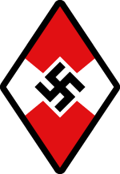
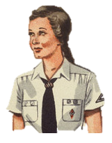
THE KEY POINTS
Lesson 22: Life in Nazi Germany for the young – The role of Youth Groups
INTRODUCTION
The youth were the most important target for the Nazis. They believed in the ‘Thousand Year Reich’ and children were essential to make sure the German ‘Master Race’ survived this long.
The Nazi policy towards young people believed:
All youth should be proud and patriotic of Germany.
All youth believed in the aims of the Nazi Party and supported Hitler.
All girls believed that their role was to be a strong and healthy, fertile mothers.
All boys believed their role was to be strong and healthy to fight and work for Germany.
Youth Groups for Boys
Youth Groups for Girls
Boys and girls were segregated as their roles in life would be different under the Nazis.
The League of German Maidens
Was divided into different age groups for girls
Age 10-14 was the Jungmaden (Young Maidens)
Age 14-21 Bund Deutsche Maden (BDM) League of German Maidens.
The Hitler Youth
Was divided into different age groups but all had the same aims.
Age 6-10 was the Pimpfe (Little Fellows),
Age 10-14 Deutsche Jungvolk (German Young People)
Age 14-18 were the Hitler Jugend (Hitler Youth).
Overall aims
To persuade girls their role in life was to become a mother and housewife.
To give girls the same loyalty to Hitler and Nazis as the boys and indoctrinate them.
To believe in the motto, Kinder, Kirche, Kuche (Children, Church, Kitchen).
Political Aim
They were a political group & had to indoctrinate boys to believe the Nazi aims.
Methods used
Boys swore an oath of loyalty to Hitler.
They attended residential courses where they learned about Nazi ideas.
They studied topics such as ‘German Heroes’ & ‘The Evil of Jews’.
They were told to report anyone, even their parents who were disloyal to the Nazis.
Boys given a Hitler Youth dagger and smart uniform which made them feel respected and powerful.
They would help spread the views of the Nazis through time.
Military Aim
To train boys in military skills from a young age and develop a range of practical skills.
Methods used
Boys practiced skills such as map reading, signalling and building forts.
By 1938, 1.2 million boys were trained to use hand guns and rifles.
There was specialist training for boys wanting to join the Navy. E.g., the Naval Hitler Youth had 45,000 members and the Flying Hitler Youth had 74,000.
The Nazi Youth Movement Background Information
Youth Groups for boys and girls were popular in Germany before Hitler came to power. They were nothing new. For example the Protestant Church Youth Group had over 600,000 children in their groups. The Nazi Party were one political party of many who set up a youth group of its own.
In 1933, as well as banning other political parties, Hitler also banned other youth groups. There was little choice for young people to join.
By 1936, all sports facilities in Germany were run by the Nazi Party and so to use the facilities, young people would have to join the Hitler Youth.
Similar methods to the boys
Political activities such as oaths of loyalty, fundraising for the Nazi Party, going to Nazi organised rallies.
Physical and character building activities were very similar such as camping and hiking were compulsory.
Personality Aim
The aim was to mould young boys into leaders, fighters, brave soldiers who learned to be loyal and ruthless in competition.
Methods used
In their oath of loyalty, boys said that they were willing to give up their life for Hitler.
Military style ‘drill’ and discipline was tough and made boys determined.
Exercise was carried out in the wintry weather to toughen them up. There were harsh physical punishments.
Different methods to the boys
Girls were trained to cook, iron, make bed, sew and prepare the house.
Girls were taught the importance of ‘racial hygiene’ – the idea that the German race should be kept ‘clean’ and ‘pure’ by only marrying an Aryan man.
Physical Aim
For boys to be fit & strong enough for the Germany armed forces.
Methods used
Regular camping and hiking expeditions at weekends
National and regional competitions for a variety of sports.
The Nazi Youth Group Statistics
1932 – 100,000 members
1933 – 2.2 million members
1935 – 4 million members
1939 – 9 million members and compulsory.
The Nazis tried to take children away from their parents as much as possible so they only heard the views and opinions of the Nazis. Youth groups were a way to indoctrinate young people with propaganda when they were not in school. Some young people loved their youth groups, yet others hated their experiences. Others found it confusing that they were being taught opposite ideas to their parents.

Slide 22
THE KEY POINTS
Lesson 23: Life in Nazi Germany: The Nazi School Education System
Before 1933
Control of TEACHERS
April 1933, the Nazis passed a law that gave them the power to sack teachers who did not support the Nazis. For example, one region in Germany called Prussia, sacked over 180 head teachers.
All teachers had to swear an oath of loyalty to Hitler.
All teachers had to join the Nazi Teachers’ League.
Teachers had to attend Nazi Teachers’ League training courses which set out the ideas they had to follow. By 1939, 200,000 teachers had been on these courses.
Teachers were expected to behave as Nazis in the classroom.
They had to teach students to do the Nazi Salute and ended each lesson with ‘Heil Hitler’.
Teachers were expected to show Nazi flags, posters and paintings of Hitler in their room.
Teachers who were official members of the Nazi Party would wear their uniforms in the classroom. This was around 30% of teachers.
Control of *NEW* CURRICULUM SUBJECTS
Race Studies - Children taught how to rate and classify different racial groups. They were taught how superior the Aryan race was and how they should not mix with inferior races such as the Jews. Charts designed by the Nazis tried to help children identify Jews from their looks.
Eugenics - A study of how to produce perfect offspring by selecting 2 Aryan parents.
In 1933, all children in Germany went to school until 14.
After 14 school was voluntary.
Boys and girls all went to separate schools.
Schools were mainly controlled by local councils with some guidance from the government.
Control of TRADITIONAL CURRICULUM SUBJECTS
Maths
Maths books were re-written to include ‘social arithmetic’. They gave ‘real life’ problems to solve about the number of Jews in Germany or the weight of a plane carrying bombs.
History
History books told students how Germany had been ‘stabbed in the back’ by the ‘November Criminals’ and the humiliation of the Treaty of Versailles.
They were full of brave and heroic accounts of the Germans past.
Events such as the Wall Street Crash would be blamed on the Jews or Communists.
Geography
Books were re-written to include the need for more Lebensraum (Living Space) for the German people in eastern Europe.
Map reading skills were encouraged for boys.
Art
All forms of modern art from the Weimar period were rejected and called degenerate.
The art of modern artists was compared to images of Germany’s disabled and mentally ill.
German
German storybooks were created to show the Nazi ideas of the perfect German race compared with the ‘evil’ nature of the Jews. For example, The Poisonous Mushroom tells a story of a Jew. Jews were hugely stereotyped and seen as child molesters and perverts.
Mein Kampf was made a compulsory school text book.
Physical Education
Time for P.E. was doubled. By 1939, P.E. was 1/3 of a child’s day. Students were encouraged to be determined and fight hard to encourage braveness and self sacrifice for Germany.
Science
Students were taught how the Aryan race were superior to the untermenschen (sub human) Jews. Students were told how inferior races could be identified with body measurements. Domestic Science
Made compulsory for girls who studied health, hygiene, cooking and domestic chores. The aim was to make them more efficient wives and mothers.
After 1933
Schools were brought in line with Nazi policies and beliefs.
The Nazi Party controlled what should be taught and how.
The Nazi Education Minister was Bernhard Rust. He saw schools as a way to control young Germans and once said that ‘the whole purpose of education is to create Nazis’.
Control of the SCHOOL DAY
Children were not allowed any free time without the influence of the Nazi Party.
School days were made longer and children would then attend Hitler Youth groups afterwards.
This took children away from the influence of their parents for most of the time.
School notice boards would be full of Nazi Party posters advertising events and meetings.
Attendance was a huge problem for schools as children were allowed to take time off school for Hitler Youth events. One school with 870 pupils showed that 23,000 school days were lost because of extra-curricular activities during one academic year.
Control of NEW NAZI SCHOOLS
Bernhard Rust set up elite boarding schools called Napolas. There were 16 Napolas by 1939.
They aimed to train the future leaders of Germany.
Pupils were specially tested for a place in the school.
They were not taught by teachers but selected members of the SA and the SS. Pupils from these schools would join the army, police or the SS.

Slide 23
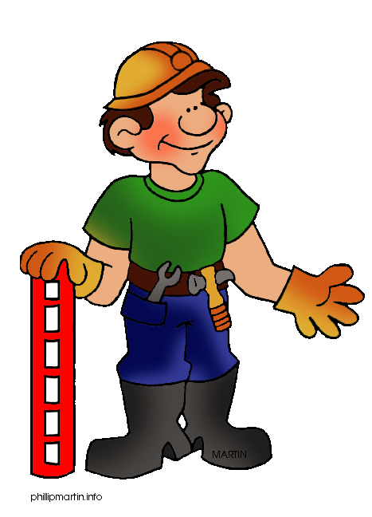
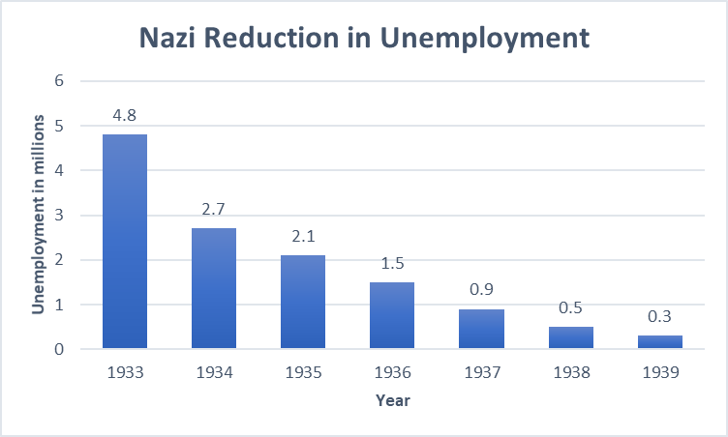
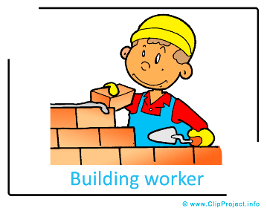


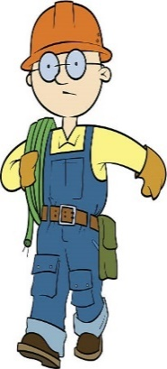









THE KEY POINTS
Lesson 24: Life in Nazi Germany – the reduction in unemployment?
German unemployment before 1933
Around 5 million Germans were still unemployed by 1933. This was 25% of all workers.
Many Germans still remembered the ‘dark days’ of the Wall Street Crash and the unemployment after WW1.
For many families, simply having a job and earning money for their family was more important than politics.
Why did Hitler need to reduce unemployment?
Unemployed workers were more likely to support the Communist Party who were rivals to Hitler.
The Nazis believed it would increase the genuine support for the Nazis and restore German pride in their country.
The Nazis wanted an AUTARKY – A country which would be self sufficient and not need to trade with other nations. This again would restore German pride, show Germany’s determination to succeed and prove the success of the Nazi regime.
How did the Nazis reduce unemployment?
Factor One
The Nazi Labour Service (RAD)
Set up in 1933 and at first voluntary.
It provided work specifically for the unemployed.
Work was focussed on ‘public works’ such as repairing roads, building hospitals, schools, sports facilities like the 1936 Olympic Stadium and bridges.
These projects were all very visible to the German public who saw them as the start of a new Germany.
It was made compulsory in 1935 when all unemployed men had to work for 6 months at a time.
It was not always popular as it was organised like the army. It had a uniform and there was strict discipline.
Factor Two
Building the Autobahns (Motorways)
The Nazis planned 7,000 miles of new motorways throughout Germany.
It was started in 1933 by Hitler himself & used as a publicity stunt.
By 1935, 125,000 men were employed.
By 1938 3,500km had been completed.
The Nazis financed it all (with help from big business leaders who would benefit from the transport links. Goods could now be traded all around Germany to benefit all industries.
Factor Three
Rearmament & Conscription
One of Hitler’s main aims was to re-build Germany’s armed forces after the Treaty of Versailles had limited it in 1919. Hitler was allowed to get away with this as no country wanted to start another war.
1936 - Hitler put Hermann Goering in charge of Four Year Plan to organise rearmament.
In 1935, he introduced compulsory military conscription. All young German men would have to serve in the armed forces.
This meant the armed forces needed more transport, arms (weapons) and equipment. Therefore, more workers were needed in factories to make these goods.
Arms industry spending = 3.5 billion marks in 1933. By 1939 = 26 billion marks.
The aircraft industry employed 4,000 in 1933. By 1935 = 72,000.
The army = 100,000 men in 1918. By 1939 = 900,000 men.
Why are the unemployment statistics not useful? Why should we not trust the official Nazi figures? Who were the hidden unemployed?
The Labour Service
Women
Jews
Changing Statistics
Even though men only worked for 6 months at a time, if they were not in work, they were not counted in the figures.
Even though women were forced out of many jobs, they were not included in the statistics.
Jews who were forced out of jobs were not then included in unemployment statistics.
The Nazis changed how numbers were collected. After 1935, even those with a part-time job were classed as fully employed.
Other Countries
Prisons and camps
The Army
Changing borders after 1936
Other countries around Europe also saw a natural recovery from the economic depression – Germany was nothing special.
Many more thousands of people were put in prisons or camps. They were not included in unemployment statistics.
1.3 million men were in the armed forces by 1939, many of these men had no other choice due to conscription.
Before war in 1939, Hitler had started invading areas around Germany, it cannot be clear if this was taken into account.

Slide 24
THE KEY POINTS
Lesson 25: Life in Nazi Germany for the German workers – how far did their lives improve?
In order to win the support and trust of the working class in Germany, it was vital that the Nazi Party was seen to be helping them and improve their standard of living.
What is meant by ‘Standard of Living’?
How good a life is based on: money, type of job, enjoyment of life, freedom, achievements, choice and opportunities.
THINK LIKE A HISTORIAN!
BE CAREFUL when judging how far people’s standard of living improved. There are many ways that people’s lives varied in Nazi Germany. It is important that we do not judge everyone as the same just based on one or two accounts.
What was good for some German workers might have been bad for others.
Certain aspects of life such as having a job may have got better but other aspects such as the pay may have got worse.
Different people have different expectations or views about what is good or bad, even if their standard of living is similar.
Sometimes people can become wealthy but their actual enjoyment of life may not be as good (or vice versa).
A person’s standard of living can depend on a number of varied factors such as age, gender, marital status, race, political beliefs, life experiences, their family etc.
FACTOR ONE: EMPLOYMENT (JOBS)
FACTOR TWO: NAZI ORGANISATIONS/GROUPS
Having a job
How the standard of living improved.
With more people in work, more German families had a wage to help them improve their standard of living.
But hang on, did everyone benefit?
Not everyone was equal: For some people such as women, Jews and non-Nazi Party members, getting a job could be hard.
Enjoyment of work: Having a job, did not mean enjoying work. E.g. young men in the German Labour Service which was like being in the army and only had work for 6 months at a time.
The Nazis made 3 main organisations which were meant to improve the standard of living for its workers. Hitler knew that with the workers’ support, there would be less opposition.
The German Labour Front DAP
Strength Through Joy KdF
Hitler banned Trade Unions which helped support workers rights and pay. In its place, The Nazi Party created the German Labour Front to control the workers which:
Protected the rights of workers in the workplace
Set minimum pay levels.
However, the negative impact on workers’ living standards were:
Lost their right to negotiate a wage, they just had to accept what they got.
Workers could not be punished if they disrupted work/production.
This organisation was specifically set up to improve the standard of living for workers.
It aimed to make workers feel their work was enjoyable and to make sure they linked this joy of work with the Nazi Party.
It provided leisure activities such as sporting events, days out, hikes, films, cheap foreign travel.
Workers had to join the Strength Through Joy organisation in order to gain these benefits.
By 1936, there were 35 million members of Strength Through Joy.
The KdF’s biggest scheme was an opportunity to save for a new Volkswagen – People’s Car. Hitler asked Ferdinand Porsche to design it. Workers just had to give 5 marks of their weekly wage to eventually give them a car.
Nobody actually gained a car as production at the car factory changed to armaments in 1938!
Wages
How the standard of living improved.
Wages improved, especially after 1936 when the country was rearming and many worked to do this.
High wage earners: Could also afford luxury goods. For example car ownership trebled (x3) between 1933-39.
But hang on, did everyone benefit?
Jobs paid differently: Some jobs had better wages than others. A rearmament factory worker would see a good wage.
Price inflation: Prices of good actually went up (inflation)by as much as 20% between 1933-39 – this was more than wages and so people’s pay did not seem like an increase.
Low wage earners: Unskilled workers still struggled to cover the cost of essentials such as food due to increased food prices.
Beauty of Labour (SdA)
Hours Worked
How the standard of living improved.
Longer hours gave some workers a chance to earn more.
But hang on, did everyone benefit?
Longer hours The average working week increased from 43 hours (1933) to 49 hours in (1939). This also meant less time with family and not really more pay in some low skilled jobs.
This organisation pushed businesses to provide better facilities for workers such as toilets, changing rooms, showers and canteens.
By 1934, the Nazi Party claimed that 34,000 companies had improved their conditions.
HOWEVER – Many companies expected the workers to do the building and decorating themselves with no extra pay.
Some workers were threatened with the sack if they did not help make these changes.

Slide 25
THE KEY POINTS
Lesson 26: Racial Policies Towards Minority Groups and how they were justified.
How did the Nazis justify (make people accept) their ideas about minority groups?
NATIONAL STRENGTH: The German public were constantly told that these racial policies (laws) would all make Germany as a nation stronger.
PERSONAL STRENGTH: Germans were told that by removing or ‘minority’ groups, they would be stronger, healthier and of better ‘stock’.
SCIENCE: The Nazis believed ‘science’ back up their ideas. People trusted science. The Nazis just used science to ‘prove’ what people believed anyway.
WIDER HISTORICAL CONTEXT: Many people in Europe had grown up with the new ideas of Charles Darwin and his idea of the ‘Survival of the Fittest’. In this way, only the best; the Aryan race would survive.
GAVE HOPE: The German people had been through so much pain, depression and uncertainty, that it was easier for them to believe the Nazi racial ideas to give them hope.
SOMEONE TO BLAME: It was easy for the German people to blame someone else for all their problems. Minority groups, especially Jews were easy scapegoats.
PROPAGANDA & CENSORSHIP: ALL of this was supported by the propaganda and censorship about Nazi racial ideas and policies were everywhere and aimed at all Germans.
Who were the ‘minority’ groups in Nazi Germany? - Anybody who did not fit the racial idea of being ‘pure blooded’ and part of the Aryan Master Race.
Jews | Black | Homosexual | Gypsy | Disabled | Slavs/Polish | Having a hereditary disease | Anti-Social (Drunk Criminal Prostitute)
The Main Nazi Racial Beliefs
Eugenics & Social Darwinism. A scientific idea which was influenced by Charles Darwin and his theory of the Survival of the Fittest. Eugenics teaches that humans can control how strong they are by only selected the ‘best’ parents to have children. This meant trying to stop inferior parents from having children or marrying. Eugenics became a subject in schools, youth groups and was constantly used in propaganda.
The Aryan Race & Racial Hygiene. The Nazis believed that ‘the best’ came from one race only –the Aryan Race. They believed the Aryan Race was superior (better) than all others. Anyone that was not Aryan were untermenschen or sub-human. The Nazis didn’t want the Aryan race ‘spoiled’ by inferior races. Their view was to keep the Aryan race ‘clean’ of ‘germs’.
How Minority Groups were treated between 1933-1939.
Homosexuals The Nazis believed homosexuals spoiled the purity and quality of the German race. They believed homosexuality was a sickness which could be cured. In some camps, this led to medical experiments to find a cure. 1935: Harsher laws brought in against homosexuality. 766 men were put in prison. 1936: The Reich Central Office for Combatting Homosexuality was created. The Gestapo were used to search out homosexual men. 4,000 men in prisons/camps. 1938: Nazi Law encouraged voluntary castration of homosexual men. 1939: It is estimated that 5,000 homosexual men died in concentration camps.
Gypsies There were roughly 26,000 in Germany. Hitler believed they did not work hard enough or contribute to Germany. He believed they were not racially pure. 1933: They were often arrested and sent to specific concentrate camps for Gypsies. 1936: More were forced to live in special camps. E.g. One camp near Berlin contained 600 Gypsies with only 2 toilets and three water taps. 1938: Gypsies were banned from travelling in groups around Germany. 1938: Gypsies were registered for medical testing for racial characteristics. 1939: Orders were given to deport all Gypsies from Germany.
Physical and Psychologically Disabled The Nazis believed that anyone with a disability was a burden on society as they were not able to contribute in many ways. They also believed they weakened the purity of the race 1933: Law for the Prevention of Hereditarily Diseased Offspring made it compulsory to be sterilised (prevented from having children) for the: mentally ill, alcoholic, ‘deformed’, epileptic, deaf or blind. 400,000 were sterilised using surgical operations. 1939: The T4 Programme - The Nazis believed that any child born with a mental or physical disability should be killed by starvation of a lethal overdose of drugs. 1939: Children up to the age of 17 were now included. 5,000 children were killed.
Slavs and Poles Hitler believed Slavs and Poles were not part of the Master Race. He wanted to push them out of Europe to make more Lebensraum for the Master Race. These people were still sent to concentration camps and arrested but were not targeted as much as other minority groups.
Important Key Terms
Eugenics: The idea of selecting Aryan parents to have children. Aryan: The idea of a superior, pure blooded race. Master Race: A term used by the Nazis to describe the Aryan Germans. Anti-Semitic: Racism & discrimination against Jews. Social Darwinism: The idea that people can control the strength of their race by selecting only the ‘best’ to breed (have children). Citizenship: A right of a citizen to live in a country. E.g., have a passport and have documents such as birth certificates to prove a person belongs to a country. Hereditary Disease: A disease which is passed on through the family. Anti-socials: A group of people such as criminals, prisoners, prostitutes. Lebensraum: The Nazi idea of expanding the ‘Living Space’ for their Aryan race. Untermenschen: Sub-human’. Anyone who was not Aryan. Lebensunwertes: People described by Hitler as being ‘unworthy of life’.

Slide 26
THE KEY POINTS
Lesson 27: The Nazi Persecution of the Jews in Germany between 1933-39.
IMPORTANT TO REMEMBER FOR YOUR EXAM! Your study of German ends in 1939. In this year, war began. Although it may be tempting to include information about the Holocaust in any answers about the Jews, you must remember that until 1939, there were no official plans for their ‘extermination’.
Persecution Poor treatment and discrimination against a particular group of people. | Anti-Semitism ‘Anti’ means against something. A ‘Semite’ is a Jew. A term used to describe discrimination against Jews. | Citizenship A right of a citizen to live in a country. E.g. have a passport & birth certificates to prove a person belongs to a country. | Scapegoat Someone who is easily blamed for something they did not do. | Segregation Dividing people up by separating them. | Kristallnacht ‘Crystal Night’ or ‘The Night of Broken Glass’. 9th and 10th November 1938. The Nazi reaction to the shooting of a Nazi in Paris by a Jew.
Why were so many people in Germany (and Europe) Anti-Semitic? Anti-Semitic views were not just the idea of Hitler and the Nazis. Anti-Semitism was common in Europe since the 1880s.
The LONG-TERM causes of Anti-Semitism | The SHORT TERM causes of Anti-Semitism in Germany.
The way they looked Jewish religious customs such as their appearance made Jews stand out as ‘different’. | ‘Jews are not German’ Germany was created as a single country in 1871. A way of promoting Germany was to promote being a true German. Jews were made to feel ‘un-German’.
Their religious beliefs Their religious beliefs were different to Christianity. Many Christians blamed Jews for the execution of Christ. | Someone to blame During hard times, e.g. the loss of war, the Versailles Treaty and economic depression, it was easier to blame another group such as the Jews. A person who is blamed for something they did not do is a ‘scapegoat’.
Jealousy Many Jews had been very successful in business and finance, even during economic problems. This created jealously | The influence of politicians Many nationalist politicians such as Hitler publically spoke against Jews. This made being Anti-Semitic even more acceptable and believed.
Science Scientific views of Charles Darwin & the belief of Eugenics promoted the idea that Jews were not part of the Master Race. | Propaganda Propaganda by the Nazi Party easily influenced German people who had not been Anti-Semitic before the Nazi Party. Many turned a blind eye to the treatment of the Jews because of this.
How far did ordinary German people have a part to play in the persecution of the Jews?
For historians, this is one of the most difficult questions to answer. It simply depended on each individual German person and what they were prepared to do (or not do) to help the Jews. The main groups German people fitted into these categories Few German people actively tried to help the Jews but risked their own lives to do this due to the harsh punishments they would receive themselves. Some German people were horrified by what was happening to the Jews but were too frightened to challenge the Nazis. Some German people knew about what was happening but turned a blind eye to it and pretended it wasn’t happening. Their personal struggles were more important. Some German people openly supported the Nazi beliefs and actions against the Jews and actively took part in their persecution. Some German people were not aware of the more extreme actions against the Jews as the Nazis kept them secret

Slide 27
THE KEY POINTS
Lesson 27: The Nazi Persecution of the Jews in Germany between 1933-39.
REMEMBER - Propaganda had already started against the Jews before 1933 in Nazi posters, newspapers and speeches. Many German people were already indoctrinated with these views against Jews. Small scale, localised persecution was also going on in places as Jews were already discriminated against in some areas of life.
The main turning point: In January 1933, when Hitler gained the position of Chancellor, he was able to create laws for the first time. Hitler and the Nazis were able to gradually build up their persecution of the Jews, with the more power and control they gained.
1933
Jews banned from government jobs, owning land & Jewish teachers sacked in schools.
1st April 1933 – The boycott of Jewish Shops and Businesses.
The Nazis tried to stop German people using Jewish shops and businesses. The SA painted the Jewish star and the word ‘Jude’ on the window of all Jewish businesses. The SA stood outside with banners stopping people. Shops were damaged with windows smashed.
1934
Some regions started to ban Jews from public spaces such as parks and swimming pools.
Some regions started to segregate public areas to keep ‘normal’ Germans ‘safe from infection’.
1935
The Nuremberg Laws which were:
1. The Reich Law on Citizenship:
Only those of German blood could be a German citizen.
Jews lost the rights of citizens such as the vote and holding a German passport.
2. The Reich Law for the Protection of German Blood and Honour
Jews were no longer allowed to marry or have a sexual relationship with a German citizen.
Jews banned from joining the German armed forces.
EVENT FOCUS: Kristallnacht – November 9th -10th, 1938
7th November
A 17 year old Polish Jew, shot a German Nazi called Ernst Von Rath in Paris. He was angry at the way his Jewish parents had been treated in Nazi Germany. Ernst Von Rath is injured and taken to hospital.
8th November
Goebbels used this shooting as an excuse to stir up more violence against the Jews.
Violence against the Jews starts in Hanover, where the Jewish family came from.
9th November
Ernst Von Rath died in hospital.
Goebbels and Hitler decided to widen the attack on Jews to the whole of Germany.
Nazi officers were told to attack Jewish homes and synagogues but do it undercover and not in their Nazi uniform. This would make it look as if the German public had started the violence, not the Nazis.
Instructions were sent to local Nazis to arrest as many Jews as the prisons would take.
9th and 10th November
Gangs smashed and burned Jewish property and attacked Jews all over Germany. Some Germans were horrified by the attacks, others were pleased and joined in.
Official Nazi figures listed 814 shops, 171 homes and 191 synagogues destroyed. The official figures state that 100 Jews were killed.
The consequence for the Jews
Goebbels blamed the Jews for starting the trouble who were fined 1 billion marks.
By 12th November 20,000 Jews had been rounded up and sent to concentration camps.
1936
Jews beginning to be banned from ‘professional’ jobs.
Some Anti Semitic posters and propaganda taken down.
1937
Jewish doctors were forbidden to treat non Jewish patients.
1938
Jews had to register all of their possessions with the Nazi government.
Jews had to carry identity cards with them at all times.
Germany unites with Austria. All Jews in Austria are persecuted the same as in Germany.
Jewish Children are banned from most schools.
Jews forced to sell their businesses in a process known as Aryanisation.
1939
The Nazis officially decide to evict all Jews away from Germany. Reinhard Heydrich set up the Reich Office for Jewish Emigration to do this. All Jews would be evicted from their own homes ready to be deported (sent away to another country).
Germany invades Czechoslovakia and then Poland. More Jews are now under Nazi control and persecuted. All Jews forced to wear the yellow Star of David in occupied countries..

