Slide 1
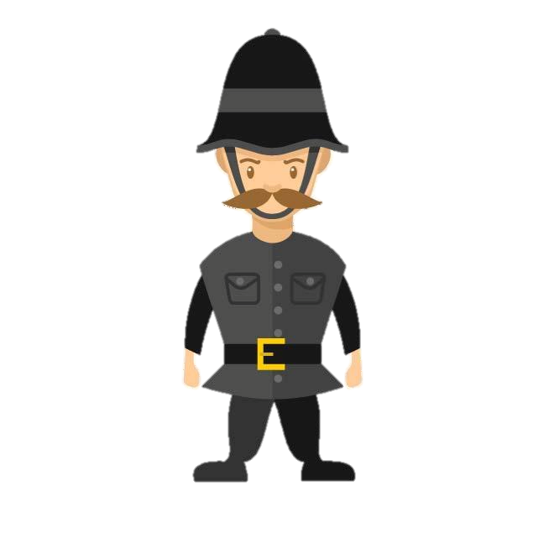
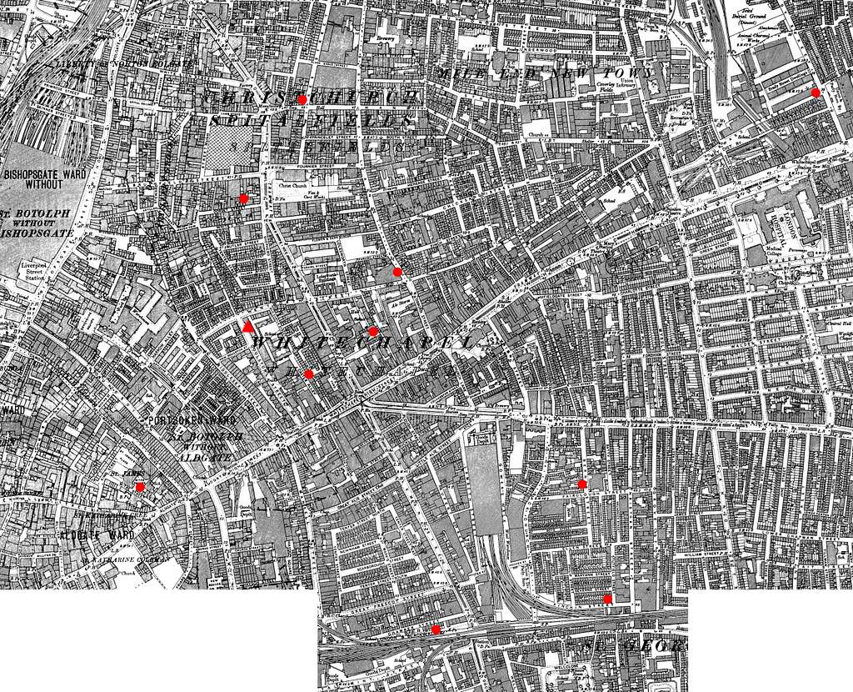
Lesson 1
An introduction to policing in the late 1800s, the Metropolitan Police and the Whitechapel District
BACKGROUND INFORMATION: There were many different police forces in England and Wales at this time. Many bigger and rural counties had a police force but many cities and towns had their own, separate police force. The title given to the person in government in charge of policing was the Home Secretary. The Home Secretary had very little control over the police forces outside of London but he did have control over the Metropolitan Police in London. Importantly, there was very little co-operation between the different police forces across England and Wales as some forces even saw themselves as rivals. For example, the Metropolitan Police force often competed against the City of London Police and rarely shared information.
Policing in London in the late 1800s
The London District of Whitechapel
Metropolitan Police Constables
The role of a police constable or ‘PC’ was to be a visible deterrent on the street who could catch criminals in the act and monitor behaviour.
Duties:
To prevention crime and disorder
Carry out foot patrols with another officer (7-10 miles a day)
Expectations:
To patrol a given area called ‘walking the beat’ with another PC.
To write a report of crimes at the end of a shift and to the Police Sergeant on return to the Police Station.
Character
Law abiding - no criminal record.
Willing to use force when necessary
Requirements
At least 5 foot 7 inches tall
Fit and in good health
Uniform and Equipment
Blue tail coat and top hat
Truncheon, handcuffs, wooden rattle
The Metropolitan Police
London’s Metropolitan Police Force was set up by Prime Minister & Home Secretary Robert Peel in 1829. London was the first place in the country to have a professional police force. Elsewhere in the country, different towns had their own separate police forces but these were organised by local politicians and ‘Watch Committees’ so were not as well organised at the ‘Met’.
The Home Secretary – Charles Warren
The Metropolitan Police reported directly to the government minister in charge of the police called the ‘Home Secretary’. At first the people of London were very suspicious of the ‘Met’ police as they believed they were just like the government or the army who were there to control the working classes. The head of the Metropolitan Police was Charles Warren and he was the Police Commissioner. He had been chosen as he was a former army general and was not afraid to call in the army for support if he needed to.
Whitechapel is an area in the East End of London. During the 1880s, it became notorious for its poverty, tensions between different immigrant groups and high levels of crime. There was widespread unemployment in the area which led to even greater poverty. Men would hang around on the gates of factories hoping for enough work for the day just to feed their family for the evening. Without work, many faced the threat of being sent to one of the many workhouses in the area.
The police in Whitechapel were run by the London Metropolitan Police. They had to deal with drunken violence, protests, theft and clashes between different immigrant groups. In 1888 they were faced by their biggest challenge. A serial killer known by the press as ‘Jack the Ripper’ carried out brutal murders on vulnerable prostitutes. The national and world press now focussed on Whitechapel and more importantly focussed on the failure of the police to catch the killer.
It is no surprise that without work turned to crime. According to the founder of the Salvation Army, the slums were a ‘dark continent full of nameless loathing where lawlessness still reigns supreme’. One survey carried out by Charles Booth found out that 35.7% of its residents were living in the worst kind of poverty. Women did not turn to prostitution in the area out of choice, they needed to do this just to earn enough money for their own family.
The attitude towards the police
During the famous Trafalgar Square Demonstrations in 1887, one event known as ‘Bloody Sunday’ Charles Warren had to call in the army to help the police stop the riots. This only led the poor, who were mainly the protestors, believing that the police favoured the middle and upper classes and were not there to protect them. It made trying to police poorer areas such as Whitechapel very difficult.
The Criminal Investigation Department
A detective department was added to the Metropolitan Police in 1842. This became known as the Criminal Investigation Department (C.I.D.) when it was made bigger in 1877 with 216 officers. This meant the police now had officers who would help solve crimes where the criminals had not been caught red handed. The CID was very small and often ineffective – as well as open to bribery, corruption and alcoholism.
Police Numbers
The Met struggled to police their area. There were roughly 13,000 men to police a population of over 5 million. To make it worse, only 1,300 of these officers were on shift at any one time.
Notes:
Source 2 Image of Whitechapel: https://creativecommons.org/publicdomain/mark/1.0/
Policeman Image: https://vectorportal.com/vector/policeman-cartoon-vector/22697 https://creativecommons.org/licenses/by/4.0/

Slide 2
Lesson 2
Housing Problems in the Whitechapel District and the attempts to improve accommodation.
The location:
Whitechapel is a district in the east-end of London. At the time it was London’s poorest district. The 1881 census puts the population of Whitechapel at over 30,000 but with only 4,000 houses. It was estimated there were over 1,000 homeless at any one time. Londoners shared the district with new immigrants such as the Irish, Jewish and Eastern European immigrants. Poverty, tension between different immigrants groups and high numbers of criminal gangs made Whitechapel a violent place to live. This was an area where few police wanted to patrol.
WORK
WAGES
The average wage for a worker in Whitechapel would be around 25 shillings per week.
THE BELL FOUNDRY
Whitechapel’s most famous work place was the Bell Foundry, where bells for church's and Big Ben were made.
SWEATSHOPS
Sweatshops, were factories where items such as clothing and shoes were made. ‘Sweatshops’ were small, cramped and dusty and many workers would work for 20 hours a day.
THE DOCKS
The docks provided work for those men working on the ships. Men would often queue at the start of the day to be given work and sent away if not.
RAILWAYS
Many Irish immigrants found work building the railways which helped transport goods away from the docks.
WHITECHAPEL ENVIRONMENT
The environment of Whitechapel itself led to higher crime rates and police struggling to deal with crime.
Streets were narrow, unlit and often over-crowded.
The noise, smell from pollution and the famous London ‘smogs’ (thick fogs) would often make a quick escape from a crime scene easy.
The streets were interlocked and maze like with very few street signs or lighting.
The over-crowding made minor crimes such as pickpocketing easy.
Whitechapel was a heavily polluted industrial city where sanitation was very poor with very little clean drinking water and no sewerage system. Evidence could easily disappear.
ORPHAN CHILDREN
There were a high number of orphans (children without parents) in Whitechapel. These children would normally get sent to the workhouse or sold on to other work. They easily took to crime in order to survive. However, thanks to the work of Dr Thomas Barnado, some children were given an education and shelter in various orphanages. In 1870, he opened up an orphanage for boys and later for girls. By 1905, he had opened 100 Barnado's Homes in London. The famous motto above the door of an orphanage was ‘No destitute child ever refused admission’.
HOUSING
ROOKERIES: Most houses were in over-crowded ‘slum’ areas known as ‘rookeries’ which included dirt, disease and crime. Houses were split into several apartments with up to 30 people sharing beds.
LODGING HOUSES: These were for those who were even poorer. They offered a bed in dirty, squalid conditions. They even had shifts for sleeping so the beds could be used by the most number of people. It was estimated that there were 200 Lodging Houses in Whitechapel for more than 8,000 people.
COFFIN BEDS &HANGOVERS: Some people were so poor that they had to rent either a ‘coffin’ bed for the evening or even lean up against a ‘two-penny hangover’ – a rope tied from one end of the room to the other.
VIOLENCE & TENSION
Over-crowding, poverty and high immigrant numbers led to tension between different groups.
High numbers of prostitutes made women vulnerable to violence.
When the ‘Jack the Ripper’ murders were taking place in 1888, it was easy for different groups to blame each other. E.g., there was an increase in Anti-Semitism as locals blamed the Jews.
IMPROVED HOUSING – PEABODY ESTATE
Whitechapel housing was not all bad. In 1875 the government created a new law called the Artisan’s Dwelling Act. This law, cleared away some of the slum areas and replaced it with 11 new blocks of flats. They were paid for by George Peabody who was a wealthy American who had moved to London and wanted to improve the conditions for the poor. The Peabody Estate opened in 1881 and provided 286 flats for a reasonable rent of 3 shillings per week.
THE WORKHOUSES
For those with nowhere to live and living in absolute poverty, the one last place was the workhouse.
They offered food and shelter for the promise of hard work. Those that were not able to work such as the old, sick, disabled, orphans were called ‘inmates’.
The work was made deliberately difficult to put people off ever having to work there. They were expected to live under strict discipline, were separated in to men and women and even punished for talking to each other.
Whitechapel Features | Linked Problems
Overcrowded Housing | Theft of property, domestic abuse, fights
Unemployment | Stealing, disruptive behaviour
Prostitution | Assaults on women, gangs intimidating women
Alcoholism | Drunken disorder on the streets, especially at night.
Workhouses | Theft – people desperate not to go to the workhouse
Orphaned Children | Petty crimes such as begging and pick pocking
Immigration | Tension and violence between older residents and new immigrants – fights over competition for work
UNEMPLOYMENT
There was high unemployment because of an economic depression at the time. Often, with nothing else to do, boredom would lead to high levels of alcoholism, disruptive behaviour and violence.
There were very few jobs were available to women. This meant many turned to prostitution as the only way to earn money to survive.

Slide 3
Lesson 3
The tensions between immigrant groups and Londoners in Whitechapel
By the 1880s, London had received an influx of immigrants from around Europe. Many moved to England’s capital city seeking a better life or to escape poverty and discrimination in their own country. However, with so little money, the poor district of Whitechapel tended to attract many immigrants. Whitechapel was near the dock yards of the River Thames which made it the first place immigrants often came to after their journey. Immigrant groups soon came into conflict with long term residents of Whitechapel now that there was a mix of cultures, traditions and languages. This conflict could often become violent which made the district of Whitechapel even more difficult to police.
The main features of Immigrant Tensions in Whitechapel
There was growing tension in Whitechapel because of the competition between immigrants and local people for housing and jobs. Each group blamed the other for a lack of work and accommodation.
Overcrowded areas of Whitechapel brought immigrants very close to each other and they all found it difficult to mix.
Racist attitudes towards the Jews, Irish and Eastern Europeans existed within the police force itself. Police officers could accuse an immigrant of a crime with little or no evidence as they were easy targets.
It was easy for the longer term residents of Whitechapel to blame ‘foreigners’ for crime. Local police could often blame an Irishman or Jew of a crime because of their own prejudice.
The local newspapers were often to blame for spreading a fear of ‘foreigners’. They created stereotypical images of Jewish people with long noses and dark beards as suspects for the Jack the Ripper murders. The opinion was that no Englishman could ever carry out such gruesome murders and so most were convinced it must be a Jew, Eastern European or Irishman.
The Irish Immigrants
The Jewish Immigrants
The Anarchists
There were greater numbers of Irish in London since the 1840s.
Many were young men who planned to use their work in London to raise enough money to migrate to America. However, many could not raise the money so stayed in the East End and Whitechapel instead. Many settled into areas near the river and did labouring jobs such as building canals, roads and railways or became dock yard workers.
The Irish were not well liked and were known for their violent drunken behaviour
Many Jews moved to Whitechapel to escape anti-Semitic violence against them in Eastern Europe and Russia. They often segregated themselves into parts of Whitechapel and did not mix much with locals. In some streets, the Jewish population was 95% of the total.
Local people were suspicious of Jews because of the cultural and language differences as well as their different attitudes to work and business.
Jewish workers were willing to work for low wages and began to run their own ‘sweatshops’. Sweatshops were workshops producing low quality clothes by workers who were paid a low wage, working long hours in poor conditions. Locals complained that Jewish sweatshops would offer work to other Jewish immigrants rather then the local people who also wanted work.
Sweatshop conditions were actually illegal. It was difficult for the police to close them down because the Jews spoke little English and the police could only use English. Many locals were simply jealous of their success.
Other Jews ran tailoring businesses (making clothes) that employed poor working class Londoners who did not like having a ‘foreign’ boss.
Cultural differences with clothes, language and food made the Jews ‘stand out’ as different. For example, Jews also worked on a Sunday as Saturday was their Holy Day. Local businesses became suspicious as Jewish shops could get money on Sundays.
There was an Anti-Semitic attitude and Jews were often stereotyped by newspapers.
Beatings & attacks on Jews increased further during the Jack the Ripper murders with many local residents believing the murderer had to be Jewish.
Anarchists are people who oppose having a government. There were attempts by Russian and Eastern European groups to bring down the government in Paris but this failed. But, some anarchist leaders fled to England. Newspapers exaggerated the threat that anarchists had and so anyone with an Eastern European accent or name was seen as a potential anarchist and treated with suspicion
The Irish ‘Fenians’.
The Socialists
The Fenians were a Catholic ‘terrorist’ group from Ireland. They wanted Ireland to have complete freedom from the UK to become their own country. They organised a bomb attack on Clerkenwell Prison in 1867 and this led to a surge in anti-Irish and anti-Catholic attitudes.
The Police even set up a unit called the Special Branch in response to the Fenians to keep watch on them.
On 24th January, 1885, the Fenians launched attacks on famous London landmarks such as the House of Commons and the Tower of London. Journalists referred to this day as ‘Dynamite Saturday’ and press coverage caused even more hatred towards the Irish.
This made life harder for the Irish as now all Irish people were seen as terrorists rather than just the few who organised the attacks.
Socialists wanted more equality and better pay for the working classes. The first British socialist political party was called The Social Democratic Federation (SDF) in 1881. It organised protests and demonstrations in London such as the Trafalgar Square demonstration in 1887 and Bloody Sunday. Socialists hated the police as the police just represented even more government control. In Whitechapel there was a significant number of people who supported socialism.

Slide 4
Lesson 4
The organisation of H Division and the difficulties policing the district of Whitechapel
Prostitution
Daily Routine: Walking the Beat
Whitechapel’s H Division
Alcoholism and Opium Dens
While it was difficult for unemployed men, it was even harder for women to find work. Many turned to prostitution simply as a way to survive. Some women worked in brothels (a house where prostitutes worked from). Others would walk the streets and would be vulnerable to assault or rape. Prostitution was not illegal at the time but it was seen as a social problem that the police were expected to deal with. There was no contraception and so abortions were common. Abortions were performed in conditions which led many women to die from infections or shock. Police often turned a blind eye to the illegal ‘backstreet abortions’. It was estimated that there were 62 brothels in Whitechapel with around 1,200 prostitutes. Women would rarely want to help the police as they feared the consequences. Prostitutes were more vulnerable as may turned to drink to cope.
Officers would patrol their area in pairs. This was called ‘walking the beat’. They were acting as a deterrent but also expected to speak to the locals to gain information. Any information or daily meetings with their ‘beat sergeant’ was written down in their police diary. Some constables avoided their beat if it was in a particularly dangerous area and some drank alcohol while on duty. However, if found out this would be punished by a fine or by being dismissed. Some sergeants had to follow constables to make sure they were not idly chatting or even asleep.
The Metropolitan Police were divided into 20 divisions. Each one was given a letter of the alphabet and responsible for a district of London. Whitechapel was covered by H Division. Each division was led by a superintendent and chief inspector. Below them were the 37 sergeants. Each sergeant supervised on average 500 ordinary ‘beat’ constables. A police constable’s pay was poor and so the quality of recruits often suffered. H Division was understaffed for the amount of crime they had to deal with. There were 15 detectives at H Division from the C.I.D.
Alcoholism was common amongst the poor and unemployed. It was their only escape from their terrible lives. Alcohol was very strong but also very cheap. On the main Whitechapel road (1.5km) there were 45 pubs or gin palaces. Gin palaces were richly decorated shops which sold cheap gin. The extravagant decoration made them popular with the local poor as a way to escape their own dirty homes. Drunken behaviour was common. Many residents of Whitechapel were difficult to deal with, there were many violent crimes and thefts caused by alcohol. Opium Dens were set up by Chinese immigrants and they were dark and grimy places where opium could be sold and smoked. People often stole money to feed their habit.
The Difficulties Policing Whitechapel
The Local Press/newspapers
The varied role of the Police
The local press gave little sympathy towards the police. They often mocked the police for not being able to catch criminals, especially the case of Jack the Ripper in 1888. This influenced further public attitudes towards the police and led to fewer people wanting to help them.
The police also had a responsibility for dealing with ‘social’ issues such as litter, runaways and even making sure dogs were muzzled in public! They were criticised for not fighting crime but also made fun of for what they had to deal with. This often meant that they were not taken seriously by the public.
Housing and Streets
Protection Rackets & Gangs
Both immigrants and locals were often without work and living in the common ‘lodging houses’. Tensions between different nationalities would be at their height and policing this was difficult. The rookeries, narrow alleyways and courtyards were another problem for H Division. These small spaces, poor lighting with maze like entrances and exits meant there were always corners where criminals could hide or jump out and attack officer. Many Whitechapel Streets were poorly lit at night. Whitechapel suffered from terrible ‘smogs’ which meant visibility could be very poor and this made seeing a crime or catching a criminal even more difficult.
There were powerful Eastern European gangs in Whitechapel such as the Bessarabian Tigers or Odessians. They made agreements with local businesses to protect them from crime as long as the owners did not report them to the police. If the businesses refused their shops would be smashed up and owners attacks. There was also violence between the gangs. People were afraid to report gang violence as they feared they would be attacked in revenge. It was almost impossible for the police to collect evidence to arrest gang members. Some officers themselves were open to bribes from the gangs.
Local Attitudes towards the Police
Poverty in Whitechapel
The Metropolitan Police was created in 1829 and by 1880, in most parts of London, they had gained respect, and fondly known as the local ‘Bobby’. However, in poorer areas like Whitechapel, the police were still seen as a form of government who were trying to control and watch over them, rather than help with crime. The police in Whitechapel were seen in a negative light and often criticised. Attacks by violent gangs were common.
The police were unpopular due to the extreme poverty of the 1880s. When the poor joined in with public protests and the police were called in, the police had a reputation for being heavy handed and violent. Many of the crimes committed were linked to poverty and unemployment as people become more desperate. People with no work would rather turn to crime rather than go into the workhouse. This made H Division’s task challenging.

Slide 5
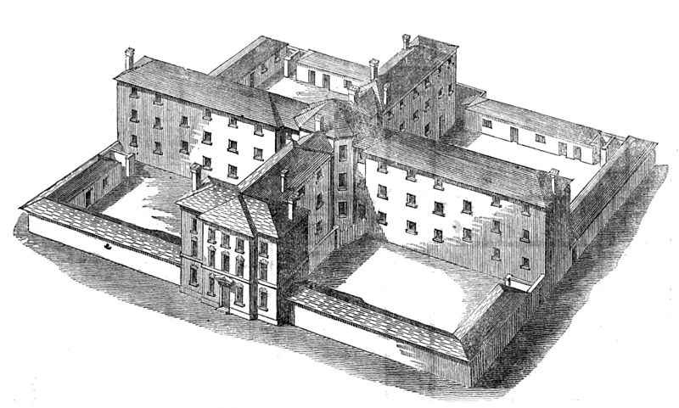
Lesson 5
Life in a Whitechapel Workhouse
What were Workhouses?
Whitechapel Workhouses
What did ‘inmates’ do in the workhouse?
Workhouses were buildings set up by the British government in the early 1800s. The government needed a way to support the increasing number of poor in Britain’s growing cities. They were a way of providing ‘Poor Relief’ to those that could not work. They provided basic shelter, food and water. However, this was in return for work. The belief at the time was to make being in the workhouse such a deterrent that the poor would find a way of getting job to avoid it. This was proof that many wealthy people at the time believed that most poor were only poor because of laziness.
Due to the increasing amount of poverty in the East-end of London, Whitechapel had an above average need for the workhouse. Conditions inside the workhouse were deliberately made worse with the aim of keeping costs down.
The work for all inmates was physical hard labour. Some inmates would be asked to break up rocks or wood, others might pick apart old rope for valuable oakum or make matches. The conditions in a workhouse were deliberately made strict, physically tough and demanding with punishments such as beatings for those that did not follow the rules. Even talking to another inmate during work hours could be punished.
Conditions in the Whitechapel Workhouses
Workhouses were based on the plans of a prison. The people in a workhouse were even called ‘inmates’.
Inmates would be separated into areas for women, men, girls and boys.
Each workhouse would also have an infirmary to care for the sick.
Conditions were poor to deter more people from using the workhouse and encourage as many as possible to seek work. This meant the workhouse was the last possible resort for anyone.
The inmates would have to wear a uniform and families in the workhouse would be split up. Workhouses were dirty and cold.
Food was prepared for the inmates but would be very basic.
There would be basic bathroom facilities and each area would have an open yard for exercise.
What type of people ‘lived’ in the workhouse?
How long would people stay in a workhouse?
Those without work in Whitechapel were classed as vagrants and might stay in the workhouse for 1 or 2 nights only. These people were held in a different part of the workhouse from the longer term inmates as they were thought to be lazy and a bad influence on others. Longer term inmates could be in the workhouse for months.
The people in a workhouse would be the very poorest in society. They included:
Those too old or sick to work,
People with a physical disability who could not work or be looked after by family.
Orphaned children.
Unmarried mothers who had been disowned by their families.
In Whitechapel this would also include immigrants such as Jews, Eastern Europeans or the Irish.
Notes:
Workhouse Building Image: https://commons.wikimedia.org/wiki/File:Sampson_Kempthorne_workhouse_design_for_300_paupers.jpg Annual report, Volume 1 By Great Britain. Poor Law Commissioners (1835), page 411 Sampson Kempthorne (1809–1873 Public Domain

Slide 6
Lesson 6/7
The Techniques used by H Division Detectives to Investigate the Jack the Ripper Murders in 1888
The Main Jack the Ripper Victims
Inspector Frederick Abberline
At least 5 prostitutes were victims of ‘Jack the Ripper’
Mary Ann Nichols (found in Buck’s Row on 31st Aug.)
Annie Chapman (found in Hanbury Street on 8th Sep.)
Elizabeth Stride (found in Berners Street on 30th Sep.)
Catherine Eddowes (found in Mitre Square also on 30th Sep.)
Mary Jane Kelly (found in Dorset Street, on 9th Nov.)
The Metropolitan Police Commissioner Charles Warren, placed Inspector Frederick Abberline and his CID team in charge of the Jack the Ripper Case. Abberline were supervised by officers of H Division. Abberline was an experienced officer with a detailed knowledge of the area. Police believed that the victims were all killed by the same killer. The killer was never caught but was given the nickname ‘Jack the Ripper’ by the press at the time.
Setting Up Soup Kitchens
Visiting Lunatic Asylums
Putting Officers in Disguise
Public Information & Eye Witnesses
The police were told by Charles Warren that they were not allowed to offer money as a reward. This was standard practice as it would lead to even more time wasters just wanting money in such a poor area. However, the police encourage poor people to come forward with information by promising them a hot meal and a warm drink. Most just came for the food and this technique was seen as a failure.
As the murders were so savage, the police believed that Jack the Ripper would be ‘insane’ (mad). They therefore visited several lunatic asylums in the area to see if any of the inmates had escaped. However, this led to no information and no inmate would have been capable of carrying out such an ‘accurate’ set of cuts on the victims.
The police were running out of ideas and so came up with a plan to dress some of their male officers up as prostitutes. The idea was to catch the killer in action by using the officers as bait. This only led to the police being further mocked by the local police and the press. The joke of the time being that the officers still wore their beards and big police issue boots.
Police were given some ‘leads’ (useful evidence) by the public. This was important as the Whitechapel residents would often know more than the police about the area. Each piece of information had to be followed up but a lot of it was very misleading and wasted a lot of time. Often, people would make suggestions about the killer based on their own prejudices against certain immigrant groups. There were few people who claimed to be eye witnesses to any of the murders.
Sniffer Dogs: Barnaby and Burgho
The police wanted to start using sniffer dogs to help find suspects. Two bloodhounds called Barnaby and Burgho were successfully trained in London’s Hyde Park ready to be used in Whitechapel. However, the Metropolitan police refused to pay for the use of the dogs and so the owner refused to allow the dogs in Whitechapel. This did not stop the local newspapers finding out about the story and creating amusing illustrations mocking the police and their techniques to find Jack the Ripper.
Post Mortem Information
Information from Journalists
A post mortem is a detailed examination of a person’s body ‘after death’ to find clues about how the victim was killed. The local doctor who carried out the post mortems was Dr Llewellyn. He suggested that the cut marks on the bodies were that of someone who was left handed and with some knowledge of human anatomy (biology)
Many local and national journalists wanted to solve the murder themselves with their eye on a good story. Locals were happier talking to journalists rather than the police and so journalists often collected a lot of information. However, journalists were too quick to jump to their own conclusions and did not always share information with police. They were more interested in the story, not the truth. The Metropolitan Police were able to use the newspapers to appeal to the public for information about specific murders. For example, a famous letter sent to the police called the ‘Dear Boss’ letter, was copied into newspapers in the hope that someone would recognise the handwriting.
Interviewing Suspects with Medical Knowledge
Evidence from Victim’s Possessions
Items found on or near each victim’s body would be used as evidence. For example, an envelope left near the body of Annie Chapman (2nd victim) had links to the army. This was investigated but nothing more came of it. Jewellers were contacted about victims’ jewellery. However, Whitechapel was that dirty and untidy that most of the objects found near each victim were likely to be litter or have no link to the murder at all.
This led the police to investigate local doctors, hospitals, vets and even 76 butchers. It was agreed at the time that the killer must have knowledge of the human body as specific body parts and organs were removed accurately.
Further Methods
After the evening of the double murder of Elizabeth Stride and Catherine Eddowes, the Metropolitan Police increased their methods with house to house searches, questioned more than 2,000 lodging house residents, distributed 80,000 police posters and questioned the sailors in the docks who might be trying to hide the killer. Even Queen Victoria and international newspapers became involved by demanding even more change to the way the police were investigating the murders.
Notes:
Policeman Image: https://vectorportal.com/vector/policeman-cartoon-vector/22697 https://creativecommons.org/licenses/by/4.0/
Newspaper cartoon : https://creativecommons.org/publicdomain/zero/1.0/ https://publicdomainvectors.org/en/free-clipart/Newspaper-vector-icon/75638.html

Slide 7
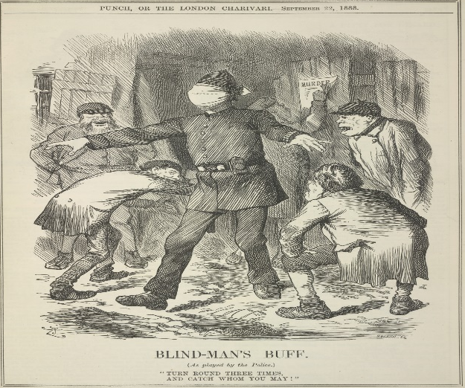
Lesson 8
What Obstacles did the police in Whitechapel have to catch Jack the Ripper in 1888?
The limits of police methods used to catch Jack the Ripper
Police Force Rivalry
The Whitechapel Vigilance Committee
When Catherine Eddowes was killed just on the border between the Metropolitan Police and the separate City of London Police the ongoing rivalry meant that vital evidence was removed. After the discovery of Eddowes, PC Alfred Long of H Division discovered a piece of Eddowes’ apron, smeared with blood half a mile away in Goulston Street. In the alleyway behind was a message chalked onto a wall which read ‘The Juwes (Jews) are the men that will not be blamed for nothing’. Charles Warren wanted to make sure the murder was investigated by the Metropolitan Police and so ordered the message to be washed off. Firstly, he feared a backlash from the Jewish community. However, it is believed he did not want their rivals the City of London police using this evidence to catch the killer before the Metropolitan Police. This bitter rivalry was one of the biggest problems of police investigation around Whitechapel at the time.
The Whitechapel Vigilance Committee were a group of businessmen and traders in Whitechapel. They were led by a trader called George Lusk. They were so frustrated with the lack of police progress after the killing of Mary Ann Nicholls, that they set up their own ‘Vigilance’ group. Vigilantes are groups who take on the responsibility of tackling crime themselves because they believe the official police force are not able to do so. They were determined to embarrass the police, stir up local feeling further and put pressure on the government to do more to catch Jack the Ripper.
A LACK OF FORENSIC SCIENTIFIC METHODS: The Metropolitan Police had almost no scientific methods to help them solve a crime. Their only hope was to catch the killer in the act.
FINGERPRINTING: Finger printing was known about but the detectives at the time did not believed in it or take it seriously enough.
BLOOD ANALYSIS: Scientists were not able to detect the difference between human and animal blood let alone blood types. In Whitechapel, any number of blood samples could be found on the streets from butchers shops, slaughter houses, to drunken attacks.
DATEBASE COLLECTIONS: There was no ‘data-base’ or collection of photographs of known criminals in the area for police to use. Police forces did not often share information with other forces. A criminal in the H Division area of Whitechapel could easily move to another part of London & not be known about.
PHOTOGRAPHY: Crime-Scene Photography was only just beginning to be used to record evidence. The quality was poor and only the body would be photographed rather than the whole crime scene which may have given more evidence.
OLD ATTITUDES: Older officers still believed that photographing the eyes of a victim might record the last image they saw in the reflection of the eyes. They were reluctant to any type of change or scientific methods which could have helped.
LACK OF EXPERIENCE: The police in Whitechapel had never had experience of such crimes before. The mutilation of at least 5 women was a shock for them as well as the local community. They had little experience and no training about how to deal with such investigations.
Rewards, Protests, Night Patrols and Body Parts
The Metropolitan Police did not want to offer a reward for the capture of Jack the Ripper as they believed it would lead to time wasters and false leads. However, George Lusk publically offered a reward for any useful information about the killer. Members of the Whitechapel Vigilance Committee took to the streets night after night, armed with burning planks of wood, whistles and hob-nailed boots. They hoped to drive out the killer or catch him in the act. They also wrote to the government to complain about the lack of protection being given to the local people, so they also set up their own nightly patrols. They met every evening in The Crown pub and after closing time and went out patrolling the streets. The Metropolitan police often came into conflict with the Whitechapel Vigilance Committee who often accused the police of failing to look after the local people of Whitechapel. George Lusk was even sent a letter and a parcel in the post, apparently from the killer. The letter is known as the ‘From Hell’ letter and the parcel contained half a human kidney. This was linked to the killing of Catherine Eddowes.
Public Involvement & Attitudes
Such was the publicity and panic about the murders that over 300 letters and postcards were sent to either the police or the local newspapers by men claiming to be the killer. The letters all had to be followed up which took time and men away from investigating further. Most of the letters were fake which was a huge waste of police resources. After the double murder of Elizabeth Stride and Catherine Eddowes, the Whitechapel public were even more critical of the police. Emotions ran high and the police were targets of this anger.
Penny Dreadful Problems
Newspapers, especially the sensationalist and cheap Penny Dreadful illustrated newspapers made the most of the murders with dramatic images of the victims and wild speculation (guesswork) about the murders. This whipped up public emotions further and put more pressure on the police. Journalists were quick to jump to their own conclusions on poor evidence or unreliable eye witness accounts. Many press articles were keen to accuse the killer of being ‘foreign’, and published articles which accused the killer of being Jewish. This led to further tension in the area with more anti-Semitic attacks for the police to deal with.
Notes:
Cartoon: https://creativecommons.org/publicdomain/zero/1.0/deed.en https://commons.wikimedia.org/wiki/File:Blind-man%27s_buff_-_Punch_%2822_September_1888%29,_139_-_BL.jpg

Slide 8
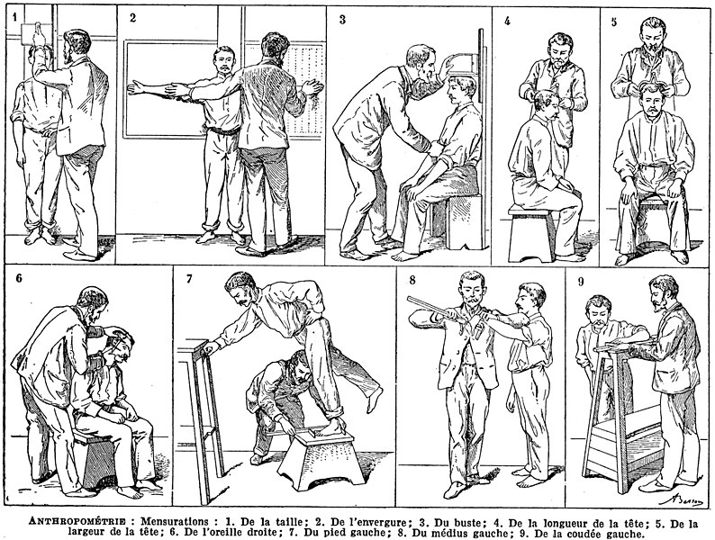
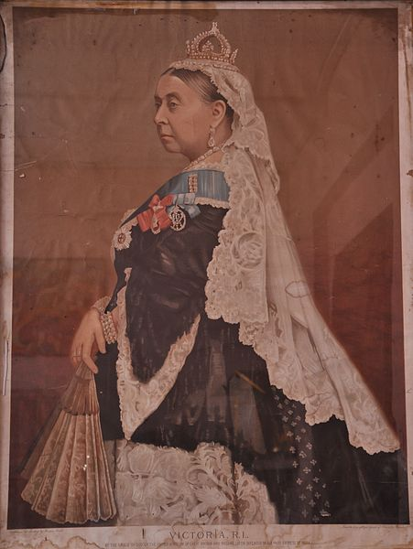
Lesson 9
The lessons learned from the investigation and the improvements made to policing after 1888
The Bertillon System in 1894
Improvements to the Whitechapel Environment
Queen Victoria’s Involvement
The failure of the police to catch Jack the Ripper, led to a review of how the police kept records of criminals and their crimes. The result was the use of the Bertillon System in 1894.
There were great improvements to lighting, housing and health – all as a direct result of the national coverage of the Jack the Ripper murders. The government and the police were forced to admit the link between crime and poverty in places such as Whitechapel. The Jack the Ripper murders in particular led to two key changes in law in 1890:
Queen Victoria became personally involved in the Ripper investigation. She sent two telegrams to the Metropolitan Police with practical advice. However, her personal interest led some people at the time to believed the royal family were involved in the murders!
The Bertillon System put together physical measurements of a criminal suspect, photography and improved record keeping to help the police find repeat criminals. Suspects and criminals would have their body measured in a variety of ways and then a ‘mug-shot’ (photograph of the head and shoulders) was taken to be kept in the same centrally stored file. This information would then be shared with different divisions if needed.
Public Health Act
The Houses of the Working Classes Act
The government gave more power and money to local councils to improve toilets, paving, rubbish collection and other sanitation services in poorer areas such as Whitechapel.
This led to the removal of the poor slum areas with newer housing developments which would be low cost for the poor to afford to live in. These houses included better sanitation and hygiene with improved living conditions.
Knowing a suspect’s measurements and image would help eye witnesses identify suspects in the future. It would help catch criminals who repeated their crimes and who were known to the police.
She wanted the dark passageways of Whitechapel to be lit using gas lighting to make the district feel safe, deter criminals and make the life of the police easier.
There were no more serial killings but murders in these areas continued regularly in the 1890s. Hooliganism increased, especially with young people pretending to be Jack the Ripper frightening women. There was more recorded violence against prostitutes and an increase in burglary in the early 1890s.
Bertillon’s photographic methods are still used today and they were the first method of centralised record keeping in the country. Measurements were later added to with unique finger printing details after 1900.
Improved Communication Methods
She demanded that the murderer’s clothes should be found as this would be key evidence.
Telephones
The only form of effective communication in Whitechapel in 1888 was the use of a whistle to call for support from nearby officers if needed. By the 1900s, the police were starting to use newly invented telephone lines. H Division did not use a telephone until 1901.
She asked that all the ships in the London dockyards were to be searched.
Bicycles
Bicycles were used by some police forces by 1896, but H Division waited until 1909 to make use of its first bicycle. Overall, despite the public outcry about the Ripper murders and the pressure put on the police, they did not learn from their failings or take on new forms of technology and transport to help their investigations.
Notes:
Bertillon System Image: https://creativecommons.org/publicdomain/zero/1.0/deed.en https://commons.wikimedia.org/wiki/File:Anthropometrie_%28mesure_des_particularit%C3%A9s_dimensionnelles_d%27un_homme%29_Anthropometry_%28measurement_of_the_human_individual%29_Public_domain_illustration_Larousse_du_XX%C3%A8me_si%C3%A8cle_1932.jpg
Photograph of Queen Victoria: https://creativecommons.org/licenses/by-sa/3.0/ https://commons.wikimedia.org/wiki/File:A_Portrait_of_Queen_Victoria_%281819-1901%29.JPG

Slide 9
SOURCES SHEET
The different types of sources to help you ‘follow up’ and find out more.
SOURCES SHEET
POLICE RECORDS
MEDIA SOURCES
SOURCES
Whitechapel H Division Police Station Records
Every police station kept information about which o how many officers were on duty in particular areas, how many arrests were made or incidents officers had to deal with.
Local Newspaper Reports
Local newspaper reports are useful to find out about smaller scale crimes in the Whitechapel area. They will often give specific names, places and details of the crimes as well as publish the names of the police officers dealing with the crime. They can be sensationalist (exaggerated) but often reflect the attitudes of poorer public at the time.
H Division Police Officer Reports
Police Officer Reports were written by the PC after they had returned to the station. They will include information about the location, crime scene, names of suspects and types of crime.
GOVERNMENT SOURCES
The 1881 Census
This is a national government survey carried out every 10 years. It is useful to tell about the population numbers, nationality, ages of people, unemployment figures and types of housing in Whitechapel.
National Newspapers
National newspaper reports are useful for showing the bigger problems of crime in an area. At the time of Jack the Ripper, the national newspapers often made fun of and criticised the police for not finding the killer. The Illustrated ‘Penny Dreadful’ newspapers. This was a sensationalised paper for the entertainment of the public. It can be very negative and mocking about the police but also highlight important local issues and attitudes towards the police.
Witness Statements
Any witnesses to a crime will have had their information written down and kept by the local police station or used in court. They are useful to tell us about people’s attitudes at the time and to give one person’s version of events.
Charles Booth’s Poverty Map.
This will highlight areas of poverty in Whitechapel as well as the location of key immigrant groups.
Coroner’s Reports
A coroner report is written by a senior doctor to prove the final cause of death. The coroner will use evidence from the police, Post-Mortems and witness statements to come to their conclusion.
Freedom Licences
Freedom Licences were the official release papers for prisoners after they had been in prison. They are useful as they include information about their crimes as well as the type and length of the punishment they have been given.
A Post Mortem Report
A post mortem is carried out by a doctor who examines the dead body after the crime. These reports can tell us about the methods used by a killer and the cause of death.
The Illustrated ‘Penny Dreadful’ newspapers.
These newspapers were highly sensationalised, dramatic accounts of events in the local area. They were often very negative and mocking about the police but also highlighted important local issues and attitudes towards the police.
‘Old Bailey’ Court Records
We have access to the records kept by courts about the cases they dealt with. Most people in Whitechapel found themselves at the Central Criminal Court in London. This court is also known as the Old Bailey. Court records can give us witness statements as well as accounts from police officers, victims and the criminals themselves.
H Division Police Officer Memoirs
A memoir is an individual account of a person’s life which is based on their diaries or just on memory. These are the personal memories and accounts written by police officers who write about their career. They can provide very detailed and personal picture of police work in this time such as the officer’s emotions and feelings about working for the police or accounts of high profile, well known crimes.
The Police Review
This was a newspaper set up by the police with the aim of telling the public a more accurate version of crimes in the Whitechapel area. It is useful for telling us about the methods used by the police to deal with crime.
Official Government Records.
These can give us a good insight into the plans of the government or their concerns about crimes.

