Slide 1
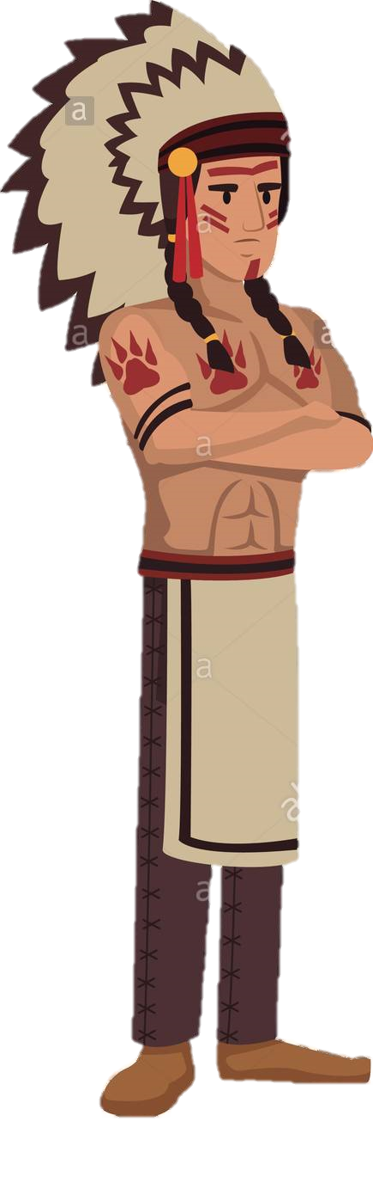
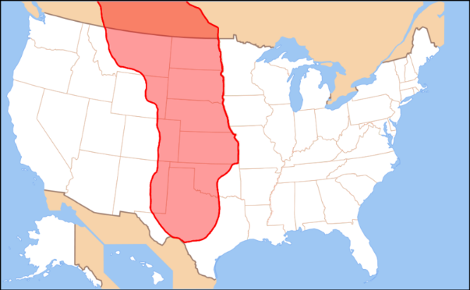

LESSON 1: Who were the Native American Plains Indians?
Before the Europeans came across the continent we now know as America, there were many other people who had lived there for hundreds of years before known as Native Americans or Plains Indians. They lived spread out from each other across the whole continent in their various tribes. By the 1600s however, Europeans had started to settled on the east coast of America, brought there by the promise of new land and resources for trading. Over time, more people to migrated from Europe to live on the American east coast. Our story begins, around the year 1830, when some ‘Americans’ from the east coast began exploring lands to the west. Over the next 60 years, hundreds, then thousands, then millions of Americans migrated into the American West – the land which had been seen as sacred by the Plains Indians. Their migration led to the rapid decline in the traditional way of life of the Plains Indians who had far less power to defend their land. Let’s find out more about these Plains Indians, their traditions and lifestyle.
The Great Plains
The Environment of the Great Plains
Organisation and Roles in each Tribe
Beliefs about Land and Nature
Parts of the Great Plains included woodlands, rivers and streams as well as tall grasslands. Other parts however, land would be dry like a desert with very little water. The climate was, and still is very extreme. It has strong winds all year round. Winters would bring freezing cold blizzards but then the summers would be extremely hot, drying up vast areas of land and rivers. Storms could also bring flooding and as well as fires from the lightening.
Wildlife in the Great Plains was well adapted to living in these extreme conditions. Animals included deer, rabbits, coyote, eagles, hawks and great herds of buffalo which were sacred to the Plains Indians.
In order to survive on the plains, they to co-operate and be well organised. Occasionally, bands would meet up and hunt together to share their skills. The many different Plains Indian communities who lived separate from each other were known as tribes. These tribes held very similar beliefs.
The leader of each tribe was called a chief. There could be more than one chief in a tribe. For example a war chief or a spiritual chief. Indian chiefs were not elected or just inherit their power from their family. They became a chief because of their wisdom, their spiritual power or their skills as hunters and warriors.
Each tribe would then be split into bands who would travel together. Each band had roughly between 10 – 50 different families which meant some were much bigger than others. The bands of a tribe would meet up every summer at a tribal camp.
Elders were experienced men in the tribe who helped Chiefs make important decisions.
Important decisions were made in the council. The men of the band would discuss any issues and also listen to the opinion of the chiefs, elders and warriors. It was normal for the men in the council to keep discussing until everyone agreed on an issue. While talking, they would smoke a ceremonial pipe. They believed the smoke from this pipe would inform the spirit world who could then help them make the right decision.
Plains Indians also had Warrior Brotherhoods where young men joined to prove their bravery and skills as hunters and fighters. These young men were trained and also taught the traditional beliefs of the Plains Indians.
Some such as the Sioux Indians believed in the Great spirit which had created all life. They believed that all living things had spirits such as animals, birds and plants as well as human beings. They believed that humans could contact the spirits through Vision Quests guided by spirit animals. For example, before the Battle Of Little Bighorn, Chief Sitting Bull had a vision of US army soldiers falling and plains Indians coming back to life. This encouraged him to fight the American Army.
Another way of contacting the sprit world was through dances such as the buffalo dance or the Sun Dance. These dances were highly respected.
Plains Indians believed that land was sacred and should not be harmed by being dug up, farmed or ploughed as this was destroying the land. Some lands were also sacred, especially high places which were seen as closer to the spirit world. For example, the Sioux believed that the ‘Black Hills’ were sacred as this is where they took their dead for burial.
Plains Indians did not believe in owning land for their own ‘property’. They believed that land was not there to be bought or sold as it should be respected.
They led nomadic lifestyles so this meant land was never over used at any one time and had time to recover.
Plains Indian Home and Family Life
The tipi was the home of each Plains Indian family. It was made from roughly 10-20 buffalo skins sewn together and supported by a wooden frame. It was the responsibility of the women to make the tipi.
It could be easily taken down and packed for transport when the Indian bands regularly moved.
At the top of the tipi were two wooden flaps that could be moved to direct the wind so that the smoke from the fire inside could escape.
The tipis were often decorated by the men with shapes and scenes recording their bravery in the hunt and battle. Inside, the fire would always burn and the floor could be covered in furs in the colder months.
Within the family there were different roles. Men were responsible for hunting, looking after the horses and protecting the band. They were judges by their skills as hunters and warriors. Women were responsible for the tipi, preparing food, making clothing and fetching water.
Attitudes to War
Plains Indians did not carry out long campaigns with huge numbers of warriors. Instead, any war tended to be a raid by a small number of warriors. Raids were only ever carried out in the summer as the winters were too harsh to fight. In fact, it was only when the Plains Indians began to fight to American settlers that any fighting took place in the winter months. Indian tribes might raid for food, horses and even women (to marry). Young men were seen as valuable and so tribes did not want to risk them.
Plains Indians took scalps as evidence of their success in battle. The scalps were then dried and hung as trophies outside their tipis. They were also used to decorate a warrior’s war gear. Scalps were taken as the Plains Indians believed that if a warrior lost his scalp he could not enter the afterlife.
A counting coup was a special type of fighting or raid where a warrior would attempt to hit (rather than kill) the enemy. This was seen as just as successful as a kill.

Slide 2
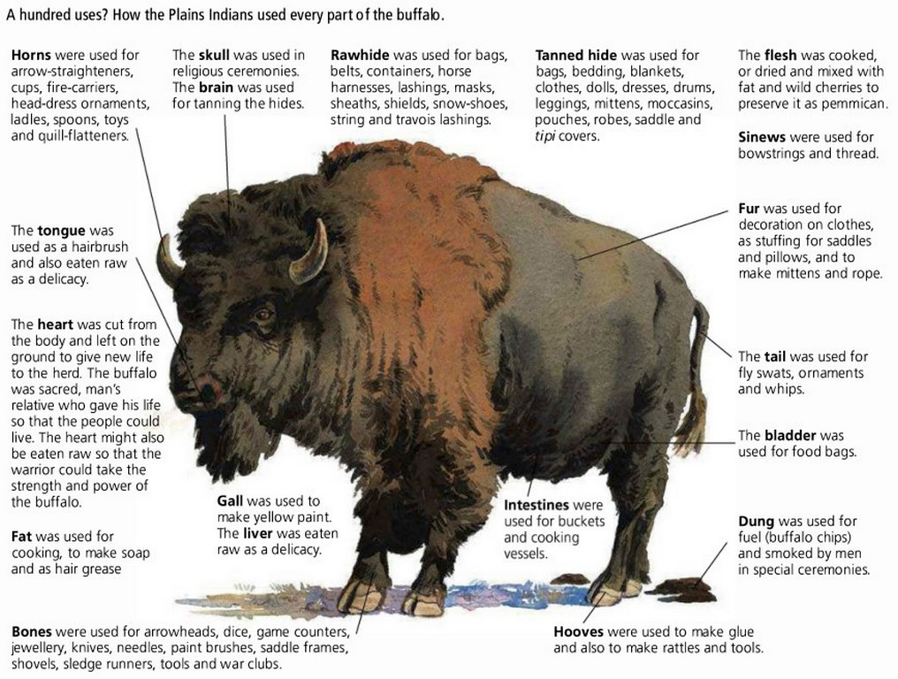
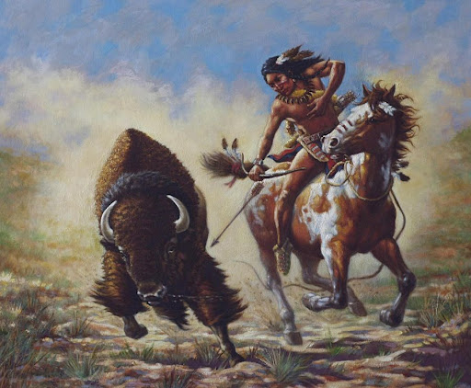
LESSON 2: The importance of the Buffalo and Horse to the Plains Indians
The Importance of the Buffalo
The buffalo were central to the survival of the Plains Indians and they were seen as a sacred animal. The whole existence of the Plains Indians depended on the animal, to the extent that the Plains Indians had a nomadic lifestyle. Being nomadic meant that they moved around rather than settling in one place. This was so they could follow the natural migration of the buffalo across the Great Plains. In the winter months, Plains Indians might stay in more protected wooden lodges but apart from this they were on the move all the time.
Before setting out to hunt, the Plains Indians would hold a ceremonial Buffalo Dance which could last for several days. The reason for this was to call upon the spirit world for good luck in their hunting and to call the buffalo closer to them.
With horses, the Plains Indians would be able to hunt effectively with bows and arrows as well as spears. Each warrior would mark his arrow so that he could identify the buffalo he had killed. Warriors gained honour and pride from their hunting and archery skills. In order to get close enough to kill a buffalo, the hunter had to put himself and his horse in great danger.
Bands would also sometimes join together for some hunts if a herd of buffalo was big enough. The buffalo hunts were very well organised and the warriors would make sure that not too many buffalo were killed for what each tribe needed. This was seen as part of the respect they would show for animal. Two or three successful buffalo hunts a year were all that was needed to feed, clothe and shelter each band.
After the hunt, the buffalo was butchered by the women and children. Some parts such as the heart were given as an offering back to the spirit world as a thank you and a show of respect for the animal. Some of the body parts such as the liver and kidneys were eaten raw as delicacies. Other parts were cooked and the rest was cut into strips to be smoked or dried in the sun. This dried meat called jerky would keep for a very long time. The hides were worked by the women and used to make tipi covers and clothes. Every other part of the buffalo would be used to make something. This was also a way of showing respect to the animal by not wasting any part of its body.
The Importance of the Horse
Originally there were no horses in America but Spanish invaders brought them over during the time of Elizabeth I. Some of these horses were then captured by the Indians. From then on, tribes bred and traded horses with each other.
Horses allowed the tribes such as the Sioux and the Cheyenne to move around the Great Plains to live and hunt buffalo far more easily. They had the speed and ability to ride long, harsh distances which allowed the Plains Indians to hunt for a long time.
Having horses for transport allowed the Plains Indians to give up staying on one location in order to become nomadic hunter-gatherers who would travel to follow the migration of the herds of buffalo they relied on.
As well as hunting the horse was used as a means of transport for the tipis and equipment the Indians needed to take with them.
Horse also changed the way the Plains Indians fought. Warrior Indians could raid over a much longer distance and it also gave a new reason for the tribes to fight each other – to steal horses. It also changed the way that individual warrior Indians fought as horsemanship skills became an important part of how powerful or brave a tribe was. The more horses a tribe had, the more status it gave them in Plains Indian society. Indians also counted their wealth by how many horses they owned. For example, the Comanche Tribe had 8,000 horses to only 3,000 people which gave them a great status.
Explaining the importance of the buffalo
It provided the food needed in such a baron landscape where little other food would be available.
It provided everything the Plains Indians needed in order to continue their nomadic lifestyle across the Great Plains.
It provided the tools needed to help with everyday tasks as well as hunting more buffalo.
It provided the equipment needed to carry food and water, something that had to be carried with the Plains Indians or else they would not have any.
It provided important ritual and spiritual symbols for the Plains Indians so they could show their respect to the Great Spirit.

Slide 3
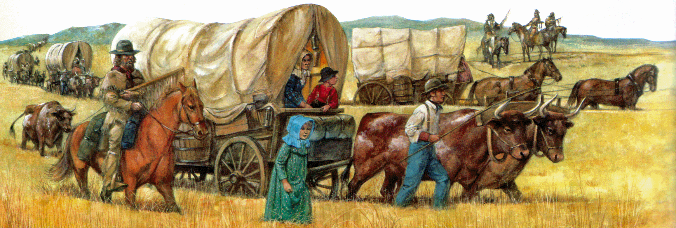
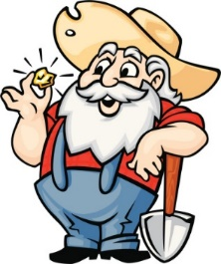
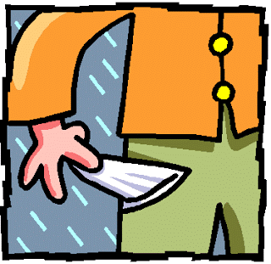
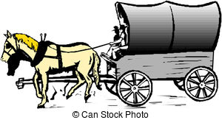
LESSON 3: What encouraged migration into the American West?
INTRODUCTION
There were a variety of factors that led people who were living in the towns and cities on the east coast of America to begin to move and settle further west. Some of these factors were ‘push’ factors. In other words, bad events were happening in their life which caused them to be pushed away from the place where they lived. However, other factors were ‘pull’ factors. These were the things in the west of America that they were attracted to and ‘pulled’ them over. Nevertheless, such a journey into the American West was for most people dangerous, long and like going into the unknown. Let’s have a look at why these early settlers migrated westwards.
THE BELIEF IN THE MANIFEST DESTINY
Many American people living in on the East Coast began to believe that it was their God given right to occupy and settle in the rest of the continent. They had a belief that the white Christian Americans had a right to populate all areas of America and that it was God’s Will for the white Christian Americans to educate and ‘civilise’ the Plains Indians. Most Americans at this time believed they were superior (better than) the Indians who they still believed were like ‘savages’. It was also this belief that made the white settlers want to change the Indians to become more like them. In fact Christian missionaries travelled into the American West to spread the religion of Christianity to the Plains Indians.
US GOVERNMENT ENCOURAGEMENT
In 1841, the US government used $30,000 to fund an expedition to map the new Oregon Trail. The report about the trail as well as the publication of the map made it sound like an exciting but more than achievable adventure for those who wanted to travel along it. The Government then spent more money advertising the Oregon Trail to encourage even more people from the east to travel west.
THE DISCOVERY OF GOLD IN CALIFORNIA 1849
100,000 people left the east to reach California as gold had been discovered. Gold was the ultimate pull factor. California’s population reached 300,000 people by 1855 and its economy grew quickly with the many so called ‘prospectors’ wanting to find gold and get rich. This was the beginning of the Gold Rush to California!
A POOR ECONOMY IN THE EAST
In the towns and cities of the east coast there had been an economic depression. Banks had collapsed and businesses struggled. People had lost their jobs and savings. Unemployment was as high as 25%. Wages had been cut 40%. People wanted a better life and they were led to believe they could get it by moving west.
NEW GOVERNMENT POLICIES
The US Government created several new laws which made access to the American West easier and less risky. For example, the Indian Removal Act (1830), and the creation of the Permanent Indian Frontier (1834) moved Plains Indians further west away from land that new settlers might want to travel. Furthermore the Indian Appropriations Act (1851) began to remove of Plains Indians into reservations.
FERTILE FARMLAND IN OREGON
The white settlers had heard from the mountain men and early settlers that there was knew better farmland on the far West coast in places such as California and Oregon. Oregon already owned by America and Britain and so provided a safe area to settle. There was huge areas of rich farmland west of the ROCKY MOUNTAINS which was known to be idea for growing fruits and farming.
OVERPOPULATION IN THE EAST
Since the first Europeans came over to the east coast in the mid 1600s, more had followed. Families grew and towns had become more crowded. Some wanted to move further west to gain more land.
THE DEVELOPMENT OF THE OREGON TRAIL
The mountain men discovered a pass (way through) the Rocky Mountains which allowed them to guide travellers through. This then opened up to become the Oregon Trail. The Oregon Trail was first publicised by an explorer called Jedidiah Smith in 1825. Slowly, other explorers dug out the trail and put down markers for others to follow. The Mountain were very important as their stories of the Oregon Trail encouraged others to seek their own adventures. The first time the trail was used with a wagon was in 1836. In 1841, only 60 people successfully used the trail using a horse and wagon. By 1846, 5,000 people had travelled the trail.
TO GAIN FREEDOM AND ADVENTURE
Some individuals, mainly men, set out in the 1830s to become PIONEERS of the American West. They were encouraged by the stories of the Mountain Men and of the US Governments publication of maps of the trails. They were motivated by the freedom of the journey, away from the over-populated east.
TO ESCAPE RELIGIOUS DESCRIMINATION
A Christian group called the ‘MORMONS’, who held slightly different beliefs to other Christian groups, were being discriminated against in the east. Many were pushed out of jobs and felt like they did not fit in. A move towards the American West would help them escape this discrimination and be an opportunity for them to find new, welcoming settlements of their own.

Slide 4
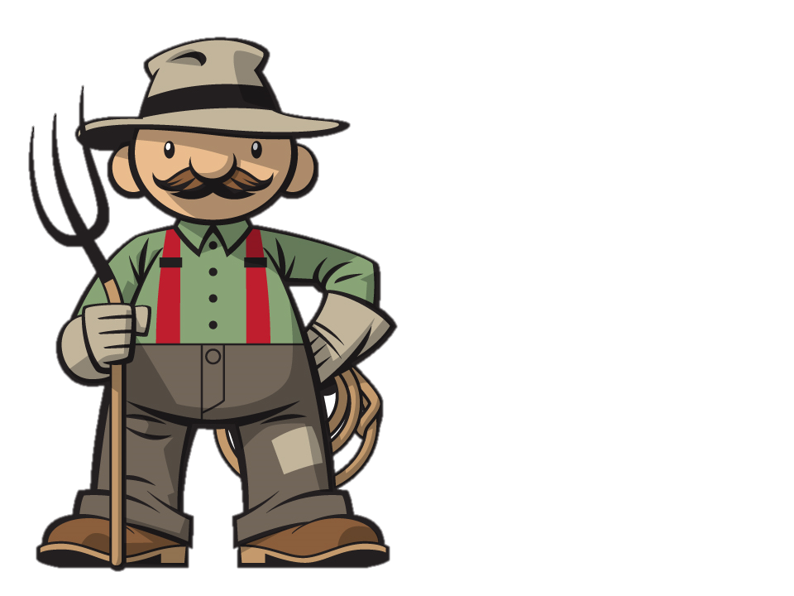
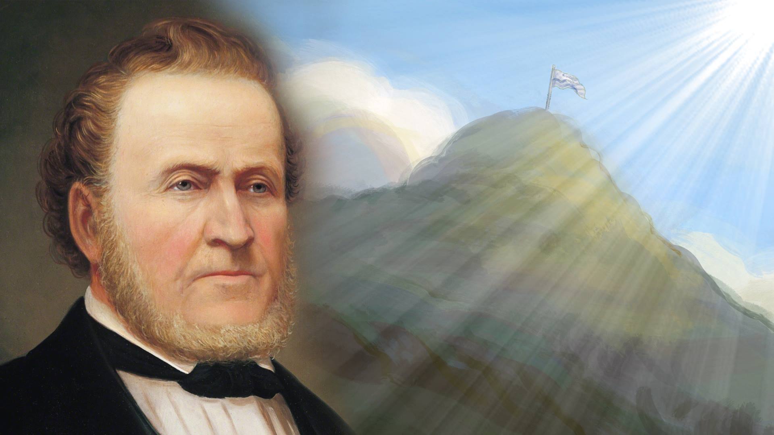
LESSON 4: Migration & Settlement - The problems of the first American migrants: The Donner Party and Mormons
The Oregon Trail was 3,200km long and would take several months to complete. This meant the migrants had to plan their trip carefully. It needed to be completed BEFORE WINTER otherwise they would get stuck in the Rocky Mountains and potentially freeze. Migrants were advised not to start their journey until April when the GRASS had grown fully enough to feed their animals. They needed to take ENOUGH FOOD with them for the whole journey as well as any essential for setting up a home once they reached their destination. The OXEN that were used to transport their goods were strong but very slow – travelling at only 3km an hour. The long rows of horse, carts, wagons and oxen were called WAGON TRAINS and could consist of up to 20 wagons. It was safer to travel as a large group but often slower. The groups also included WHOLE FAMILIES with a mixture of women, men, children and the elderly. It was also important to make sure that the people who attempted this migration had a wide RANGE OF SKILLS such as farming, building and hunting ready for their new life in the American West.
The migrants also faced a number of dangers along the way. Getting ill or any medical emergency could result in severe problems. Getting stuck or stranded would mean running out of supplies and starving. There were the dangers of snake bites or insect bites which could result in infection. At least 20,000 migrants died because of this during this time. The water borne disease of cholera was a fatal problem and came from people sharing contaminated water, including using water which had been used to clear toilets. The migrants also had the constant fear of being attacked by the Plains Indians who they reported watching them. However, attacks were rare.
The Failure of the Donner Party in 1846
The Success of the Mormon Migration 1846-7v
The Donner Party set off on their journey to California in May 1846. They were well equipped and led by the Donner Brothers, Jacob and George. The large group of 300 migrants and 60 wagons travelled as a ‘Wagon Train’. However, compared with other parties, they had more elderly people, women and children.
In July, at the Rocky Mountains they decided to split into two groups. 80 migrants including the Donner Brothers tried a new ‘short cut’ rather than the usual route which they thought would reduce the journey by 550km. This new route was untested and only mentioned briefly in an old route book written by the old mountain men.
The route was far more difficult than they thought. They lost wagons, many oxen and cattle and more importantly they lost time – a whole month.
It was not until October that they returned to the original route. They began their last climb over the Sierra Nevada mountains. However, snow began to fall and the party became stranded. They had to cross many rivers and found it difficult to find food. There were also many arguments in the group about what they should do. Already weak with their previous struggles they were not well equipped for the snow or a winter on the mountains.
By December, people had started to die, their livestock had died and food was running low. It was then that 17 men, women and children set off to cross the mountain to get help. Some died on the way and some of the others resorted to cannibalism to survive. Eventually, just 7 made it to a small settlement in California.
When news of the Donner Party spread, rescue parties from California travelled to help. However, even they struggled to reach anyone. Out of the original number of 300 migrants, only 46 survived to reach California. News of their suffering spread and was a key factor in far fewer people coming to California the year after. However, this trend changed when gold was discovered in California in 1849.
The Mormons were a religious group living in the east. They followed an influential leader called Joseph Smith. However, they faced discrimination wherever they lived and were often driven away. They were very hard working and successful. This made other Americans very jealous of them, especially when the economy suffered. Mormons were told that they were God’s chosen people, and so also faced criticism for this. They had sympathy for the Plains Indians which many American people were suspicious about. Finally, they also held a belief that a man was able to have more than one wife – an idea called polygamy. This was shocking to many Christian families who saw this as a sin. Joseph Smith was eventually attacked by a mob who murdered him in 1845. They were then ordered to leave the state of Illinois.
In 1845, they gained a new leader, Brigham Young. Young decided that the Mormons would be safer moving to the American West to an isolated place known as the Great Salt Lake Valley, east of the Rocky Mountains. Here they could be left in peace and the land would provide for them. By the end of 1847, around 2,000 Mormons had reached the Salt Lake Valley and began to settle there. However, such was Young’s planning that thousands more Mormons followed his route. It is believed that over 70,000 Mormons followed his same trial to the Salt Lake Valley between 1847 - 1869.
Why were the Mormons Successful?
Brigham Young planned every part of the migration from the preparation beforehand to how they would become self sufficient when they reached there. The journey was well supplied with food and equipment. They even had a boat built ready for any river crossings.
They used the start of the route set out by the Donner Party and cleared land to help other Mormon families as they made their journey west. Rest camps were set up with people left behind to help repair wagons. Thousands of wooden cabins were built where the weather could become cold as a way to survive the winter months. Young
Young got the help of experienced trail guides rather than trying to do it all himself. He also divided people into more manageable groups with the right variety of skills to survive in each group. Young insisted on very strict discipline and his decisions were well respected by everyone. The migrants had so much confidence in young that they believed he was a prophet sent by God.
Young taught the migrants how to form their wagons in a CIRCLE at night which helped keep in any heat for the humans as well as the animals which they took with them. The Mormons had a range of SKILLS to lead a community when they got there such as blacksmiths, carpenters and millers.

Slide 5
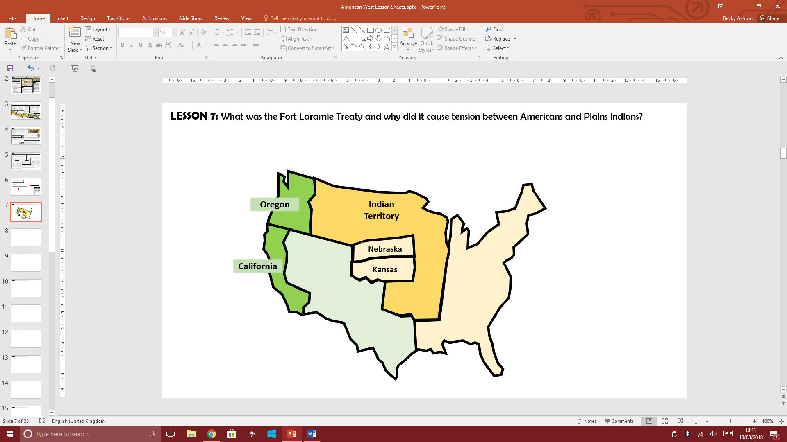
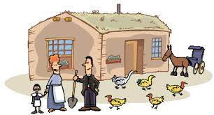

LESSON 5: Migration & Settlement - Why were the Great Plains difficult to farm and live on?
BACKGROUND INFORMATION
Once the settlers had reached California and Oregon they wanted to set up farms and settle on their own land. Some land in California and Oregon was excellent for farming as the soil was rich and fertile. Settlers even grew enough wheat to export to Europe and make money. Being on the coastline, machinery could be shipped in to help the farmers who settled there. However, the American government had also encouraged settlers to take up land in two other new territories on the Great Plains - Kansas and Nebraska. The land in these new areas had not even been studied to see how suitable it would be for growing crops, building and farming. Unfortunately, for the many settlers who ‘claimed’ land here before even seeing it, there were huge problems living and farming on the Great Plains.
Living Problems
Farming Problems
Water Shortage
Extreme Weather
Water Shortage
Difficult Ploughing
On many places on the Great Plains, water was scarce. It was difficult for people and animals to keep clean or have suitable drinking water.
The weather could be extremely hot in the summer and bitterly cold in the winter. With very low rainfall this made life on the Great Plains difficult and uncomfortable. The Plains Indians had understood this and so moved with the seasons, however these new settlers who called themselves homesteaders stayed in their one home in the same spot. They hated the fierce winds that howled around their homes and had the potential to destroy crops and other resources they needed. When it did rain, storms could be powerful and fires were caused by lightening storms.
For farming, the shortage of water was a major problem. It led to the failure of crops. This in turn could lead to starvation. In some places, homesteaders could irrigate land to bring water to their sod houses. However, on the Great Plains there were no rivers or lakes. Wells were a possible solution for some but digging a well was back breaking as well as expensive. Even then, there was no guarantee of finding water. Humans, crops and their animals all suffered.
The Great Plains had never been farmed before and the land was tough, dry and full of long roots from the grasses that grew there. Homesteaders had to attempt to plough the land but the ploughs they brought with them were often too weak and needed repairing. Farmers had to dig by hand or hire an expensive plough team with oxen. Ploughing by hand was backbreaking and slow.
Lack of Fuel
There was very little wood to burn as fuel or use for cooking. Any fuel had to be transported with the settlers when they migrated from the east in the earlier years of the migration into the American West. Homesteaders used dried buffalo dung which were called ‘cow chips’ to fuel and heat their homes.
Protecting Crops
There was no timber for fencing and so there was nothing to protect crops from the weather or from the herds of buffalo which natural migrated across the land. No fences also made it hard for homesteaders to mark their land and so sometimes this would lead to arguments over land boundaries.
Building Materials
Growing Crops
There were some homesteaders who settled in river valleys where trees would grow. These people could use wood for building homes. Some wealthier homesteaders also started to import timber from the east but this was far too expensive for most people.
The homesteaders simply believed they could grow the same crops they had used in the east of America such as maize or wheat. However, these crops were not suited to the dry soils and often failed. It was impossible to buy or import any foods into the American west and so many homesteaders struggled in their first years of the settlement.
Dirt and Disease
The sod houses were very difficult to keep clean and contained no end of bugs, fleas, mice, snakes and other irritating insects. These conditions, especially with the shortage of water often caused diseases to spread. Illness was very common, especially amongst children.
Natural Hazards
The only real building material for families was from the earth. Blocks of earth called ‘sods’ were cut out by hand or with a special plough. Then the house was roofed with boards covered in grass and more sods. The outside of the home would then be plastered with clay like mud and left to dry. If they were well built they were cheap to build, warm in the winter but it was difficult to stop rain from leaking in when it rained.
In the long hot summer, when the grass was dry, it was easy for Prairie fires to start. If they were too big to tackle then crops and homesteads could be destroyed. Fire could be started by Plains Indians encouraging new grass roots, lightning strikes or accidents from campfires. There were also plagues of Rocky Mountain grasshoppers which swept across the Plains. In 1856 they caused great damage in Nebraska. They could kill off crops and infest the wool on the sheep that were farmed.
Extreme Weather
Drought in the summer and cold in winter damaged or destroyed crops. In Kansas, no rain fell between January 1859 and November 1860.

Slide 6
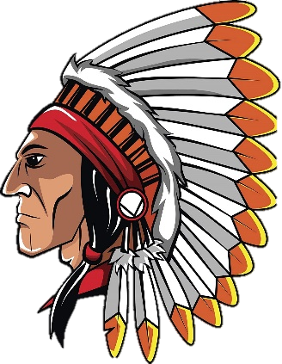
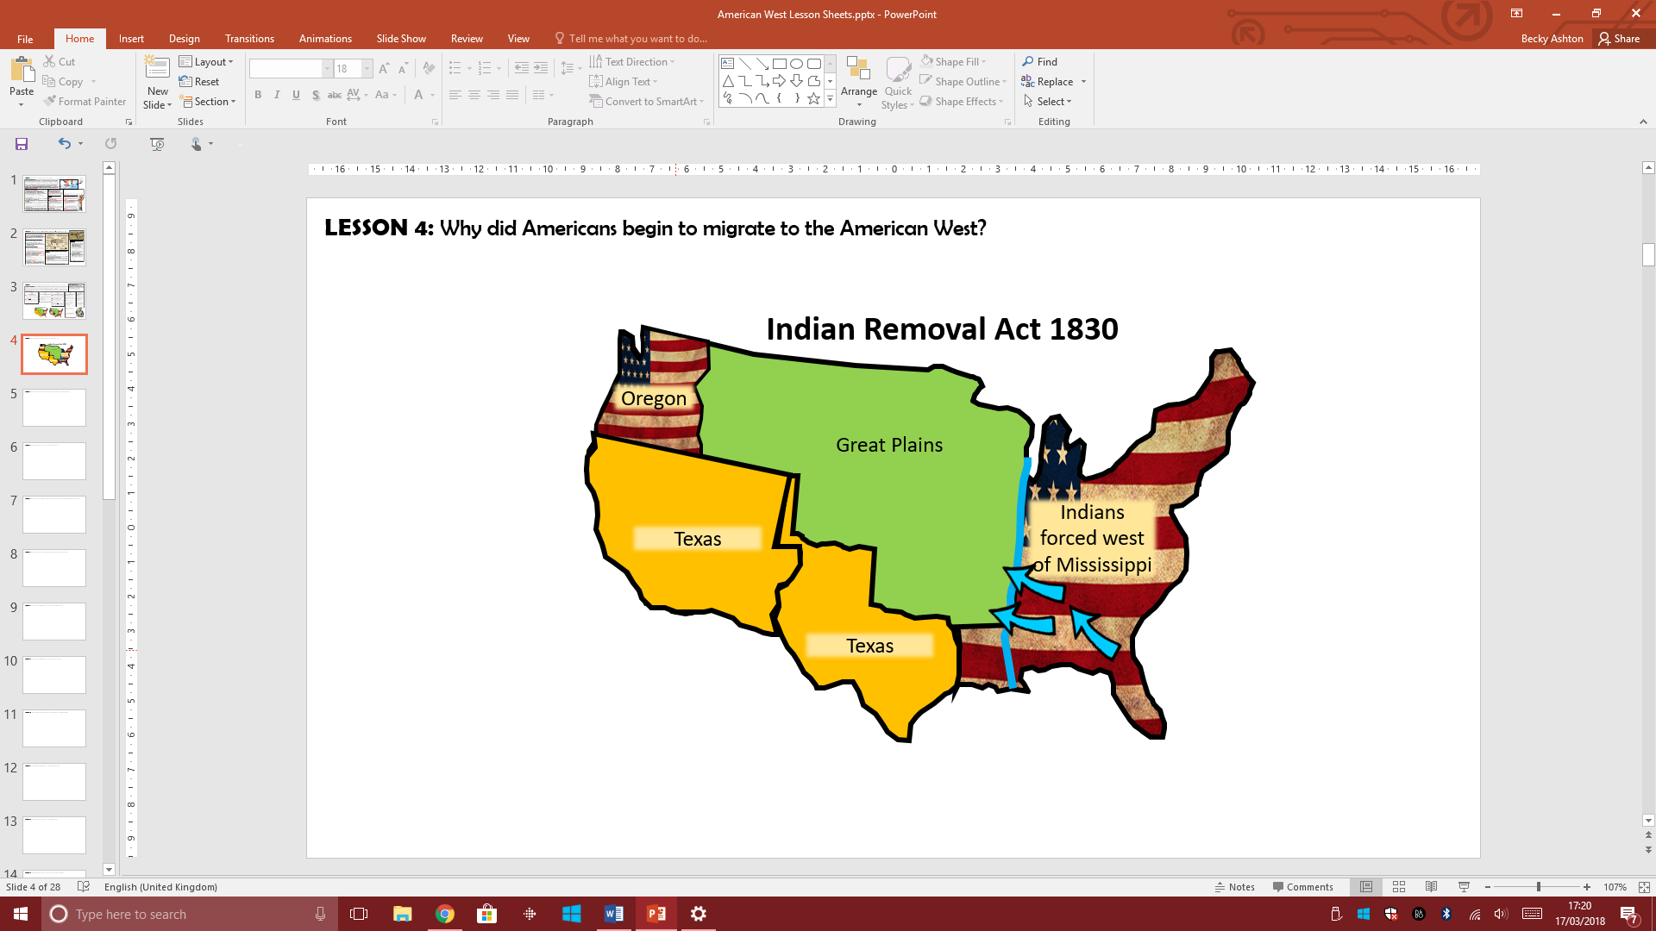
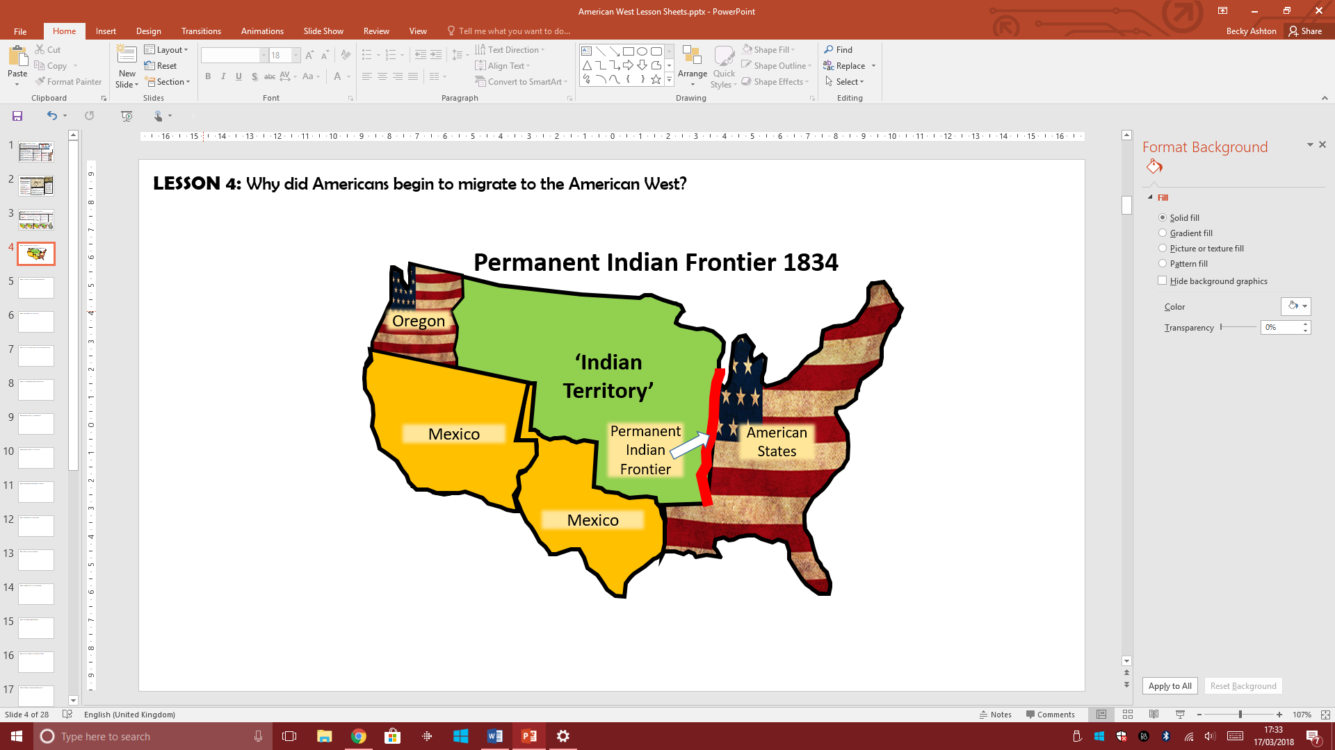
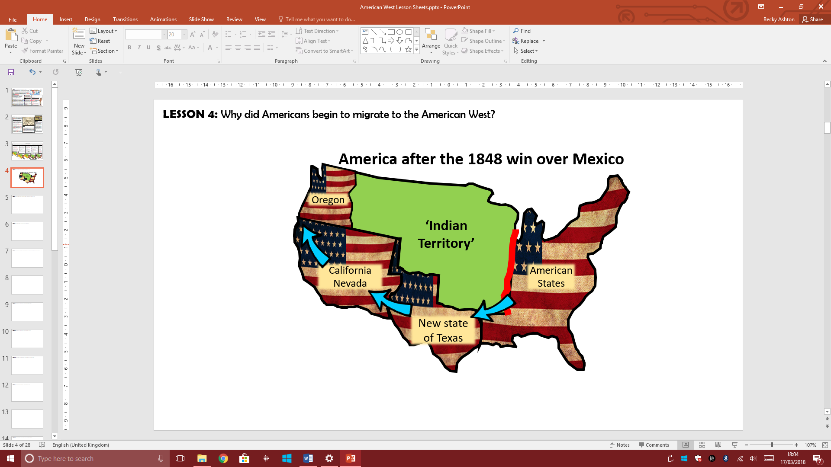
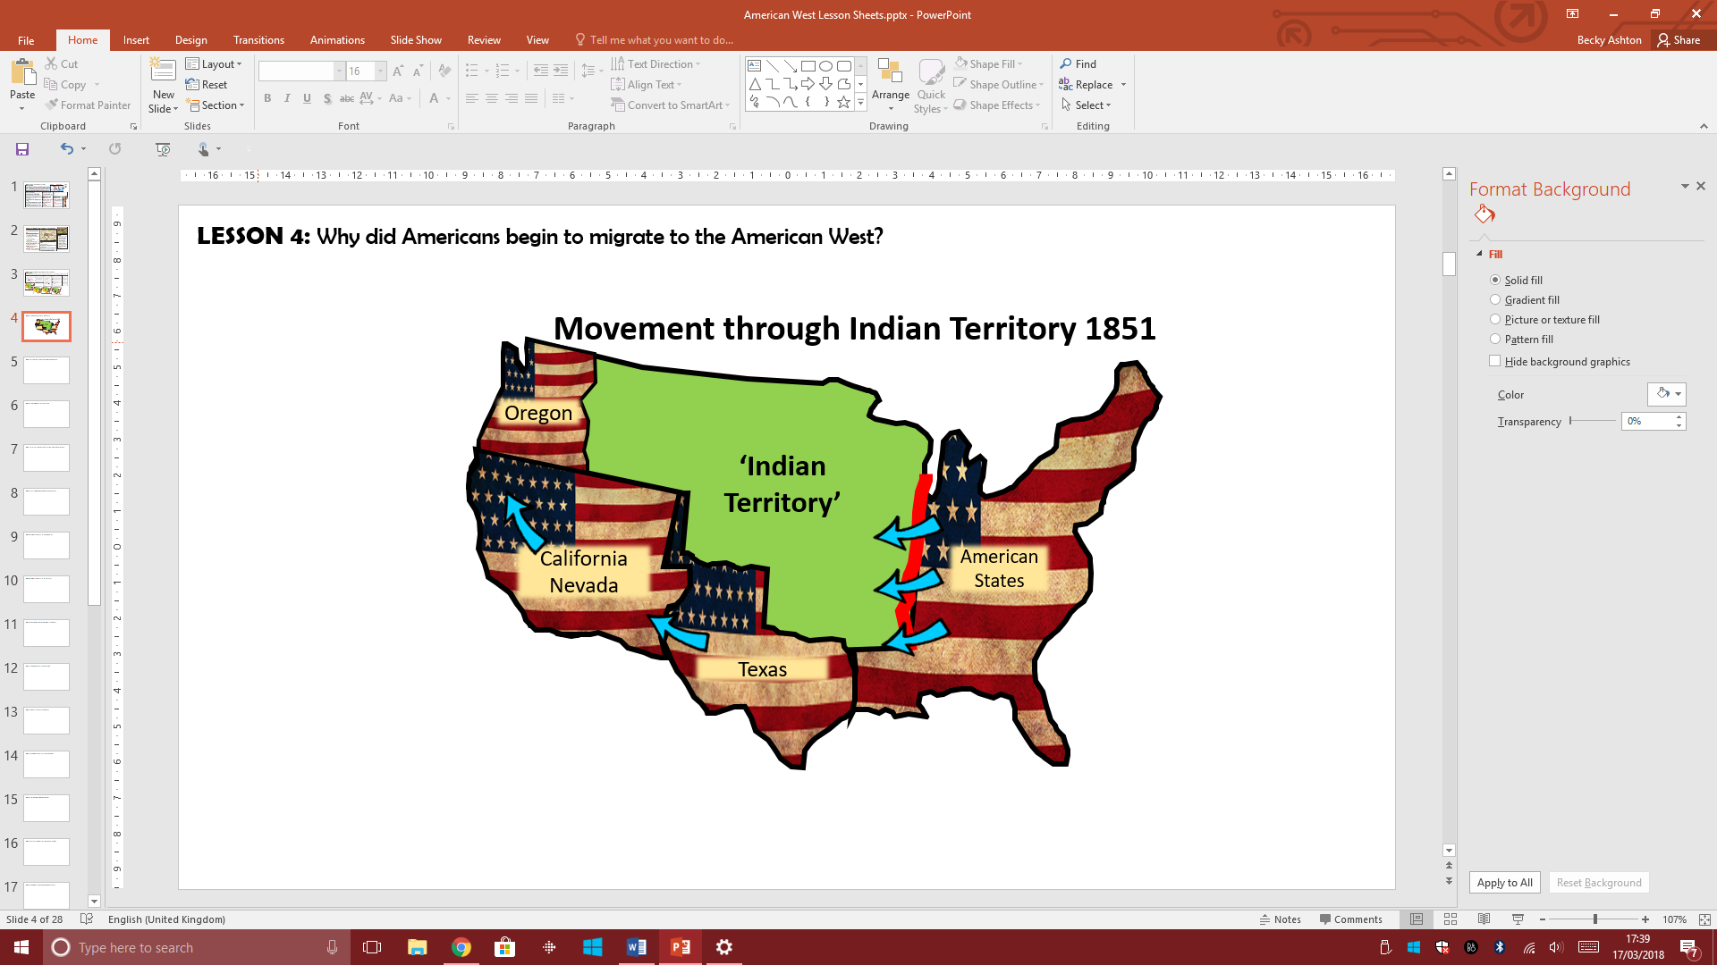
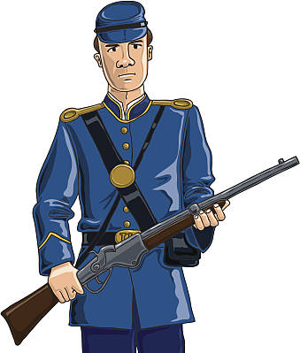
LESSON 6: Conflict & Tension - The American Government policies towards the land of the Plains Indians?
BACKGROUND INFORMATION
When the very first European settler began arriving on the east coast of America, they had come across the native people of the land. The relationship between the two sides had varied from being helpful and friendly to becoming hostile and sometimes violent. By the 1830s, many more Americans in the east wanted to explore the land to the west. This meant that they would come into more contact with the Plains Indians. The Plains Indians became seen as a barrier that got in the way of this migration west. Therefore, the America government had to become involved. Over the next few years, plans and laws were passed which increasingly moved the natives away from the land that the American settlers wanted. Eventually, these laws aimed to place Plains Indians into smaller areas of land called ‘Reservations’ and then remove the Plains Indians altogether. In each case, the Plains Indians were promised protection in return for more land. Each time, the Plains Indians were moved into smaller and smaller areas of land with no respect of understanding for their traditions, cultures or lifestyle.
The Indian Removal Act 1830
Permanent Indian Frontier 1834
American Defeats Mexico 1848
The Indian Appropriations Act 1851
The American President Jackson pressured 46,000 Plains Indians living in the east of America to move west of the Mississippi River into land which was then named the Indian territory.
Jackson promised they would not have to move from here ever again. This caused huge upset for the Indians who had to move hundreds of miles from their sacred lands.
Thousands died and the route that was taken by the Indians was given the name of ‘The Trail of Tears’.
After the Indian Removal Act, the American government wanted to create a visible and physical border between Indian Territory and the Americans. This line between the two sides was known as the Permanent Indian Frontier.
To show this, American troops built a military road and began to build forts along the border.
This law actually banned any Americans from settling on any land beyond the Indian Territory.
The land in the south was originally owned by Mexico. However, America defeated Mexico and gained more land (see the map). This land was given the state name of Texas and it was located below the Indian Territory.
This meant that Americans could now travel through Texas to get to the west and states of Oregon and California.
Using Texas would be less expensive than travelling by sea. New trails were set up through Texas and more US troops were sent there to guard against any Indian tribes. However, by now some Americans were crossing the Indian frontier to get to Texas and the west.
By the 1850s, the American government wanted to encourage more settlement in the west without the risk of being attacked by Plains Indians.
In the Indian Appropriation Act, the American government provided money to pay for Plains Indians in the Indian Territory to be placed into ‘Reservations’. Reservations were areas of land that were to be used by the Plains Indians but would be managed by the US government.
Hunting lands were also included in the reservation lands to allow the Plains Indians to continue to hunt for buffalo and other animals. However, it meant that their nomadic life would be restricted significantly.
By restricting the Plains Indians so much like this, it was hoped by the American government that Plains Indians would want to give up their traditions and want to live just like American people.

Slide 7
LESSON 7: Conflict & Tension – The Fort Laramie Treaty 1851
The Tension between the Plains Indians and the White Settlers
After the 1840s, more migrants were beginning to use trails such as the Oregon Trail to settle in the American West. These migrants had also begun to move across land which had been designated as protected Indian Territory – many motivated by the discovery of gold in California in 1849. The settlers became more fearful of the Plains Indians. They had heard frightening stories of tribes ‘raiding’ each other’s camps for food, horses and weapons. The settlers believed they might be scalped by the Plains Indians or have children taken away. However, actual attacks on the settlers themselves were rare. The settlers also had a strong racist views about the Plains Indians and believed they had a right to the land that they were travelling on. The migrants disrupted the movement of the buffalo by frightening them to stampede or hunted too many buffalo for their meat. The oxen brought by the settlers often ate most of the grass available for the buffalo which meant the buffalo herds were disturbed. The white settlers put pressure on the US government to protect them. The American government responded by arranging to negotiate with Plains Indians at Fort Laramie in 1851.
What happened at the Fort Laramie Treaty?
The US government organised a meeting with the Plains Indian tribes from the Great Plains. Their aim was for the tribes to agree to end any ‘frightening’ conflicts and raids between each other - as this was scaring the white settlers. As a way to encourage more migration, they also wanted the Plains Indians to promise safe access for the migrants across the Great Plains. Finally, the government also pushed for the Plains Indians to live in a fixed area of land called a ‘Reservation’. Putting Plains Indians into reservations would allow the US government to control them more easily.
Where was Fort Laramie?
Fort Laramie was located in the central Great Plains. The fact that it was a ‘Fort’ means that the American Army were already stationed there to protect white settlers. It was in the middle of Sioux Indian land.
The Problems and Unfairness of Agreeing the Fort Laramie Treaty
Indian Leaders | MAIN PROBLEM: The US wanted each tribe to name just one chief to represent the whole tribe at Fort Laramie. The Plains Indians did not work like this as they had lots of different chiefs for different roles. CONSEQUENCE: The Chiefs selected had little experience or knowledge of what they were doing. They did not know what the best agreement would be for their own tribes or others as the experience was so new.
Meeting all tribes | MAIN PROBLEM: Some tribes did not attend the treaty and many were not really interested in what was happening. In fact some were mainly there for the free food and gifts on offer. CONSEQUENCE: Some tribes were not aware of what was agreed to as their own Chief was not present. Chiefs did not take the treaty seriously.
Using Maps | MAIN PROBLEM: The US Government wanted exact boundaries on a map. The Plains Indians did not use the land like (they did not believe in borders or boundaries). CONSEQUENCE: Plains Indians would simply not understand borders put on a map. This meant they were likely to go beyond a borderline and break the terms of the Fort Laramie Treaty.
Language Issues | MAIN PROBLEM: The Treaty was written in English and there were not enough people to properly translate it to make sure the tribes understood its meaning. CONSEQUENCE: It was impossible for the Plains Indians to know what they had just signed. They were heavily manipulated by the US government.
The US Government Agreed the following:
To protect the Plains Indians from attacks by the white settlers trying to settle on Plains Indian lands. To pay the tribes a yearly payment of $50,000 a year as long as the Plains Indians kept to the terms of the treaty. This also included paying the Plains Indians in food and products for them to use.
The Consequences of Fort Laramie Treaty 1851
RESERVATIONS – For the first time the US government looked at restricting the land the Plains Indians had. This eventually led to the Plains Indians being put into reservations.
MOVEMENT FOR AMERICANS: Settlers could now freely travel across Plains Indian territory. This meant it broke the border set out in the 1834 Permanent Indian Frontier. It eventually led to even more settlement of the Great Plains.
RAILROADS: Railroad surveyors were allowed on to the Great Plains for the first time. This then resulted in the first railroads being build across the American West in the 1860s.
ARMY FORTS: The US army were allowed into the Great Plains and allowed to build forts. This led to further settlement on the Great Plains with migrants guarded by the US army. They rarely protected the Plains Indians from white settlers as promised in the treaty.
The Plains Indians ‘agreed’ the following:
To end the traditional fighting and ‘raiding’ between their tribes. To allow migrants safe travel through their lands. To allow railroad companies to enter their land safely to survey the land. To allow the government to build roads and army forts through their land. Allow more army forts to be built. Pay compensation if any Indian broke the terms of the treaty above.
LOSS OF INDEPENDENCE: By giving the Plains Indians food and resources as part of their yearly payment, the Indians became to rely on the US Government for these resources, especially if they struggled to hunt buffalo. Therefore, the Plains Indians were starting to lose their independence.
FORMAL RELATIONSHIP: It was the first ‘treaty’ signed between the two sides. This meant it was the first time a formal relationship had been made. This led to the American government taking advantage of the Plains Indians in future ‘agreements’.

Slide 8
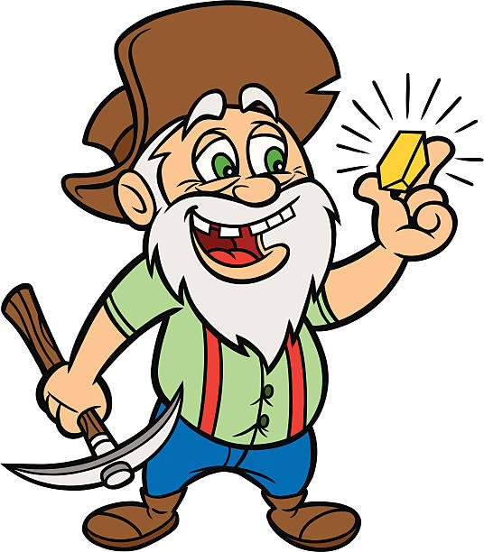
LESSON 8: Conflict & Tension – Lawlessness in Early towns of the California Gold Rush (1849)?
In the 1840s, when the number of people settling in the ‘west’ was low, there was little lawlessness. However, the California Gold Rush changed this. Huge numbers of migrants came into the American West searching for their fortune, the number of law enforcement officers to maintain law and order remained low or non-existent. The population of California dramatically increased and mass migration made the need for law and order much essential. Compared to 8,000 people in California in 1846, by 1850 it became 120,000 and then by 1855 increased to 300,000. This huge increase in population resulted in a number of problems.
A Consequence of Mass Settlement - Lawlessness
The System of Law and Order in the American West
GROWING MINING CAMPS
When gold was found, the camps grew very quickly to hold 1000s of people. This was too quick for the local officials there to deal with the amount of crime when it happened.
PROSTITUTION
There were a high number of prostitutes in the mining towns making their money from the men who had travelled alone. This could also result in drunkenness and violence.
The new territories which were being settled in were under the control of the federal (or national) government. However, these new territories only gained their own government, laws and a legal system when the population reached over 60,000. When a territory became an official ‘state’ it was given a governor, three judges to hear court cases and a US marshal. The US Marshall was the officer in charge. Over a population of 5,000 communities could elect their own sheriff. The sheriff was responsible for law enforcement and tax collection. They ran the jails and appointed their own deputies. They had no legal training but kept order as best as they could. In times of need, a sheriff or a US Marshall could also order other men in the community to join a posse to hunt down law breakers. A posse would be ordinary men, known to the sheriff and often used quite violent methods to catch any criminals.
CON MEN
Experienced prospectors tried conning new, inexperienced prospectors into buying worthless land. They planting a few bits of gold on the land to make it look like a good buy but then bought the best land themselves.
VIOLENCE & ROBBERY
Some men went outside the camps ready to rob other prospectors of their gold. Fights would break out which could become violent as most often happen as a result men also carried weapons such as pistols and knives.
The Main Problems with Lawlessness
Vigilante Groups
GEOGRAPHY: Each territory covered huge areas of land with scattered settlements. A sheriff would have to cover up to 200,000km in his area. There were simply not enough officers to cover the vast areas of the new territories of the West.
COMMUNICATION: The only form of transport was a horse or on foot. Any news of lawlessness travelled slowly which led to many crimes going unsolved.
POOR PAY: The government did not spend that much money on the new territories and so law enforcement officers were badly paid. This made it hard to recruit new officers and some officers were tempted into corruption and bribery – accepting money from criminals to avoid arrest.
LACK OF TRAINING: Officers had no official legal training. They often acted unfairly favouring their friends over others. This led to even more tension.
RACIST VIOLENT INCREASED: Racist attacks increased as a result of mass migration to settlements such as California – especially against the American Indians and the Chinese migrants. Unfortunately, the American Government itself was also racist and white Americans were encouraged to attack American Indians and laws were passed that discriminated against Chinese migrants. They also banned Chinese and Plains Indians from being a witness in court.
With so few law enforcement officers, communities set up their own vigilante groups. These were groups of ordinary men who set out to find and punish suspected law breakers themselves. Many mining camps set up vigilante groups to solve crimes and San Francisco had a vigilante Committee of around 200 people. They were successful and reduced the problems of crime in some communities. However, their version of a trial could be very unfair with many vigilante members being more violent than their suspects. They would often ‘lynch’ or hang any person they suspected as being guilty.
ALCOHOL
Mining camps often had many drinking saloons. Alcohol consumption among the men led to fights and arguments over money, land and women.
CLAIM JUMPING
Law said that the person who found the gold had a right to the land and the gold found there. But claiming gold became a competition and other men set out to steel land where gold was found. This was known as CLAIM JUMPING. This was difficult to prove with so few law enforcement officers.
RACIAL TENSIONS
Prospectors came from around the world and mixed in the camps. This led to tension between different cultures. Famine in China led to a huge increase in Chinese migrants coming to California. By 1851 there were 20,000 Chinese migrants in California who had escaped famine in China. They all competed for jobs working in the mines.
GANGS IN SAN FRANSCISCO
Failed prospectors came to San Francisco. Desperate for money, gangs began to control the city and there was a particularly bad crime wave in 1851. Law officers could not deal with the violence. Gang members were known to walk into a saloon, kill people and casually leave.
Settling Mining Disputes
Mining communities did not have easy access to the legal system such as judges and courts. This often made it difficult to solve issued about who had claimed which land. Local communities started to create their own courts with respected community members recording information about who owns which land and settling arguments over land.
THE MINING TOWN OF ARURA - CALIFORNIA
The mining town of Aurora grew in the 1860s from 800 people (1861) to 14,000 by 1864. The population was mostly male and white, with a small Chinese community. There were around 300 women but half were prostitutes. There was one school and a church. However there were 25 saloons (pubs) and just as many gambling houses and brothels and a large brewery.

Slide 9
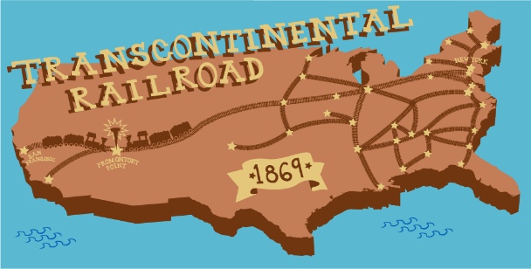
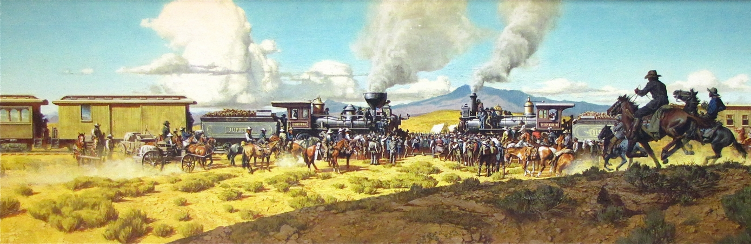

LESSON 9: Settlement in the American West - The Transcontinental Railroad (1869)
The US Government wanted to increase the number of settlers migrating into the American West. In 1862, they agreed to build a transcontinental railroad that would link the east coast of America with California & Oregon in the West. The construction of the 2,000 km railroad took until 1869. It had a significant impact on the development of the American West. The railroad was built by a mixture of Chinese and Irish immigrants as well as ex-Civil War soldiers, European immigrants and freed slaves. In 1855, surveyors began to enter Plains Indian land to survey the best route for the railroad. In 1862, the Pacific Railroad Act was passed by the American government which officially gave the go-ahead for its construction. By 1869 it had been completed with the Union Pacific and Central Pacific railroad companies meeting in the state of Utah.
The Building of the Transcontinental Railroad
The Impact of the Railroads on Settlers and Homesteaders
Travelling west became easier, quicker and cheaper. The railroad increased the growth of towns along the route. Towns appeared at each rail stop whose population grew rapidly. These growing towns also gave the Homesteaders more social opportunities away from their isolated homesteads. Homesteaders and their families back in the east could now visit each other easily for the first time. This reduced the isolation they felt and also gave an incentive for more family members to move west. The railroad also encouraged businesses to publish catalogues full of goods which were sent to families in in the American West. Families could order goods which were then sent to their nearest railroad station. Homesteaders could now order manufactured goods from the city and have them delivered via train to the nearest station.
The Impact of the Railroads on Farming
Farmers could use the railroad to sell any of their surplus crops to other parts of America. This gave them more income and in turn allowed them to increase the size of their farms. Farmers in California and Oregon could transport their grain to other parts of America, especially the big cities in the east. This also allowed farmers to set up new business and trade links to help their farms expand.
The Impact on the Cattle Industry
The railroads encouraged the growth of the cattle industry and the new cow towns which grew near the tracks. It would be possible for cattlemen from Texas to sell their cattle for meat and leather goods in the cities of the east for a lot more money. Cattlemen would also be able to transport meat to the growing populations of the American West such as the new mining towns.
The National Impact of the Railroad
The American government were now able to bring in the army at short notice to deal with any issues with the Plains Indians. There were huge trade benefits for the country as the railroad opened up trade routes with Europe and Asia from the Pacific and Atlantic Ocean. The creation of such a magnificent railroad made the idea of the Manifest Destiny seem real. It promoted confidence and hope.
The Two Railroad Companies
The American government promised plenty of jobs and profit for the two railroad companies who were chosen to build the line The Union Pacific and the Central Pacific. These two companies had a lot of power over what could happen with the land they were given alongside the railroad tracks. For example, the government promised they would use the US Army to protect railroad workers from possible Indian attacks.
Settlement
Each railroad company had its own Bureau of Immigration which persuaded people from other countries to settle on the plains. One agent, CB Schmitt apparently persuaded 60,000 Germans to emigrate to Kansas. The railroad companies encouraged settlers from America and Europe to buy land near the tracks. The railroad companies even put on special trips to show possible buyers the attractions of the land.
Investment
The railroad companies were given $16,000 for every mile of track built. This increased to $48,000 for every mile for the hardest parts across the mountains. Overall, $61million was spent on its construction. However, 12,000 men died during its construction.
Telegraph Communication
At the same time, the government funded the building of the first transcontinental electric telegraph: this was a key communication line which ran alongside the railroad tracks. It allowed telegraph messages to be sent across the continent for the first time.
THE IMPACT OF THE RAILROADS ON THE PLAINS INDIANS?
Plains Indians moved away from the railroad routes as a precaution. It was alien to them and caused fear among their people. The building also scared away the buffalo herds but also ate into the grassland which was essential for the survival of the buffalo. The tracks also created a barrier which blocked the natural migration of the herds. For the railroad workers and settlers, buffalo hunters were employed and killed vast numbers of the animal to provide meat. Buffalo hunting was even promoted by the railroad companies. One buffalo hunter named William Cody claimed to have killed 4,280 buffalo over 17 months. Therefore, the railroad prevented Indians from living their traditional nomadic life. Importantly, it also went against the agreement that was made in the Fort Laramie Treaty which actually promised to protect Indian lands from railroad surveys. It was no surprise that Plains Indian attacks increased on the railroad workers and this in turn increased the tension between the settlers and the Plains Indians.
Land
Both railroad companies were given 6,400 acres of land which ran alongside the railroad tracks. They could then advertise and sell this land to settlers from the east. Overall, this equalled 45 million acres of land taken from the Plains Indians.

Slide 10
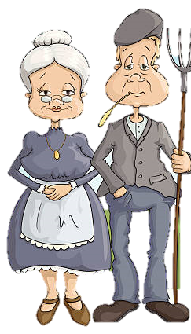
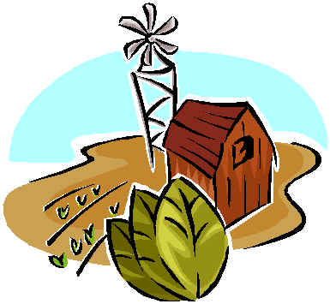
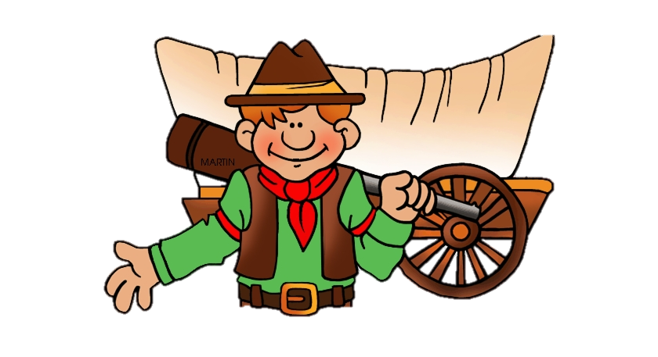
LESSON 10: Settlement in the American West - The Homestead Act (1862)
The American Civil War
The American Civil War ran between 1861 and 1865. It was fought between the Northern states called the ‘Union’ and the 7 states of the South called the ‘Confederates’. The North won and as a result, the 7 confederate states became part of the United States of America. Over 600,000 soldiers died fighting in the war with over 400,000 wounded. After the Civil War, thousands of soldiers were demobilised (came out of the army) and returned home. Ex soldiers from the southern states found it difficult to return home to the south. Much of the fighting had taken place in the south and the land and buildings had been devastated.
President Lincoln then passed a law called The Homestead Act. This allowed anyone to claim 160 acres of land in the West, as long as they lived on and farmed the land for 5 years. This was a way that the government encouraged the further settlement of the American West. The Homestead Act gave African American people a right to buy and own land in America for the very first time. It also gave the ex-soldiers from the American Civil War a chance to start a new life. In this lesson, we will discover what the Homestead Act was, its consequences and how it dramatically increased settlement in the American West.
The Abolition of Slavery
As part of re-building the south, African American slaves were freed. Many in the south who still used the African Americans for work, disagreed with this. However, the government in the North was keen to abolish slavery. Therefore, President Lincoln passed a law called the Emancipation Proclamation. This law legally freed over 4 million African American Slaves.
Why the Homestead Act?
Before 1862, the American government had tried to promote and sell land in the American West. However, it was too expensive for most American families to buy and very few large businesses were willing to buy so much land. The government needed to make the land more attractive and cheaper to buy. This way, ordinary American people would be more likely to move from their homes in the east to set up a new life in the American West. The result of this was President Lincoln’s Homestead Act of 1862.
What was the Homestead Act?
The Homestead Act was a law which allowed ordinary settler families from elsewhere in America to buy up small chunks of land called a ‘Homestead’ in the American West.
Land was divided into small areas of 160 acres. This would be enough land for a family to build a home and farm the land. However, it would be small enough to lower the cost of buying the land.
The 160 acres only initially cost $10 to ‘make a claim’ for the land. This meant that settlers could simply pay a $10 deposit and pay the government back for the rest at a later date. $10 was very affordable for most people. Once a claim for the land had been made and the family lived there for 5 years they could opt to buy the land for good for $30.
The Positive Impact
Many families were encouraged to move into the American West because the cost pf a claim was so low. This was far better than big businesses buying up vast areas of land and doing nothing with it. Lots of families resulted in vast numbers of people populating the West.
By 1876, 6 million acres of government land was sold for homesteads. Eventually, over 80 million acres of land were settled in as a result of the Homestead Act.
It led to parts of the Great Plains being settled in for the first time.
Half of Nebraska’s land became Homestead Land and by 1875, the population was big enough for it to become a state in its own right.
The government also promoted the Homestead Act abroad, especially Europe. By 1875 over half of Nebraska’s population, 123,000, were also recent immigrants and their children.
The Negative Impact
Only 13 million acres of claims had been fully bought up by 1884. This was a result of the white settlers finding it very difficult to farm. The quality of land that many homesteaders bought varied hugely with some families struggling to feed themselves before they could even think of making a profit from their crops or animals.
Only 16% of the land available from the government was actually bought up by Homesteaders.
60% of the homesteads were not ‘proven up’ (fully bought) because of the problems with farming.
The government gave 300 million acres of land to railroad companies. It would be the railroad that really encouraged settlers to the West.
Despite the government’s aim to encourage small families, big businessmen still found ways to buy up land for their own purposes. For example, cattle ranch owners would make their employees file claims for land and then hand over the rights to them to the ranch.
Who could buy land?
Anyone over the age of 21
Anyone younger than 21 as long as they had been an ex-Civil War soldier. Even those from the southern confederate states who were sold the land as a chance to make a new start in life.
Single women could file a claim
Anyone from abroad who wanted to become an American citizen
Any African American ex-slaves with the money for the deposit.
The only group not allowed to claim land were the Plains Indians
Overall Importance
It encouraged a new start for many ex- soldiers, and African Americans after the Civil War. It dramatically increased the settlement of land in the American West. It was proof that the American government were keen to populate land in the west as much as possible to the cost of the Plains Indians.

Slide 11
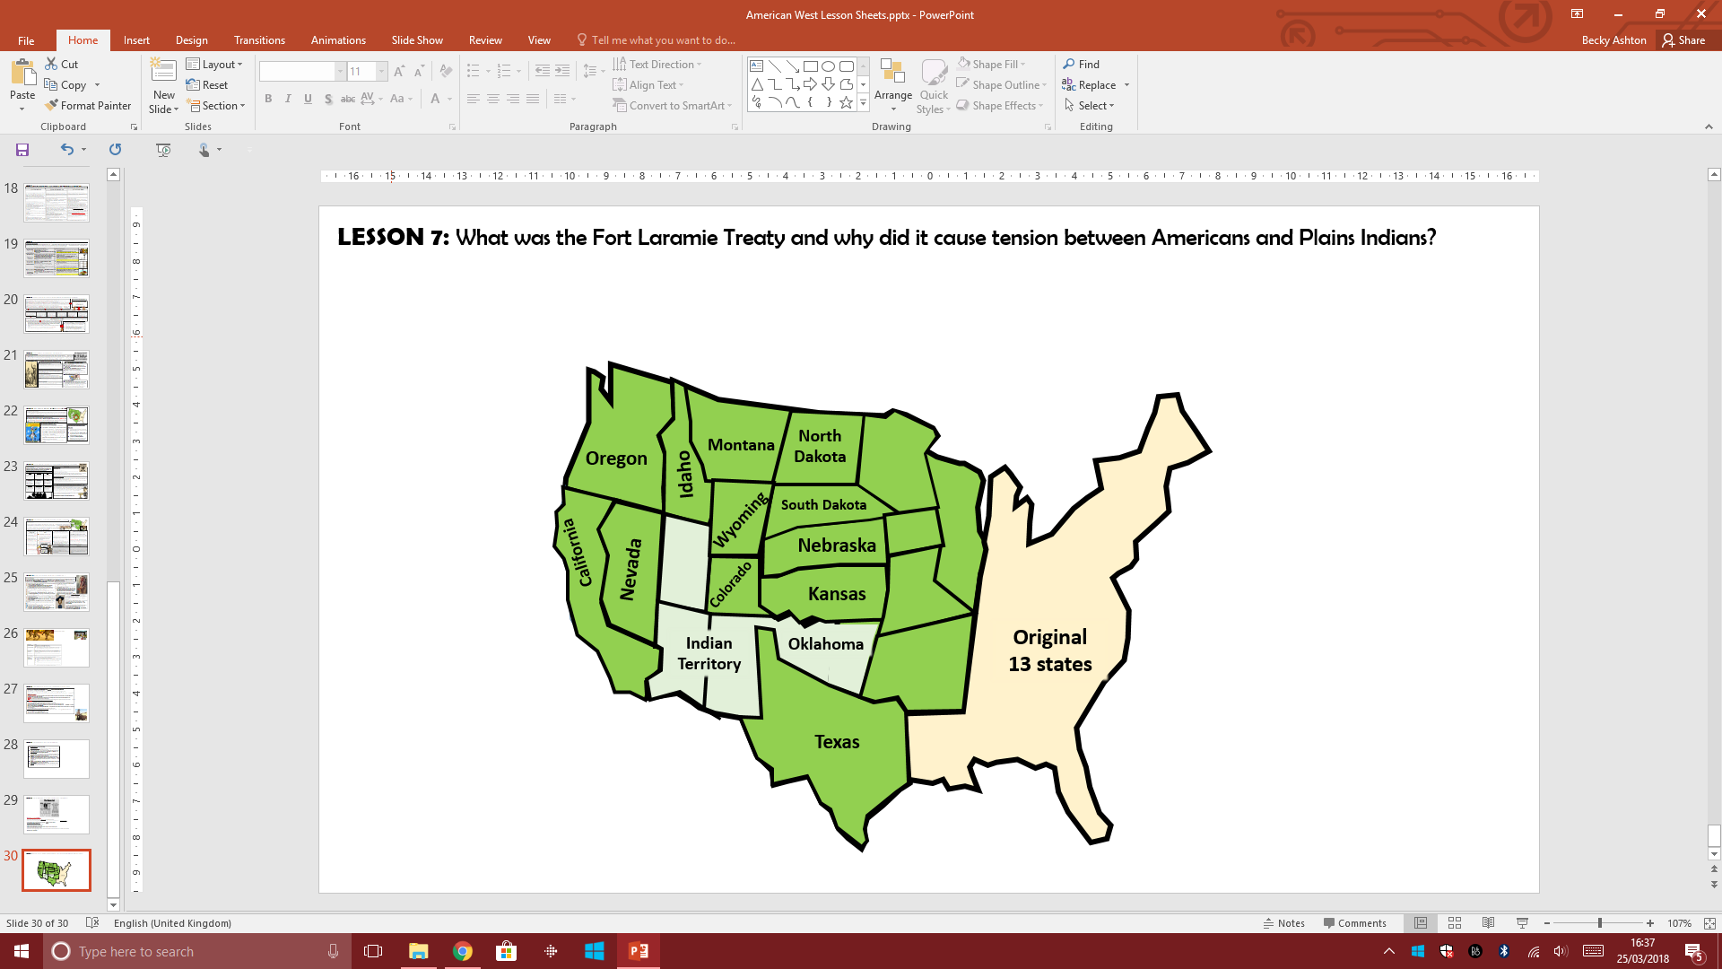
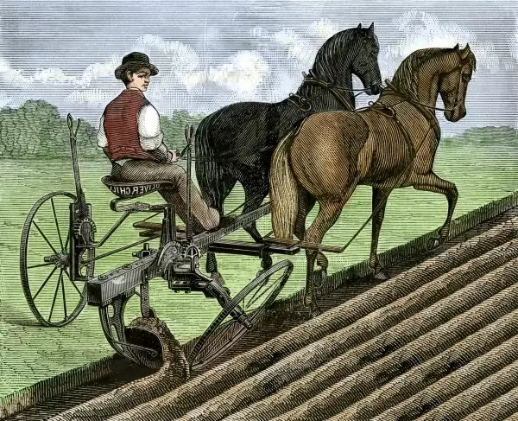
LESSON 11: Settlement in the American West - How did new farming methods help the Homesteaders in the West?
The Homestead Act encouraged the settlement of the American West by allowing people to ‘claim’ 160 acres of land for a small deposit of only $10. However, 60% of these claims were not ‘proven up’ (paid for in full). The land on the Great Plains was incredibly difficult to farm and survive on. While some families who claimed land were fortunate with land, many others struggled, especially in the states of Dakota, Nebraska and Kansas in the Great Plains. We will examine the problems faced by the Homesteaders, and then look at how inventors, farmers and manufacturers tried to overcome these problems. It’s important to know that most of the inventions were at first very expensive. This meant that it was only in the late 1870s that such inventions became cheaper and more widely used.
A lack of Timber
Homesteaders needed wood for building homes, fences to keep in their livestock and prevent their crops from being eaten. Wood was needed for fire, fuel and heat – especially in the bitterly cold winters.
A lack of Water
Rainfall on the Great Plains was low and there were few rivers and lakes. Water was needed to drink, clean, grow crops, keep land fertile and keep animals alive. The only real source of water on the plains was from natural springs deep below the ground which were difficult to access.
Dry Land
The dry, tough land often broke older ploughs which some homesteaders brought with them. They often got stuck in the deep, strong roots of the prairie grass. The land was too dry to grow important crops. The land was so dry that any sudden rainfall was likely to run off rather than soak into the soil.
Poor Land
Not only was the land dry but it also lacked the nutrients to grow the crops that were needed to survive such as wheat and corn.
Natural Hazards
Insects such as grasshoppers would destroy crops quickly. Mountain locusts could strip a field of crops in hours. In 1874 was known as ‘The Year of the Locust’ as huge numbers devastated crops across Nebraska and Kansas. Due to the dry land, fires could be caused quickly, either by human error or lightening strikes during sudden storms.
PROBLEM
The Timber Culture Act (1873)
The Timber Culture Act allowed a homesteader to claim another 160 acres if he or she promised to plant trees on a ¼ of that land. More trees would act as a wind-break to slow down the winds of the Great Plains and shelter crops from damage.
Turkey Red Wheat (1873)
A railroad company persuaded a community from Russia to settle on the Great Plains. They were tough people who were used to farming similar land. They brought with them a type of wheat called ‘Turkey Red’.
The Invention of Barbed Wire (1874)
Barbed wire was invented by Joseph Glidden. It was a much better way to fence off crops to protect them from livestock and other animals. It was also an effective way to enclose livestock to prevent them from escaping.
The Self Governing Windmill (1854) and steel blades for windmills (1870)
Windmills were used to pump water out of the ground to help farmers water their land as well as use water for the family.
‘The ‘Sulky Plough’ (1875)
This was an easy to operate, ride on plough which was better at cutting through tough roots. In 1837 John Deere invented a particularly strong steel plough which could deal with the tough prairie grass roots. It was known as the Sod Buster
There was no solution and in many ways the homesteaders simply had to learn to adapt to their new environment. Some struggled so much with their crops that they had to rely on donations of food and clothing from other states. The ongoing struggles like this put many homesteaders off from staying in the American West.
SOLUTION
Dried buffalo Dung (also known as ‘Buffalo Chips’)
When dried, it could be lit and used as fuel.
Slowly, sod houses were replaced with timber homes. 16 million acres of land had been claimed under the Timber Culture Act by 1878 with most of this land being taken up in Dakota, Nebraska & Kansas. However, many of the trees that were planted died due to the low rainfall. Only in Minnesota was there large increases in trees.
A newly invented windmill called Halliday’s windmill could pump water out of deep wells up to 30 ft deep. Stronger and more effective steel blades for the windmills were then invented in 1870. They could better stand up to the strong winds of the Great Plains which meant they needed repairing less. However, these pumps were still not powerful enough to collect water from the deeper springs and they would need constant repairs. It was not until the 1880s that these windmills were developed further.
It could plough up tough weeds and grass on the Plains. It made ploughing easier and quicker. 50,000 sulky ploughs sold in 6 years. However, they were very expensive for most farmers. Many farmers stuck with the older walk along ploughs which they were used to using and could repair themselves.
Turkey Red wheat grew well in the land of the Great Plains. Soon homesteaders were able to farm the wheat and then sell their grain for profit. It was a major boost for the homesteaders as well as the economy.
Barbed wire became cheaper than buying in timber, quicker to erect if damaged and effective at blocking livestock. However, it was not widely used until its price dropped by 90% by the 1880s. Early types of barbed wire also rusted quickly. Glidden became a millionaire, especially after new laws required homesteaders to fence off their land from roaming cattle.
CONSEQUENCE
Buffalo chips allowed families to cook and eat hot food. It was easily available.

Slide 12
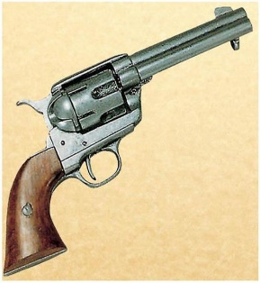
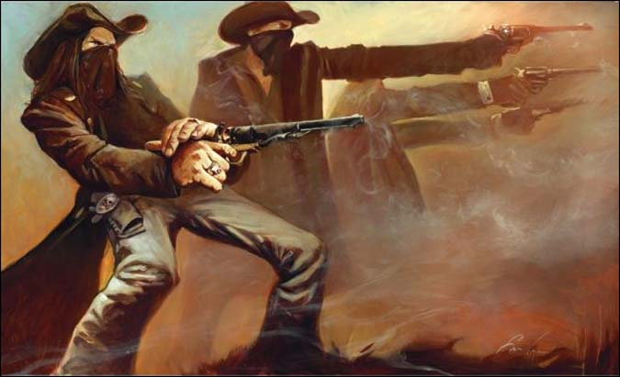
LESSON 12: The increase in lawlessness in the American ‘Wild West’.
The Causes of Lawlessness
Types of Crime in the American West
Methods of Tacking Lawlessness
The American Civil War
After the American Civil War in 1865, many men from both sides (Confederates and Unionists) decided to make a fresh start in the American West. Most of these soldiers still held on to their guns. The soldiers often still felt bitterness towards the men who they fought against and they found it difficult to readjust to normal life living alongside each other. Many were also unemployed and needed to find other ways to find money.
The Code of the West
With the absence of any organised law & order, the code that most men lived by was that it was a person’s responsibility to settle arguments themselves and that it was weak to back down. Arguments could end in shootings and if you shot someone in self defence this was not breaking the law as long as the other person was armed too. Violence often became a way to settle arguments.
Highway and Stage Coach Robbery
With more settlers arriving in the West, stage coaches were created to transport people and goods between settlements. These stagecoaches would often carry huge sums of money and became a target for robbers. Stage coach companies often had to hire armed guards or the army to protect them.
National Federal Government
The government appointed US Marshalls to oversee a state. From 1870, they were allowed to appoint a deputy to help them cover the vast areas of land. The US Marshalls were also allowed to bring in a local ‘posse’ to help them hunt down criminals as well as build jails.
Vigilante groups
Vigilantes were groups of men who took the law into their own hands. There were over 200 such groups in the West. Their methods were often outside the law and just as violent as the actions of the people they were trying to catch. They often resorted to punishments such as shooting and lynching once the outlaws were caught.
Local Government
Locals could appoint Town Marshalls who were chosen by the people of a town every year.
Pinkerton Detective Agency
This was a private company set up in 1850. It was hired by banks, railroad and stagecoach companies to provide protection for them. It was also hired to catch individual outlaws. This was further proof of how little people trusted the law enforcement of the official authorities.
Train Robbery
In 1866, the first train robbery took place. The Reno Gang stole $13,000 from a railroad car when they broke into a safe. They struck again in 1868 and stole another $96,000. From here, other gangs of outlaws robbed trains. As a result, railroad companies had to toughen the doors of their trains and hired several armed guards who could be ready to chase any robbers. The Reno Gang were finally caught by a vigilante group who then went on to lynch them.
The US Army
Occasionally, the US army could be ordered to intervene with tackling lawlessness in some areas.
Sheriffs
Sheriffs were elected by the people of a county for two years and often had to cover wide areas of land.
Lawlessness in Abilene, Kansas
Geography
The American West was a vast area and apart from the railroads, there were few transport routes. Any attempt to catch criminals would be slow and law enforcement officers would have to travel huge distances to deal crime. The training and pay for lawmen was often poor and some resorted to crime.
From 1868, Abilene was a growing and prosperous cattle town located right next to the railroad. It was the job of the cowboys to bring the cattle to the railroad at Abilene where the cattle would be loaded onto the cattle trucks. After the hard months bringing the cattle over 1,600km to Abilene, the cowboys were finally paid. They celebrated in the saloons, the gambling tables and at the local brothels. In the winter, the population of Abilene was around 500. However, in the summer months with the arrival of the cowboys, it could be as high as 7,000. Cowboys regularly had gun fights, and Abilene attracted further prostitutes and outlaws. Local residents reacted to this by building a jail in 1870. However, the cowboys tore it down and even shot down a sign banning guns. Their wild behaviour was made worse as many cowboys were southerners who kept their support of the Southern Confederacy but residents of Abilene were supporters of the Union North. The Residents of Abilene wanted something to be done and so hired new Town Marshalls.
Competition & Rivalry
There was increasing conflict between the many different groups of settlers coming to the American West, especially about issues such as land and money. For example, between the homesteaders and the cattle ranchers, the Chinese, Mexican and European immigrants, the cowboys and the townspeople. All of the new settlers also saw themselves in competition with the Plains Indians. This meant that most people were armed with weapons and ready to protect themselves from any attack.
Bank Robbery
As settlements grew, more banks were built. Some outlaws began to target banks to carry out robberies. For example Jesse and Frank James, ex soldiers from the Civil War carried out bank robberies across several states between 1866 – 76. It was only in 1882 when Jesse James was shot and his brother Frank handed himself in.
Thomas Smith (1870)
‘Wild’ Bill Hickock (1871)
In 1870, the Abilene’s town leaders hired Thomas Smith as the new Town Marshal. Smith issued a ban on carrying guns and had a fierce reputation, using his boxing skills to knock out cowboys who caused trouble. However, by late 1870 he was shot and then killed with an axe while trying to arrest a suspected murderer.
Following Thomas Smith’s death, the people of Abilene hired ‘Wild’ Bill Hickock who had fought for the North in the Civil War. He was paid $150 per month but added to his income by gambling. Some residents disapproved of him as he drank too much and lived with a succession of prostitutes. However, he did keep the cowboys under control and enforced the ban on carrying weapons. Eventually however, in a gunfight, he killed one man and accidently killed his deputy officer. He contract was not renewed. Finally, the people of Abilene made it clear that the cattle and the cowboys were no longer welcome in Abilene and they moved to different towns along the railroad.
Shootings
Between 1866 – 1900 it is estimated that around 20,000 people dies of shooting in the American West – roughly 600 a year. Some men became famous as gunfighters such as men like John Wesley Hardin and Wild Bill Hickock.

Slide 13

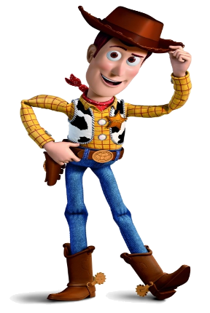
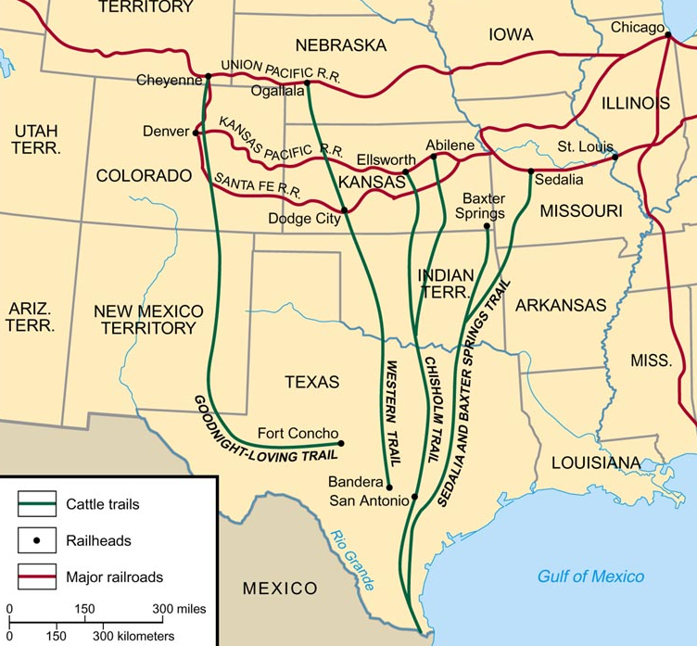
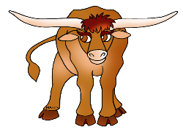
LESSON 13: The growth of the cattle industry in the American West?
BACKGROUND INFORMATION:
The development of the cattle industry had a huge impact on the American West. With very few cattle on the Great Plains at the start of the 1840s, the industry developed quickly during the 1860s and 1870s. As a result, the cattle industry created many jobs and gave men the opportunity to make huge sums of money. The three main individuals who had an important impact on the development of the cattle industry were Charles Goodnight, Joseph McCoy and John Iliff.
STAGE FIVE: The Goodnight and Loving Trail takes cattle west (1866).
One solution was pioneered by Charles Goodnight and his partner Oliver Loving. When they returned to their ranch after the Civil War, their herd of cattle had increased from 180 to 5,000 cattle. In 1866, instead of driving the cattle to the east coast, they decided to set up their own trail named the Goodnight-Loving Trail into the American West. They discovered that they could sell their cattle for food to feed the US army who had begun to settle in the American West. They also sold the meat to feed the Plains Indians who had already been placed onto reservation land. Other groups of settlers such as the gold miners in Colorado, the homesteaders and the railroad builders also provided a good sales market for Goodnight and Loving. By 1870, the US government were buying between 50,000 to 60,000 cattle a year to give as rations to the Indian Reservations. They would also sell the cattle to the Navajo Indians who were in desperate need of food. Here both men were able to sell 800 cattle for $12,000 which was four times as much as they would get in Texas. By 1876, Goodnight was so successful that his cattle ranch in Texas had expanded to 1 million acres.
STAGE SIX: Joseph Mccoy’s Chisholm Trail (1867).
A further development in the cattle industry was made in 1867. A cattle trader from Chicago named Joseph McCoy realised that a small town on the railroad would be a perfect place to transport cattle from Texas. The town’s name was Abilene and it was located in the state of Kansas. Joseph McCoy made the right decision in choosing Kansas for three main reasons. Firstly, Kansas had now relaxed its rules about Texas Fever and now allowed Texan cowboys to bring their cattle to the state. Secondly, there was grassland all the way from Texas to Abilene in Kansas which meant the cattle could be well fed along the cattle drive. Joseph McCoy developed a cattle drive route called the Chisholm Trail to bring the herds of Texas Longhorns north. Finally, as Abilene was right on the railroad tracks, cattle could be brought there and immediately loaded onto the cattle trucks ready to be transported to the east coast cities such as Chicago. McCoy used his business skills to buy land along the railroad tracks for stockyards where the cattle could be kept as well as build a depot where the cattle could be loaded. He also built a hotel for cattle traders to stay as well as made sure that Abilene and the Chisholm Trail was clearly marked out for cowboys to use. He spent $5,000 marketing his new venture and sent riders down to Texas to tell the cattlemen there all about Abilene. His new venture was a huge success. By 1867, 35,000 cattle had been driven up the Chisholm Trail and then 3 million between 1867 – 1872. Abilene became known as the first ‘cow-town’ and McCoy became hugely wealthy.
STAGE 2: Texas Fever 1855
It was soon discovered however that the Texas Longhorns carried a deadly disease called ‘Texas Fever’. If any cattle from states like Missouri mixed with the Texas Longhorns, the disease would spread and the results would be fatal. Therefore Missouri banned the Texas cattle drives in 1855. The state of Kansas also banned the cattle drives in 1859. Cattle could no longer go to these places, despite beef being in high demand.
STAGE 4: Post Civil War (1865).
After the Civil War, the demand for beef increased again. Beef was in huge demand in the north-eastern cities such as Chicago. With so many cattle in the south, each cow was only worth $5. However, in the north, especially in big industrial cities such as Chicago, the cattle were worth $40 each. Cities like this had also developed industrialised meat processing plants which turned the animal into food quickly, easily and cheaply. The only problem was, getting the cattle from Texas to the east. Some cattle ranchers organised a large cattle drive to the east but they were prevented from crossing through the state of Kansas by farmers and homesteaders who were worried about Texas Fever.
STAGE 1: Cattle in Texas: 1850s
Cattle had originally been bred in the southern states of Texas. The cattle were a breed called Texas Longhorns. They were very tough and could easily survive on the open plains – large areas of land with no fences. The cattlemen in charge of the cattle were called ‘cowboys’.
In the 1850s, beef became a popular food and the cattle ranchers in Texas became very wealthy. Cowboys herded the cattle and took them on ‘long drives’. Long drives were when cowboys would take the cattle along cattle trails, hundreds of km long from Texas to states in the east of America such as Missouri.
STAGE 3: The American Civil War (1862 – 65).
When the American Civil War began cattle ranching stopped. The cattle were simply left to roam the open plains of Texas for themselves. It was estimated that by the end of the Civil War, there were close to 5 million Texas Longhorns in Texas. However, with nobody to take care of them during the war, their meat quality was low, they were in poor health and the price of cattle fell dramatically.

Slide 14
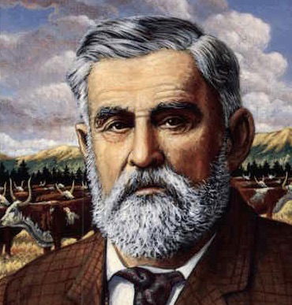
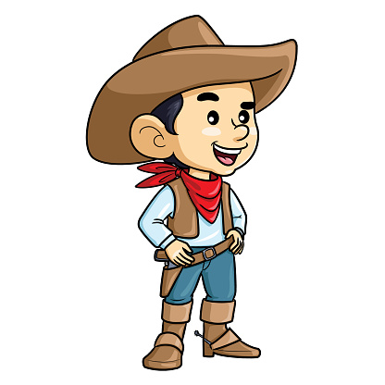
LESSON 13: The growth of the cattle industry in the American West?
The Problems with the Cattle Drives
While good money was being made using cattle trails such as the Chisholm Trail and the Goodnight –Loving Trail, there were still some problems.
Many Homesteaders who were beginning to settle on land in the American West were starting to refuse the cattlemen access through their land, making the cattle drives more difficult.
The long drive from Texas was also exhausting many of the cattle. Some cattle were becoming too thin to sell for beef and prices of these over exhausted cattle fell. One man, called John Iliff came up with the answer.
The importance of Charles Goodnight
He solved the problem of Texas Fever bans in Kansas and Missouri by driving cattle west.
He realised that he could sell the cattle in the American West to help feed the starving Indians.
He realised there was a huge market for meat from the growing gold mining towns, railroad worker, US army and Homesteaders.
His success influenced other cattlemen to drive their cattle into the American West rather than drive them to the east.
The importance of Joseph McCoy
He was the first to find a way for the cattle industry to make money after the American Civil War.
He was the first to make use of the railroads to transport cattle east. He built stockyards for the cattle near the railroads.
He was the first see the potential of Abilene as a ‘cow-town’ which could open up even more trade.
He extended the Chisolm Trail all the way to Abilene to make it easier for other cattlemen and cowboys to use.
He promoted the new Chisolm Trail in Texas by spending $5000 on advertising it to other cattlemen.
STAGE SEVEN: John Iliff starts to ranch on the Plains in the 1870s.
One cattle rancher, John Iliff began to buy some of the less valuable cattle that could not be sold from the likes of Goodnight and Loving. He began to see if it was possible to look after, breed and rear cattle on the grasslands of the American West, rather than have them being brought up on the long drives from Texas.
John Iliff realised that there was great demand for beef from the gold prospectors as well as from the Indian tribes who were running low on food.
By 1870, Iliff had built up his own herd in the state of Colorado in a town called Denver. He had over 26,000 cattle over 16,000 acres of land. He became Denver’s first millionaire, selling beef to the mining towns, the teams building the railroad and to the government for Plains Indian Reservations.
What was important was that he had proven that it was possible to raise cattle on the Plains rather than bringing the cattle from Texas. This was the start of cattle ranching on the open range. The Open Range means a large area of unfenced land over which livestock would roam freely until the cowboys brought them in.
STAGE EIGHT: The Rise of the Cattle Barons
The 1870s saw a ‘beef bonanza’ in the American West. In other words, vast amounts of money was being made from the cattle industry.
Some long drives continued from Texas to towns such as Abilene in Kansas. However, more cattlemen were influenced by John Iliff and began cattle ranching on the ‘Open Range’ of the Plains.
The costs were low with free grass, cheap land and transportation by rail with high profits to be made from selling the meat. A few wealthy men, backed by even wealthier investors, bought up vast areas of land to build their own cattle ranch. These so called Cattle Barons, were wealthy, powerful and very influential. They could even have influence over local politics as well as law and order – especially when it came to dealing with the crime of cattle rustling (stealing cattle).
The importance of John Iliff
He was the first to raise cattle on the Great Plains rather than Texas. This led to large scale OPEN RANGE cattle industry where the cattle were not fenced off but allowed to roam free
The money he made, turned him into Denver’s first Millionaire.
He won a contract with the government to supply a 7,000 Sioux reservation with beef.
He showed others that this could also be done and because of this the 1870s saw a ‘Beef Bonanza’. The men who dominated this industry were called CATTLE BARONS. They made huge profits, had lots of investment and were able to sell meat cheaply. These men were so powerful they also controlled local politics as well as lots of land.

Slide 15
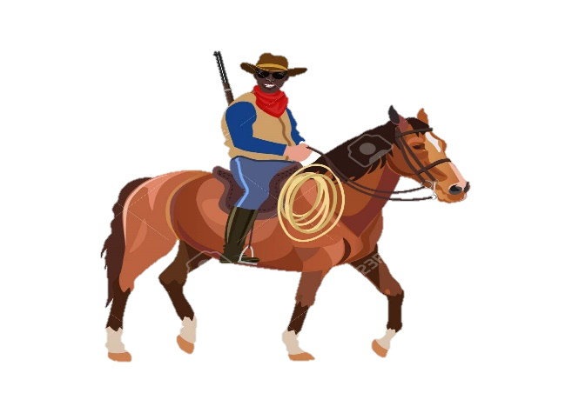
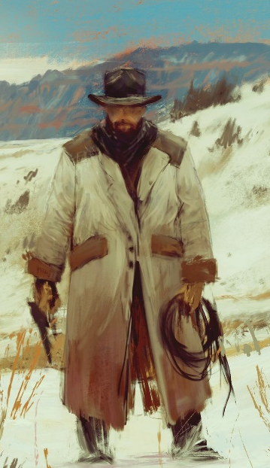
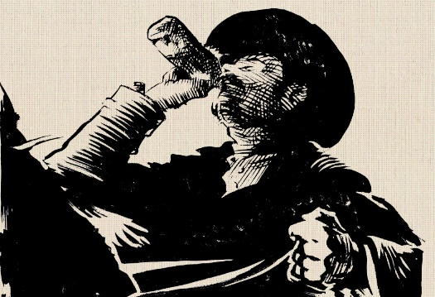
LESSON 14: The Changing role of the cowboy during the development of the Cattle Industry
BACKGROUND INFORMATION:
The original cowboys were Spanish vanqueros in Texas. The word ‘cowboy’ came into use around the 1870s. They were the men who worked with cattle on the cattle drives and the cattle ranches. Many were from the southern states with 25% being African American and 12% Mexicans. They were not well paid and their life was tough. One of the many consequences of the growth of the cattle industry was the impact it had on the lifestyle and work of the cowboy. Originally, their work was in Texas, where most Texas Longhorn cattle were located before the American Civil War. Then, with the changes brought about by Goodnight & Loving and Joseph McCoy, they were responsible for ‘driving’ the cattle along cattle trails from Texas to places such as Missouri, Abilene in Kansas or Denver in Colorado as a way to meet the railroad. With the development of cattle ranches by John Iliff on the ‘Open Plains’ in the American West however, their lives changed once again.
1. Cowboys on a Texas Ranch (1850s)
Before the development of the cattle industry in the American West, the Texan cowboys would work on huge ranches which often covered enormous areas of open land.
2. Cowboys on the ‘long drive’ cattle trails (1860s)
Once individuals such as Goodnight & Loving and Joseph McCoy started using the cattle trails, the life of the cowboys changed dramatically and life became even harder. Cowboys would still have to ‘round –up’ the cattle on the large ranches in Texas along with the other jobs expected of working on a ranch. However, they would then have to get the cattle ready for the long cattle drives north.
3. Cowboys on the Open Range of the Great Plains (1870s)
When ranches were built on the Plains by men such as John Iliff, the life of the cowboys changed once again. They no longer had to drive cattle from Texas. They still carried out the spring round ups like they had done in Texas and cattle still needed to be herded to the railheads where they were transported. However, this would take days rather than months compared to the cattle drives.
In the spring and summer months, cowboys from several ranches would work together to herd together the Texan Longhorn cattle that had been out all winter. Some cattle took a lot of finding over the vast and difficult areas. When the cattle were ‘rounded up’ cowboys began to brand them to show who they belonged to and deliver the new spring calves. Life on the Texas ranch was hard with most men in their 20s. In most ranches the cowboys would stay in a bunkhouse with the other cowboys. This was however, more comfortable than living outdoors on the long trial. There was not much entertainment and the rules were strict. Charles Goodnight for example, banned gambling with dances being held in local ranches only once or twice a year.
The Dangers of the Cattle Drive Drive
Driving cattle up the Goodnight Loving Trail to Denver took around 6 months and the Chisholm Trail to Abilene took around 4-5 months. It was a difficult job to keep the cattle together as large herds of longhorn cattle were easily spooked and this led to a stampede. Any stampede would mean them running for long distances and losing weight quickly and becoming less valuable. There were often dangers such as getting cattle to move and swim across rivers, dealing with snake bites and wild animals. Another tricky task was to negotiate with Indian tribes to cross their territory, guarding the herds from theft and fending off attacks by Indians.
How the Cattle Drive Worked
Only 12-15 cowboys would be responsible for roughly 3,000 cattle. They would work in groups led by a ‘Trail Boss’. A Trail Boss could get paid around $100 a month for the Chisholm Trail and the other cowboys around $30 a month. They always took with them a ‘Chuck Wagon’ which transported food, water and equipment. Every group also had a ‘wrangler’ who would care for the horses. Cowboys slept in the open air and took it in turns to stay awake and night to guard the animals. Sometimes they would ride for between 12 and 24 hours a day and in all weathers just to meet the deadline they were given to reach the end of the trail. They were skilled horsemen and mainly young, single men who had to be very fit and strong to carry out the exhausting work.
The Winter Months on the Open Range
One of the biggest changes for the cowboys was to deal with the conditions they faced in the winter months. Cowboys would have to ride out in all conditions such as snow storms to break up ice for the cattle to find grass and access drinking water. They might have to dig cattle out of snow drifts. Sometimes, the cowboys would have to stay out overnight and stay in simple sod houses or cabins dotted around the ranch. Some cowboys spent the winters on their own, a cold and lonely way of life.
Life on the Open Range
There were fewer dangers on the Open Plains and it was now possible for the cowboys to be on the look out for cattle rustlers and Indian attacks. Like the days back in Texas, most ranch owners were very strict with the cowboys about their behaviour and insisted on discipline. They were banned from drinking, gambling, using guns and knives were banned. Compared to the cow towns like Abilene, the life of a cowboy on an Open Range ranch would be boring. Many cowboys found it difficult to change from their old lifestyle where they had freedom on the cattle trails.
During the winter months, when the cattle were free to roam and the ranches would not employ many cowboys. With little work, cowboys had to find other jobs such as working in bars to earn a living. Some rode from ranch to ranch to try and find some work. Those cowboys lucky enough to work in the winter, would repair equipment, check on stray animals and plan for the year ahead.
The end of the Cattle Drive
At the end of the trail, they would reach the railroad where the cattle were put into boxcars and then the cowboys would be paid. The cowboys would get drunk, go dancing with the towns female population, gamble and fight. Some cowboys often spent so much money in the cow towns that they had to borrow more money to return to Texas ready for the following year’s drive. They would then return to Texas ready for the next years long drive.
Abilene

Slide 16
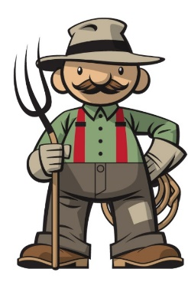

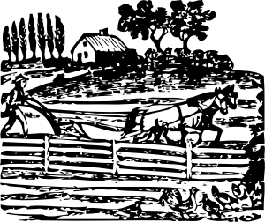
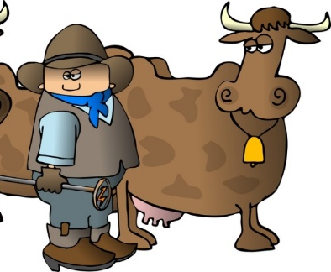
LESSON 15: Rivalry between the Homesteaders and the Cattle Ranchers
Background information:
Now that ‘Open Range’ cattle ranching had been introduced to the American West in the 1870s, it brought with it another new group of settlers – the cowboys and the cattle ranchers. Now there was much more competition for land. One the one hand, since the Homestead Act of 1862, thousands of homesteaders had bought up small areas land for their families to farm on the Great Plains. However, now that cattle ranching became profitable, the wealthy cattle ranchers and cattle barons began to buy up huge amounts of public land for their cattle to set up ranches. This led to increased tension and rivalry between then two groups. Let’s find out what the cattle ranchers and the homesteaders argued over and what the eventual consequences of this would be.
The Complaints of the Homesteaders
The homesteaders did not like the amount of public land that the ranchers were buying up and using for their cattle. The Ranchers were legally allowed to use this ‘public’ land but the homesteaders believed they were being too greedy and not leaving enough land to share with others.
As a way of protecting their land, the homesteaders would start to fence off the best land they had bought. For example, land with access to water, woodland and natural springs would be fenced off and protected. It was a complaint by the homesteaders that cattlemen were illegally using the water on homestead land for their cattle.
The Homesteaders did not like how rich and powerful the cattle ranchers were becoming. If ever a case went to court about an argument over land, the cattle ranchers, especially the more powerful cattle barons would always win. The cattle ranchers had more money to pay for the best lawyers but also more influence on the judges in their state. The wealth of the ranchers also meant that they could buy the best land with access to natural resources such as water and timber.
The homesteaders believed that they were being unfairly accused of cattle rustling (steeling cattle). Quite often, this would result in cattle ranchers using violence against the homesteaders. For example, they would cut down homestead fences, use violence against them or take them to court.
The homesteaders were annoyed that the ranchers were not fencing off their cattle (remember that cattle ranching was ‘open’ at this time. Homesteaders complained that the cattle entered their land, ate their crops and damaged buildings and equipment.
The homesteaders knew that the workers on the ranch, called ranch hands were asked to buy land through the Homestead Act pretending that this was for their own family’s use. However, homesteaders knew that once this land had been bought, the land would be given over the ranch owner to give the ranch owner more land. This was not illegal but went against the spirit of the Homestead Act and annoyed the original Homesteaders.
The Complaints of the Cattle Ranchers
Ranchers needed a lot of land so their herds could feed on the open range where grass was available. They became frustrated with the homesteaders who they accused of deliberately trying to block them by buying up more land around a ranch.
The ranchers argued that their cattle had a right to roam freely on the open plains, after all, this is what was bringing vast amounts of money to the area. For this reason they believed it was the responsibility of all homesteaders to fence off their own land and not the responsibility of the ranch owners to fence off their cattle. Simply, they believed that if cattle ate the crops from the land of a homesteader, that was the fault of the homesteader for not protecting their crops.
Cattlemen also argued with many homesteaders who were also sheep herders. Both groups were in competition over the use of land for their animals to graze. Cattle ranchers claimed that the sheep brought in diseases such as ‘sheep scalp’. They also argued that the sheep ate too much of the grass, leaving nothing left for the cattle. Both sheep herders and cattle ranchers began to fence off their land to stop the other using it. However, both groups also began to cut down these fences in protest. There were violent clashes between the ranchers and sheepherder and some resulted in several deaths in the 1870s. Some sheep farmers fenced off their herds but these were taken down by the cattle ranchers who had more power and influence.
These ongoing arguments also put a strain on local law enforcement. While the cattle ranchers with all of their money and influence tended to win any cases against the homesteaders in court, many issues were not dealt with and led to further tension and violence between the two groups. Eventually, this consequence of this was conflict. For example, later on we will examine the Range Wars and one famous range war known as the Johnson County War in 1892

Slide 17
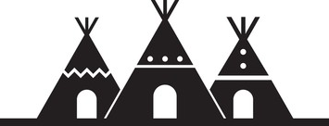
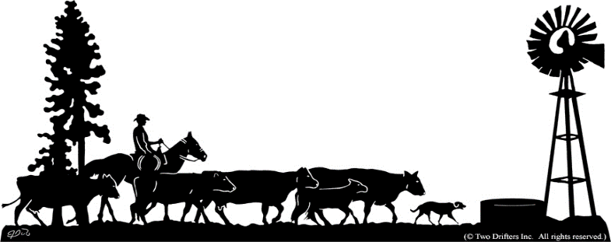
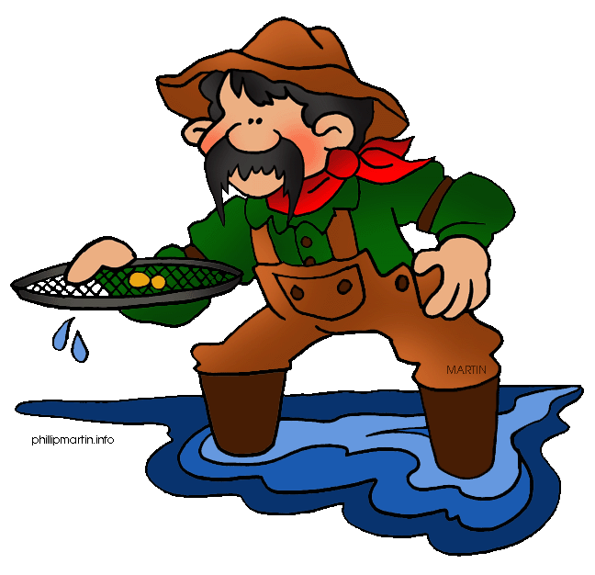
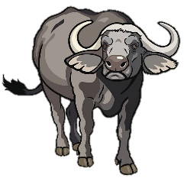
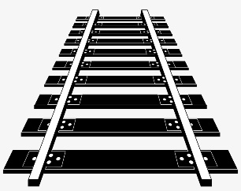


LESSON 16: The impact of the railroads, the gold rush and the growing cattle industry on the Plains Indians.
Background information:
While the building of the railroads, the Californian ‘Gold Rush’ and the development of the cattle industry were all good news for the settlers in the American West as well as the American Government, each had a dramatic impact on the traditional lives of the Plains Indians. The impact of these developments was often forgotten or ignored. Consequently, further tension and conflicts were triggered between the tribes of the Plains Indians and the settlers in the American West.
The Impact of the Railroads on the Plains Indians
The Impact of Gold Prospecting
The Plains Indian tribes had agreed to the terms of the Fort Laramie Treaty in 1851. This meant that they had agreed to allow railroad surveyors and construction teams to enter their land. Remember however, that the Plains Indians were not made aware of the impact this would have. Furthermore, the American government, unknown to the Plains Indians, were giving huge ‘grants’ (money) to the railroad companies to buy vast areas of land around the railroad lines which would also be developed.
The 1849 Californian Gold attracted thousands of prospectors wanting to get rich. The attitude of these men meant that they had no respect for the Indian lands or people. Mining towns developed quickly with thousands of prospectors arriving overnight once they heard of gold.
The Consequences:
The Impact of the Cattle Industry
The railroad created a natural border which stopped the natural migration of the buffalo. This meant that buffalo herds were not able to access new grasslands for grazing. With less grassland, the health of the buffalo suffered and the size of buffalo herds reduced.
The railroads also prevented tribes from hunting the buffalo they relied on so much. As many buffalo had to find new grasslands, it was more difficult for the Plains Indians to access and locate the buffalo herds, especially with the barrier of the fenced off railroad.
Railroad companies also began to advertise and encourage buffalo hunting. Hunters would board trains with their guns and when they came across a buffalo herd, would get off and hunt. Some hunters hunted from the train itself. This led to a massive slaughter of the buffalo and would eventually result in their extermination.
As part of the Pacific Railroad Act, the American government began to gradually take away the Plains Indians rights to land along the railroad routes. As land was bought for the railroads, some tribes were forced off their land and forced into reservations. In 1870, the Pawnee Tribe, who had been friendly to the US Government, agreed to move onto a reservation which was not even part of their spiritual homeland. They agreed to do this as they were promised they would be protected by the government and also promised food and equipment.
The route of another railroad, the Northern Pacific Railroad ran through Dakota and Montana territories where thousands of Plains Indians still lived. However, the railroad was given 40 million acres of land which it could sell to settlers. Therefore, even more Plains Indians were forced off their lands.
The cattle industry led to even more settlers moving into the American West such as the ranchers and cowboys. It also led to millions of cattle being bred and ranched on the plains of states such as Kansas, Nebraska, Colorado, Montana and Dakota.
The Consequences
Some Plains Indians were murdered by greedy Californian prospectors or forcibly moved away by prospectors who believed they were getting in the way of their gold. In migration of men from all over the world brought in new diseases that devastated the Plains Indian populations.
Mining towns grew quickly with permanent buildings such as Churches, schools and shops. These were all alien to the life of the Indians.
Treaties such as the Fort Laramie Treaty were soon broken with any hint of gold in an area. In 1862, gold was found in Montana Territory. The quickest way for prospectors to get there was through protected Lakota Sioux Land using a trail called the Bozeman Trail. So many settlers used this trail, that eventually it led to Red Cloud’s War in 1866.
The Consequences
Cattle and buffalo ate the same diet; grass. Therefore, as the number of cattle increased on the Plains, the number of buffalo decreased. From just 130,000 cattle in the West in 1860, by 1880 there were 4.5 million cattle across a number of states.
Cattle trails from Texas also impacted the life of the Plains Indians. Plains Indians organised patrols to watch out for who was using the trails. Some tribes such as the Comanche disliked trespassers on their land, attacked the cowboys and stole horses and cattle. This resulted in the US army being brought in to protect the cowboys. The army would sometimes ride out to attack the tribes which made tensions even worse.
Some Plains Indians who struggled to hunt buffalo went to work as cowboys or work on ranches. This was a more settled life for the Plains Indians but it took them away from their traditional lifestyle. It meant that they worked for money and had to rely on the ranch for employment.

Slide 18
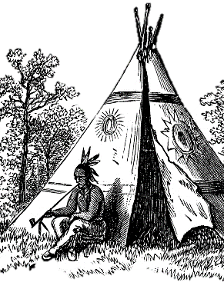
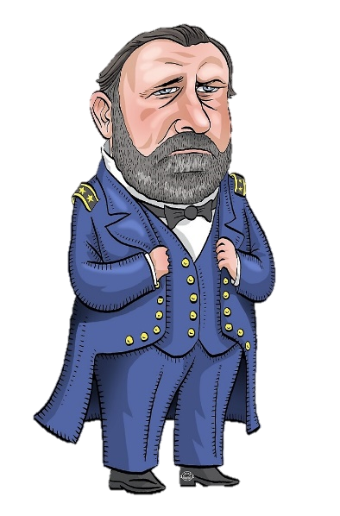
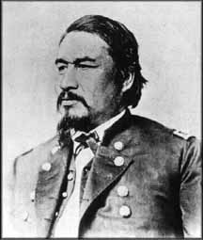
LESSON 17: US Government Policies towards the Plains Indians in the 1860s – The use of Reservations
By the 1860s, it was clear that the American government were encouraging more settlers West. As a result, previous agreements such as the Fort Laramie Treaty (1851) were being broken. Remember that the Fort Laramie Treaty of 1851, promised yearly payments called annuities, food, and equipment to the Plains Indians. It promised protection from attacks by white settlers as well as not having to lose any more land. However, the Plains Indians did not understand the idea of ‘borders’, especially as free movement was needed for hunting buffalo. This meant that the American government used the fact that the Plains Indians often crossed ‘borders’ as proof that they were not following the terms of the treaty. This gave the government a reason to punish the Plains Indians. As a result, many Plains Indian tribes were moved onto reservation land and forced to live with even more restrictions as well as follow a way of life that was very different from traditions.
What were Reservations?
Why did Plains Indians agree to move to reservations?
Broken Promises
Forced onto Reservation Land
The US Government placed Indians in reservations. Reservations were large areas of enclosed land guarded by the US Army that the Indians were expected to live within the borders of under the supervision of the US government.
What might be surprising is that Plains Indian councils and chiefs often agreed to move onto reservations rather than be forced there. They agreed because the tribes’ councils believed there was no other way for the tribe to survive. They were promised that they would be looked after by the American government with supplies of food and goods. The American government also told the Plains Indians that they could continue to hunt on their hunting grounds before returning to the reservations.
It soon became clear that the government rarely kept to these promises. Eventually some tribes learnt of the broken promises and either refused to move onto reservation land or simply walking away from the reservation land they had been placed on.
As a result, the US army was increasingly used to force Plains Indians to move to reservation land or return to them if they left. The tension and conflict between Plains Indians and the US army increased dramatically. It also led to rising tensions within the reservations themselves.
The increasing problems and tensions with the use of Reservations
President Grant’s ‘Peace Policy’ 1868
The government wanted reservations to control the Indians more easily. They believed and hoped that reservation life would encourage Plains Indians to learn about farming, be taught about Christianity, and Plains Indian children could be taught to read and write English as well as be taught American traditions. The US Army again promised to protect the Plains Indians from attacks by other tribes and outlaws. However, the reality of life on a reservation had a serious impact on the Plains Indian people.
The government showed no understanding of the nomadic or traditional lifestyle of the Plains Indians.
Indian chiefs agreed to reservations but could not force others in the tribe to staying on the reservation. Often young warriors would wander off hunting and have to be brought back by the US Army. They would then be punished by the government who would withhold food or supplies to the tribe.
Reservations were sometimes a long distance from the tribe’s sacred places.
Sometimes traditional tribal enemies were placed on the same reservation. For example the Apache and Navajo Indians were placed on the same reservation land.
Reservations often had very poor farmland so crops failed. This made the Indians rely even more on the US Government for food.
Each reservation was run by a corrupt and cheating organisation called the Bureau Of Indian Affairs. The agents who ran the reservations would be white Americans who would take advantage of their power in order to make themselves wealthy. Their racist attitudes meant that Reservation Agents cared very little for the Plains Indians.
Reservation land was often reduced in size as white settlers complained that they needed more land in the American West. The US Government gave in to this demand which made it more difficult for the Plains Indians to survive.
There was far more tension between the Plains Indians and the US army. In 1868, President Grant put forward a ‘Peace Policy’ to try to calm these tensions. His main aim was to improve the way the reservations were managed.
He replaced corrupt reservation agents with religious men, specifically Quakers who had a reputation for fairness & peace.
He appointed an American Indian, named Ely Parker as the main Commissioner of Indian Affairs.
He gave $2 million to make sure Plains Indians on the reservations were well cared for.
The Indian Appropriation Act 1871
However, any Plains Indians who refused to go to reservation land were to be treated as hostile and would be attacked by the US army. Surprisingly, despite coming from American Indian descent, Ely Parker believed that the US Government should no longer try to negotiate with the Plains Indian tribes. Instead he believed that they should be treated as ‘helpless and ignorant children’ and the government should decide for them what was best. As a result, a new law declared that the Plains Indian tribes would no longer be recognised as an independent nation or power. This made it even easier for the US government to do what it wanted with the Plains Indians and take even more of their land. It seemed that President Grant’s Peace Policy had failed.

Slide 19
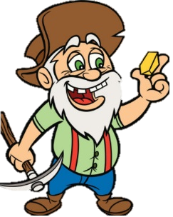
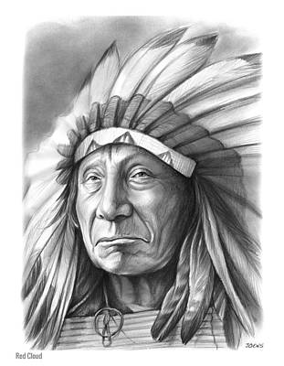

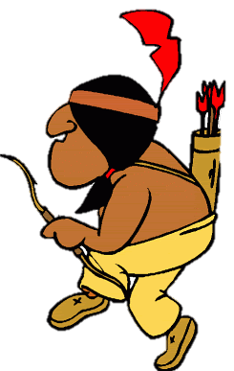
LESSON 18: Conflict between the Plains Indians and the American Army
Red Cloud’s War 1866 - 68
Tribe & Chief: The Lakota Sioux led by Chief Red Cloud
Little Crow’s War 1862
The Sand Creek Massacre 1864
The Cause of Tension
The 1851 Fort Laramie Treaty promised to protect their land. Red Cloud was angered when prospectors began using a trail called the Bozeman Trail through Sioux lands. Red Cloud wanted the Bozeman Trial to close.
Tribe & Chief: The Dakota Sioux led by Chief Little Crow
Tribe & Chief: The Cheyanne led by Chief Black Kettle
The Cause of Tension
The 1851 Fort Laramie Treaty had promised a payment of $1.4 million to the Sioux with an additional yearly payment of $80,000 if they went onto a reservation. However, in 1858, the Dakota Sioux had to sign away half of their reservation land to the government to pay off the debts they had. Little Crow said to the government: ‘you promised us that we should have this land forever but now you take half away’. Once the land had been signed away, Little Crow believed this would mean security for his people. However, settlers still trespassed through Sioux Indian land and buffalo numbers dropped leaving them with little food.
The Cause of Tension
The 1851 Fort Laramie Treaty had promised the Cheyanne to protect their land. But when gold was discovered in their Colorado Territory in 1858, settlers began crossing the land, scaring buffalo and setting up mining camps.
What the Cheyanne and Black Kettle wanted:
They wanted their land protected from prospectors.
What did the US Government promise?
They promised that is the Lakota Sioux allowed the use of the Bozeman Trail, they would get money and a promise that the size of their land would be protected.
What did the US Government promise?
In the Treaty of Fort Wise (1861), Black Kettle agreed to move to reservation with the promise of protection from any further settlers from the US army.
The problems:
Red Cloud had been warned by Little Crow not to trust any government promises. He then found out that the US army were building up the Bozeman Trail even more without being warned.
What the Dakota Sioux wanted:
Little Crow wanted his tribe to have the safety to hunt the buffalo they needed on their land as well as the money promised them.
The problems:
After hearing about Little Crow’s war in 1862, few Cheyanne Indians trusted the US government. Young warriors known as ‘dog soldiers’ refused to move to the reservation. Over three years they were that desperate for food that they attacked trains and stole food from settlers Black Kettle set up a camp at a place called Sand Creek where he believed he was protected by the army.
The problems:
The government refused to hand over the agreed $1.4 million until the Sioux had paid their debt. By 1862 however, the Sioux could not cope with trying to farm the reservation land and were starving. Some of their tribe tried to hunt for food outside the reservation but were punished by the reservation agents who began to charge them even more money for food. Eventually, some of the tribe resorted to eating grass to survive. However, the reservation agents had a full storehouse full of food but simply refusing to give any to the Sioux Indians.
What did Red Cloud decide to do about it?
Red Cloud decided to fight rather than trust the government. His tribe attacked workers and soldiers on the Bozeman trail who were building more army forts. He also united with two other Sioux chiefs, Sitting Bull and Crazy Horse. This was important as it was the first time the tribes had united against the US government.
How did the US Army deal with the Cheyanne in Sand Creek?
The local governor in charge of Sand Creek was determined to ‘kill and destroy’ the ‘hostile’ Indians. He appointed Colonel Chivington, a Civil War hero to deal with the tribe. Chivington and 700 cavalrymen attacked Black Kettle’s tribe at Sand Creek. Despite the Indians waving white flags in surrender, the army massacred 130 men, women and children. They scalped the Indians & took body parts to display in local saloons as a show of strength.
Red Cloud’s War
Here were over 3,000 Plains Indians fighting only 700 US army troops. The Lakota Sioux sent out 2 scouts who were deliberately spotted by the US army. The two scouts led 80 US army soldiers into a trap. The US army, under the leadership of Captain William Fetterman, were surrounded by Sioux Indians. He and his 80 men were killed in what was then known as ‘Fetterman’s Trap’.
The actions of the Dakota Sioux – Little Crow’s War
Some of the tribe began to raid the reservation agency storehouses to get food. They began attacking settlers and 600 settlers and US soldiers were killed in fighting.
The reaction of the Cheyanne
Black Kettle told other tribes about the actions of the US army and informed them that the US government should not be trusted in any agreement. They went on to attack forts and kill soldiers & settlers.
The Consequences
The families of the killed white settlers and the government wanted revenge for the Indian attacks. 400 Indians were arrested and 38 men executed. The rest of the Dakota Sioux were placed into even worse reservation land called Crow Creek where farming was impossible. Many starved to death in the winter of 1862.
The consequences of Red Cloud’s War
The US Government and army were humiliated by their defeat and realised they could be defeated. They actually closed the Bozeman Trial but only because another route to the gold had been found. Red Cloud agreed to the Second Fort Laramie Treaty in 1868 which set up a Great Sioux Reservation. However, Sitting Bull and Crazy Horse refused to sign another treaty.
The Consequences of the Sand Creek Massacre
The government put the tribe on half the size of reservation land they were promised before. They limited buffalo hunting and restricted their movement. The tribe were promised compensation payments for the deaths at the Sand Creek Massacre – a promise that was never kept.

Slide 20






LESSON 19: Further changes to farming between 1870 - 1890
Background Information
The first settlers into the American West faced huge challenges with tough, dry soil, extreme weather and a lack of access to water and timber. Farming land effectively enough to survive was proved a challenge with some homesteaders selling up. However, with the expansion of the railroad, farmers were able to buy a wider range of new machinery and crops to help farm their land. The US Government, who were keen to further expand settlement in the West, also invested huge amounts of money in developing new technology to help farmers. This was helped in particular with the rise of industrialisation in America. Therefore, from the 1870s, farmers were beginning to transform the Plains into rich and fertile farmland.
Farming Method: Dry Farming
Farming Method: Steel Wind Pumps
Farming Method: Barbed Wire
Farming Method: Mechanisation
Dry farming was a new experimental technique that aimed to keep as much water in the dry soil of the Plains as possible. It was a method that farmers and homesteaders could better prepare their soil to grow the crops they wanted. It was developed in 1879 by a Dakota farmer named Hardy Webster Campbell.
By the 1870s, there was still a high number of farmers to gave up on their land due to a lack of access to water. However, Daniel Halliday invented a new metal bladed wind pump which was stronger and more efficient. Later on, this was developed further by adding steel to the metal blades for added strength.
The early forms of barbed wire were expensive and prone to rust after a short time. However, during the 1880s, improvements were made by coating the wire in plastic to preventing it from rusting. Barbed wire also became mass produced and so its price fell, especially as it was easy to bring in my train.
The development of the American West came just as America was experiencing its own industrial revolution. Inventors and manufacturers were keen to make good money designing and making machinery which could help the farmers in the West. Machines were created to help the dry farmers prepare soil.
Importance/Consequences
Importance/Consequences
Importance/Consequences
Importance/Consequences
Mechanised ploughs could reach deeper into the soil.
Seed drills were developed which automatically planted seeds at the right depth.
New flour mills meant that the abundance of Turkey Red wheat could be milled quickly.
The strong steel plough invented by John Deere in the 1830s was further developed by James Oliver.
All of these inventions and developments made farming faster, more efficient and more productive. As a result, farming was able to make far more money.
Trade became vital between the farmers in the American West and the big industrial manufacturers in the big cities of the east. Therefore this further helped the US economy.
It allowed soil to trap more water. This meant that once a crop was planted, its roots could grow stronger and longer and gain better access to water deep underground.
Farmers found that dry farming worked well, especially with the Turkey Red Wheat which was introduced during the 1870s.
With more wheat, more flour could be milled by windmills creating more food for the settlers. The additional food grown from dry farming also meant farmers could sell their crops. This was an important factor to improve the trade and economy of the West.
More homesteaders began to use the technique with successful results. Knowing that such farming techniques worked also promoted even more settlement into the West.
The new blades were useful as they were designed to rotate with any wind direction. This was useful for the strong winds of the Great Plains that often changed direction.
It meant fewer blades broke and therefore fewer needed expensive and time consuming repairs.
The metal blades were more efficient for farmers ass they only needed oiling once a year, compared to the older wooden blades which would have needed oiling every week.
Water could be accessed as deep as 100m underground.
In the longer term, both homesteaders and ranchers were able to make use of the new wind pump blades to help them access water for themselves, their crops and their animals.
Timber was still in short supply and so barbed wire was good at protecting crops from animals such as cattle and the buffalo.
It was a useful way for ranch owners and homesteaders to clearly show the boundary of the their land.
The plastic coating not only lasted longer but fewer animals were harmed if they were caught up in it.
The cost reduced so much that most homesteaders and ranchers could easily afford to use it on their land.
The barbed wire reduced lawlessness as it provided an effective way to stop cattle rustling which increased in the 1870s.
In the long term it encouraged more settlers to the American West in the knowledge that they could protect the land they claimed.
It encouraged further settlement of the American West.
It increased the areas of land that could be farmed as well as increase the crop yields.

Slide 21







LESSON 20: Further development of the Cattle Industry: The end of the Open Range
The Cattle Industry so far…
Unfortunately, by the 1880s, so much money went into cattle ranching on the Plains that cattle became overstocked. There were too many cattle on the same areas of grassland and with too many of them, the price of cattle fell.
1850s: Texas Longhorn cattle mainly ranched in Texas.
OVERSTOCKING
Too many cattle were grazing on the same amount of grass. This led to the grass eroding.
OVERGRAZING
Grass did not have time to re-grow once eaten. Cattle did not have enough to eat and the land dried up.
POOR CONDITION
With less grass, the cattle became weaker. This produced poorer quality meat to sell.
LESS PROFIT
By 1882, profits were going down. Ranchers kept the cattle just in case the prices increased again. Hence, even more cattle.
A FALL IN DEMAND
With so much beef available for cities in the east, prices reduced. Cattle ranchers received less money
EXTREME WEATHER
When drought hit in 1883, the grass dried even more. Prairie fires from storms also reduced the grass further.
1861: The American Civil War results in cattle herds being left to multiply. Cattle herds in poor condition.
1865: After the Civil War, the demand for beef increases in the north.
1861: Cattle still banned from entering some states such as Kansas and Missouri due to Texas Fever
The Great Winter Die Up 1886 - 7
The winter of 1886 into 1887 was very harsh with temperatures falling to -55 degrees. Cattle were already weaker due to overstocking but now they struggled to get to the grass through the deep snow and ice. At least 15% of the open range cattle died which led to thousands of lost cattle. Many cattlemen and their ranches became bankrupt. The stock that did survive into the spring of 1887 were in poor condition but everyone tried to sell what they had – this made beef prices even lower. The larger ranches which had made huge profits in the 1870s had the most problems – the area they had to cover to save their cattle was too large. The smaller ranches, with cowboys able to locate and save their cattle coped much better.
1866: Goodnight & Loving Trial moves cattle instead to the West (reservations, army forts, mining towns and railroad builders).
1867: Joseph McCoy uses the Chisholm Trail to drive cattle to Abilene. Stockyard are built at the railhead where cattle is transported to the east.
The only way for cattle ranches to survive was to end ranching on the huge areas of the open range. Cattleman began to develop much smaller ranches.
The Consequence of the end of the open range for cowboys
The Great Winter Die Up had consequences for the cowboys as well as the ranch owners.
It meant that there was much less demand for the cowboys. Those that remained were just employed as basic ranch hands during parts of the year and many had to seek other employment.
Their lives were far less adventurous with far less freedom. All they needed to do was to brand the cattle, look after their horses and the calves, repair barbed wire fences and inspect the grasslands.
They were mainly responsible for ‘Riding the Line’ which meant patrolling the boundary of the ranch.
They lived in bunkhouses which were often not very comfortable and poorly maintained.
Smaller herds could be easily found in bad weather for food and shelter.
Smaller ranches were a lot easier to manage, to keep a watch on cattle and make sure they were well fed and watered.
More homesteaders took over cattle ranching as they could keep cattle on their small area of land. This gave more people an opportunity to make a living from cattle ranching.
Smaller ranches would provide water easily during drought with better metal wind pumps.
Smaller ranches were easier to guard so there was a reduced amount of rustling.
Smaller ranches meant higher quality meat which led to higher prices and profit.
1871: John Iliff begins ranching on the open range in the West removing the need for long cattle drives.
1875: Refrigerated railroad cars developed. Ranched beef can now be sold to distant markets easily.
1876: The cattle industry experiences a beef bonanza. Investors support ranching on the Plains. Cattle barons gain huge wealth and influence.

Slide 22



LESSON 21: Later settlement of the American West: The Exodusters 1879.
Background Information Settlers migrated to the American West for the same reasons they had in the 1840s. They still believed in the racist idea of the Manifest Destiny with the belief that the Plains Indians were inferior to them. It was also believed that they had a God given right to force Indians onto reservation land in order to take the land in the American West which they were ‘destined’ to own. However, as well as settlers from the east and a range of immigrants from places such as Europe, Mexico and China; another group of settlers began to migrate into the American West in 1879. This time, it was the newly freed slaves: the African Americans. During the American Civil War, the southern ‘Confederate’ states continued to use black African American people as slaves. Racist attitudes against the black Americans continued. However, the states of the ‘Union’ north wanted an end to slavery. As the north gained victory in 1865, President Lincoln passed a law called the Emancipation Declaration which officially ended slavery. Over 4 million black African Americans were freed.
They were part of the Exoduster Movement. ‘Exodus’ is a mass movement of people and ‘dust’ refers to the dry areas of Kansas they moved to.
The Causes of the Exoduster Movement in 1879
Consequences of the Exoduster Movement
Racist attitudes continued in the ex- Confederate states of the south
People in the south of America struggled to accept that black Americans should be freed from slavery. They did everything they could to restrict the rights and freedoms of the black Americans. Black Americans were banned from voting, stopped from buying land and often intimidated and threatened into working in similar slave conditions. It was clear that black American families were not made to feel welcome in the south.
By 1880s, there were over 43,000 black Americans in Kansas. Some settlements in Kansas were even established by black Americans themselves
Many Exodusters had travelled through areas affected by yellow fever and were very ill. The Kansas government helped them by setting up areas for them to stay in until they recovered. They also used state funding to help them get set up in Kansas.
The Exodusters were generally better off than they had been in the southern states and some attitudes towards them were more welcoming.
The Influence of Benjamin Singleton
Benjamin Singleton was an ex-slave who moved to Kansas in 1873. He promoted the idea of migrating and encouraged more to move. He promoted migration to Kansas at meetings and in newspaper adverts in the southern states. He helped hundreds of black Americans move. Singleton himself even declared ‘I am the whole cause of the Kansas Immigration’.
The Influence of Henry Adams
Another individual was American Henry Adams. He promoted the idea of black emigration to the American West. It was obvious that moving away from the southern states was a priority for many black Americans and their families.
The Homestead Act
The Homestead Act made it clear that ‘ex slaves’ had to right to claim homestead land. They could do this for as little as $5. For many, this sum of money was possible and many took up the offer.
Rumours
Ex- slaves had heard a rumour that the American government had given Kansas to former slaves for them to settle. This was not true but by 1879, 40,000 had set off for Kansas, Missouri and Illinois.
A freed slave and his family thanking President Lincoln after the Emancipation Declaration
However….
Other settlers in Kansas had already taken the best farmland. This left the Exodusters with poor farmland in the Kansas Uplands. Despite the claim for land being cheap, some struggled to pay all of the administrative payments for their land and had to rely on local charities for help. As the exodus was unplanned, both the local government and charities struggled to help.
There was more opposition to the Exodusters than they imagined. Many white Americans in Kansas thought the Exodusters should not be helped and should return to the south. They believed it was wrong that the Kansas State Government helped the Exodusters and not the settlers who were already there and struggling. Part of this was due to racist attitudes.
Some Exodusters filtered back to the southern states. Many migrants remained poorer than the whites in Kansas. Some moved to other states in the West during the late 1880s.
Religion
The second book of the bible (called Exodus) taught black Americans that migration would be helped by God who would provide protection for them and help them escape oppression.
A new start
Black Americans wanted to move away from somewhere they had been kept as slaves. They wanted better jobs and to build a new life.

Slide 23



LESSON 22: Later settlement of the West: The Oklahoma Land Rushes in the 1889 - 1895
Background Information
By the 1890s, a huge amount of land which had previously been part of the Indian Territories had claimed in American West. The Indian Territory was the land that the US government had set aside for settlement by the Plains Indians and who had been forced to move their after the Indian Removal Act way back in 1830. The Indian Territory was divided up into different sections for different tribes. However, in the middle of the Territory was a section that the government had not officially given to any particular tribe. Settlers had tried to move onto this land but had been moved away by the army as a way to prove that they had kept the promise to protect Indian land. However, by 1893 this changed when the land in the state of Oklahoma became available to claim for the first time.
Why did land in the Indian Territory of Oklahoma open up to settlement?
Demand for land results in the Land Rush
In 1887, a significant new law called the Dawes Act changed the life of the Plains Indians forever. The Dawes Act stated that Indian tribes no longer had any rights to their traditional land. The US government no longer promised protected land in the Indian Territory which had previously been given to tribes such as the Apache, Comanche and the Cheyenne. Instead, individual Plains Indian families now received only 160 acres of land each (the same as a homesteader) for their family. Even worse, many Plains Indians were then cheated into selling their land at a very cheap price by white land speculators. Furthermore, as many Plains Indian families knew very little about farming land they decided to sell their land. This left vast amounts of land in the former Indian Territory unoccupied and with no ownership.
By 1889, the US government under the leadership of President Benjamin Harrison decided to open up the middle of the former Indian Territory for settlement. The land was divided up into 160 acre sections with each section clearly marked out.
Some hoping to claim land attempted to enter the territory before the official start of the land rush but were turned back by the US army. These people were known as ‘Boomers’ and over 50,000 hopefuls set up camp on the boundary lines waiting for the land to become available.
Using massive publicity campaign, President Harrison announced that at 12 noon on 22nd April, 1889, the areas would be opened up for claims.
Thousands more rushed to the boundary of the land and waited.
When the clock struck 12, canons boomed out signalling the start of the land rush. Everyone rushed over the boundary line using horses, wagons on foot and even using bicycles. They travelled out to find the best land they could and claim it as theirs. This process was known as a land rush.
There were seven major land rushed in Oklahoma starting in 1889 when 2 million acres of former Indian Territory was opened up. The largest land rush was in 1893 when over 100,000 people crowded to claim 8 million acres of land which had been opened up for settlement. The last land rush came in 1895 88,000 acres was claimed.
The Importance of the Land Rush
It proved yet again that the Indian Territory was never really protected by the US government and the rights of the Indians were never respected. The US government repeatedly attempted to move the Plains Indians onto reservation lands with the further promise of protection.
It proved that the government were willing to give into the demands of the white settlers for more land in the West.
The land rush was a huge publicity stunt for the government which in itself attracted even more white settlers to claim land.
It proved the ongoing demand for land in the American West now that effective farming methods could be used.

Slide 24





LESSON 23: Dealing with law and order: The impact of Billy the Kidd and Wyatt Earp in the 1870s and 1880s
Background Information
The development of the West continued to cause conflict between the different groups who had decided to settle there and who still struggled to make a living. The causes of lawlessness continued in many areas.
Billy the Kidd
Billy grew up in the mining camps in New Mexico with no steady job. He stole food, became involved in cattle rustling and horse stealing. He became known for being able to escape from jails.
In 1878 Billy became involved in a conflict over resources between cattle baron John Chisum and other smaller cattle ranchers who were desperate for land. This was called the Lincoln County War. Billy fought against a powerful rancher called Murphy who was eventually killed.
Despite the Lincoln Country War ending with the death of Murphy, Billy threatened to kill everyone who had been involved the death of his friend during the conflict. He formed his own gang and had many hideouts around New Mexico.
Local people appealed to the president to end all the violence linked with Billy the Kid. The president appointed a new governor and a new local sheriff called Pat Garret to bring Billy to justice.
In 1881, Garratt captured Billy and brought him to court. He was sentenced to death but made a dramatic, murderous escape from jail. Garret tracked him down again and shot him dead.
POVERTY
Many settlers still struggled to make a living Stealing food and resources was hard to resist.
RESOURCES
Ranch owners, Indians and homesteaders still competed for the best land with access to water and grass.
FEAR
People were afraid to act against powerful gangs, corrupt police, powerful ranch owners & businessmen.
ATTITUDES
Men were expected to sort out their own problems and many had weapons such as guns. Killing by self-defense was accepted in law.
VIGILANTES
Local vigilante groups would often deal with criminals quickly. Criminals would be lynched and beaten. The undermined official systems of law.
LAWMEN
There was a shortage of reliable men to become sheriffs. Many were ex-criminals themselves and chosen for their toughness.
He was an exciting figure. Newspapers reported on him in a dramatic way and Pat Garret’s book about him made some believe he was a hero of the West. Those with less power such as homesteaders, minority groups and small ranch owners liked the way he stood up for them. He proved that the system of law in Lincoln County was still too weak to deal with him and his gang. He proved that there was tension between the influential cattle barons and the weaker, small landowners.
GEOGRAPHY
The areas were that large that criminals knew they could get away with crimes and hide easily from the law men.
WEAK LAW SYSTEM
Lawmen were often corrupt and bribed by gangs. Judges and juries were easily influenced.
RACIST ATTITUDES
There was a greater mix of white Americans, Native Americans, Mexicans, Chinese and black Americans.
Wyatt Earp and the OK Corral 1881
1874: After helping the local town Marshall to break up trouble between a rowdy group of cowboys, Wyatt Earp was offered a job as a deputy Marshall in a cow town called Wichita in Kansas.
1879: He then became a town Marshall in Dodge City, Kansas before moving to Tombstone in Arizona.
1880: Tombstone was a rich town and controlled by mine owners and businessmen. Two rich ranching families hired Wyatt as their Deputy Sheriff to bring law and order in the town. They wanted to attract more investors into the town and so wanted it to be a peaceful place where business could take place.
However, by the 1880s, lawlessness decreased. Local townspeople needed peace for their family businesses to be successful. People tended to vote in people who were willing to pass laws to ban guns within the towns. As forms of transport and communication developed, law offices and judges were able to keep in better contact with each other. Therefore the violence of Billy the Kid and Wyatt Earp became the exception rather than the rule.
On 26th October, 1881, near Tombstone’s OK Coral( a ‘corral’ is an enclosure for cattle or horses), Wyatt killed two local men from a big ranch businesses. They claimed that the ranch owners had opened fire first but many townspeople doubted this story.
1881: Wyatt’s older brother Virgil was the first to be hired as a lawman and became the Town Marshall of Tombstone. He then hired Wyatt and Morgan Earp to be his deputies. They had a lawless past with rumours that Wyatt has been involved in stagecoach robberies and cattle rusting. They soon developed a personal rivalry with the rowdy and drunken cowboys who were known for violence.
1882: Trouble continued with the ranchers shooting one of Wyatt’s brothers dead and injuring the other. In retaliation, Wyatt shot the men who were responsible. Their violent approach to law keeping had only resulted in more conflict. Wyatt was becoming a murderer with no regard for the law. Wyatt and his brothers were forced to flee Tombstone.

Slide 25


LESSON 24: The Range Wars – The events of the Johnson County War (1892)
Johnson County
Johnson County was located in the state of Wyoming. This was another area which had originally been set aside as Indian Territory but was soon settled by Americans once the Union Pacific Railroad ran through it.
By 1892 these tensions ultimately led to a conflict known as the Johnson County War
1. The killings began in 1889. Jim Averill ran a small store and a saloon with his partner Ella Watson. However, they both lived on land that was claimed by a local cattle baron named Albert Bothwell. Bothwell wanted them off the land. He then accused Ella Watson of being a prostitute as well as steeling cattle from his ranch. In fact, the rumour was that she had been given the cattle in return for her ‘services’.
The Cattle Barons
By the 1870s, Johnson County was settled by cattle ranchers. As ranching developed, rich and powerful cattle barons took hold of the area. With so much money and power, the big ranchers set up a powerful organisation called the Wyoming Stock Growers Association (WSGA). Among its members were high level politicians and state governors. It set out to keep control over the cattle industry and stop the success of the smaller ranchers.
2. In response, Jim Averill wrote to a local newspaper accusing Bothwell of being a ‘rich land grabber’. Averill and Watson were hanged outside their cabin. The sheriff arrested some men believed to be responsible but the case against them failed when witnesses were either killed or disappeared. Nobody was found guilty for the crime despite local people claiming they knew that the cattle barons were behind it. There were further attacks on small ranch owners which left three more dead. However, Bothwell took over the land as well as Ella’s cattle.
3. In response, the homesteaders and small ranch owners decided to set up their own association in 1892. They also decided to carry out the round-up of their cattle a month before the WSGA rounded up their cattle. This way, they could claim any of the spring’s unbranded new calves for themselves. This was not illegal but clearly the cattle barons would be at a disadvantage.
Problems for the Cattle Barons
By the 1880s, they faced problems. After the bad ‘Winter Die Up’ of 1886/7, the big ranch owners struggled with smaller ranches coping better. There were also more homesteaders and small cattle ranchers settling in Wyoming. This led to arguments over land as well as accusations about cattle rustling.
4. Angry, the cattle barons planned a full scale invasion of Johnson County. This was with the full support of Wyoming’s governor who even supplied them with a case of guns. The WSGA raised $100,000 for the invasion and any legal costs. Some of this money was used to hire 22 gunmen to kill the 70 homesteaders and small cattle ranch owners whose names had been written on a death list. These were the people who they believed were cattle rustlers. The gunmen were paid $5 per day and promised $50 for each rustler killed. They even paid the Union Pacific Railroad to bring the gunmen in for them on a specially ordered train. The gunfighters and cattlemen made up a force around 50 men.
The complaints of the Cattle Barons
The WSGA blamed any cattle rustling on homesteaders or smaller ranch owners. They also accused homesteaders of deliberately fencing off water supplies so cattle from the large ranches were unable to access water. The WSGA decided to take the law into their own hands. They hired a gunfighter called Frank Canton as a chief detective to catch rustlers. Some homesteaders were driven away or had their homes burned down. Tension grew as the cattle barons and homesteaders both needed to make a living from the plains.
5. Their plan was to capture the town of Buffalo, kill the sheriff and then kill the 70 people on the death list. They began by cutting down the telegraph wires which stopped the townspeople from contacting the outside world for help. However, things began to go wrong.
6. The gunmen stopped to attack a smaller ranch called the KC Ranch. There they were held up by Nate Champion. Single handed, and even after the death of his brother, he held off the invaders all day until they finally burnt him out of his cabin and shot. The next day, the people of Buffalo were armed and ready. 300 of them led by Sheriff Angus, surrounded the WSGA men in a local ranch. The WSGA men were only saved when the US cavalry arrived, ordered there by the President himself. Their powerful friends had used their influenced again.
The Outcome
Its Importance
The complaints of the homesteaders
The homesteaders and small ranch owners resented how powerful the cattle barons had become and felt powerless when WSGA members had roles in the government and local law courts. Indeed, very few men linked with the cattle barons being punished for their behaviour towards homesteaders. Many decisions over land ownership went in the favour of the cattle barons who could afford the best lawyers. Finally, homesteaders and smaller cattle ranchers were powerless when the cattlemen were able to take the law into their own hands and hire men to attack them.
The WSGA gunmen were put on trial. However, they had backing from the rich cattle barons, local judges and 2 US senators. The WSGA’s lawyers argued that the trial could not have been fair if it was held in Johnson County and so the gunmen were moved – much to the anger of Sheriff Angus. Away from Johnson County, the people chosen to be on the jury were more likely to be on the side of the cattle barons. Also, knowing that Johnson County was short of money, the WSGA lawyers extended the trial as long as they could until Johnson County ran out of money. This meant that the trial was dropped and the WSGA men were freed.
The Johnson County War proved just how powerful the cattle barons remained in the West. They had the support from the US government as well as the US army in situations where they needed help. They were able to get away with serious crimes due to their influence in courts. It also proved still how dealing with tensions was still achieved through violence rather than using any official law enforcement methods.

Slide 26






LESSON 25: Conflict with the Indians: The Battle of Little Bighorn (1876) & a change in US Government Policy
Background Information:
Between the 1830s and 1870s, several Plains Indians tribes had made agreements with the US government. This involved the Plains Indians being moved away from their spiritual land with the promise of protection and money from the government who also promised to protect the tribes from any further changes to their traditional lifestyle. A key reason for these broken promised was the discovery of gold on Indian land. For example, in 1859 gold was found in the Rocky Mountains. The Cheyenne refused to leave and this resulted in the 1864 Sand Creek Massacre. In 1863, gold was discovered in Montana with the Bozeman Trial opening up through Sioux lands. This led to Red Cloud’s War in 1866. Time after time, the agreements between the Plains Indian tribes and the American government were broken and further tension followed. By 1876, the Sioux tribes combined their forces and defeated the US Army, led by US Army commander George Custer and his 7th Cavalry. This was a shock to the American people as well as the American Government. It also led to a huge turning point in the treatment of Plains Indians.
The Events Leading to Little Bighorn
The Battle of Little Bighorn (June 1786)
Railroads
In 1874, the railroad came closer to traditional Sioux hunting grounds in Dakota. This land should have been protected by the 1868 Fort Laramie Treaty. However, US Army commander, George Custer with his 7th Cavalry were put in charge of protecting railroad builders from Plains Indian attacks.
Little Bighorn Valley
The US planned to attack the Sioux and force them back to their reservation. Custer’s scouts came across a camp of 2,000 Plains Indian warriors in the valley of Little Bighorn. Custer only had 600 cavalrymen and was ordered to wait for more soldiers to arrive before heading to Little Bighorn Valley.
Custer Attacks
However, Custer ignored the orders to wait for support and apparently said ‘The largest Indian camp in North America is ahead and I am going to attack it’. Custer went for a glorious victory over the Sioux. On 25th June, he recklessly led 200 of his men into the Little Bighorn Valley.
Sioux Attack
Custer and his men were spotted by Sioux Scouts who reported his presence to Chief Sitting Bull. Sitting Bull ordered the women and children of the tribe to safety. Meanwhile, Crazy Horse and 2,000 warriors led an attack on Custer & his men. Outnumbered, Custer and all 200 cavalrymen were killed.
Custer’s defeat
Some of the Indians were better armed than the cavalrymen. They had been given ‘repeating rifles’ by local traders. The cavalrymen only had ‘single-shot’ rifles. It was clear that Crazy Horse had planned the attack carefully, something that was an entirely new tactic for the Indians. The Battle of Little Bighorn was a huge failure and humiliation for the US army.
Custer’s Gold Rush
However, Custer also used his time to prospect for gold in the Black Hills of Dakota. Within 6 months thousands of prospectors followed claiming land to search for gold – breaking the terms of the 1868 Fort Laramie Treaty.
The government negotiates
With the knowledge of gold in the Black Hills and demand from the prospectors for access to the land, the US government tried to negotiate with the Sioux. They offered to buy the Black Hills for $6 million or pay them $400,000 a year to mine the land.
The Consequences of the Battle of Little Bighorn
A return to the reservations
After the battle, the Indians were followed and attacked by the US army. By this point, there were too many soldiers for them to fight and they were running low on ammunition and supplies. They gave in and rode back to their reservations under the control of the government.
A change in policy
The government became more aggressive towards the Indians. Instead of trying to negotiate they now followed a policy of ‘Assimilate or Die’. They were aiming to wipe out the Plains Indians altogether unless they changed their way of life to be more ‘American’.
A change in attitude
News of the defeat reached the rest of America on 4th July – the 100th anniversary of USA’s independence. It was a huge shock to the American people who demanded revenge against the Indians. Public opinion about the Plains Indians changed. Rather than being seen as ‘weak savages’ who needed to be treated like children, they were now seen as a real threat. There was huge pressure on the government to crush the Plains Indians.
The Sioux Response
The Sioux rejected the offer and were angry that the government had not protected their land as promised in 1868. They continued raids and attacks on prospectors on the Black Hills. Thousands of Sioux and Cheyenne warriors left the reservation to join with the Sioux leaders Sitting Bull & Crazy Horse.
US Government Demands
By December 1875, the government ordered the Sioux to return to their reservation within 60 days. President Grant stated that any Sioux outside the reservation would be attacked by the US army if they did not return.
The starvation of the Sioux
The Sioux were moved onto an even smaller reservation where they were unable to farm. Many Sioux starved with no help from the Reservation Agency. The Sioux were forced to sell the Black Hills, give up their weapons and horses and live under army rule.
Further Settlement
The US government ordered the building of two more army forts near Sioux land with an extra 2,500 soldiers to protect the land. The Black Hills became open for prospectors.
No more Plains Indian Resistance
On May 4th, 1877, Sitting Bull escaped over the border to Canada. On May 5th, 1877 Crazy Horse rode into his reservation and surrendered. However, he was killed in the Autumn. Therefore, the armed resistance of the Sioux was over.
Snow
However, deep snow made it impossible for all of the Sioux to obey President Grant’s order, even though they had tried. By the spring of 1876, 7,000 Sioux had built up 1,000 lodges on land outside their reservation. Chief Sitting Bull apparently said ‘If the whites want a war we will give it to them’.

Slide 27





LESSON 26: Conflict with the Indians: The Wounded Knee Massacre (December 29th, 1890).
Background Information:
The Battle of Little Bighorn in 1876 was a significant victory for the Sioux against the US army. However, the humiliation and shock of the defeat resulted in the US government becoming more aggressive in their attitude and treatment of the Plains Indians. The government now followed a policy of ‘assimilate or die’ whereby the Indians faced the end of their traditional way of life. The American public also demanded harsh action and revenge against those who had attacked Custer and his men at Little Bighorn. Consequently, the Plains Indians in the reservations were becoming desperate. They were living on poor land with few farming skills, the government had cut their rations as a punishment for Little Bighorn, their movement was tightly restricted and their relationship with the reservation agents and US army was declining further. This coupled with a drought in the summer of 1890 meant the Sioux were desperate for help from somewhere. For this help they looked to the spirit world.
The frozen body of Sioux Chief Big Foot taken two days after the Wounded Knee Massacre
Facing Starvation
The US Government had cut Sioux food rations, partly as a continued punishments for their defeat of Custer at the Battle of Little Bighorn. They received very little help during a drought which hit in 1890 wiping out the many of the crops they had grown on reservation land. Chief Sitting Bull had returned from Canada and was trying to encourage Sioux tribes to resist against the US government to help save his people.
The Ghost Dance
A Sioux Indian named Wovoka claimed to have had a vision. This vision told him that if the Plains Indians rejected white ways of life and danced a sacred dance, the Great Spirit would appear and bring all the dead Plains Indians as well as the buffalo back to life. A great flood would then wash away the white people and their spiritual lands would be returned to them once again. This dance became known as the Ghost Dance.
The Ghost Dance spread
The belief in the Ghost Dance spread to other reservations, especially with the help and influence of Sitting Bull. More Plains Indian bands began to take part in the Ghost Dance on their reservations with the hope of restoring their traditional way of life and bringing them hope.
Fear of the Ghost Dance
However, the reservation agents, US army troops and local governors were becoming very unsettled and worried about what the Sioux were doing with their dance. They were also concerned about the huge influence that Sitting Bull was having on the Sioux people.
The Consequences
The Wounded Knee Massacre
It is believed that a Sioux warrior resisted being disarmed. This resistance led others Indians to dance. In the confusion of the Ghost Dance, a gunshot was heard. The 7th Cavalry reacted. In 10 minutes 250 Sioux were dead. Half were women and children. This also included the death of Big Foot.
Wounded Knee Creek
The US 7th Cavalry caught up with the Plains Indians, gathered them together and took them to a place called Wounded Knee Creek. The plan was to stay at Wounded Knee Creek overnight due to the snow and then continued back to the reservation in the morning.
Big Foot
Sitting Bull’s followers fled south away from their reservation and joined with another Sioux band. This band was led by Big Foot. The bands gathered together in unity against Sitting Bull’s death.
The massacre was the last clash between the US army and the Sioux.
The American public praised the US Army as they too, were worried about the Ghost Dance. It confirmed their view that the Indians were ‘hostile’ and ‘wild’. This also proved how little the Americans still understood about the traditions and beliefs of the Plains Indians. It also proved that the US government were worried that the Ghost Dance would be successful and the Plains Indians might one day rise up against them.
Public opinion was positive as they believed the massacre was rightful revenge for the loss of Custer and his men at the Battle of Little Big Horn.
Finally, by 1890, the US government announced that the Indian Frontier had ended. Nowhere within the USA now belonged to any other nation or people.
Sitting Bull’s Death
The US government were convinced that Sitting Bull was encouraging the Ghost Dance and influencing his people into another rebellion. On 15th December, 1890 a group of government officials burst into Sitting Bull’s home and shot him dead.
President Harrison’s Orders
President Harrison was informed of the dance and how it was creating a fearful atmosphere in the reservations. He ordered the US 7th Cavalry (the same unit which had been defeated at Little Bighorn) army into the reservations to force an end to the Ghost Dance.

Slide 28





LESSON 27: The extermination of the buffalo and its consequences.
Background Information:
When settlers first began migrating to the American West in the 1840s, there was an estimated 35 million buffalo on the Great Plains. Buffalo were the basis of the Plains Indian nomadic lifestyle as well as an essential part of their survival. The Plains Indians however, respectfully used nearly every part of the buffalo and only killed the number they needed to survive. However, as settlement increased, the numbers of buffalo rapidly decreased. Some historians argue that this was a deliberate policy of the American government. Afterall, one way to control and reduce the numbers of Plains Indians was to destroy the one animal they relied on the most. However, other historians believe that a number of factors played a part in the destruction of the buffalo. By the mid-1880s, buffalo hunters complained that there very few buffalo to hunt. In fact, It is estimated that by 1890, the number of buffalo had been reduced to less than 1,000.
The factors which led to the extermination of the buffalo
The Impact on the Plains Indians
America’s Industrial Revolution
By 1871, a new machine could turn buffalo hide into leather for clothing. With a huge demand for leather in the cities, hunters rushed to kill as many as they could with a buffalo hide being bought for between $1 - $3. This encouraged huge numbers to hunt the buffalo. Also, factories began to take the bones from the buffalo, ground them down and turn them into fertilisers or carbon which was used in sugar refining. ‘Bone pickers’ would collect the bones, take them to the railroad and from here the bones would be transported to the factories in the east.
The Railroad
As more railroads were built, there was an increasing demand for meat to feed workers. This increased further when refrigerated railroad cars could transport more meat and further distances. The railroads were the only way the buffalo hides could be quickly transported to the factories in the cities. The more the railroads spread, the more buffalo were hunted.
The loss of the buffalo shattered the Plain’s Indian way of life. Some attempted to ‘assimilate’ by cattle ranching or farming crops. However, with little knowledge and experience, cattle herds could become infected by disease and crops failed year after year due to the poor quality land the Plains Indians had been given. Farming went against the tradition of not harming the land.
The government reduced the food rations given to the Plains Indians. With no buffalo or food, this led to in starvation on the reservations as well as poor health and little resistance to new diseases such as flu and measles. Many died as a result.
With no buffalo, the Plains Indians had no choice but to stay on the reservations. They lost their independence as they now depended on the US government for food, money and property. Without the buffalo, the Plains Indians lost their nomadic lifestyle and had to live in ‘fixed’ permanent properties which were fenced off. Plains Indians traditionally believed that the land was owned by the Great Spirit and should never be ‘property’.
Buffalo Hides
Hunters killed more buffalo than they needed and apart from the hide the rest of the animal was left to rot. Between 1872-74, 4.5 million buffalo were killed just by buffalo hunters. Plains Indians would have only needed to kill 1 million and make use of the whole animal.
The Impact for the US Government
The US government aimed to ‘assimilate’ the Plains Indians into an American way of life.
Plains Indians resisted going into the reservations as long as there were buffalo to hunt. However, the extermination of the buffalo allowed the US government to keep the Plains Indians in the reservations and encouraged them to learn to farm. The government had agreed with the Plains Indians that they would be allowed outside the reservations to hunt, as long as there were buffalo. Once the buffalo went, this right would disappear. Consequently, the US government controlled the movement of the Plains Indians.
Without the buffalo, the Plains Indians had to learn to farm This it gave the government a reason to eventually limit the food they could send to the Plains Indians.
The government benefitted from the extermination of the buffalo at it allowed them to build even more in the West. For example, it was able to develop the railroads without the buffalo potentially causing harm to workers.
The extermination of the buffalo also allowed the further development of cattle ranching. Cattle ranchers had long called for the end of the buffalo who also ate the grass they wanted for their cattle. It proved again how powerful the cattle barons were within the government.
Buffalo Hunting
Railroad companies advertised buffalo hunting trips to the Great Plains. For them it was a sport. In 1880. an estimated 5,000 whites were killing and skinning buffalo. By 1883, the herds in the north had gone.
Development
Towns, farms, shops, railroads and trails all took up the land which the buffalo would have used for feeding and blocked the natural migration of the buffalo. The buffalo struggled to survive on the limited supply of fresh grass they needed to survive.
Drought & Disease
There had been repeated droughts in the 1840s as well as diseases which were spread by new cattle and horses brought to the Plains by ranchers & homesteaders.
Improved Weapons
More powerful rifles were invented which was powerful enough to kill a buffalo in one shot. Many hunters killed more buffalo than they were able to skin and so wasted a lot of hides.
The Cattle Industry
The grassland used by the buffalo was eaten by the huge numbers of cattle on the open plain ranches.

Slide 29



LESSON 28: The Plains Indians’ life on the reservations
Background Information:
Despite making several agreements that Indian Territory would be protected, over time, the US Government gave in to pressure from white Americans and opened up even more land for settlement in the West. The US government forced Plains Indians onto smaller and smaller reservations and the Plains Indians lost their ability to live their traditional, independent way of life. It was believed that the American government as well as many white Americans that the only way of solving the ‘Indian problem’ was to deliberately force Plains Indians into smaller reservations to ‘civilise’ or ‘assimilate’ the Plains Indians. This way they would be forced to become more like ‘white Americans and forget their traditions.
The Impact of Life on the Reservations
Tribal Chiefs and councils lost their power
At first, food rations were given to the chiefs to hand out to families. Later this policy changed and families had to collect their own food. This weakened the power and authority of the chief.
The government removed the legal right for the chiefs of a tribe to decide what happened to the tribe. This was because some tribal chiefs such as Sitting Bull had begun to refuse any further treaties with the government.
In the 1880s, the chief was no longer in charge of a reservation. The US government representatives instead talked with other tribes people who they could easily bribe or threaten.
By 1885, US law courts began to decide on decisions between the government and the Plains Indians. From then, the Plains Indians had lost all ability to govern themselves and have any part in decision making. Therefore the role of a tribe’s council and chief had been removed.
Assimilation & Schools
Indian children were sent to schools that were away from the reservations. If their parents refused, their food and rations were cut until they agreed to allow their children there.
Once in school, the children lived in strict, military style conditions and were educated in Christianity. They were punished for using traditional language or keeping sacred items.
By 1887, over 2,000 Plains Indian children were pupils at 117 boarding schools and 2,500 were in day schools. Their image had to be changed with their hair cut and had to wear the clothes of the white Americans.
One boarding school leader said that his aim was to ‘kill the Indian in him and save the man’. However, these Plains Indians who had been educated as Americans still faced harsh prejudice from other Americans.
Plains Indian Agents & Police
The American government tactically began to appointed Reservation Agents who were from a Plains Indian background to look after food and equipment rations. These Plains Indian agents were well looked after, clothed and fed but in return they had to promise to keep the rest of the tribe in order. Some Indians became greedy and were often corrupt, taking a bigger share for themselves. This way, the government were deliberately turning Plains Indians against each other.
Why did Plains Indian Tribes agree to move onto reservation land?
The American government were clever at persuading the Indians by promising them what they wanted, especially the promise of food due to the decline in buffalo numbers and that their reservation land would not reduce in size. Before the 1870s, tribal chiefs such as Sitting Bull believed the promises that they were given about their land being protected if they moved onto a reservation.
Tribes did not want to mix or integrate into the lifestyle of the white settlers and so the best option for their survival was to move onto ‘their own’ segregated reservation where they believed they would be left alone and could continue with their traditional ways.
The tribes were threatened with violence or reduced rations to get them to move onto smaller reservations.
After 1885, the power of a tribes ‘council’ (the group who made decisions for the tribe) was lost completely as the tribes were told that they had to follow the laws of the US Government law courts. These courts forced Indians to give up their land.
Social and Emotional Impact
The Plains Indians were dependent on the US government for food, clothing and supplies. Furthermore, the government began to limit these supplies over time. Plains Indians were introduced to alcohol for the first time. Unused to such a substance, many Plains Indians became ill or began to rely on alcohol. Depression spread through the reservations. Many were demoralised.
Disease
The Indian people were very susceptible to the diseases of other settlers such as measles, whooping cough and the flu. With poor health, this caused further deaths on the reservations. Reservation agents would regularly withhold medical supplies and treatments.
De-skilled
Without their traditional lifestyle, they lost their hunting, riding and fighting skills. They found it hard to learn new skills such as farming as well as learn skills to gain other employment.
Farming & Land
Plains Indians did not have the skills needed to farm. Indian reservations were often located on the land least wanted by the whites. This meant poor soil and a lack of water. Crops failed due to droughts, pests and animal diseases. Many Plains Indians died as a result.
Beliefs
Feasts, dances and ceremonies such as the Sun Dance were banned. The power of the medicine men was vanished. The US government aimed to replace this spiritual belief with Christianity.

Slide 30


LESSON 29: Government policy: The Dawes General Allotment Act 1887.
Background Information:
You will have already heard of the Dawes Act when you studied the reasons for the Oklahoma Land Rush from 1889 to 1895. The Dawes General Allotment Act of 1887 was simply like a Homestead Act but for the Plains Indians. Rather than being given areas of reservation land for a whole tribe or band to live on, the Dawes Act gave each individual Indian family an allotted area of 160 acres of land with single Plains Indians given 80 acres of land. The Dawes Act had many consequences for the Plains Indians and was a deliberate government policy to finally destroy the traditions of Plains Indian tribes and ‘assimilate’ them into Christian, American society.
US government changing policy between c. 1830 - c. 1890
The Dawes General Allotment Act 1887
The impact of the Dawes Act
When the Permanent Indian Frontier was set up in 1834, the US government promised that no settlement would take place west of the Mississippi River. However, as demand for land further west increased, these type of agreements were broken.
The government then chose a policy of putting the Plains Indians on reservations as a way to keep them away from white settlers. At first these reservations were protected by law and signed by tribal chiefs.
By the 1880s reservation land had been drastically reduced. The power of the tribal chiefs was taken away and the US government pushed for Plains Indians to be ‘assimilated’ into the American way of life and ‘civilised’.
Finally, in 1890, the US government stated that the Indian Frontier had ceased to exist and no more land would be legally protected for the Plains Indians. Plains Indians had to make a choice of assimilating into American life of suffering even more.
In this law, reservation land stopped existing. In return, each Plains Indian family was given full ownership of a 160 acre plot of land on former reservation land. Single Plains Indians were given 80 acres and orphans under 18 received 40 acres.
Plains Indians who took up the offer could legally become American citizens as long as they did not sell their land for 25 years.
The government made sure that in this law, the remaining land in the reservations could then be sold off to white settlers. This land was often bought by railroad companies and land speculators. Thus, further increasing the settlement of the American West.
The Plains Indians lost half the reservation land they had held before 1887. Consequently, there was still plenty of land left over after each family had been given 160 acres to be sold to white settlers.
Very few Plains Indians who were given land could make a living as the land they were given was too poor to farm. Many gave up trying to farm, sold their land to whites and so ended up in even more poverty. Other Plains Indian families were cheated out of any good land they had by whites.
No land in the West was protected for the Plains Indians. It was all now opened up for settlement. There were now enough white settlers in the old reservation lands to make new states such as North Dakota, South Dakota, Montana & Wyoming.
The Dawes Act did not actually achieve its aim of making Plains Indians independent homesteaders and American citizens. By 1890, most Plains Indians had given up and sold the land they had been given. Many Plains Indians refused to chose the option of assimilating and many sunk into poverty and sickness. They became even more dependent on US government handouts.
By owning individual land it would remove the identity of the tribe and force independence.
It would reduce the influence the tribal chiefs ad over their tribe.
It would encourage families to farm for themselves rather than rely on the tribe or the government.
The reasons for the Dawes Act 1887
By the 1880s, it was believed that reservations were a problem. Many whites argued that there was no point offering reservation land to Plains Indians if they were not able to farm it properly.
Others believed that as long as reservations existed, the Plains Indians would continue to live as a tribe and not as ‘white Americans’.
Furthermore, despite the chiefs not having any real power in law, many Plains Indians still looked up to their chiefs. The US government wanted a new policy which would take away the identity of the Plains Indians for good and force them to live as white Americans.
It was in this time that the USA’s first national park was established to protect America’s wilderness areas – Yosemite in 1890. However, this was for the benefit of the white settlers in the West rather than the Indians.
The aim of the Dawes Act
It would encourage and force Indians to ‘assimilate’ into the American culture and lose their Native American identity.
It would remove the government cost of running a reservation and allow the government to sell more land.
It would free up even more land for the white settlers who had pressured the government.
President Arthur in 1881.
The allotment system will have a direct and powerful influence in dissolving the tribal structure, which has been so prominent a feature of savage life.

