Slide 1


How to revise in history

Slide 2


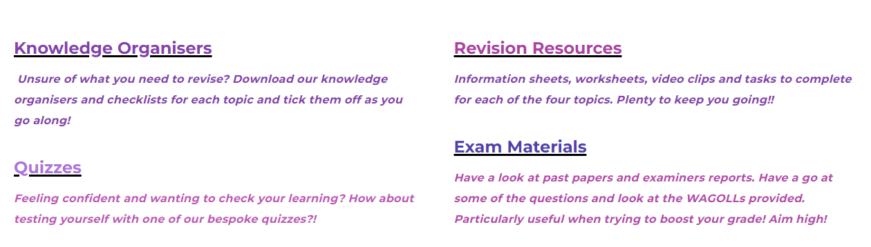
The History Website…
https://saxhistory.weebly.com/
Notes:
WAGOLL

Slide 3
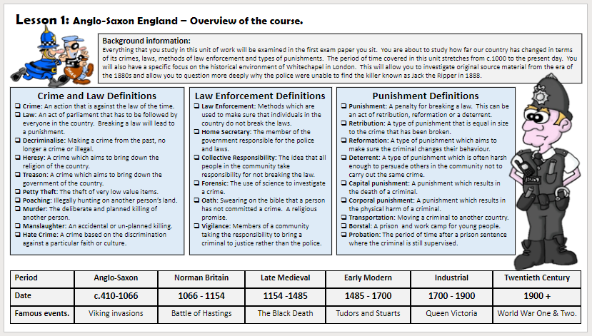
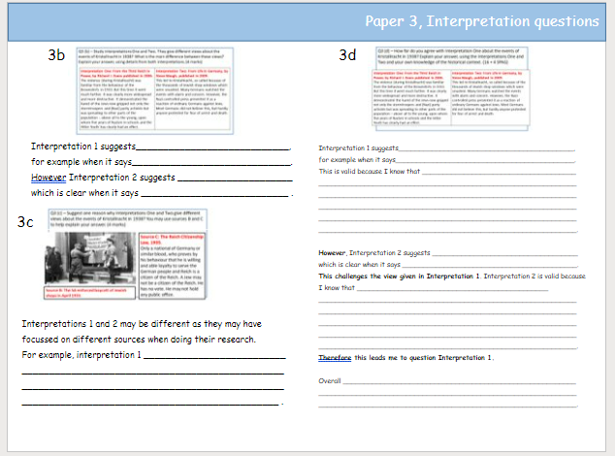
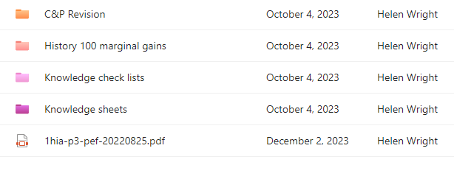
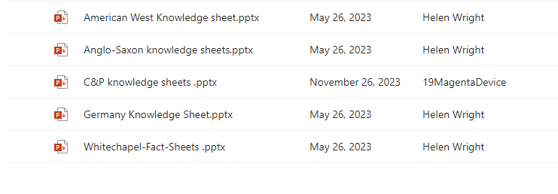
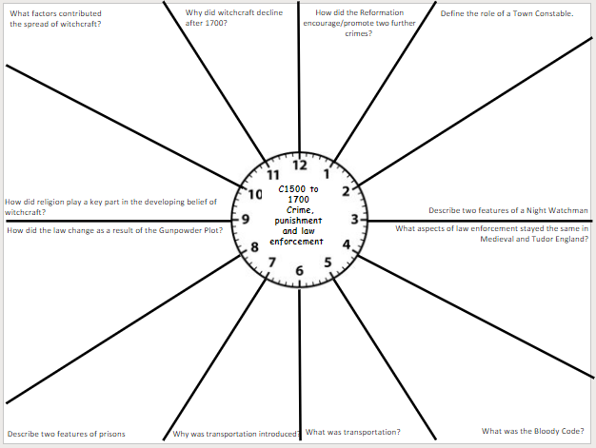
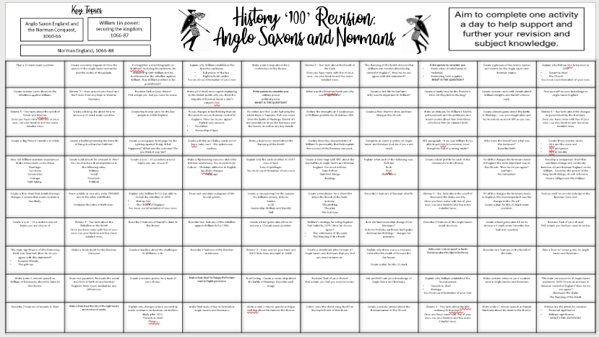
TEAMS Revision Folder…
Notes:
WAGOLL

Slide 4
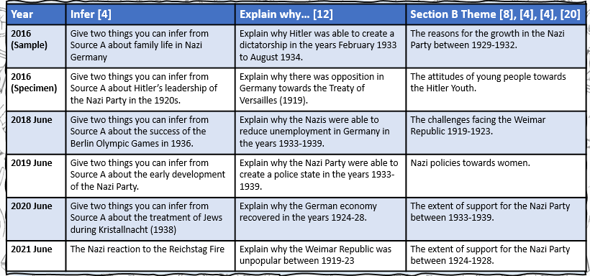
How to revise history… Practise exam questions
Notes:
WAGOLL

Slide 5
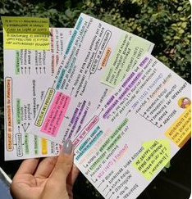
How to revise history… Flash cards
Write the topic on one side of the flash card and then break down the content in to no more than 5 bullet points on the other side.
Use highlighters for key details
Read and re-read them as many times as you feel you need to.
Notes:
WAGOLL

Slide 6
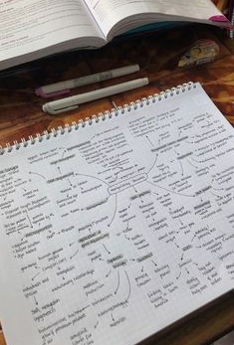
How to revise history… Mind maps
You could aim to revise a particular topic theme.
Break it down into different factors. Eg: Increase in witchcraft:
  Matthew Hopkins
  Civil War
  Changing attitudes
  Monarchy
  In one colour, write what you can remember and then get your notes and upgrade in another colour.
Notes:
WAGOLL

Slide 7
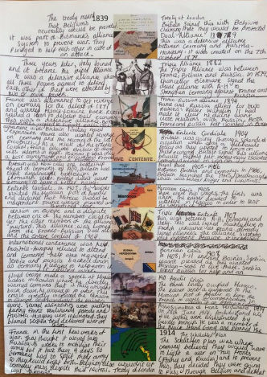
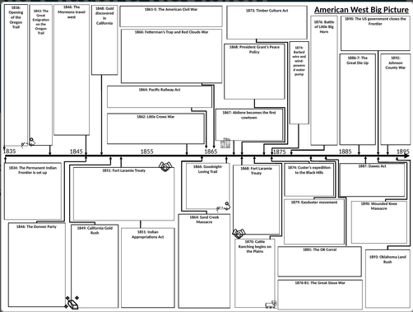
How to revise history… Timelines
You could aim to revise a particular topic theme.
  In one colour, write what you can remember and then get your notes and upgrade in another colour.
Notes:
WAGOLL

Slide 8
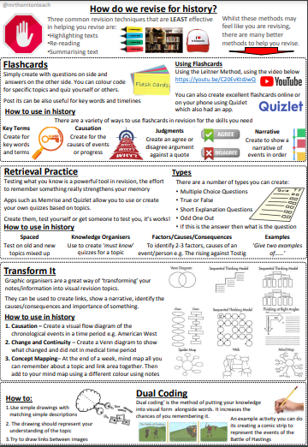
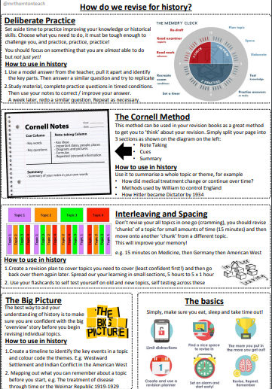
How to revise history… finding a technique that works for you…
Notes:
WAGOLL

