Slide 1
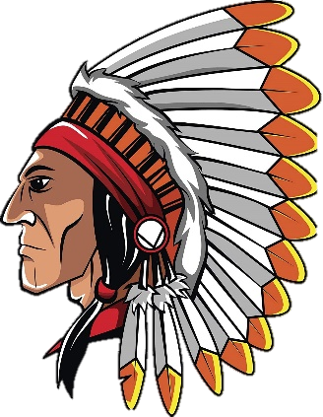
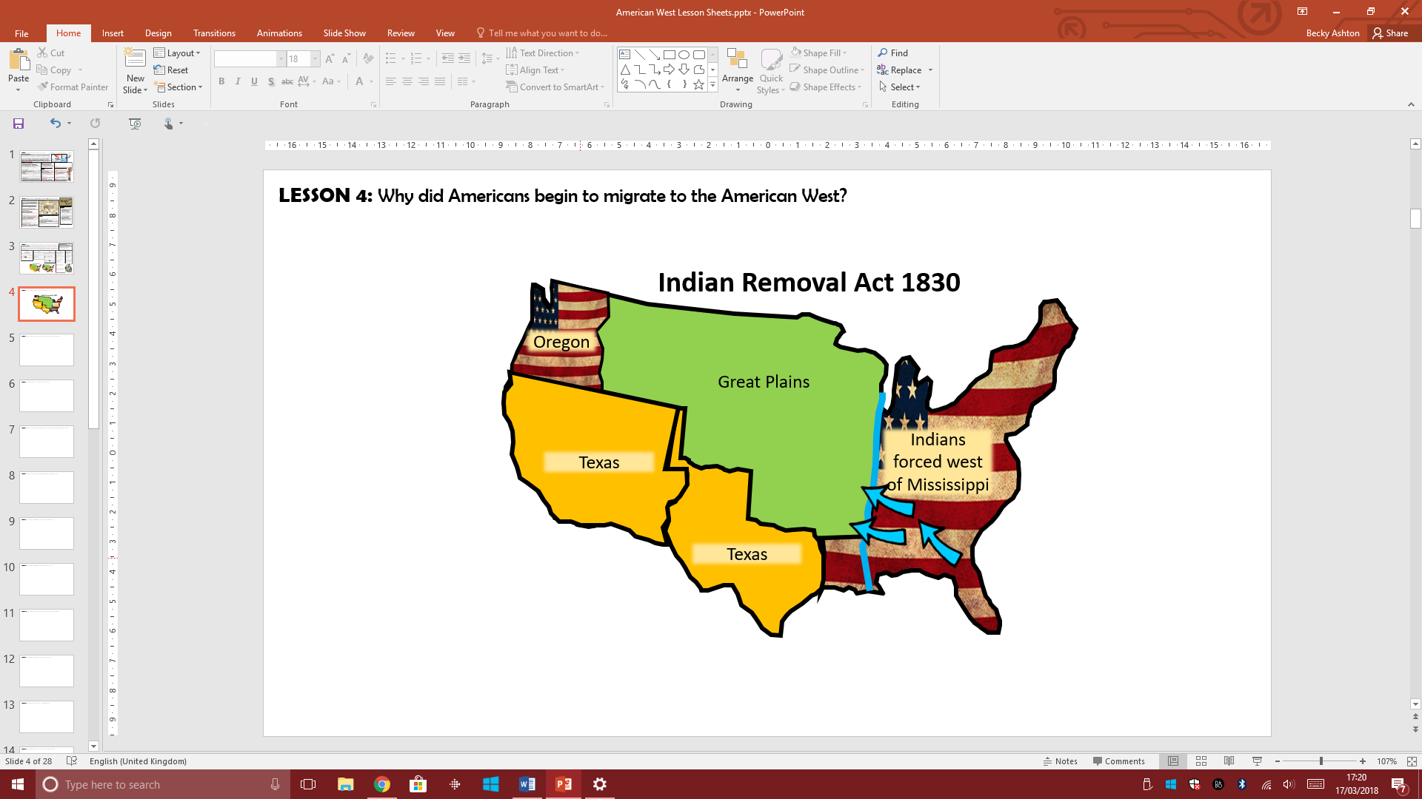
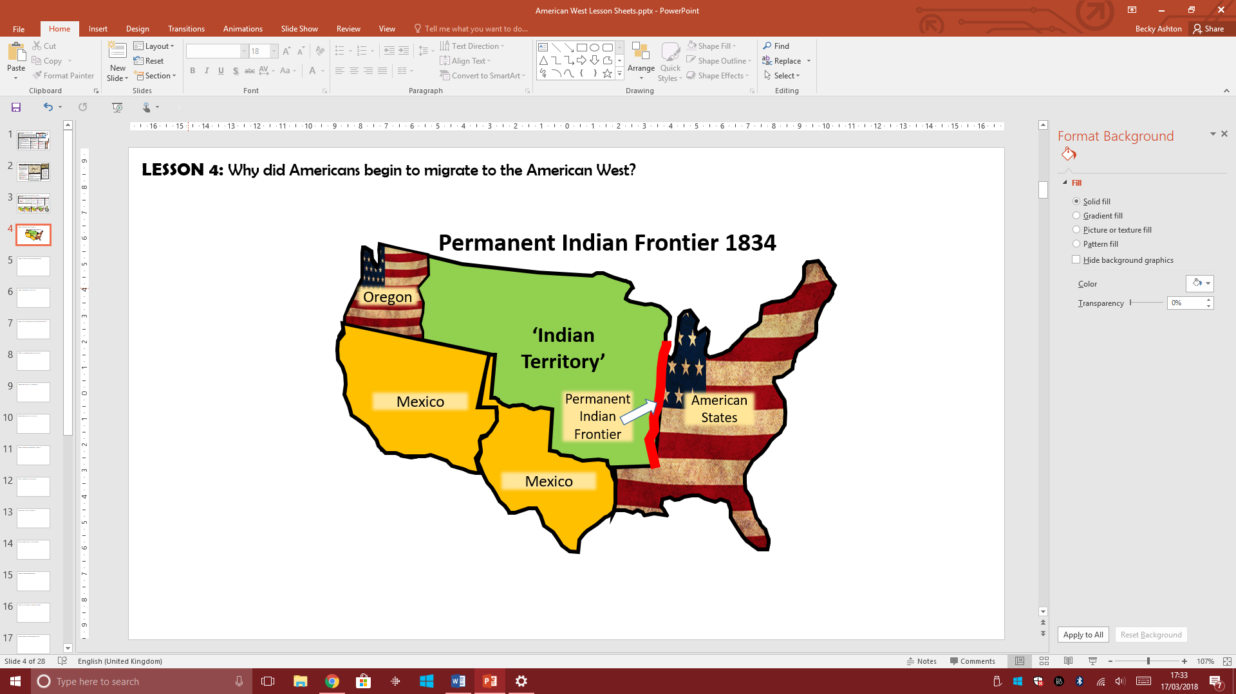
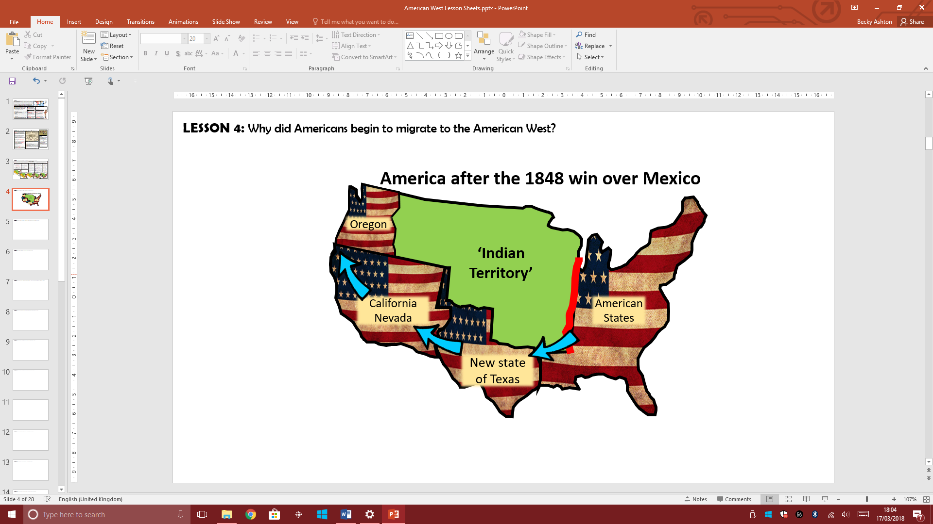
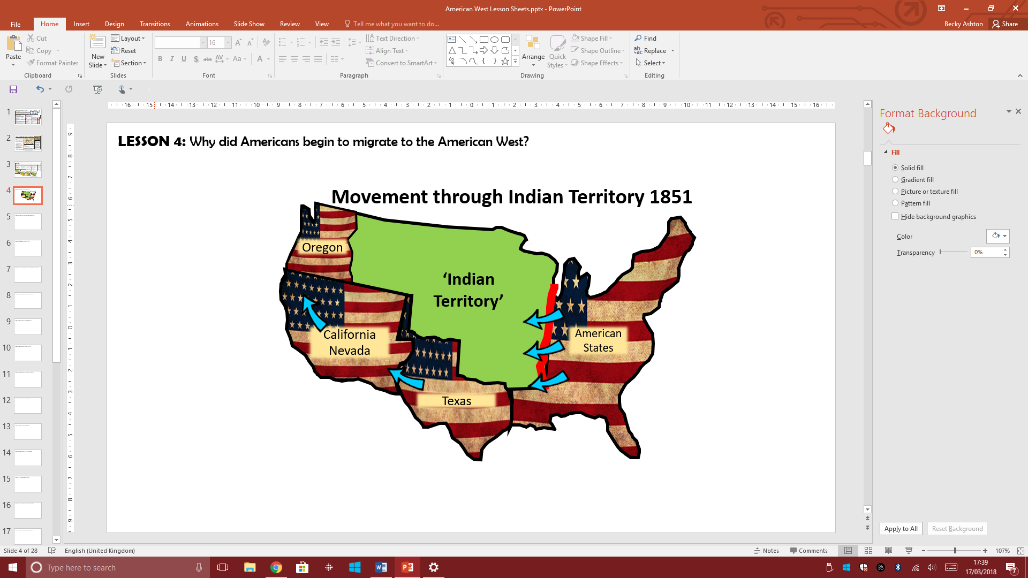
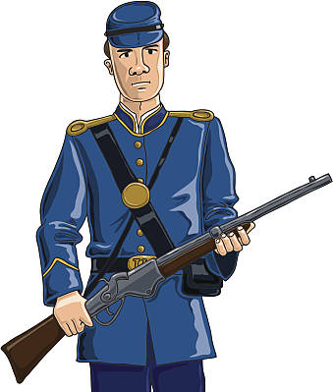
Conflict & Tension - The American Government policies towards the land of the Plains Indians?
BACKGROUND INFORMATION
When the very first European settler began arriving on the east coast of America, they had come across the native people of the land. The relationship between the two sides had varied from being helpful and friendly to becoming hostile and sometimes violent. By the 1830s, many more Americans in the east wanted to explore the land to the west. This meant that they would come into more contact with the Plains Indians. The Plains Indians became seen as a barrier that got in the way of this migration west. Therefore, the America government had to become involved. Over the next few years, plans and laws were passed which increasingly moved the natives away from the land that the American settlers wanted. Eventually, these laws aimed to place Plains Indians into smaller areas of land called ‘Reservations’ and then remove the Plains Indians altogether. In each case, the Plains Indians were promised protection in return for more land. Each time, the Plains Indians were moved into smaller and smaller areas of land with no respect of understanding for their traditions, cultures or lifestyle.
The Indian Removal Act 1830
Permanent Indian Frontier 1834
American Defeats Mexico 1848
The Indian Appropriations Act 1851
The American President Jackson pressured 46,000 Plains Indians living in the east of America to move west of the Mississippi River into land which was then named the Indian territory.
Jackson promised they would not have to move from here ever again. This caused huge upset for the Indians who had to move hundreds of miles from their sacred lands.
Thousands died and the route that was taken by the Indians was given the name of ‘The Trail of Tears’.
After the Indian Removal Act, the American government wanted to create a visible and physical border between Indian Territory and the Americans. This line between the two sides was known as the Permanent Indian Frontier.
To show this, American troops built a military road and began to build forts along the border.
This law actually banned any Americans from settling on any land beyond the Indian Territory.
The land in the south was originally owned by Mexico. However, America defeated Mexico and gained more land (see the map). This land was given the state name of Texas and it was located below the Indian Territory.
This meant that Americans could now travel through Texas to get to the west and states of Oregon and California.
Using Texas would be less expensive than travelling by sea. New trails were set up through Texas and more US troops were sent there to guard against any Indian tribes. However, by now some Americans were crossing the Indian frontier to get to Texas and the west.
By the 1850s, the American government wanted to encourage more settlement in the west without the risk of being attacked by Plains Indians.
In the Indian Appropriation Act, the American government provided money to pay for Plains Indians in the Indian Territory to be placed into ‘Reservations’. Reservations were areas of land that were to be used by the Plains Indians but would be managed by the US government.
Hunting lands were also included in the reservation lands to allow the Plains Indians to continue to hunt for buffalo and other animals. However, it meant that their nomadic life would be restricted significantly.
By restricting the Plains Indians so much like this, it was hoped by the American government that Plains Indians would want to give up their traditions and want to live just like American people.

Slide 2
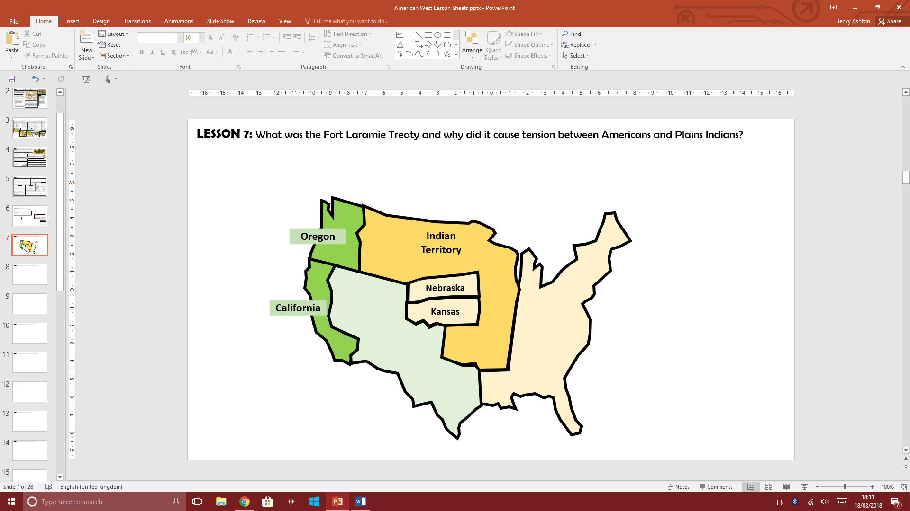
Conflict & Tension – The Fort Laramie Treaty 1851
The Tension between the Plains Indians and the White Settlers
After the 1840s, more migrants were beginning to use trails such as the Oregon Trail to settle in the American West. These migrants had also begun to move across land which had been designated as protected Indian Territory – many motivated by the discovery of gold in California in 1849. The settlers became more fearful of the Plains Indians. They had heard frightening stories of tribes ‘raiding’ each other’s camps for food, horses and weapons. The settlers believed they might be scalped by the Plains Indians or have children taken away. However, actual attacks on the settlers themselves were rare. The settlers also had a strong racist views about the Plains Indians and believed they had a right to the land that they were travelling on. The migrants disrupted the movement of the buffalo by frightening them to stampede or hunted too many buffalo for their meat. The oxen brought by the settlers often ate most of the grass available for the buffalo which meant the buffalo herds were disturbed. The white settlers put pressure on the US government to protect them. The American government responded by arranging to negotiate with Plains Indians at Fort Laramie in 1851.
What happened at the Fort Laramie Treaty?
The US government organised a meeting with the Plains Indian tribes from the Great Plains. Their aim was for the tribes to agree to end any ‘frightening’ conflicts and raids between each other - as this was scaring the white settlers. As a way to encourage more migration, they also wanted the Plains Indians to promise safe access for the migrants across the Great Plains. Finally, the government also pushed for the Plains Indians to live in a fixed area of land called a ‘Reservation’. Putting Plains Indians into reservations would allow the US government to control them more easily.
Where was Fort Laramie?
Fort Laramie was located in the central Great Plains. The fact that it was a ‘Fort’ means that the American Army were already stationed there to protect white settlers. It was in the middle of Sioux Indian land.
The Problems and Unfairness of Agreeing the Fort Laramie Treaty
Indian Leaders | MAIN PROBLEM: The US wanted each tribe to name just one chief to represent the whole tribe at Fort Laramie. The Plains Indians did not work like this as they had lots of different chiefs for different roles. CONSEQUENCE: The Chiefs selected had little experience or knowledge of what they were doing. They did not know what the best agreement would be for their own tribes or others as the experience was so new.
Meeting all tribes | MAIN PROBLEM: Some tribes did not attend the treaty and many were not really interested in what was happening. In fact some were mainly there for the free food and gifts on offer. CONSEQUENCE: Some tribes were not aware of what was agreed to as their own Chief was not present. Chiefs did not take the treaty seriously.
Using Maps | MAIN PROBLEM: The US Government wanted exact boundaries on a map. The Plains Indians did not use the land like (they did not believe in borders or boundaries). CONSEQUENCE: Plains Indians would simply not understand borders put on a map. This meant they were likely to go beyond a borderline and break the terms of the Fort Laramie Treaty.
Language Issues | MAIN PROBLEM: The Treaty was written in English and there were not enough people to properly translate it to make sure the tribes understood its meaning. CONSEQUENCE: It was impossible for the Plains Indians to know what they had just signed. They were heavily manipulated by the US government.
The US Government Agreed the following:
To protect the Plains Indians from attacks by the white settlers trying to settle on Plains Indian lands. To pay the tribes a yearly payment of $50,000 a year as long as the Plains Indians kept to the terms of the treaty. This also included paying the Plains Indians in food and products for them to use.
The Consequences of Fort Laramie Treaty 1851
RESERVATIONS – For the first time the US government looked at restricting the land the Plains Indians had. This eventually led to the Plains Indians being put into reservations.
MOVEMENT FOR AMERICANS: Settlers could now freely travel across Plains Indian territory. This meant it broke the border set out in the 1834 Permanent Indian Frontier. It eventually led to even more settlement of the Great Plains.
RAILROADS: Railroad surveyors were allowed on to the Great Plains for the first time. This then resulted in the first railroads being build across the American West in the 1860s.
ARMY FORTS: The US army were allowed into the Great Plains and allowed to build forts. This led to further settlement on the Great Plains with migrants guarded by the US army. They rarely protected the Plains Indians from white settlers as promised in the treaty.
The Plains Indians ‘agreed’ the following:
To end the traditional fighting and ‘raiding’ between their tribes. To allow migrants safe travel through their lands. To allow railroad companies to enter their land safely to survey the land. To allow the government to build roads and army forts through their land. Allow more army forts to be built. Pay compensation if any Indian broke the terms of the treaty above.
LOSS OF INDEPENDENCE: By giving the Plains Indians food and resources as part of their yearly payment, the Indians became to rely on the US Government for these resources, especially if they struggled to hunt buffalo. Therefore, the Plains Indians were starting to lose their independence.
FORMAL RELATIONSHIP: It was the first ‘treaty’ signed between the two sides. This meant it was the first time a formal relationship had been made. This led to the American government taking advantage of the Plains Indians in future ‘agreements’.

Slide 3

Conflict & Tension – Lawlessness in Early towns of the California Gold Rush (1849)?
In the 1840s, when the number of people settling in the ‘west’ was low, there was little lawlessness. However, the California Gold Rush changed this. Huge numbers of migrants came into the American West searching for their fortune, the number of law enforcement officers to maintain law and order remained low or non-existent. The population of California dramatically increased and mass migration made the need for law and order much essential. Compared to 8,000 people in California in 1846, by 1850 it became 120,000 and then by 1855 increased to 300,000. This huge increase in population resulted in a number of problems.
A Consequence of Mass Settlement - Lawlessness
The System of Law and Order in the American West
GROWING MINING CAMPS
When gold was found, the camps grew very quickly to hold 1000s of people. This was too quick for the local officials there to deal with the amount of crime when it happened.
PROSTITUTION
There were a high number of prostitutes in the mining towns making their money from the men who had travelled alone. This could also result in drunkenness and violence.
The new territories which were being settled in were under the control of the federal (or national) government. However, these new territories only gained their own government, laws and a legal system when the population reached over 60,000. When a territory became an official ‘state’ it was given a governor, three judges to hear court cases and a US marshal. The US Marshall was the officer in charge. Over a population of 5,000 communities could elect their own sheriff. The sheriff was responsible for law enforcement and tax collection. They ran the jails and appointed their own deputies. They had no legal training but kept order as best as they could. In times of need, a sheriff or a US Marshall could also order other men in the community to join a posse to hunt down law breakers. A posse would be ordinary men, known to the sheriff and often used quite violent methods to catch any criminals.
CON MEN
Experienced prospectors tried conning new, inexperienced prospectors into buying worthless land. They planting a few bits of gold on the land to make it look like a good buy but then bought the best land themselves.
VIOLENCE & ROBBERY
Some men went outside the camps ready to rob other prospectors of their gold. Fights would break out which could become violent as most often happen as a result men also carried weapons such as pistols and knives.
The Main Problems with Lawlessness
Vigilante Groups
GEOGRAPHY: Each territory covered huge areas of land with scattered settlements. A sheriff would have to cover up to 200,000km in his area. There were simply not enough officers to cover the vast areas of the new territories of the West.
COMMUNICATION: The only form of transport was a horse or on foot. Any news of lawlessness travelled slowly which led to many crimes going unsolved.
POOR PAY: The government did not spend that much money on the new territories and so law enforcement officers were badly paid. This made it hard to recruit new officers and some officers were tempted into corruption and bribery – accepting money from criminals to avoid arrest.
LACK OF TRAINING: Officers had no official legal training. They often acted unfairly favouring their friends over others. This led to even more tension.
RACIST VIOLENT INCREASED: Racist attacks increased as a result of mass migration to settlements such as California – especially against the American Indians and the Chinese migrants. Unfortunately, the American Government itself was also racist and white Americans were encouraged to attack American Indians and laws were passed that discriminated against Chinese migrants. They also banned Chinese and Plains Indians from being a witness in court.
With so few law enforcement officers, communities set up their own vigilante groups. These were groups of ordinary men who set out to find and punish suspected law breakers themselves. Many mining camps set up vigilante groups to solve crimes and San Francisco had a vigilante Committee of around 200 people. They were successful and reduced the problems of crime in some communities. However, their version of a trial could be very unfair with many vigilante members being more violent than their suspects. They would often ‘lynch’ or hang any person they suspected as being guilty.
ALCOHOL
Mining camps often had many drinking saloons. Alcohol consumption among the men led to fights and arguments over money, land and women.
CLAIM JUMPING
Law said that the person who found the gold had a right to the land and the gold found there. But claiming gold became a competition and other men set out to steel land where gold was found. This was known as CLAIM JUMPING. This was difficult to prove with so few law enforcement officers.
RACIAL TENSIONS
Prospectors came from around the world and mixed in the camps. This led to tension between different cultures. Famine in China led to a huge increase in Chinese migrants coming to California. By 1851 there were 20,000 Chinese migrants in California who had escaped famine in China. They all competed for jobs working in the mines.
GANGS IN SAN FRANSCISCO
Failed prospectors came to San Francisco. Desperate for money, gangs began to control the city and there was a particularly bad crime wave in 1851. Law officers could not deal with the violence. Gang members were known to walk into a saloon, kill people and casually leave.
Settling Mining Disputes
Mining communities did not have easy access to the legal system such as judges and courts. This often made it difficult to solve issued about who had claimed which land. Local communities started to create their own courts with respected community members recording information about who owns which land and settling arguments over land.
THE MINING TOWN OF ARURA - CALIFORNIA
The mining town of Aurora grew in the 1860s from 800 people (1861) to 14,000 by 1864. The population was mostly male and white, with a small Chinese community. There were around 300 women but half were prostitutes. There was one school and a church. However there were 25 saloons (pubs) and just as many gambling houses and brothels and a large brewery.

Slide 4
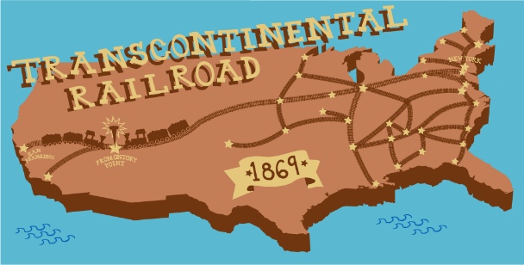
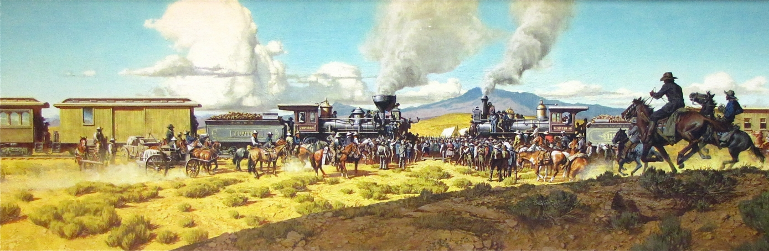

Settlement in the American West - The Transcontinental Railroad (1869)
The US Government wanted to increase the number of settlers migrating into the American West. In 1862, they agreed to build a transcontinental railroad that would link the east coast of America with California & Oregon in the West. The construction of the 2,000 km railroad took until 1869. It had a significant impact on the development of the American West. The railroad was built by a mixture of Chinese and Irish immigrants as well as ex-Civil War soldiers, European immigrants and freed slaves. In 1855, surveyors began to enter Plains Indian land to survey the best route for the railroad. In 1862, the Pacific Railroad Act was passed by the American government which officially gave the go-ahead for its construction. By 1869 it had been completed with the Union Pacific and Central Pacific railroad companies meeting in the state of Utah.
The Building of the Transcontinental Railroad
The Impact of the Railroads on Settlers and Homesteaders
Travelling west became easier, quicker and cheaper. The railroad increased the growth of towns along the route. Towns appeared at each rail stop whose population grew rapidly. These growing towns also gave the Homesteaders more social opportunities away from their isolated homesteads. Homesteaders and their families back in the east could now visit each other easily for the first time. This reduced the isolation they felt and also gave an incentive for more family members to move west. The railroad also encouraged businesses to publish catalogues full of goods which were sent to families in in the American West. Families could order goods which were then sent to their nearest railroad station. Homesteaders could now order manufactured goods from the city and have them delivered via train to the nearest station.
The Impact of the Railroads on Farming
Farmers could use the railroad to sell any of their surplus crops to other parts of America. This gave them more income and in turn allowed them to increase the size of their farms. Farmers in California and Oregon could transport their grain to other parts of America, especially the big cities in the east. This also allowed farmers to set up new business and trade links to help their farms expand.
The Impact on the Cattle Industry
The railroads encouraged the growth of the cattle industry and the new cow towns which grew near the tracks. It would be possible for cattlemen from Texas to sell their cattle for meat and leather goods in the cities of the east for a lot more money. Cattlemen would also be able to transport meat to the growing populations of the American West such as the new mining towns.
The National Impact of the Railroad
The American government were now able to bring in the army at short notice to deal with any issues with the Plains Indians. There were huge trade benefits for the country as the railroad opened up trade routes with Europe and Asia from the Pacific and Atlantic Ocean. The creation of such a magnificent railroad made the idea of the Manifest Destiny seem real. It promoted confidence and hope.
The Two Railroad Companies
The American government promised plenty of jobs and profit for the two railroad companies who were chosen to build the line The Union Pacific and the Central Pacific. These two companies had a lot of power over what could happen with the land they were given alongside the railroad tracks. For example, the government promised they would use the US Army to protect railroad workers from possible Indian attacks.
Settlement
Each railroad company had its own Bureau of Immigration which persuaded people from other countries to settle on the plains. One agent, CB Schmitt apparently persuaded 60,000 Germans to emigrate to Kansas. The railroad companies encouraged settlers from America and Europe to buy land near the tracks. The railroad companies even put on special trips to show possible buyers the attractions of the land.
Investment
The railroad companies were given $16,000 for every mile of track built. This increased to $48,000 for every mile for the hardest parts across the mountains. Overall, $61million was spent on its construction. However, 12,000 men died during its construction.
Telegraph Communication
At the same time, the government funded the building of the first transcontinental electric telegraph: this was a key communication line which ran alongside the railroad tracks. It allowed telegraph messages to be sent across the continent for the first time.
THE IMPACT OF THE RAILROADS ON THE PLAINS INDIANS?
Plains Indians moved away from the railroad routes as a precaution. It was alien to them and caused fear among their people. The building also scared away the buffalo herds but also ate into the grassland which was essential for the survival of the buffalo. The tracks also created a barrier which blocked the natural migration of the herds. For the railroad workers and settlers, buffalo hunters were employed and killed vast numbers of the animal to provide meat. Buffalo hunting was even promoted by the railroad companies. One buffalo hunter named William Cody claimed to have killed 4,280 buffalo over 17 months. Therefore, the railroad prevented Indians from living their traditional nomadic life. Importantly, it also went against the agreement that was made in the Fort Laramie Treaty which actually promised to protect Indian lands from railroad surveys. It was no surprise that Plains Indian attacks increased on the railroad workers and this in turn increased the tension between the settlers and the Plains Indians.
Land
Both railroad companies were given 6,400 acres of land which ran alongside the railroad tracks. They could then advertise and sell this land to settlers from the east. Overall, this equalled 45 million acres of land taken from the Plains Indians.

Slide 5






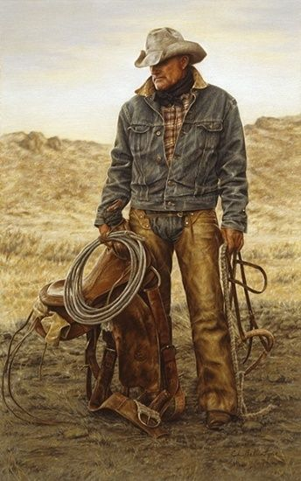

Further development of the Cattle Industry: The end of the Open Range
The Cattle Industry so far…
Unfortunately, by the 1880s, so much money went into cattle ranching on the Plains that cattle became overstocked. There were too many cattle on the same areas of grassland and with too many of them, the price of cattle fell.
1850s: Texas Longhorn cattle mainly ranched in Texas.
OVERSTOCKING
Too many cattle were grazing on the same amount of grass. This led to the grass eroding.
OVERGRAZING
Grass did not have time to re-grow once eaten. Cattle did not have enough to eat and the land dried up.
POOR CONDITION
With less grass, the cattle became weaker. This produced poorer quality meat to sell.
LESS PROFIT
By 1882, profits were going down. Ranchers kept the cattle just in case the prices increased again. Hence, even more cattle.
A FALL IN DEMAND
With so much beef available for cities in the east, prices reduced. Cattle ranchers received less money
EXTREME WEATHER
When drought hit in 1883, the grass dried even more. Prairie fires from storms also reduced the grass further.
1861: The American Civil War results in cattle herds being left to multiply. Cattle herds in poor condition.
1865: After the Civil War, the demand for beef increases in the north.
1861: Cattle still banned from entering some states such as Kansas and Missouri due to Texas Fever
The Great Winter Die Up 1886 - 7
The winter of 1886 into 1887 was very harsh with temperatures falling to -55 degrees. Cattle were already weaker due to overstocking but now they struggled to get to the grass through the deep snow and ice. At least 15% of the open range cattle died which led to thousands of lost cattle. Many cattlemen and their ranches became bankrupt. The stock that did survive into the spring of 1887 were in poor condition but everyone tried to sell what they had – this made beef prices even lower. The larger ranches which had made huge profits in the 1870s had the most problems – the area they had to cover to save their cattle was too large. The smaller ranches, with cowboys able to locate and save their cattle coped much better.
1866: Goodnight & Loving Trial moves cattle instead to the West (reservations, army forts, mining towns and railroad builders).
1867: Joseph McCoy uses the Chisholm Trail to drive cattle to Abilene. Stockyard are built at the railhead where cattle is transported to the east.
The only way for cattle ranches to survive was to end ranching on the huge areas of the open range. Cattleman began to develop much smaller ranches.
The Consequence of the end of the open range for cowboys
The Great Winter Die Up had consequences for the cowboys as well as the ranch owners.
It meant that there was much less demand for the cowboys. Those that remained were just employed as basic ranch hands during parts of the year and many had to seek other employment.
Their lives were far less adventurous with far less freedom. All they needed to do was to brand the cattle, look after their horses and the calves, repair barbed wire fences and inspect the grasslands.
They were mainly responsible for ‘Riding the Line’ which meant patrolling the boundary of the ranch.
They lived in bunkhouses which were often not very comfortable and poorly maintained.
Smaller herds could be easily found in bad weather for food and shelter.
Smaller ranches were a lot easier to manage, to keep a watch on cattle and make sure they were well fed and watered.
More homesteaders took over cattle ranching as they could keep cattle on their small area of land. This gave more people an opportunity to make a living from cattle ranching.
Smaller ranches would provide water easily during drought with better metal wind pumps.
Smaller ranches were easier to guard so there was a reduced amount of rustling.
Smaller ranches meant higher quality meat which led to higher prices and profit.
1871: John Iliff begins ranching on the open range in the West removing the need for long cattle drives.
1875: Refrigerated railroad cars developed. Ranched beef can now be sold to distant markets easily.
1876: The cattle industry experiences a beef bonanza. Investors support ranching on the Plains. Cattle barons gain huge wealth and influence.

Slide 6
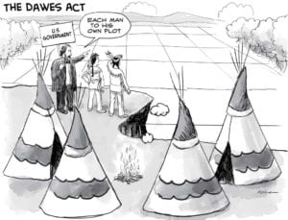
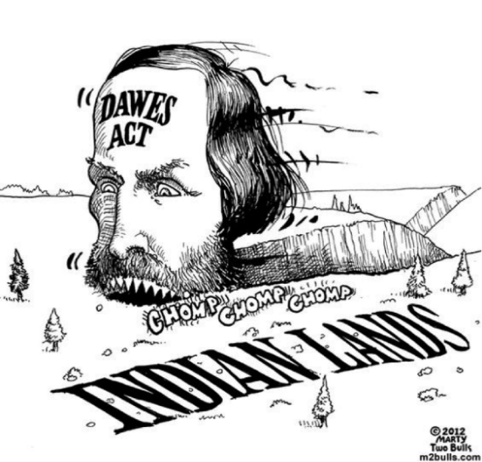

Government policy: The Dawes General Allotment Act 1887.
Background Information:
You will have already heard of the Dawes Act when you studied the reasons for the Oklahoma Land Rush from 1889 to 1895. The Dawes General Allotment Act of 1887 was simply like a Homestead Act but for the Plains Indians. Rather than being given areas of reservation land for a whole tribe or band to live on, the Dawes Act gave each individual Indian family an allotted area of 160 acres of land with single Plains Indians given 80 acres of land. The Dawes Act had many consequences for the Plains Indians and was a deliberate government policy to finally destroy the traditions of Plains Indian tribes and ‘assimilate’ them into Christian, American society.
US government changing policy between c. 1830 - c. 1890
The Dawes General Allotment Act 1887
The impact of the Dawes Act
When the Permanent Indian Frontier was set up in 1834, the US government promised that no settlement would take place west of the Mississippi River. However, as demand for land further west increased, these type of agreements were broken.
The government then chose a policy of putting the Plains Indians on reservations as a way to keep them away from white settlers. At first these reservations were protected by law and signed by tribal chiefs.
By the 1880s reservation land had been drastically reduced. The power of the tribal chiefs was taken away and the US government pushed for Plains Indians to be ‘assimilated’ into the American way of life and ‘civilised’.
Finally, in 1890, the US government stated that the Indian Frontier had ceased to exist and no more land would be legally protected for the Plains Indians. Plains Indians had to make a choice of assimilating into American life of suffering even more.
In this law, reservation land stopped existing. In return, each Plains Indian family was given full ownership of a 160 acre plot of land on former reservation land. Single Plains Indians were given 80 acres and orphans under 18 received 40 acres.
Plains Indians who took up the offer could legally become American citizens as long as they did not sell their land for 25 years.
The government made sure that in this law, the remaining land in the reservations could then be sold off to white settlers. This land was often bought by railroad companies and land speculators. Thus, further increasing the settlement of the American West.
The Plains Indians lost half the reservation land they had held before 1887. Consequently, there was still plenty of land left over after each family had been given 160 acres to be sold to white settlers.
Very few Plains Indians who were given land could make a living as the land they were given was too poor to farm. Many gave up trying to farm, sold their land to whites and so ended up in even more poverty. Other Plains Indian families were cheated out of any good land they had by whites.
No land in the West was protected for the Plains Indians. It was all now opened up for settlement. There were now enough white settlers in the old reservation lands to make new states such as North Dakota, South Dakota, Montana & Wyoming.
The Dawes Act did not actually achieve its aim of making Plains Indians independent homesteaders and American citizens. By 1890, most Plains Indians had given up and sold the land they had been given. Many Plains Indians refused to chose the option of assimilating and many sunk into poverty and sickness. They became even more dependent on US government handouts.
By owning individual land it would remove the identity of the tribe and force independence.
It would reduce the influence the tribal chiefs ad over their tribe.
It would encourage families to farm for themselves rather than rely on the tribe or the government.
The reasons for the Dawes Act 1887
By the 1880s, it was believed that reservations were a problem. Many whites argued that there was no point offering reservation land to Plains Indians if they were not able to farm it properly.
Others believed that as long as reservations existed, the Plains Indians would continue to live as a tribe and not as ‘white Americans’.
Furthermore, despite the chiefs not having any real power in law, many Plains Indians still looked up to their chiefs. The US government wanted a new policy which would take away the identity of the Plains Indians for good and force them to live as white Americans.
It was in this time that the USA’s first national park was established to protect America’s wilderness areas – Yosemite in 1890. However, this was for the benefit of the white settlers in the West rather than the Indians.
The aim of the Dawes Act
It would encourage and force Indians to ‘assimilate’ into the American culture and lose their Native American identity.
It would remove the government cost of running a reservation and allow the government to sell more land.
It would free up even more land for the white settlers who had pressured the government.
President Arthur in 1881.
The allotment system will have a direct and powerful influence in dissolving the tribal structure, which has been so prominent a feature of savage life.

