Slide 1
John Greenman
University of Hull
Professor of Tumour Immunology
Centre for Biomedicine - HYMS

Slide 2
Reading University 3 years BSc
Southampton University 4 years PhD +
Oxford University 4 years as PDRA
Hull University 30 years

Slide 3
What is the Immune System?
The body’s protective shield!

Slide 4
What does the Immune system do?

Slide 5
Roles
Recognition
  Self from non-self
Reaction
  Appropriate response
Recovery
  Return organ to normal function
Remembering
  More efficient response on second encounter

Slide 6
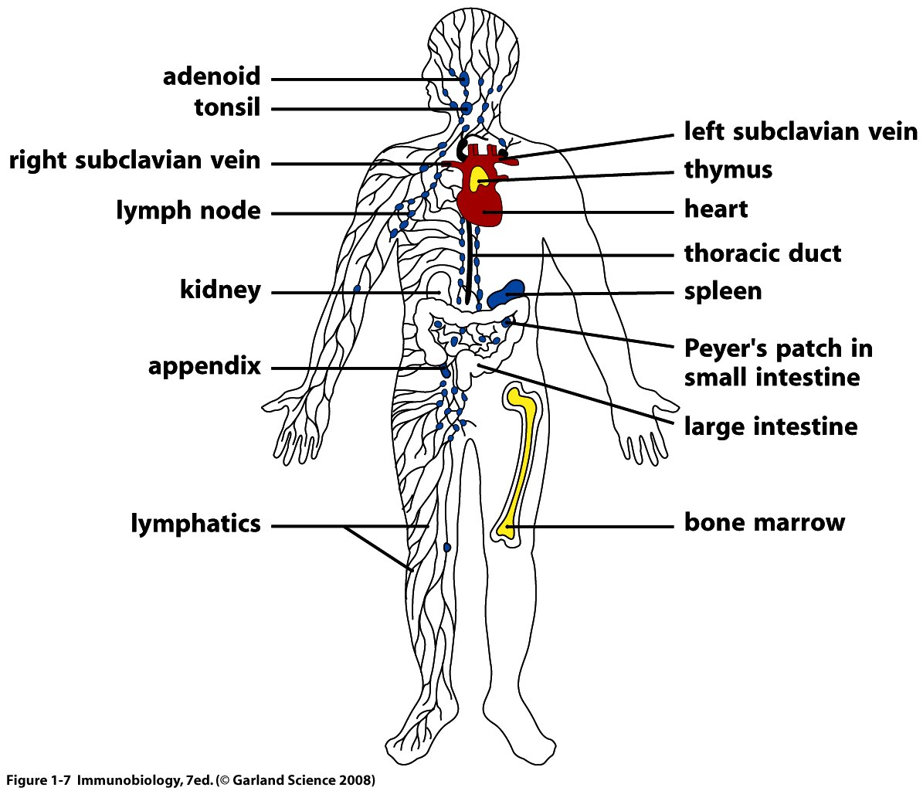
Lymphatic system
Cardiovascular system

Slide 7
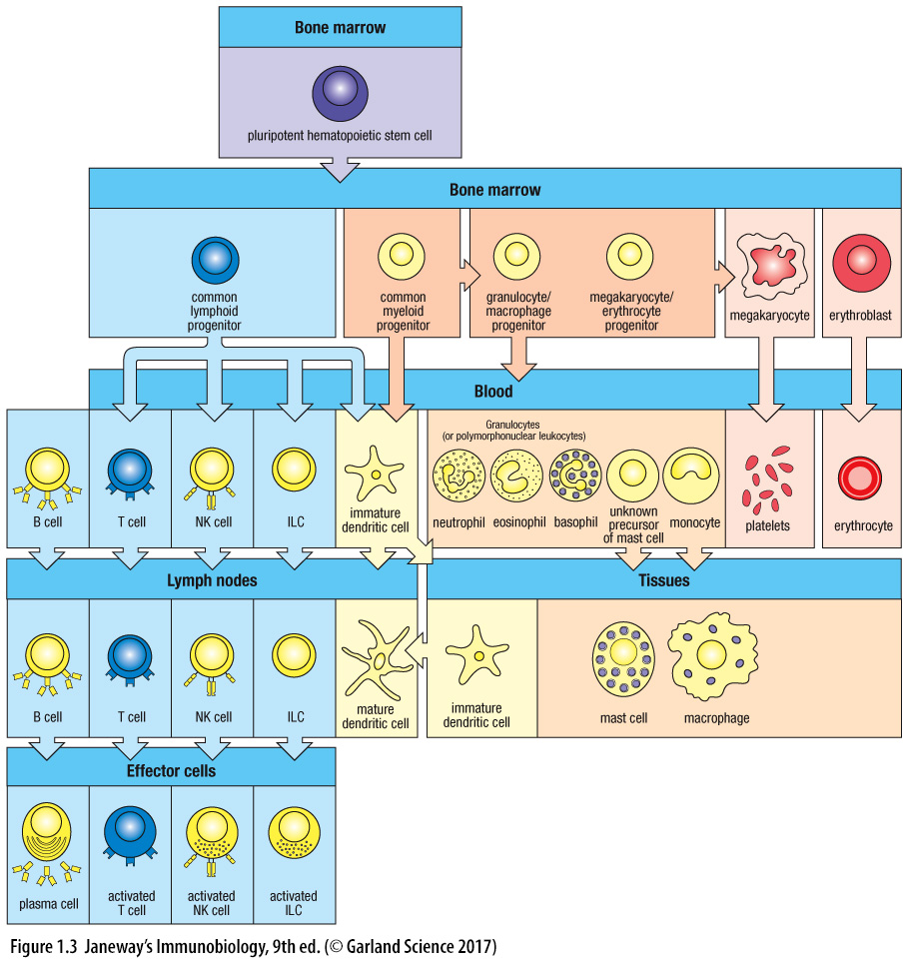

Stem cell = Pluripotent

Slide 8
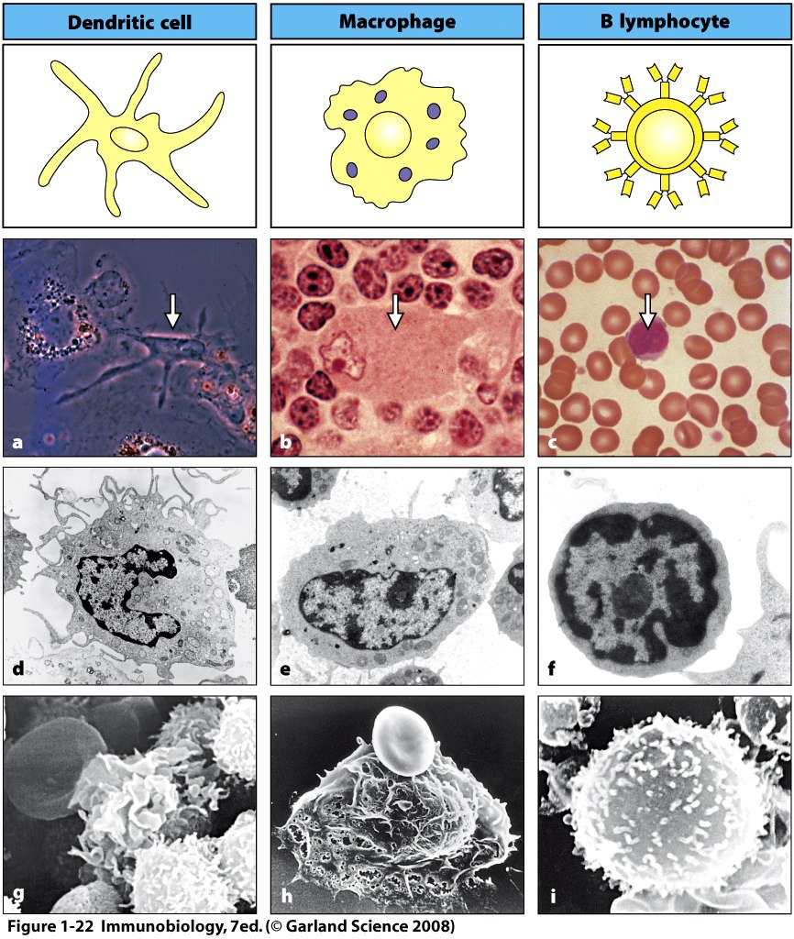

Slide 9
Dendritic Cell Macrophage B lymphocyte

Slide 10
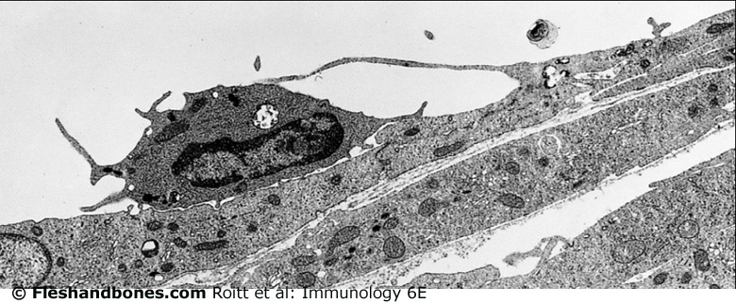

Slide 11
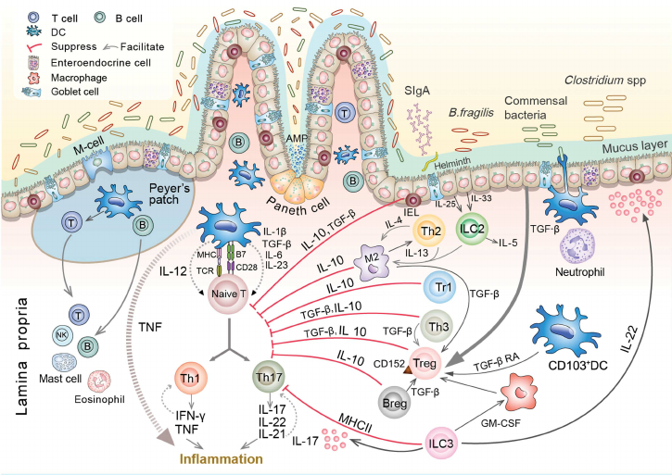

Slide 12
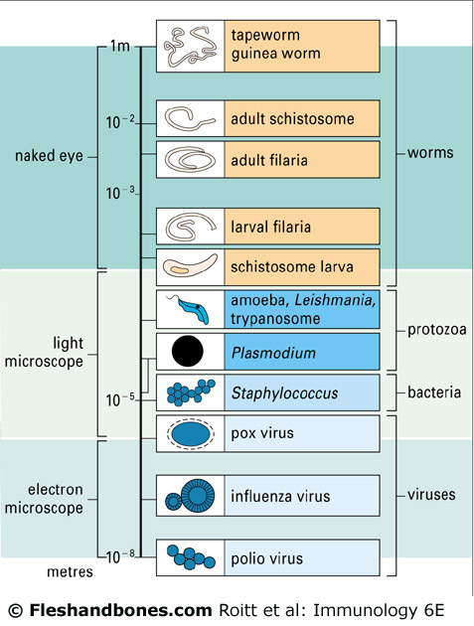
The
invaders

Slide 13
Immune checkpoint antibodies
used to treat cancer
Vaccines against
SARS CoV-2 &
new drugs
CAR-T cells
to treat cancer
Immunology the
present & future
?
Treatment of
“superbugs”
e.g. MRSA
Anti-hayfever
and autoimmune
diseases

Slide 14
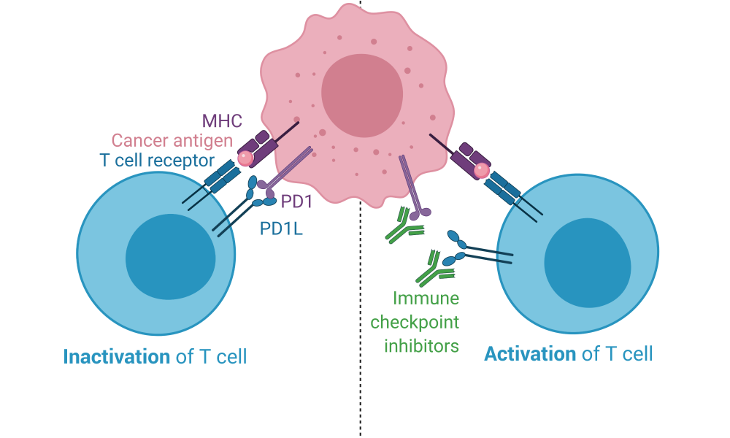
Immune checkpoint inhibitors
Immune checkpoint inhibitor drugs
Causes inhibition of T cells
No inhibition of T cells
Canada’s Michael Smith Genome Sciences centre

Slide 15
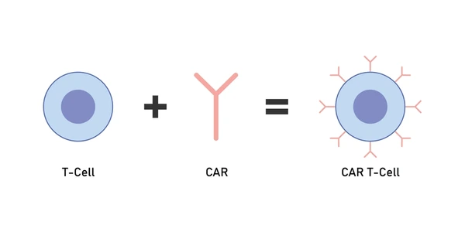
CAR T-cells
Chimaeric Antigen Receptor T cells
CAR – comes from B cells – it’s an antibody

Slide 16
Any questions?

Slide 17
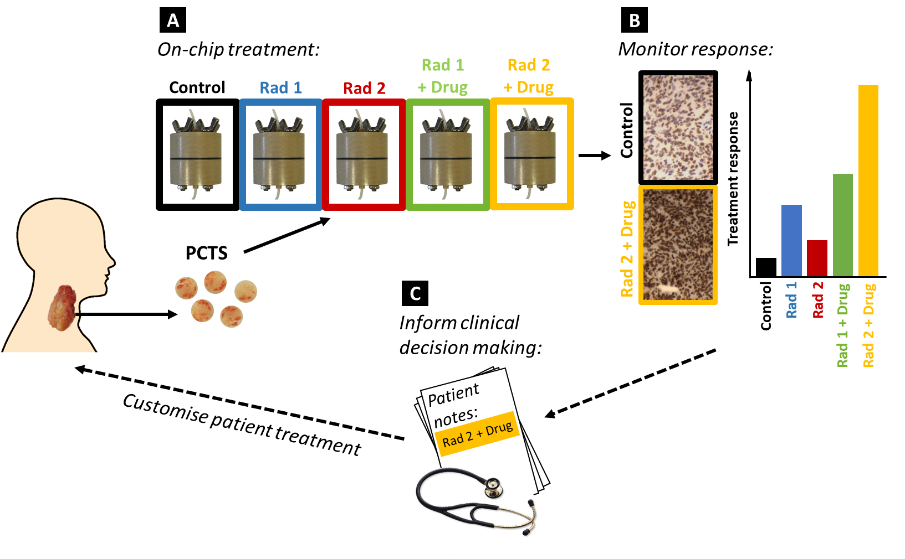
Tumour on chip to inform treatment
Kennedy et al. 2019 Science Reports 9, 6327

Slide 18
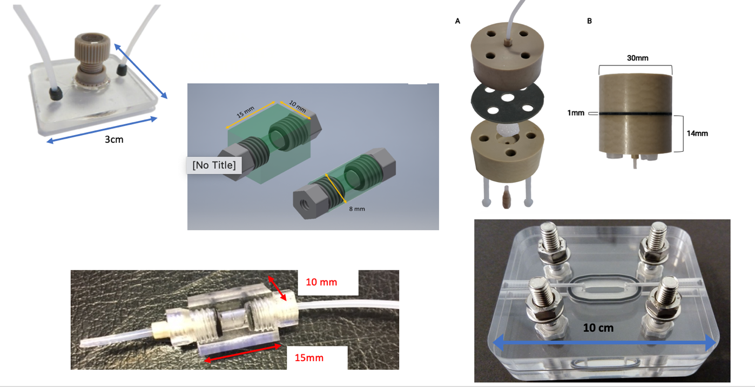
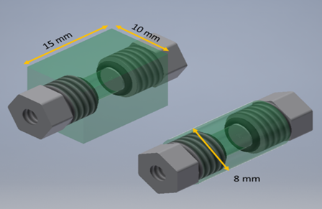
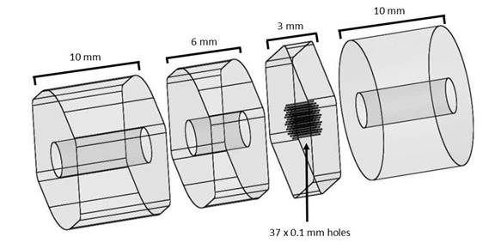
Devices for tissue biopsies, slices, spheroids etc

Slide 19
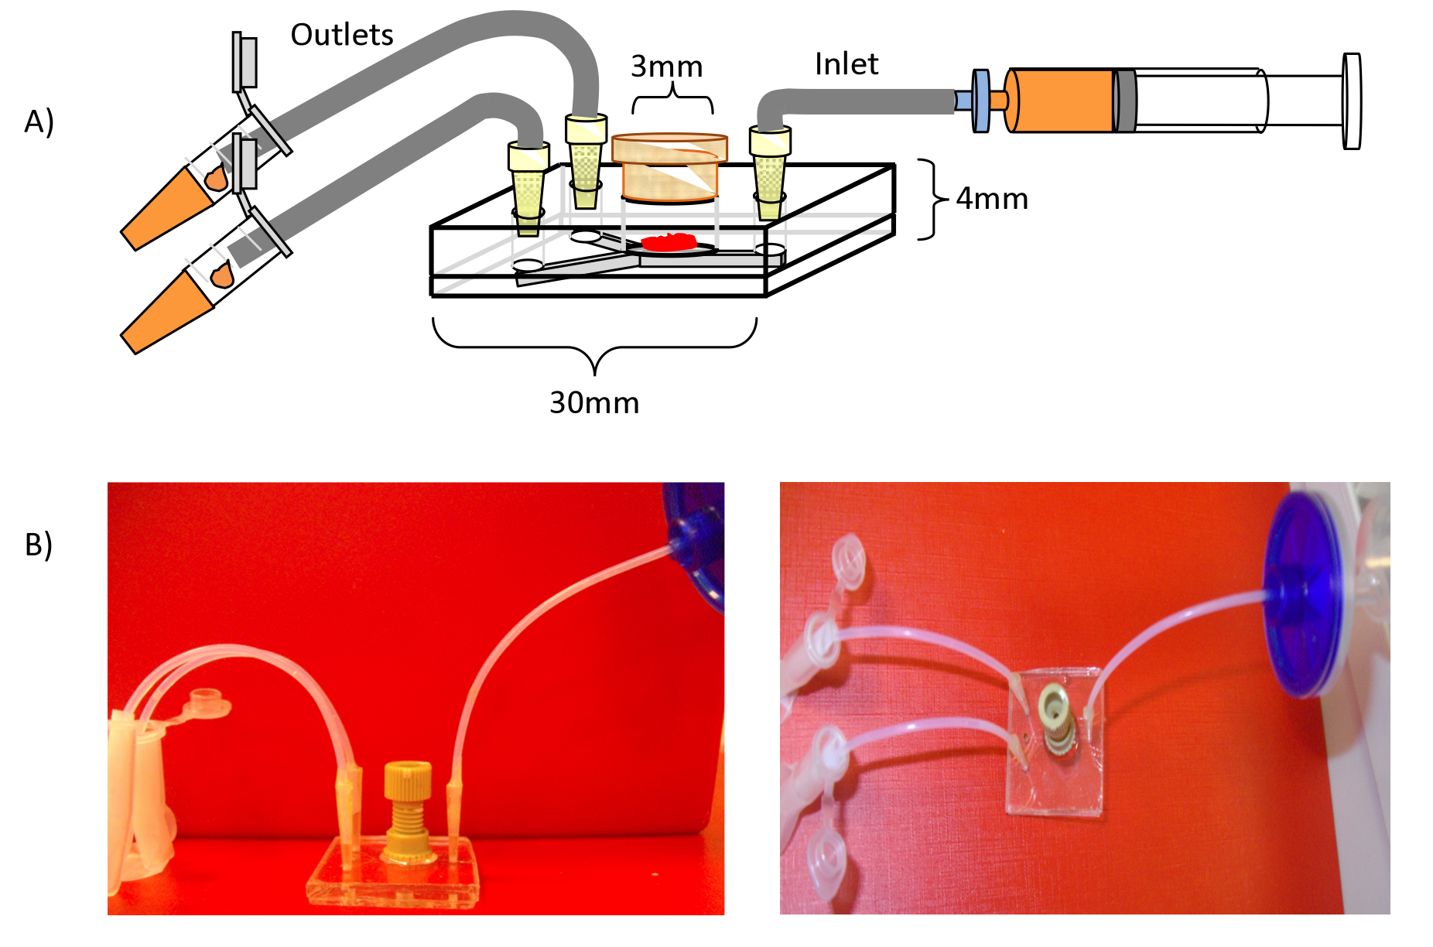
Device in action
Hull tissue-maintenance device

Slide 20
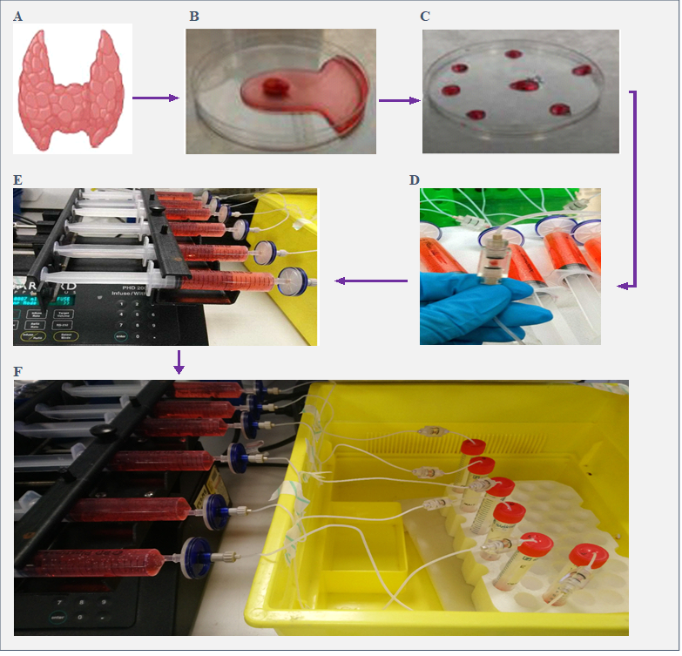
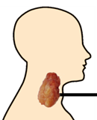
From resection to microfluidic device
Time scale:
approx. 30 min from theatre
Tissue mass:
Approx. 10-20 mg
Time on device:
Up to 12 days
Analysis of Tissue & Effluent

Slide 21
What career roles are possible?
RESEARCH SCIENTIST
Academia
CRO
Government
TECHNICIAN
Companies
e.g. Water,
food, energy,
pharmaceuticals
Benefits
Global opportunities
Job satisfaction
Future study, MSc PhD
SPECIALIST /
TECHNICIAN
NHS labs
e.g. Consultant,
Pathology labs – microbiology biochemistry, virology
Teacher
Scientific writer
Insurance
Entrepreneur

