Slide 1
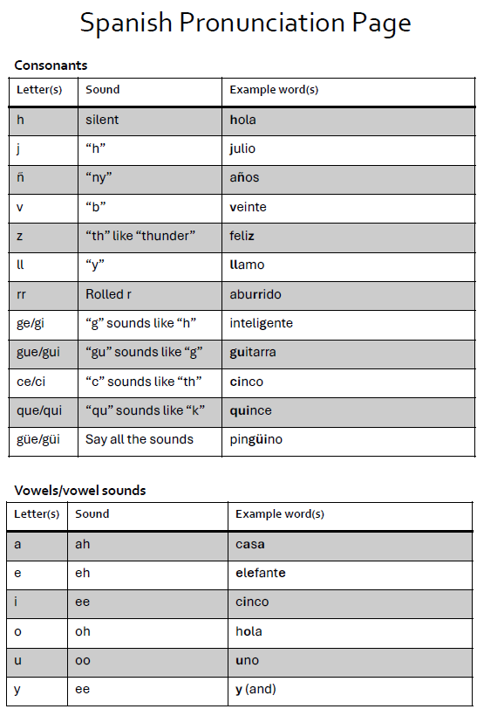
Year 7. Autumn
Formal Assessment
What will the assessment look like?
Listening | Dictation. Your teacher is going to say sentences in Spanish and you will have to write them down in Spanish. Pay attention with the spellings. | Phonics. Questions about the sounds that letters make in Spanish.
Reading | Comprehension. Answer questions about texts in Spanish. Both the questions and the answers will be in English. | Vocabulary. Multiple choice questions about vocabulary and understanding questions in Spanish.
Writing | Write a short paragraph introducing yourself. Include your name, age, birthday and how you are feeling. Use the words because and but.
How to revise
Write down some sentences in Spanish using the sentence builder and try to translate them without looking at it.
Write some sentences in English using the sentence builder and try to translate them without looking at it.
Memorise the vocabulary of a column of the sentence builder for 2/3 minutes and try to write down as many words or expressions as you can.
Extended writing. Write a text that covers these topics using the sentence builders and then try to replicate it without looking.

Slide 2
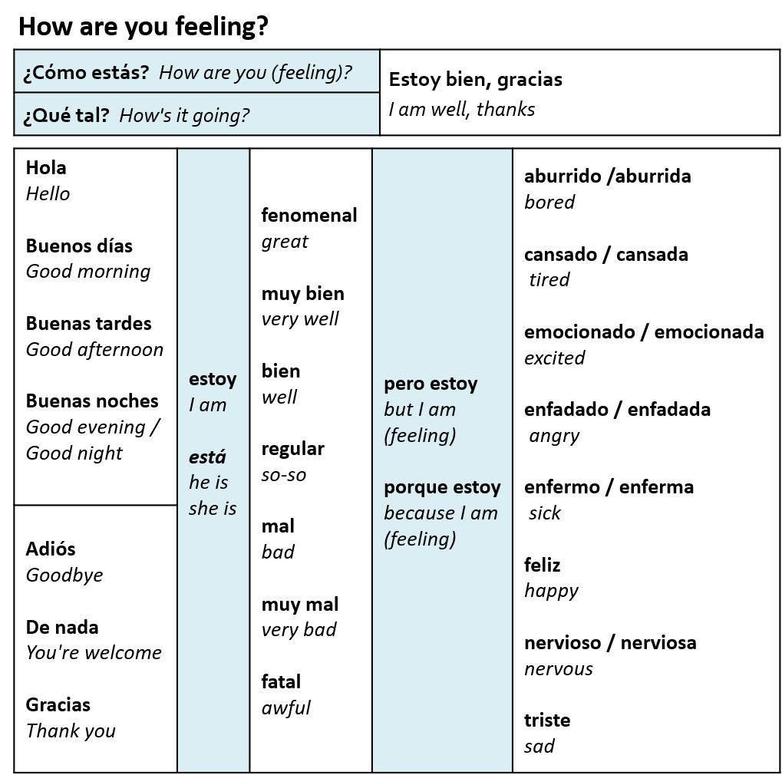
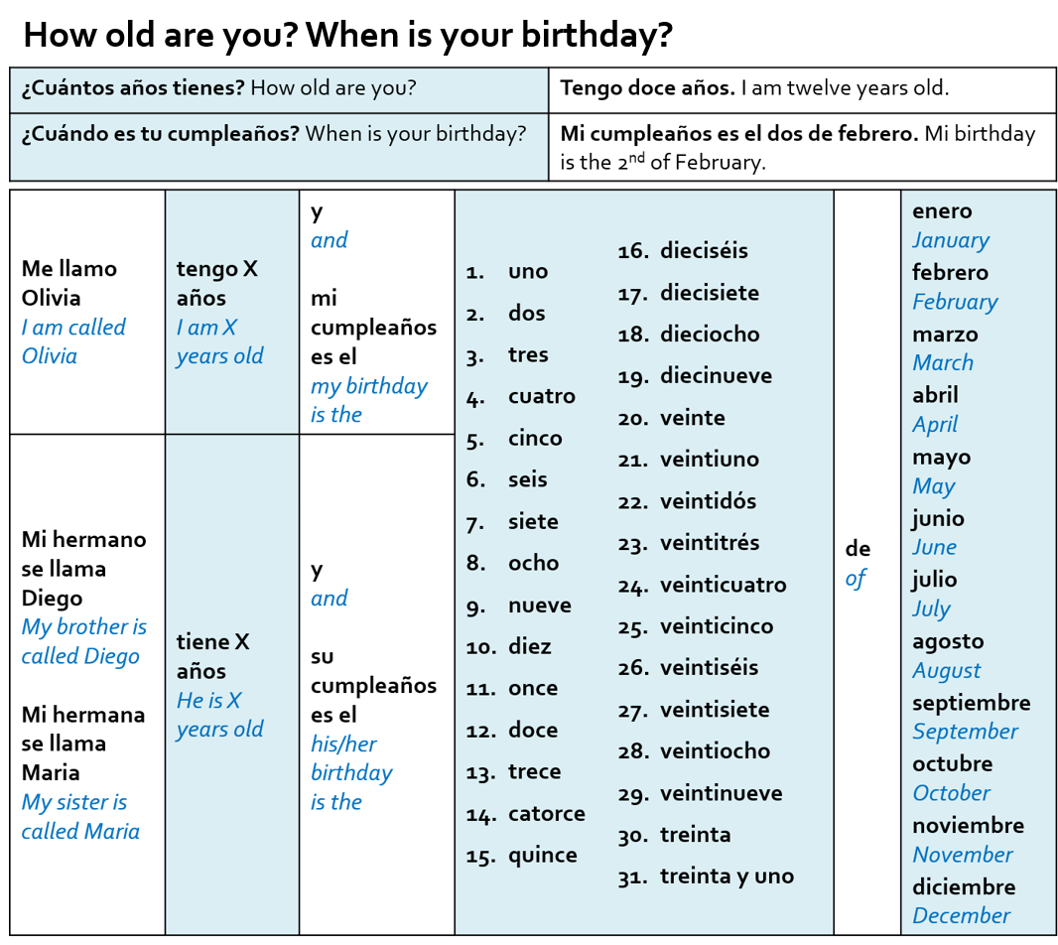
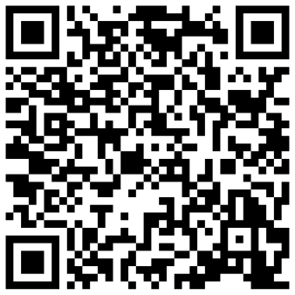
Dates and names
Scan the QR code
Generate a random date.
Translate the sentence into Spanish

