Slide 1


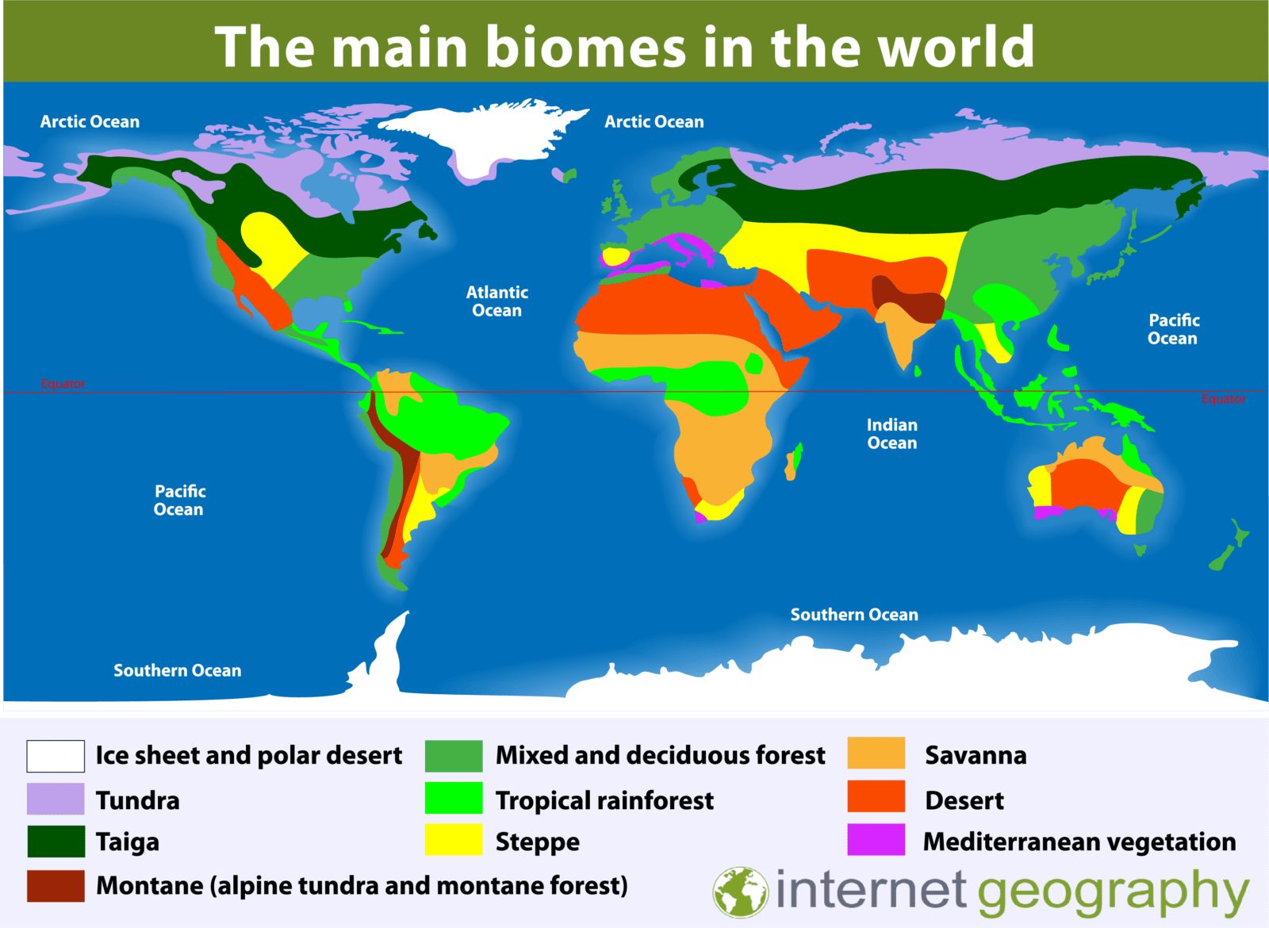
Subject: Geography
Year: 9 Term: 1
RETRIEVAL FROM YEAR 8
Key words:
Birth Rate: The number of babies born per 1000 per year.
Death Rate: The amount of people dying per 1000 per year.
Densely populated: A lot of people in one area
Sparsely populated: small amount of people in one area
Population density: the amount of people in an area
What would make an area dense or sparsely populated?
KEY KNOWLEDGE
Europe
Asia
North
America
DENSE | SPARSE
Job opportuntiies Accessible Variety of trasnport e.g trains, cycle, cars, planes Education such as university, schools and colleges Varied climate Natural resources Fertile soil Access to services Recreation opportunities | No jobs Inaccessible Mountainous Lack of education Extreme climate Lack of resources Lack of services Infertile soil Lack of recreation
South
America
Africa
Oceania
Antarctica

Slide 2

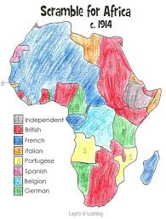

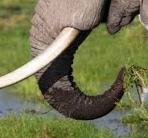
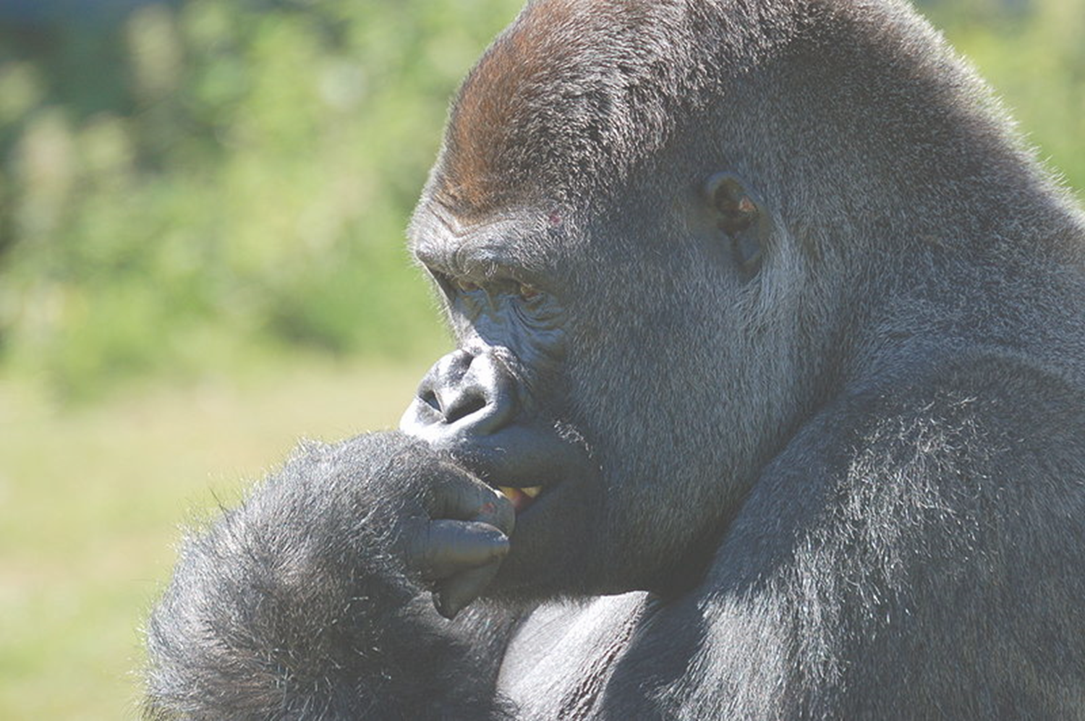
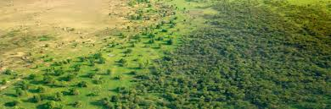
APPLICATION OF KNOWLEDGE
COLONIALISM
DESERTIFICATION
Rwanda owned by Belgium, Hutu and Tutsi forced to live together.
GENOCIDE
Colonialism is the control over one territory and its peoples by another.
Short terms effects:
People taken from their homes to work elsewhere
Resources taken and used elsewhere
Exploitation
Long term effects:
Civil war
Less working age population
Less resources to sell
Corrupt governments
Poor job opportunities
July 1994 Uganda took control of capital and stopped the killings.
Desertification is the degradation of dry land to the extent that It becomes unproductive and infertile.
List of Tutsi were given to Hutu to kill (10,000 died)
Belgium left in 1959 and the Hutu took power.
Causes:
Over farming
Over grazing
Population increase
Climate change
Effects:
Loss of biodiversity
Famine
Food insecurity
Loss of livestock
The spread of desertification
Solutions:
Great Green Wall
Stone Lines
Efficient stoves
Belgium preferred Tutsi over Hutu because they had lighter skin.
6th April Hutu President was shot down in his helicopter. Tutsi were blamed.
UN sent in troops to help but were unsuccessful.
POACHING
BUSHMEAT
Poaching for elephant tusks in countries in Africa is a huge problem. They are killed for their ivory tusks which can be made into ornaments and also used for traditional medicinal purposes.
The Bushmeat crisis in the Congo is when people are hunting in the rainforest putting animals at risk of extinction. They are doing this because there is no farming/no jobs and people need to feed their family.
What can be done about it?
Increase rangers in national parks
Improve security and cameras
Track animals with tracking technology
Increase fine and prison sentences
Educate people about it
What can be done about it?​
Increase rangers in the rainforest​
Increase fine and prison sentences​
Educate people about it
Increase farming
Increase jobs in the area

