Slide 1

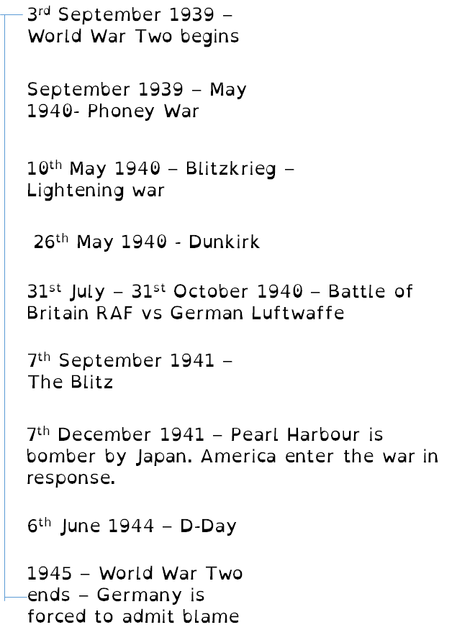
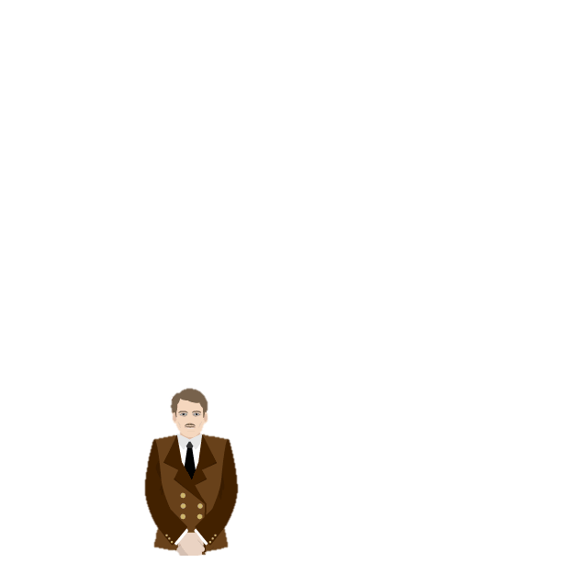
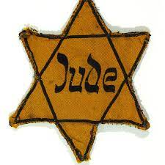
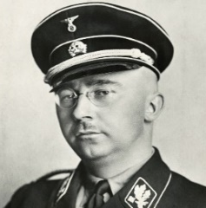

Subject: History
Year: 9 Term: One
WW2 Timeline
Discrimination
When Hitler came to power in 1933, he began to discriminate against the Jews. He blamed Jews for Germany losing World War 1 In 1933, a one day boycott of Jewish shops was organised. Jewish teachers, doctors and lawyers were sacked from their jobs. Jewish children were banned from schools and Jews were removed from parks, bars and swimming pools. In 1935 the Nuremburg Laws took away the citizenship rights of all Jews.
The Concentration Camps
Concentration Camps opened in 1933. They were run by the SA and the SS. Even one even for women.
One well know camp opened in 1933 was Dachau.
Camps were located in isolated areas, away from public knowledge.
By 1939 there were 150,000 people under ‘protective arrest’. They had not officially committed any crimes but they were locked up for doing or saying things the Nazis did not approve.
The SS (Protection Squad)
Created: 1925
Leader: Heinrich Himmler
Purpose: An organisation which controlled all other police units. Could act outside the law and arrest anyone they felt was a threat to the Nazi regime.
The badge all Jews were made to wear was the Star of David.

Slide 2
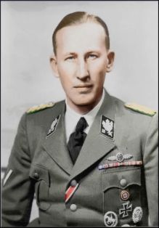
Subject: History
Year: 9 Term: One
Kristallnacht – Night of Broken Glass
In early November 1938, a German man (Von Rath) working for the German Government in Paris was shot dead by a Jew. Herschel Grynszpan claimed he was seeking revenge for the bad treatment his parents had received by the Nazis In two days and nights, more than 1,000 synagogues were burned or damaged. Rioters ransacked and looted about 7,500 Jewish businesses, killed at least 91 Jews, and vandalized Jewish hospitals, homes, schools, and cemeteries.
The Gestapo
A non-uniformed secret police.
They Identified anyone who criticised or openly opposed the Nazi Party.
They spied on people, tapped phones, opened mail & used networks of informers.
They were given permission to use torture to gain confessions.
Their main weapon was fear because Germans could not tell them apart from ordinary Germans.
Prisoners could be imprisoned without a trial and family members often received letters saying they had died in prison. Many were sent to Concentration Camps.
Prisoners were sometimes released from camps on purpose to
spread the fear of the camps to family & friends.
Even children were encouraged by their teachers and Hitler Youth leaders to inform on their parents – even if they made an anti Hitler Joke.
In 1939 alone, 160,000 people were arrested

