Slide 1
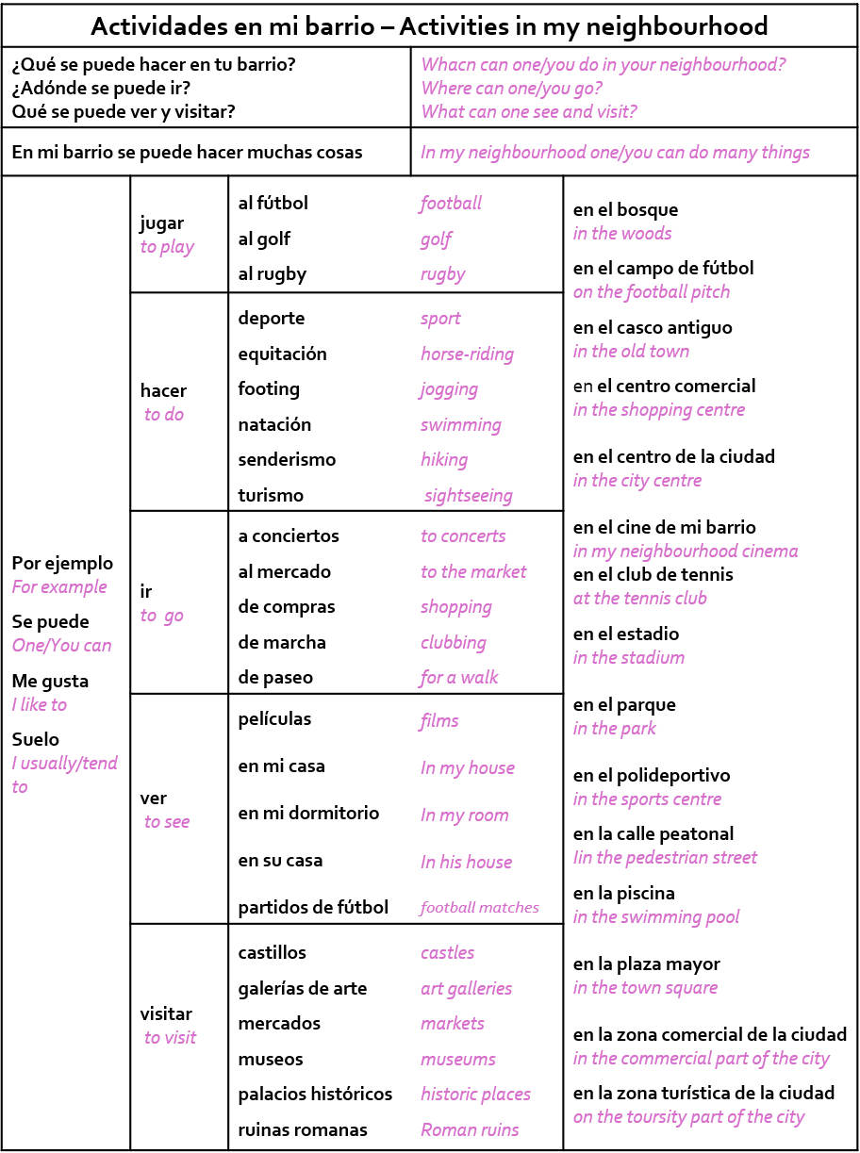
Year 9. Autumn
Formal Assessment
What will the assessment look like?
Listening | Dictation. Your teacher is going to say sentences in Spanish and you will have to write them down in Spanish. Pay attention with the spellings. | Comprehension. You will hear an audio about things to do in a neighbourhood in Spanish, you will have to fill a grid with key information in English.
Reading | Comprehension. Answer questions about texts in Spanish. Both the questions and the answers will be in English. | Vocabulary. Multiple choice questions about vocabulary and understanding key expressions in Spanish.
Writing | Write a paragraph about what you can do in a neighbourhood. You will be given suggestions and you will be expected to use activities with the verbs go, play, visit and do as well as places in town.
How to revise
Write down some sentences in Spanish using the sentence builder and try to translate them without looking at it.
Write some sentences in English using the sentence builder and try to translate them without looking at it.
Memorise the vocabulary of a column of the sentence builder for 2/3 minutes and try to write down as many words or expressions as you can.
Extended writing. Write a text that covers these topics using the sentence builders and then try to replicate it without looking.

Slide 2
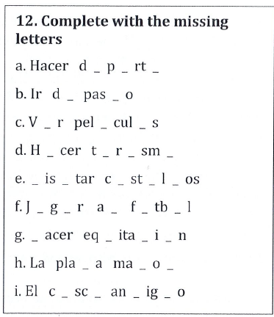
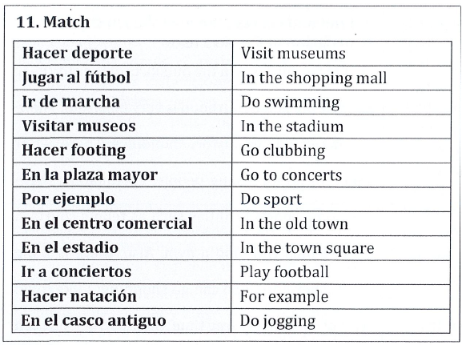
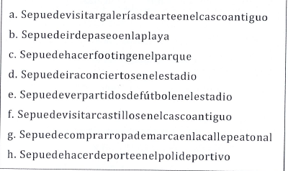
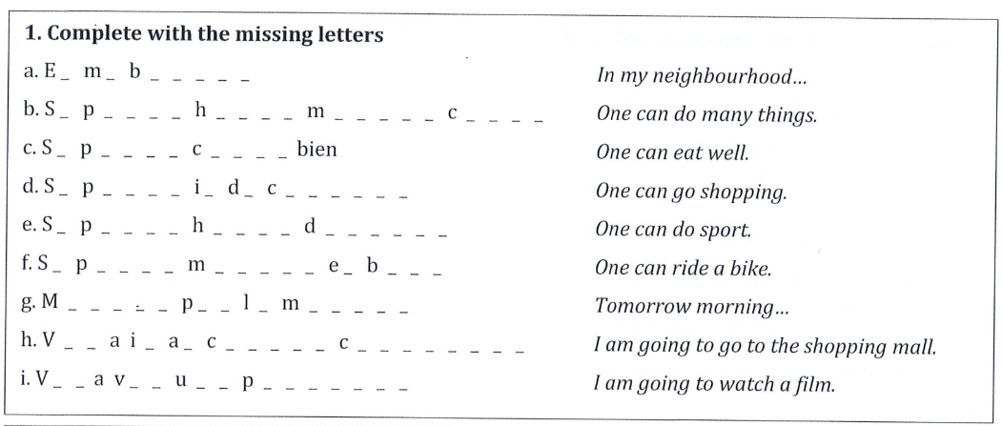
Activities to practice
Separate the sentences and translate them into English.
Translate the following expressions into English:
mi barrio
se puede
me gusta
suelo
jugar
ir
hacer
ver
visitar

